Slide 1
A Study on Snoop-Based Cache Coherence Protocols
Linda Bigelow
Veynu Narasiman
Aater Suleman

Slide 2
Shared Memory Machine
P₁
P₂
P₃
P_{N}
. . .
$
$
$
$
MEMORY

Slide 3
Invalidation-Based Protocols
The MSI Protocol
Possible Bus Operations:
Bus Read (BR)
Get Permission (GP)
RWITM
Write-Back (WB)
M
SBR / WB
SRWITM / WB
PW / GP
PW / RWITM
S
I
PR / BR
SGP, SRWITM / -

Slide 4
Example Invalidation-Based Protocols
Berkeley-Ownership (MOSI)
  New state: Owner
  On a Snoop Bus Read in Modified state:
    Supply data to requesting processor
    Transfer to the Owner state
    Do NOT Write Back
  Owner must supply data for future Bus Reads
  On eviction, block must be written back if in the Modified or the Owner state
  Advantages
    Avoid memory
    Potentially fewer Writebacks
  Disadvantages
    Owner may be busy always supplying data

Slide 5
Example Invalidation-Based Protocols
Illinois (MESI)
  New State: Exclusive
  On a Read Miss:
    Transfer to Exclusive if block is private
    Otherwise, transfer to Shared
  Once in Exclusive, a processor write can go through without any bus transaction
  Advantages
    Fewer Get Permissions (less bus traffic)
  Disadvantages
    Increased Bus Complexity (Shared Line)
  Question: Can regular MSI outperform MESI?

Slide 6
Example Invalidation-Based Protocols
MOESI
  Two new states
    Exclusive
    Owner
  Gets both the advantages and disadvantages of MESI and MOSI
  Additional Disadvantage
    Extra bit required to keep track of state

Slide 7
Update-Based Protocols
Replace Get Permission with Bus Update
  On snooping a Bus Update
    Grab data off Bus and update your copy
    Remain in Shared state (do not invalidate!)
  Examples
    Firefly
      Uses Write-Throughs instead of Bus Updates
    Dragon
      Uses Bus Updates
      Requires a new state: Shared Dirty

Slide 8
Update or Invalidate?
Invalidation-Based Protocols
  Good for Sequential Sharing
  Suffers from Invalidation Misses
    Problem is worse as block size increases
Update-Based Protocols
  Good when reads and writes are interleaved among many different processors
  Suffers from unnecessary Updates
    Problem gets exaggerated as cache size increases

Slide 9
Improving Invalidation-Based Protocols
Read Broadcasting
  Aims to reduce Invalidation Misses
  On Snooping a Bus Read in Invalid
    Grab data off Bus and transit to Shared
  Many processors in Shared and one writes:
    Writing processor issues GP, goes to Modified
    All others go to Invalid (tag still stays the same)
    Invalidated processor wants to read:
      All other invalidated processors snoop the read, grab the data, and transit to shared
      When they read, it’s a hit (no Bus Read required)
  Reduces Invalidation Misses, increases processor lockout

Slide 10
Improving Update-Based Protocols
Hybrid Protocols
  Competitive Snooping
    Each cache block has a counter associated with it
      Initialized to a threshold value when block is loaded
      Decrement counter when you Snoop an Update
      Set counter back to threshold on local read or write
      If counter reaches zero, invalidate the block
    Writing processor can detect when everyone else has invalidate, and transits to Modified
  Archibald Protocol
    Do not invalidate as soon as counter reaches 0
    Wait until all counters reach 0

Slide 11
Bus Interface Unit (BIU) Overview
Provides communication between the processor and external world via the system bus
Responsibilities
  Interfacing with the bus
    Arbitrating for bus
    Driving address and control lines
    Supplying/receiving data
  Controlling flow of transactions
    Request buffer to hold data that processor needs to put on bus
    Response buffer to hold data that memory sends back to processor
  Snooping the bus
    Tag look-up
    State update
    Appropriate response: assert shared line, write back, update, etc.

Slide 12
Simple BIU
Single-Level Cache, Single-Ported Tag Store
P
Cache Controller
Tags & state
Cache
Data
BIU
Cmd
Addr
Response Buffer
Request Buffer
Addr
Cmd

Slide 13
Tag Store Access Problem
Who gets priority??
P
Cache Controller
Tags & state
Cache
Data
BIU
Cmd
Addr
Response Buffer
Request Buffer
Addr
Cmd

Slide 14
Processor Lockout
P
Cache Controller
Tags & state
Cache
Data
BIU
Cmd
Addr
Response Buffer
Request Buffer
Addr
Cmd

Slide 15
BIU Lockout
P
Cache Controller
Tags & state
Cache
Data
BIU
Cmd
Addr
Response Buffer
Request Buffer
Addr
Cmd

Slide 16
Duplicate Tag Store
P
Cache Controller
Tags & state for snoop
Tags & state for P
Cache
Data
BIU
Cmd
Addr
Response Buffer
Request Buffer
Addr
Cmd

Slide 17
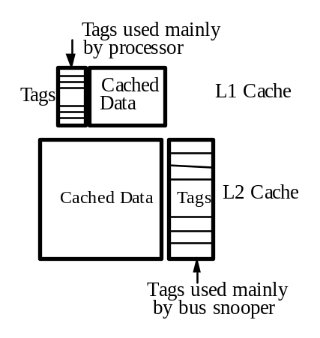
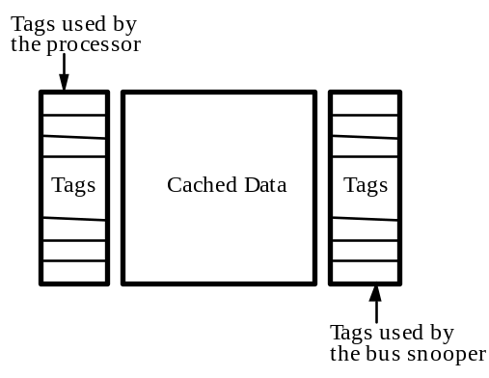
Multilevel Cache Hierarchy
BIU looks up tags in L2 tag store
Cache controller looks up tags in L1 tag store
L2 must be inclusive of L1
L2 acts as a filter for L1 for bus transactions
  Add bit to indicate whether or not the block is also in L1 (reduces processor lockout)
L1 acts as a filter for L2 for processor requests
  Write through L1 or add bit to indicate a block in L2 is modified-but-stale (reduces BIU lockout)
Figures taken from Parallel Computer Architecture: A Hardware/Software Approach

Slide 18
Write-Back Buffer
Write back due to snooping a RWITM may generate two bus transactions
  Dirty block written back to memory
  Memory supplies block to requestor
To satisfy request faster
  Delay write back by putting in a buffer
  Supply data to requestor
  Write back to memory
Issues
  BIU needs to snoop against write-back buffer (as well as tag store)
  If hit in write-back buffer, need to supply data and possibly cancel the pending write back

Slide 19
Cache-to-Cache Transfers
Faster to transfer data between two caches than a cache and memory
What does the BIU do?
  Snoops the request
  Indicates if its cache can supply the data
  Indicates if the data is in a modified state
Which cache supplies data if multiple have it?
  Predetermined priority
  All put same value on bus at same time
What about memory?
  Should be inhibited from supplying data
  May need to be written to if data is dirty

Slide 20
M5 Simulator
Simple Processor Model
  Functional CPU model
  No IPC statistics generated
  Faster
Detailed Processor Model
  Cycle accurate simulator
  Models an out-of-order processor
  ~10-20X slower than the Simple Model
Experiments were conducted using the simple model and the detailed model

Slide 21
SPLASH-2 Benchmarks
Simulated benchmarks from SPLASH-2
PARMACS macros from UPC
  Conditional variables were not padded
Created reduced data sets for some benchmarks
Were able to successfully setup and run:
  7 benchmarks in Simple processor
  5 benchmarks in Detailed processor

Slide 22
Simulated System
2 Processor system
64KB L-1 Data Cache
  3 cycle latency
  64 B block
  2 way associative
  32 outstanding misses
64KB L-1 Instruction Cache
2MB L-2 Cache
  10 Cycle latency
  32 way associative
  16-byte-wide bus to memory
Main memory
  100 cycle latency

Slide 23
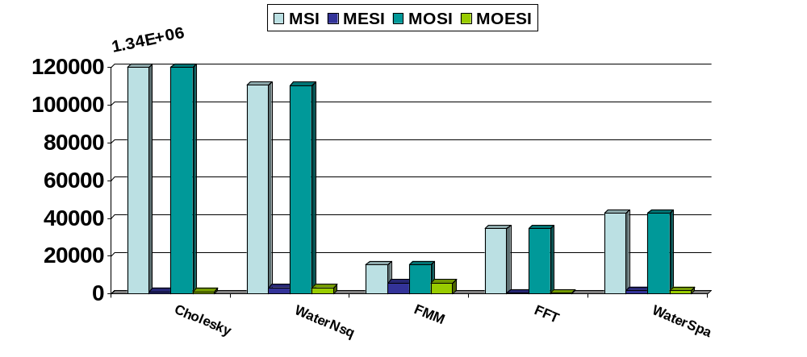
Number of Bus Invalidates (GPs)
All of the benchmarks show a reduction when Exclusive state is added (some more than others)

Slide 24
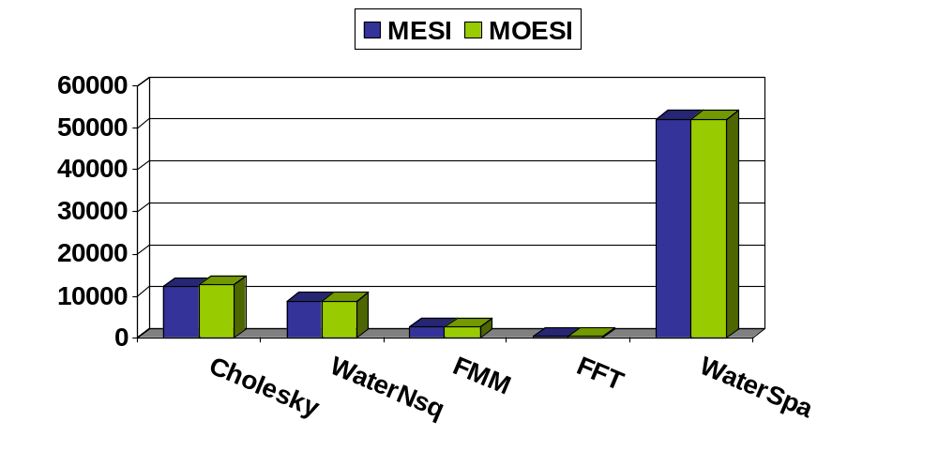
E to S Transitions
Exclusive state only beneficial if the reduction in number of GPs outweighs the number of E to S transitions

Slide 25
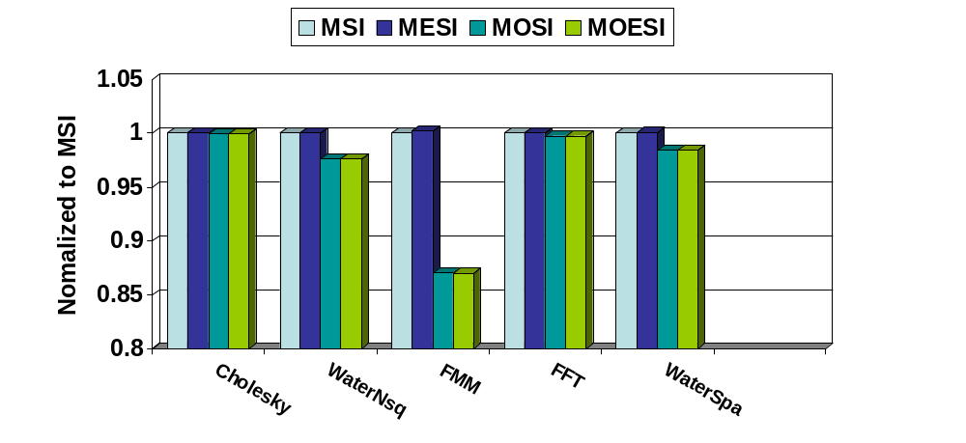
Write Backs to Memory
Not much difference for Cholesky and FFT
Differences in FMM, WaterNsq, and WaterSpa

Slide 26
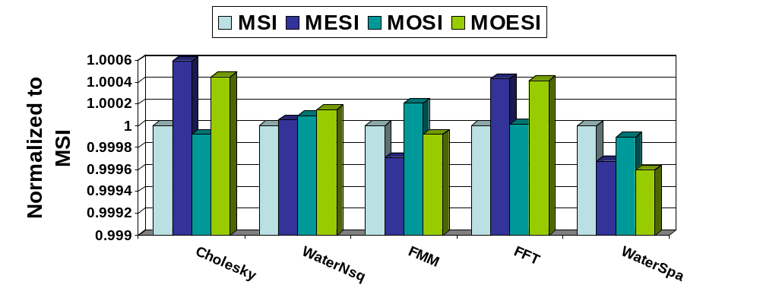
Throughput IPC

Slide 27
Owner Protocols
Less performance benefit than expected
Reasons
  Minimal Reduction in write backs
    More replacement write backs
  Load balancing problems
  After Owner evicted, must get data from memory

Slide 28
MONOESI
When an owner is evicted, the ownership of the block gets transferred to the Next Owner
Introduces a new state Next Owner (NO) in the MOESI protocol
When the owner is evicted:
  Next Owner snoops the write back
  Transitions to the Owner state
  Memory write back is inhibited
Overhead
  Added support for snooping write backs
  Two extra lines: Owner and Next Owner

Slide 29
!Mem+ = inhibit memory & supply data
shd = shared line
M
PW
E
PW / GP
SBR / shd
SBR / shd, !Mem+
SRWITM / !Mem+
O
SRWITM / !Mem+
PR & !shd / BR
PW / GP
PW / RWITM
SGP
SRWITM / !Mem+
PR & shd / BR
S
I
SGP, SRWITM

Slide 30
!Mem+ = inhibit memory & supply data
shd = shared line
!Mem = inhibit memory
O = owner
NO = next owner
M
PW
E
PW / GP
PW / GP
SBR / shd
SBR / shd, !Mem+, O
SRWITM / !Mem+
O
SRWITM / !Mem+
NO
PR & !shd / BR
PW / GP
PW / RWITM
SGP
PR & O & !NO / BR
SGP, SRWITM
SRWITM / !Mem+
PR & ((shd & O & NO) |
(shd & !O & !NO)) / BR
S
I
SGP, SRWITM
SWB / !Mem

Slide 31
Future Work
Use MONOESI to solve the load balancing problem in MOESI
Coherence aware cache replacement policy
Use a lower priority for BIU on a Read Broadcast

Slide 32
Questions?

Slide 33
Example Invalidation-Based Protocols
Goodman’s Write Once
  GP replaced by a Write Through
  New state: Reserved
  Advantages
    May lead to fewer Writebacks
  Disadvantages
    Increased Memory traffic due to Write Throughs

