Slide 2
MPPT
An MPPT, or maximum power point tracker is an electronic DC to DC converter that optimizes the match between the Solar Array (PV panels), and the Battery pack.

Slide 3
What is Maximum Power Point Tracking?
The charge controller looks at the output of the panels and compares it to the battery voltage.
It then figures out what is the best power that the panel can put out to charge the battery.
It takes this and converts it to best voltage to get maximum AMPS into the battery.
In Addition to this functionality,

Slide 4
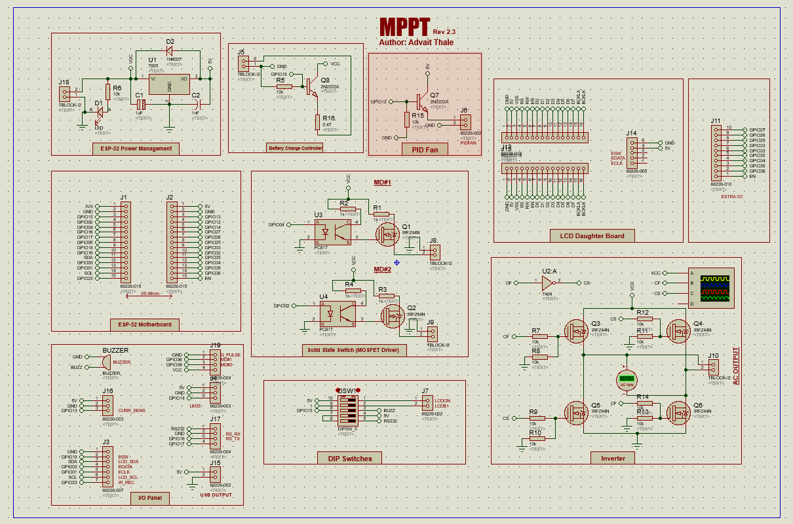
Schematic

Slide 5
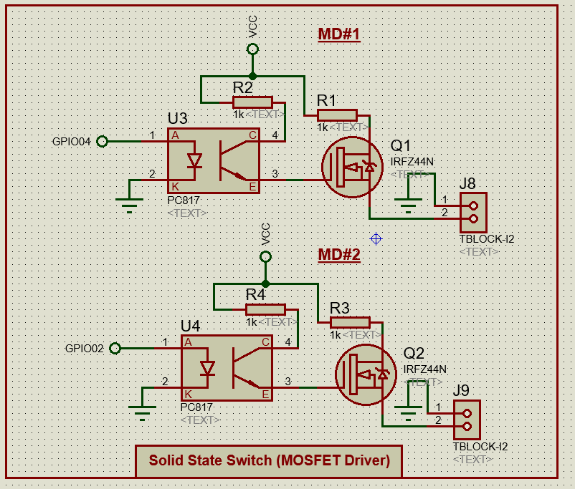
Solid State Relay Outputs(MOSFET Driven)
One thing all MPPTs lack is they don’t provide terminal of soft starter output, thus there is constant risk of damaging load or batteries.

Slide 6
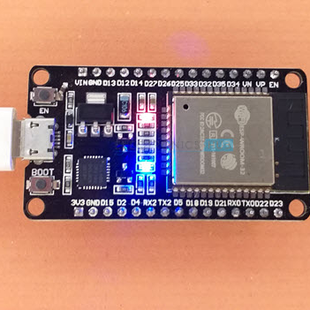
ESP32 (Wi-Fi Enabled)
All the operations are administered by ESP32 including MOSFET Drives, Status Display, all I/Os,

Slide 7
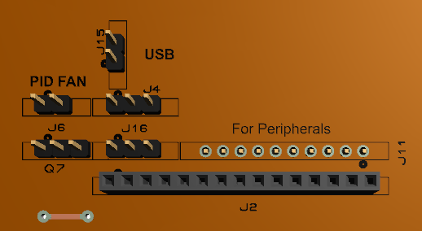
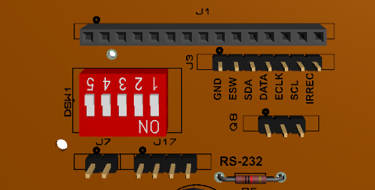
Panel and Peripheral I/O

Slide 8
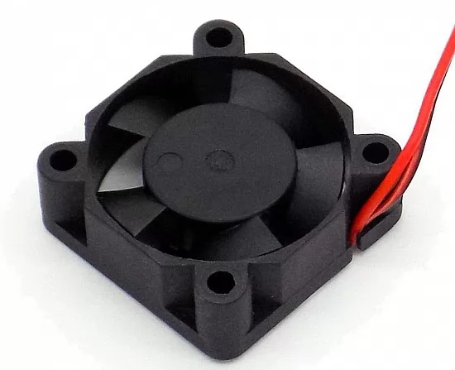
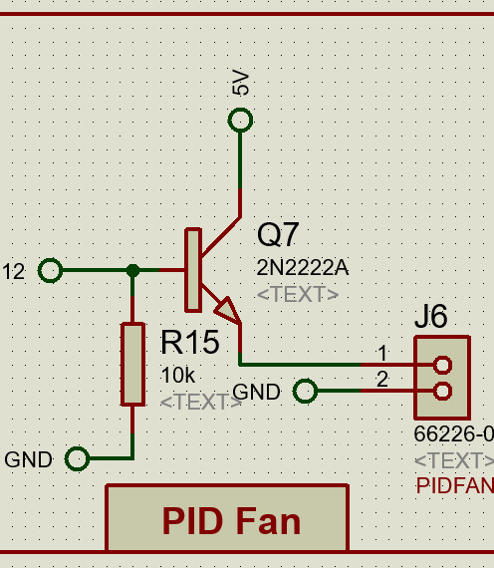
PID Driven Fan
To save precious power generated, the in internal cooling fan is controlled by a control system design which is PID.
The feedback variable is set by LM35 temperature sensor, which as battery temperature increases spins fan faster.

Slide 9
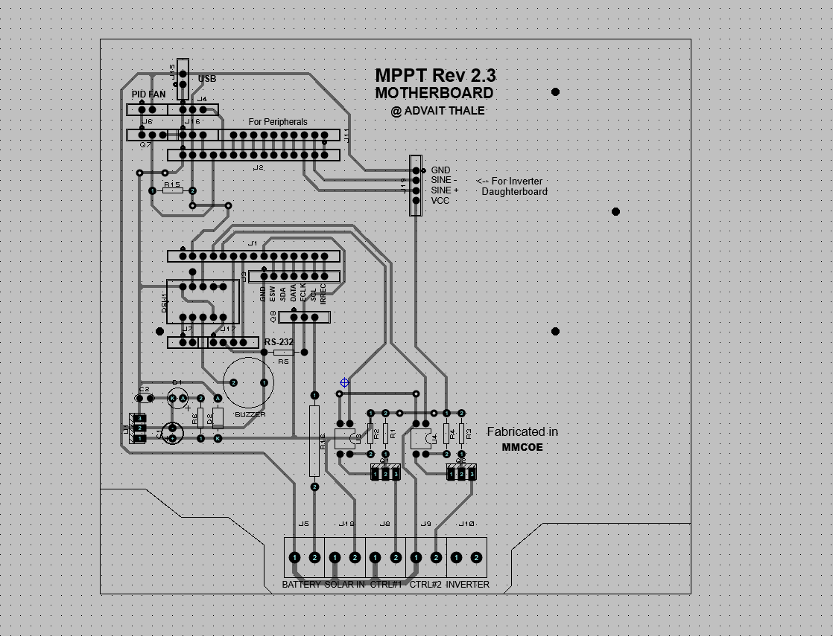
PCB Artwork

Slide 10
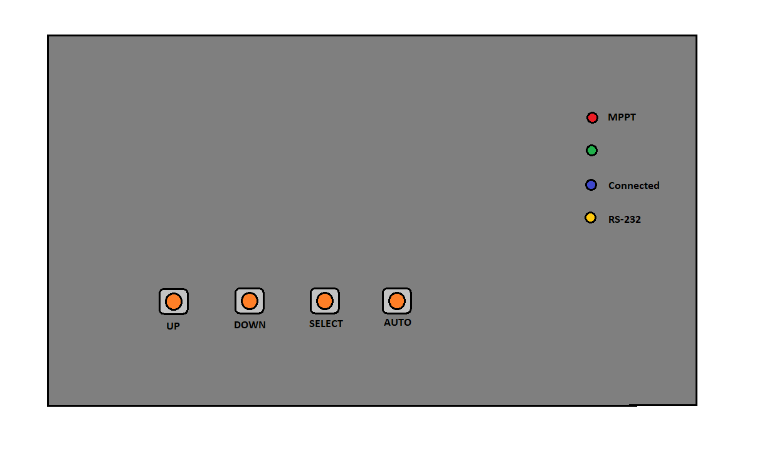
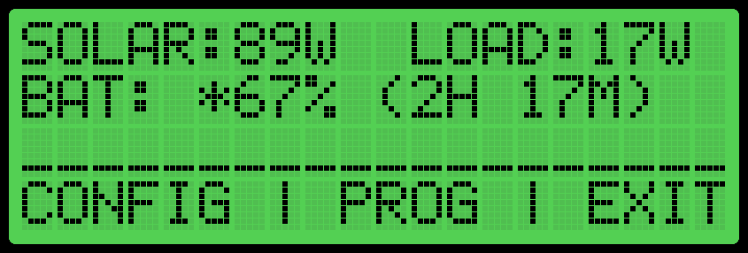
Previous Prototype (#3)
.

Slide 11
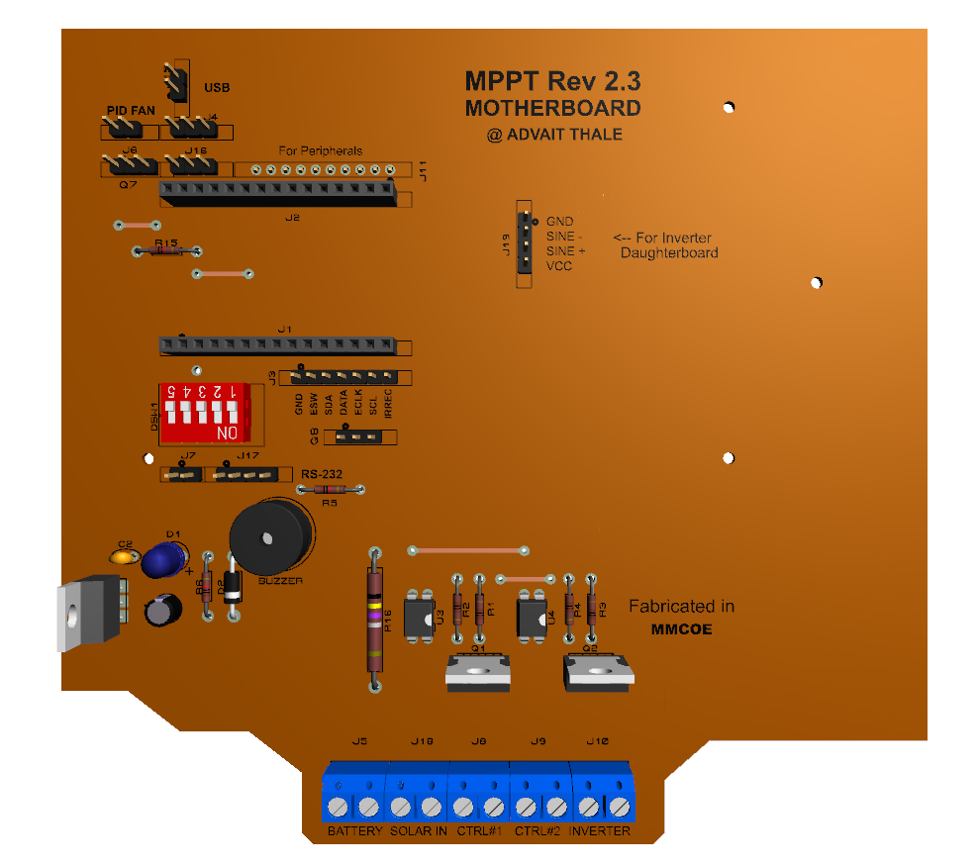
3D Render of PCB

Slide 12
Interface Daughterboard
To display and change system variables, the status display, rotary encoder with switch and some status LEDs are mounted on separate daughterboard which will be installed on the top.
3D render of Interface Daughterboard shown below:

Slide 13
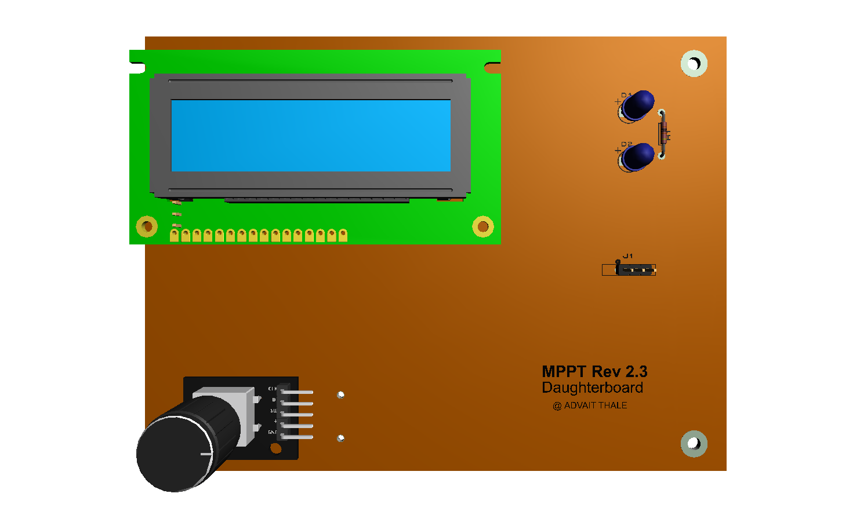

Slide 14
Future Expansion: Inverter Daughterboard
The Inverter Daughterboard contains a MOSFET driven inverter to convert generated DC to AC.
Due to space limitations Inverter is placed on separate board with control signal headers from main board.

Slide 15
Additional (Automation) Features
2 x Software/ controlled Relay outputs (up to 240V AC)
I/O for addition sensors (configurable)
DIP Switches for Boot configuration & customization
RS-232 D9 Port for Data Log (at 9600)

