Slide 1
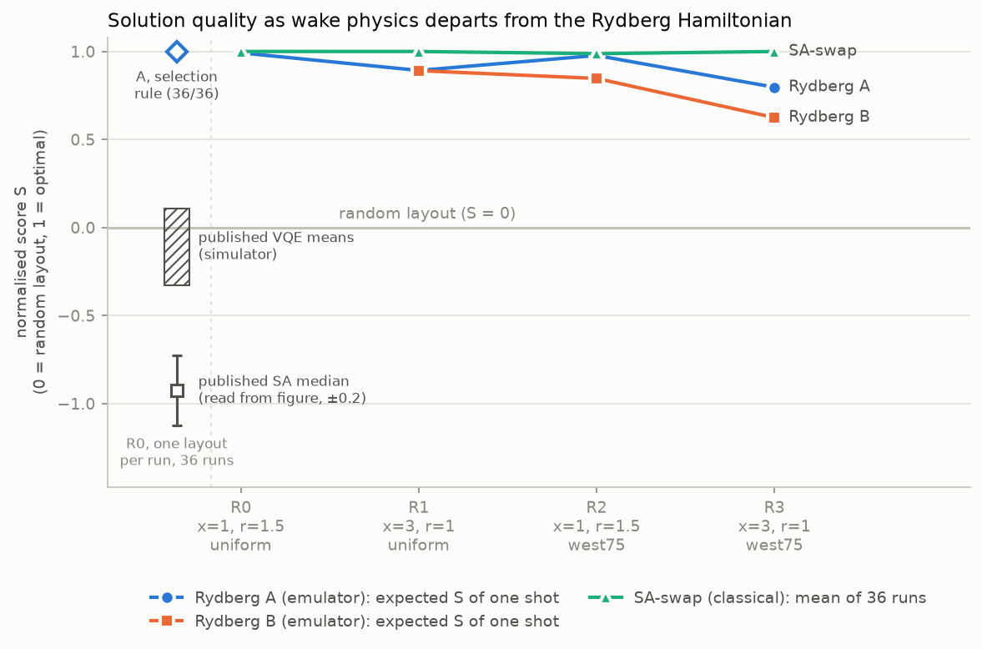
Emulated Rydberg atoms solve native wakes, not long directional ones
R0 published
x = 1, r = 1.5, uniform wind
79 optima = king-graph MIS
R1 ours
x = 3, r = 1, uniform wind
1 optimum (four corners)
R2 ours
x = 1, r = 1.5, 75% from west
same 79 optima as R0
R3 ours
x = 3, r = 1, 75% from west
2 optima, not MIS
Rydberg-native → increasingly non-native wake physics (wake length x, spread r, wind regime)
36/36
R0: the paper's selection rule picks an optimal layout in every run (S = 1.00). Published VQE means: S −0.33 to +0.11, about random.
S = 0.89
R1: the same rung-blind program still has the optimum as its ground state; van der Waals tails mimic the long wake.
P(opt) ≈ 0
R3, every encoding below 0.001: scalable ones misrank the optimum; the one fit that ranks it well fails on dynamics. Both bottlenecks bind.
Why it matters: it shows which wake models a neutral-atom array encodes natively, before spending QPU time.
Noiseless emulation (QoolQit 1.4.0, emu-sv). S = 0 random layout, 1 optimal. Published: Hancock et al., arXiv:2312.13123. R1–R3 are our instances.

Slide 2
QoolQit in practice, and a two-job QPU ask
What helped
What we hit
One program, many devices
Dimensionless Register → Drive → QuantumProgram, compiled to AnalogDevice; the same program passes Orion Beta's limits.
24-atom cap
LocalEmulator + emu-sv cannot sample above 24 atoms (torch.multinomial 2²⁴): 5×5 dropped.
Exact, fast emulation
emu-sv agrees with QuTiP to 4e-5; a 16-atom run takes 8.8 s on GPU.
Radius measured from the origin
max_radial_distance ignores the register centre; registers must be centred.
Native MIS encoding
Blockade on a square grid solves the published instance with no QUBO embedding.
No QUBO tooling in 1.4.0
QUBOInstance and AdiabaticDriveShaper are absent; we wrote our own L-BFGS embedding.
Device limits in code
AnalogDevice specs (spacing, radius, amplitude, duration) are readable, so every program is checked before it runs.
Exact spacing check
A spacing of exactly 1.0 fails compile_to after rounding; rescale to 1 + 10⁻⁶.
QPU ask
2 jobs × 500 shots
≈ 67 min at 0.25 Hz (Orion Beta)
One Encoding A program, scored for R0 and R1.
R0: emulator-vs-QPU gap on a native instance (predicted P(opt) ≈ 0.52 with SPAM errors).
R1: does the van der Waals tail effect survive? (four corners predicted most probable, P ≈ 0.23 vs 0.02).
Failure log: 16 entries in the notebook. Device figures: Pasqal, Technical Overview for Advanced Users, Orion Beta (2025). SPAM values: De Léséleuc et al. 2018.

