Slide 1



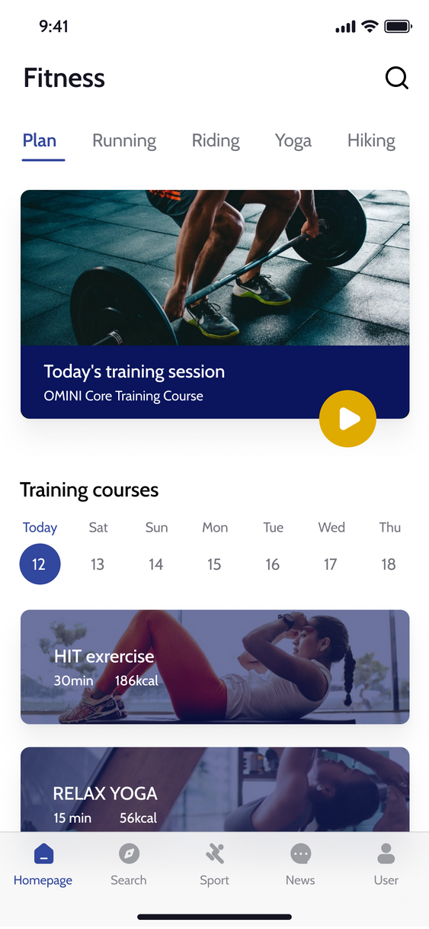

EVOFIT
Home
AI help
Service
Get in Touch
EvoFit APP
High Fidelity Prototype
Chang Liu
Yuan Tao
Yueyang Xu
Advaith Kandiraju

Slide 2
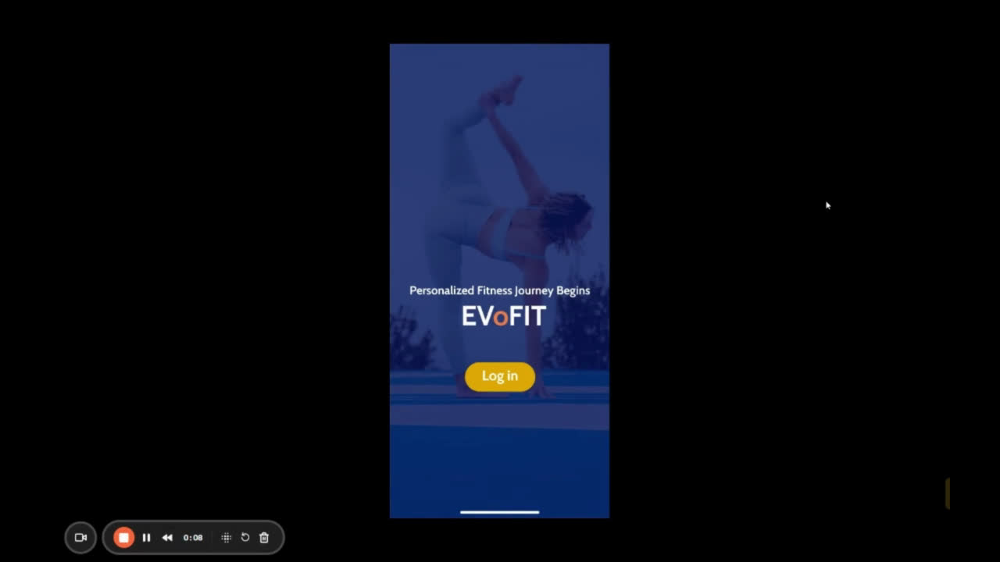
Brief
Basic Introduction to EvoFit

Slide 3

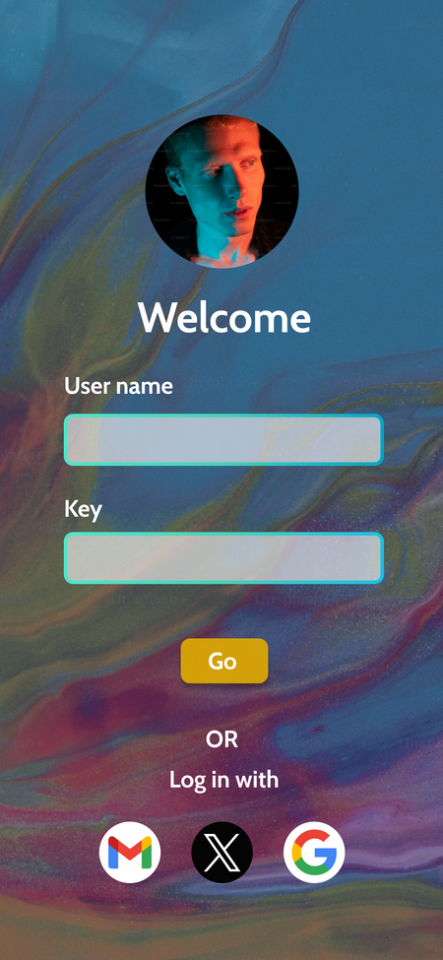
EVOFIT
Home
AI help
Service
Get in Touch
OPENING PAGE
& LOG IN PAGE
Next Slide

Slide 4
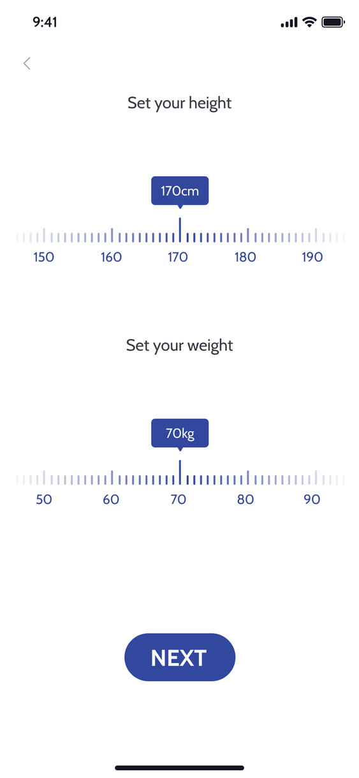
EVOFIT
Home
AI help
Service
Get in Touch
Individual Information
Page
Next Slide

Slide 5
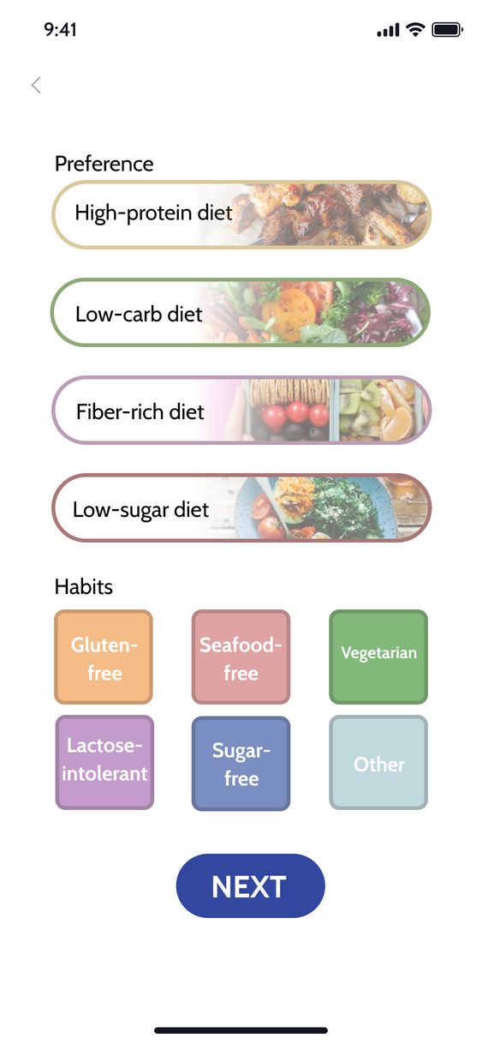
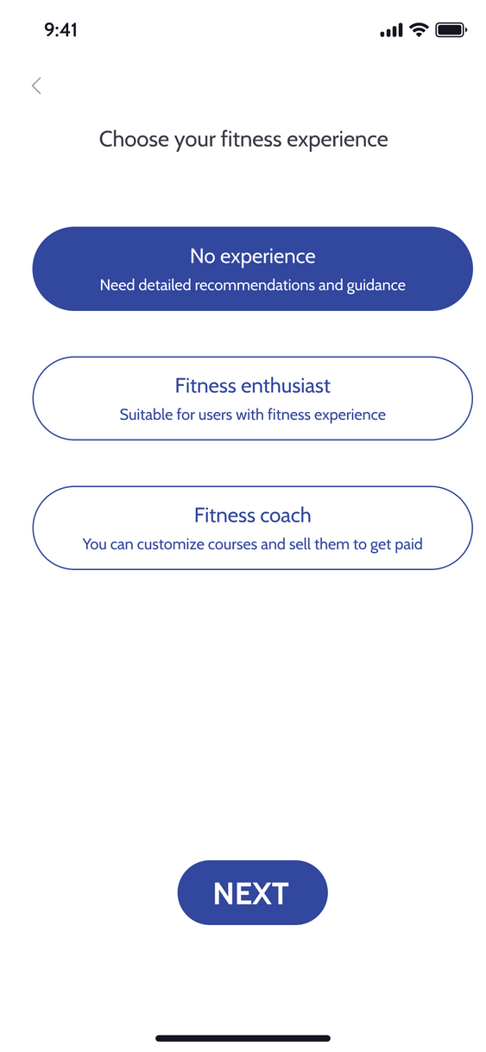
EVOFIT
Home
AI help
Service
Get in Touch
Preference
Setting Page
(Food & Fitness)
Next Slide

Slide 6
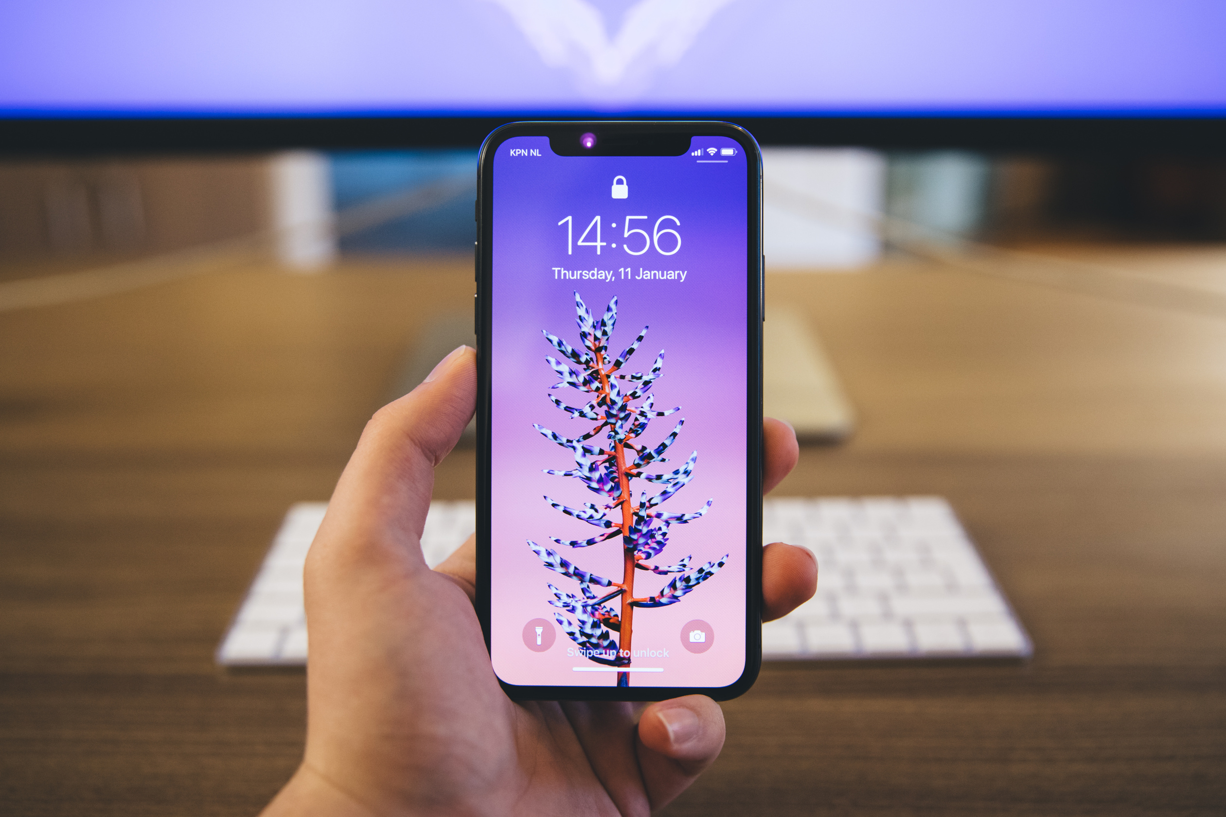
EVOFIT
Homepage
Find what you like.
Next Slide

Slide 7
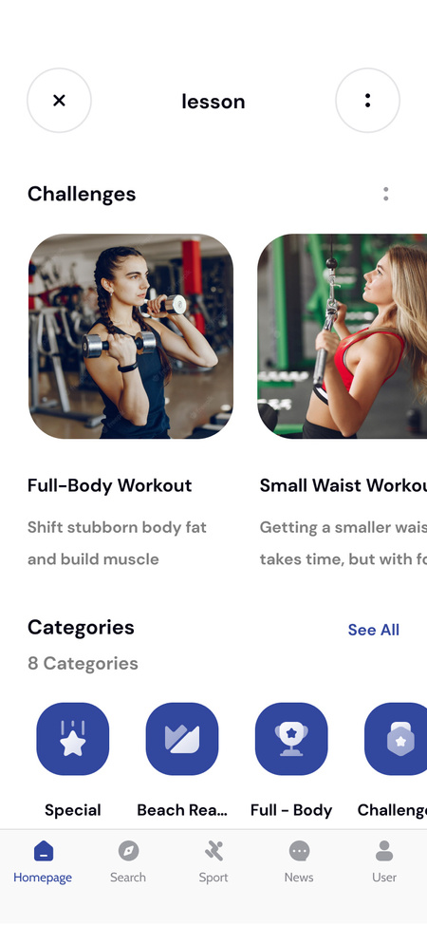
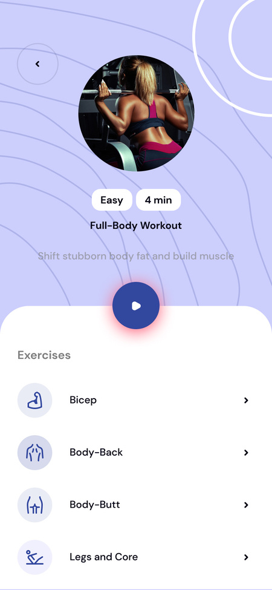
EVOFIT
Home
AI help
Service
Get in Touch
Lesson
Learn, Practice, Master

Slide 8
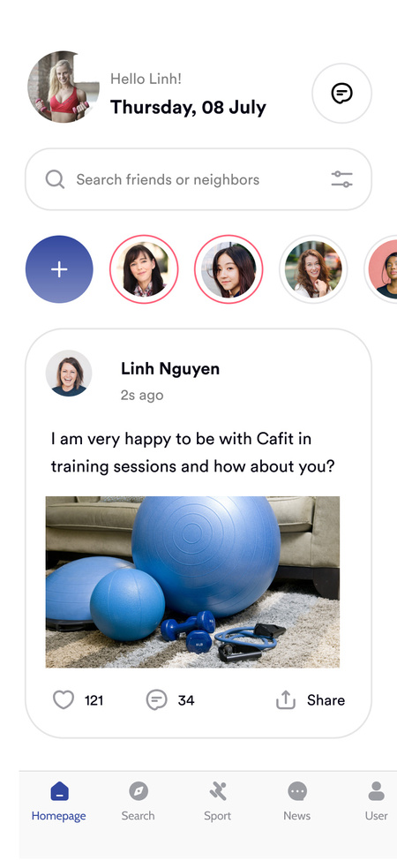
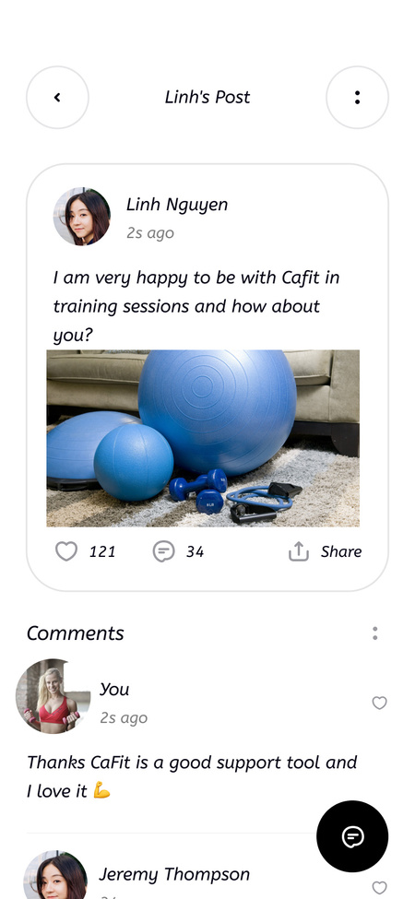
EVOFIT
Home
AI help
Service
Get in Touch
Community
Connect, Share, Grow

Slide 9
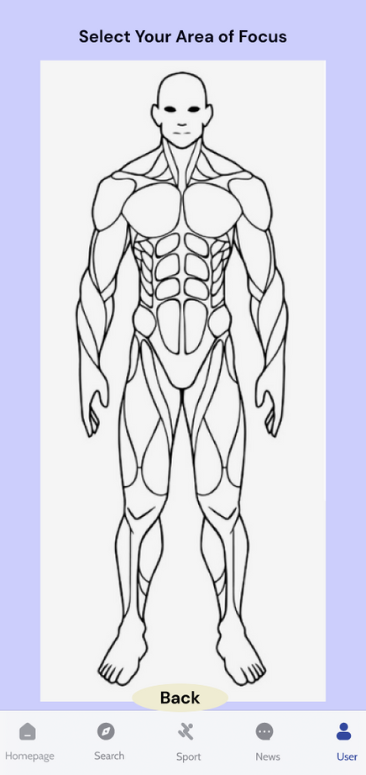
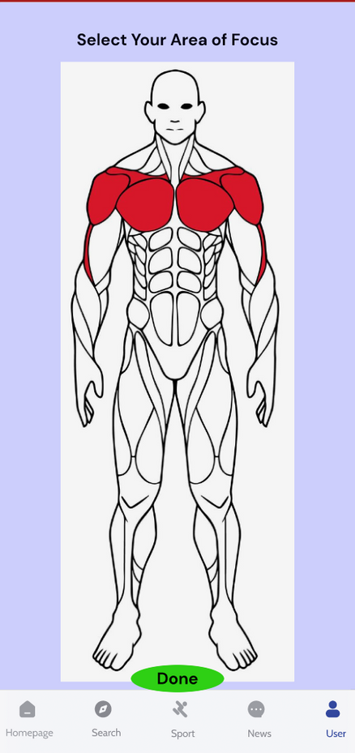
EVOFIT
Home
AI help
Service
Get in Touch
Focus Area
Focus, Build, Repeat

Slide 10
EVOFIT
Home
AI help
Service
Get in Touch
Focus Area
Focus, Build, Repeat

Slide 11
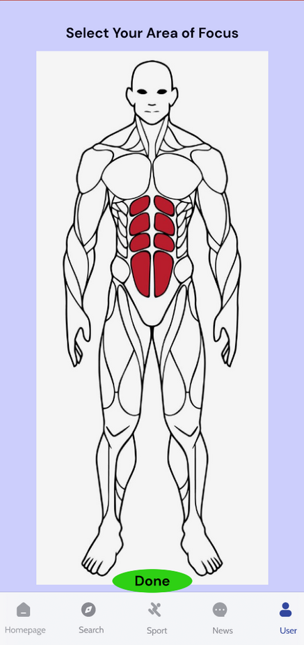
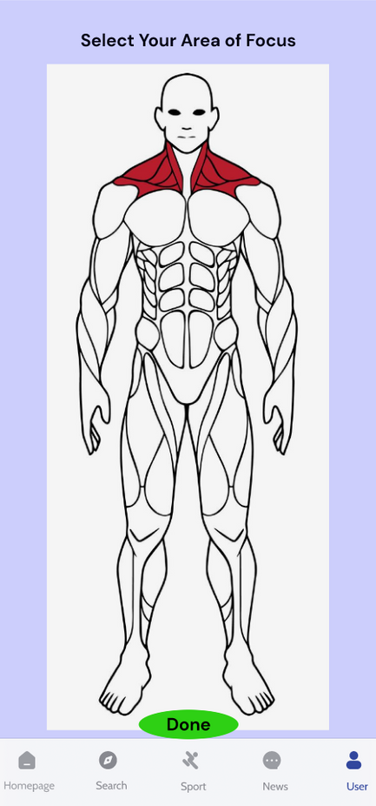
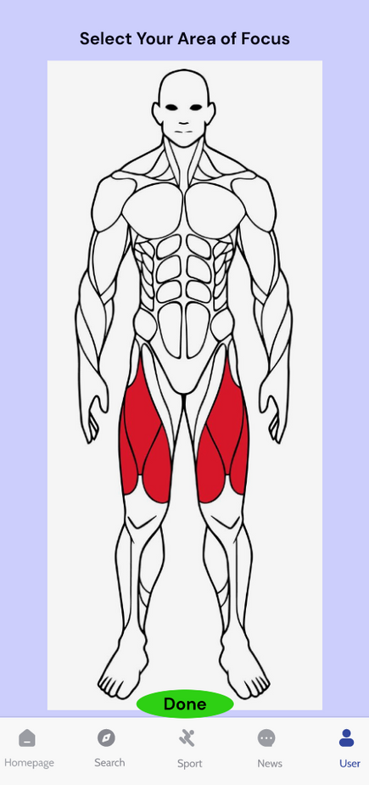
EVOFIT
Home
AI help
Service
Get in Touch
Focus Area
Focus, Build, Repeat

Slide 12
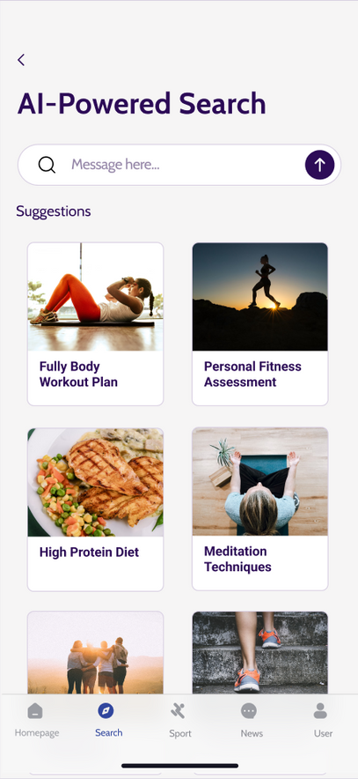
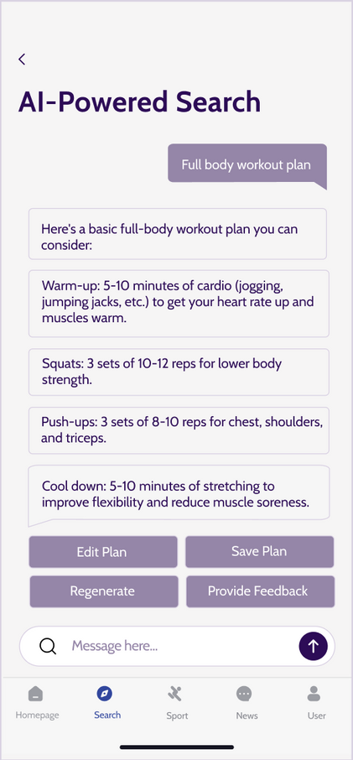
EVOFIT
Home
AI help
Service
Get in Touch
AI-Powered Search
Discover, Explore, Optimize

Slide 13
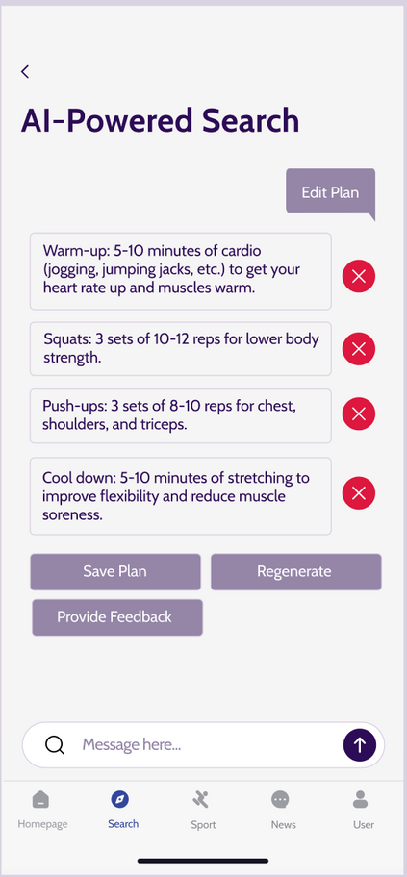
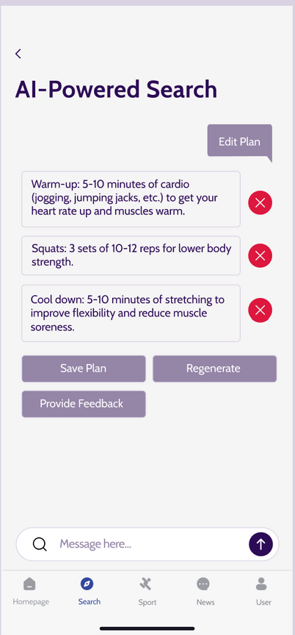
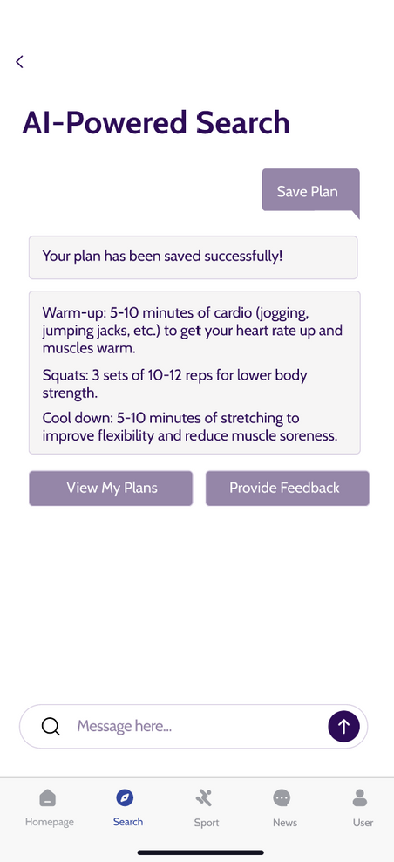
EVOFIT
Home
AI help
Service
Get in Touch
AI-Powered Search
Optimize your experience.

Slide 14
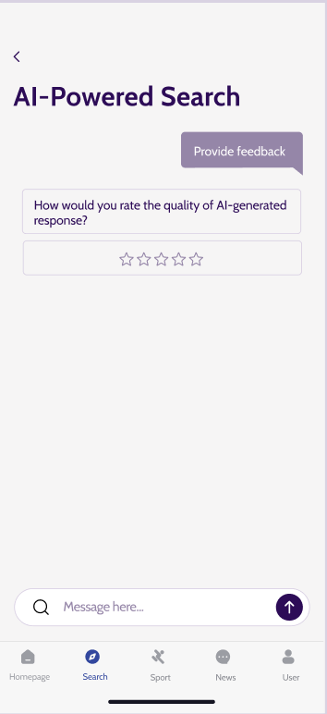
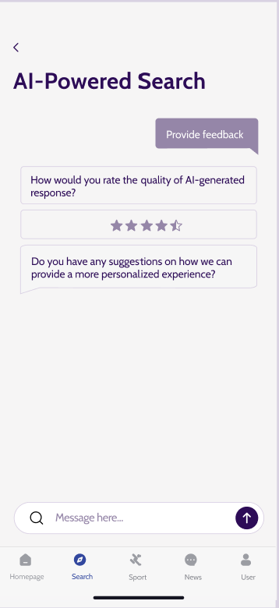
EVOFIT
Home
AI help
Service
Get in Touch
AI-Powered Search
Provide feedback.

Slide 15
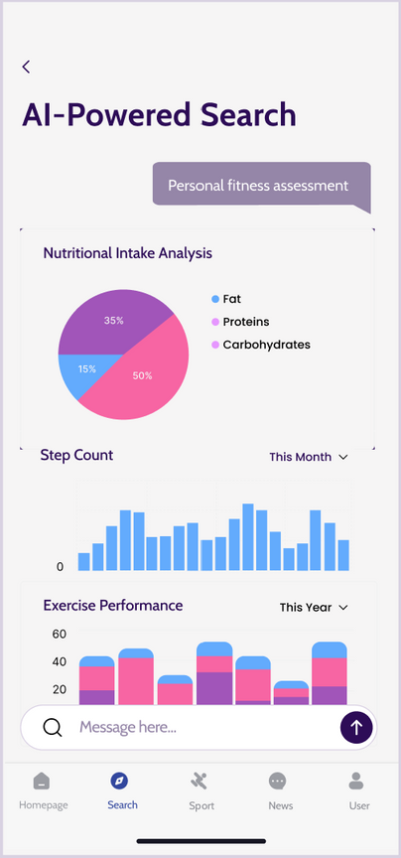
EVOFIT
Home
AI help
Service
Get in Touch
AI-Powered Search
Discover personalized analysis.

Slide 16
Link to Figma:
https://www.figma.com/design/fPV23SgA9CcWcc5evMrFHO/Untitled?node-id=0-1&t=miM7nXc15EjMkt0h-0

Slide 17

Thank You

