Slide 1
Lending Club - Case Study
Chidambaram Ananthakrishnan & Chethan Gowda

Slide 2
Introduction & Objective
Lending Club operates as an online loan marketplace, offering borrowers quick access to loans at competitive rates. The company faces significant financial losses primarily from borrowers who default on their loans.
To mitigate these losses, Lending Club aims to uncover the key factors contributing to loan defaults through exploratory data analysis (EDA) of their loan data. The objective is to gain insights that will enable informed decisions on loan approvals, setting suitable interest rates, and effectively managing risk.
Ultimately, the goal is to minimize financial risk by identifying and understanding the drivers behind loan defaults.

Slide 3
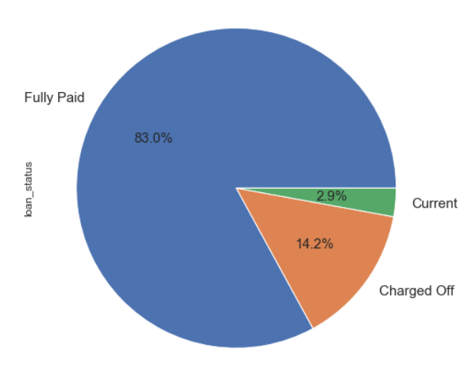
Data Overview
The dataset comprises comprehensive records of loan applications processed between 2007 and 2011.
It includes detailed information on applicant demographics, loan specifics, and the repayment status of loans categorized into three types:
Fully Paid (Not Default)
Charged Off (Default)
Current (Excluded from analysis)

Slide 4
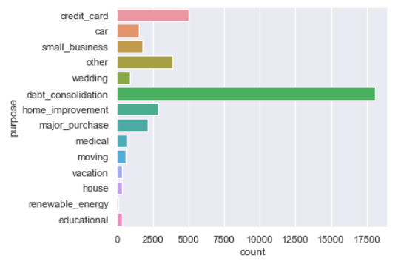
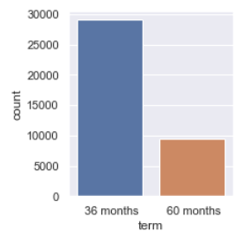
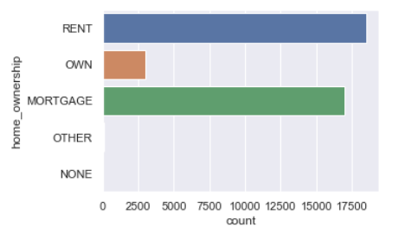
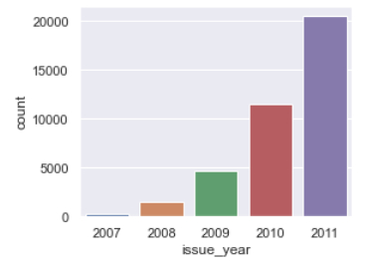
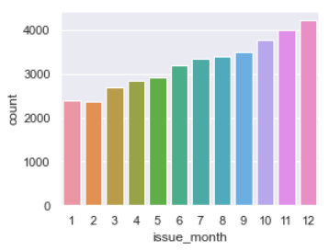
Observations
The majority of loans have a duration of 36 months.
Most loans are used for debt consolidation purposes.
A significant portion of loans is acquired by individuals residing in rented accommodations or mortgaged properties.
There is an upward trend in loan counts observed both on a monthly basis (January to December) and annually from 2007 to 2011.

Slide 5
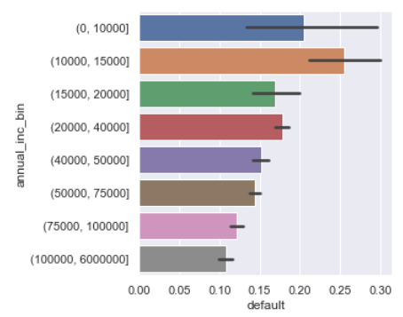
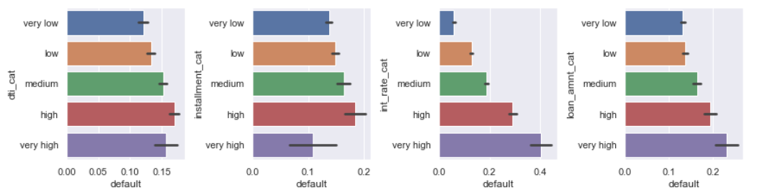
Observations
Higher annual income correlates with higher default rates.
Borrowers with annual income exceeding $15,000 are less likely to default.
A higher debt-to-income ratio (DTI) is associated with higher default rates.
Higher interest rates correspond to higher default rates.
Larger loan amounts are associated with higher default rates.

Slide 6
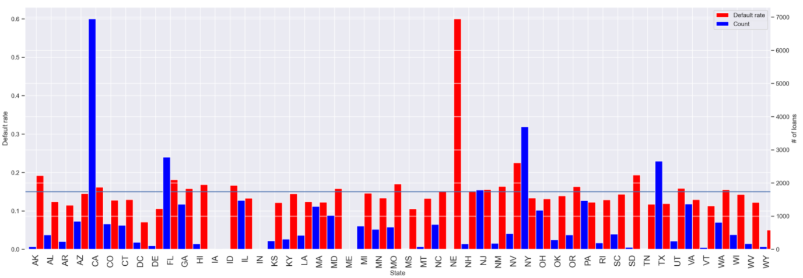
Observations
Most borrowers originate from highly populated states such as CA, NY, NJ, and FL, each with at least 2000 loans. These states also show a high default rate of 15% or more.
Nebraska, despite having the highest default rate, has only 5 loans in total. Nevada also exhibits a high default rate.

Slide 7
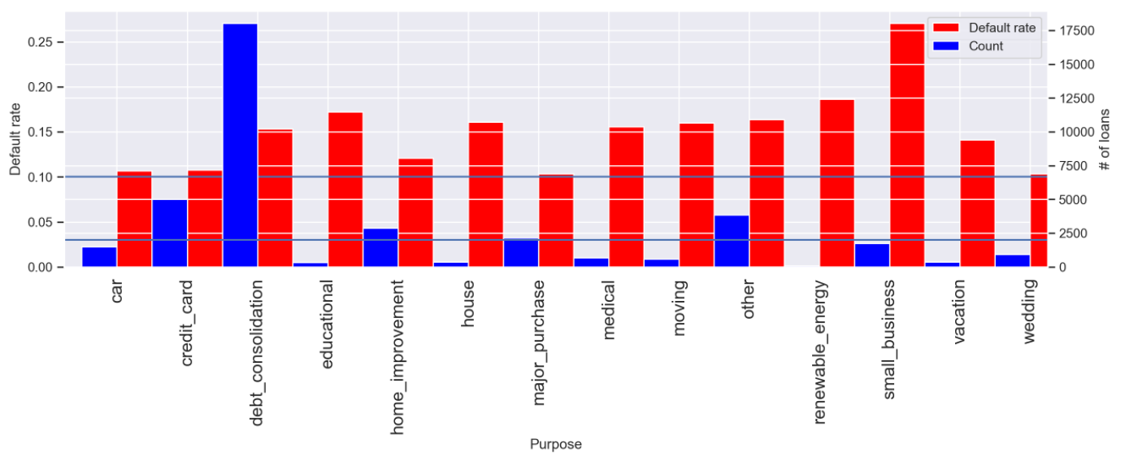
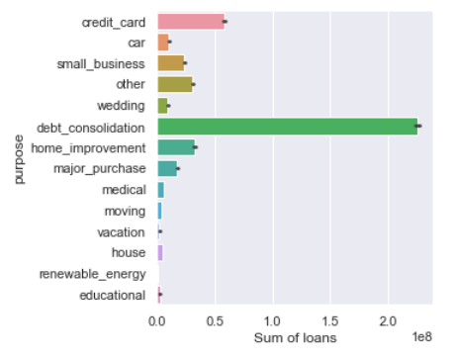
Observations
The loan purposes with more than 2000 counts and a default rate of at least 10% include credit card, debt consolidation, home improvement, and major purchase.
Debt consolidation accounts for the majority of loan investments and exhibits a notably high default rate exceeding 15%.

Slide 8
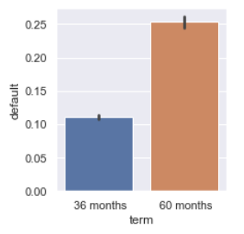
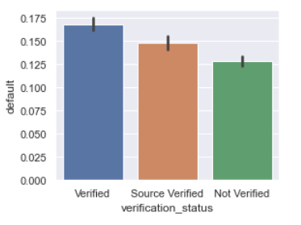
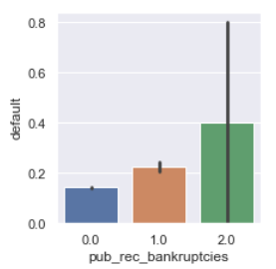
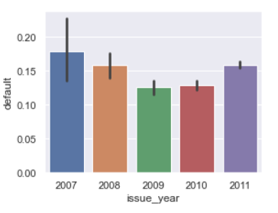
Observations
60-month loans have a higher default rate (~15%) than 36-month loans.
Verified loans have the highest default rate, followed by Source Verified loans, while Not Verified loans have the lowest default rate.
Borrowers with prior bankruptcies are more likely to default, especially those with multiple bankruptcies.
Loans issued in 2009 saw a decreased default rate, likely due to more cautious lending practices post the 2007-2008 banking crisis.

Slide 9
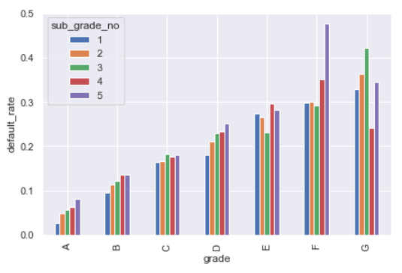
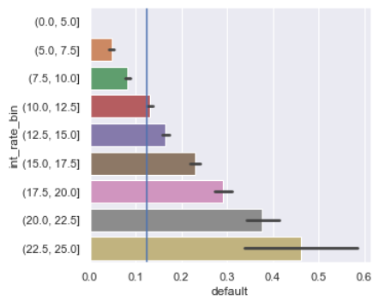
Observations
Loans with grades of 'C' and higher exhibit a high default rate, notably exceeding 40% for F5 and G3 grades.
There is a pronounced increase in default rates for loans with interest rates exceeding 12.5%.
Default rates surpass 30% for loans with interest rates greater than 20%.

Slide 10
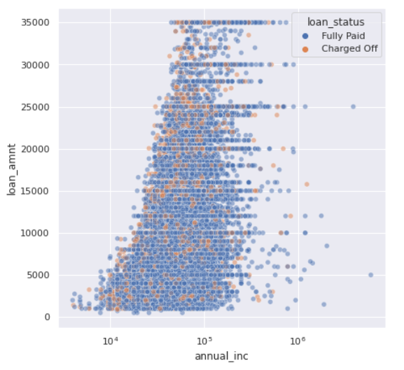
Observations
Borrowers with higher annual_inc go for higher loan amount

Slide 11
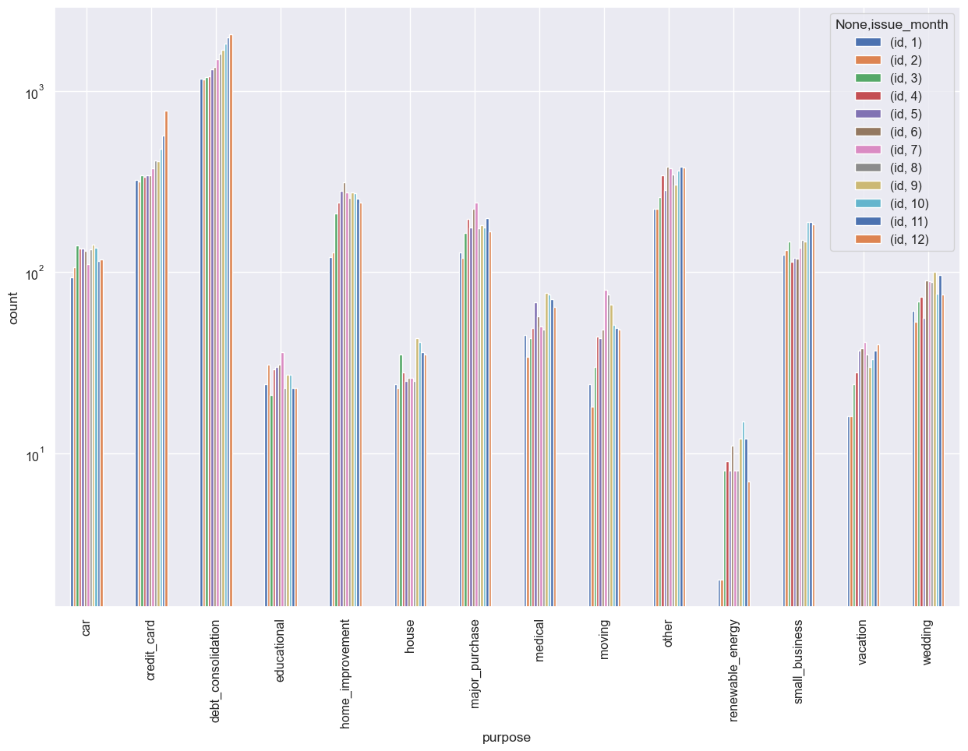
Observations
Interest go higher with the Grades

Slide 12
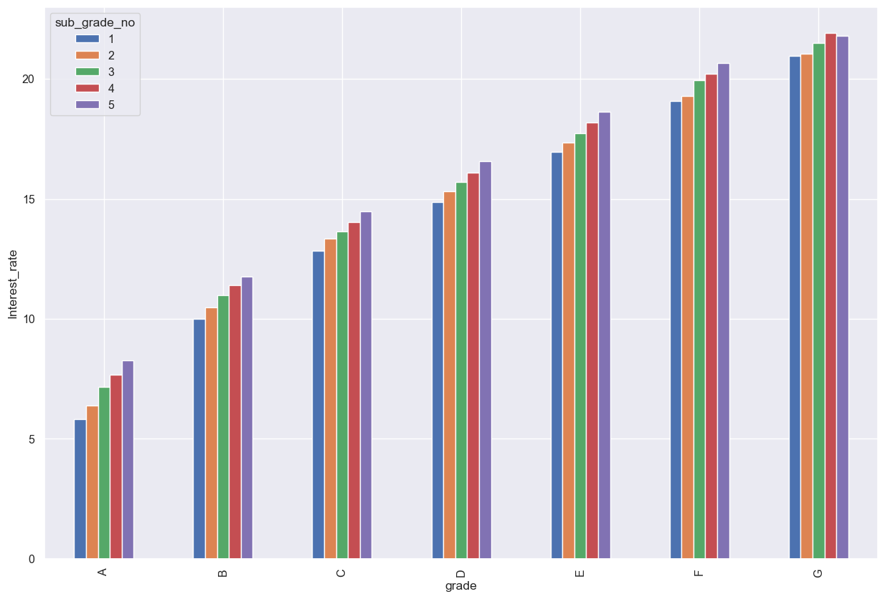
Observations
Safer investments leads to lower default rate as we have
seen in the year of 2009.
Number of loans increase with the month of the year.
Only two of the purpose of the loans can be seen having increasing trend with month which are credit_card & debt_consolidation and these are top 2 reasons for loans.

Slide 13
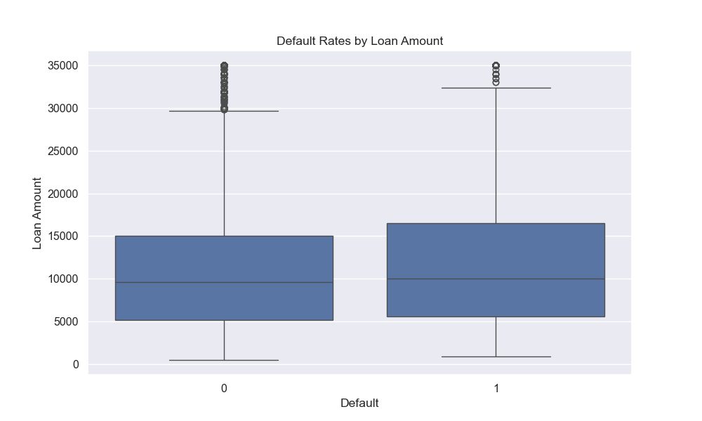
Default Rates by Loan Amount

Slide 14
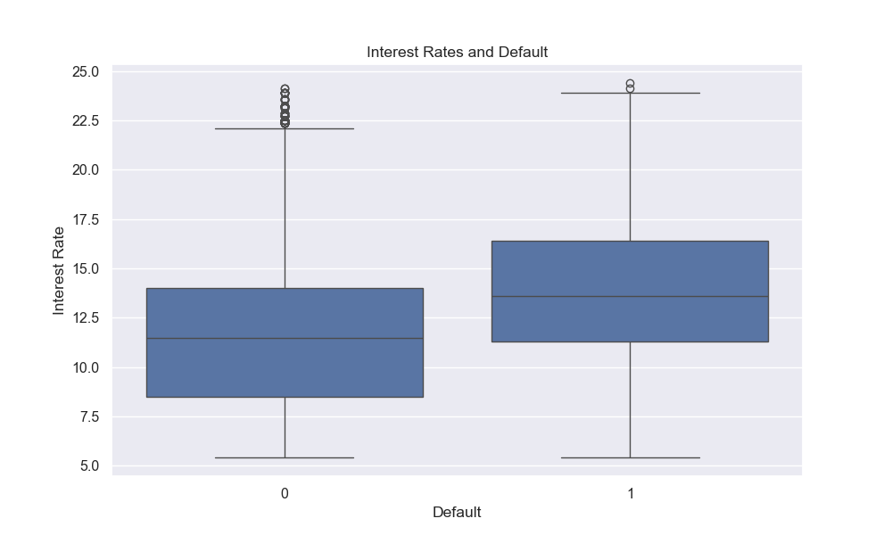
Interest Rates and Default

Slide 15
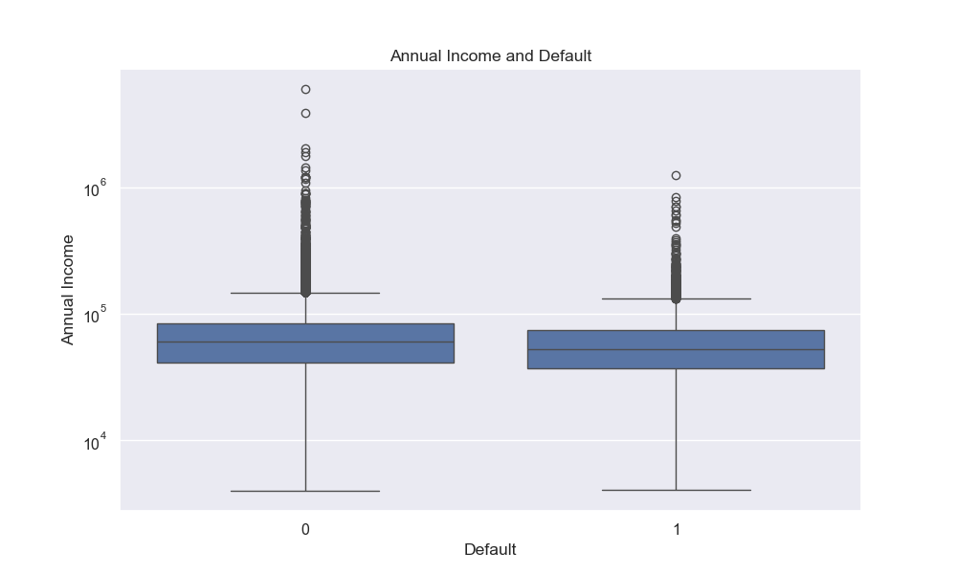
Annual Income and Default

Slide 16
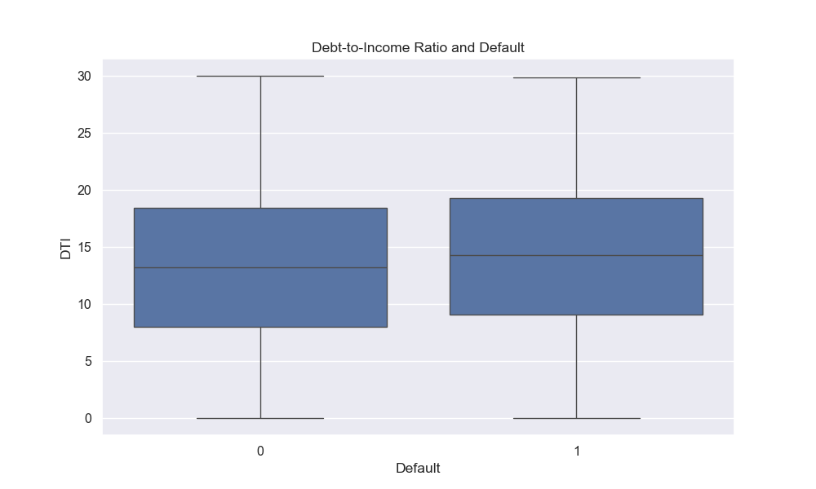
Debt-to-Income Ratio and Default

Slide 17
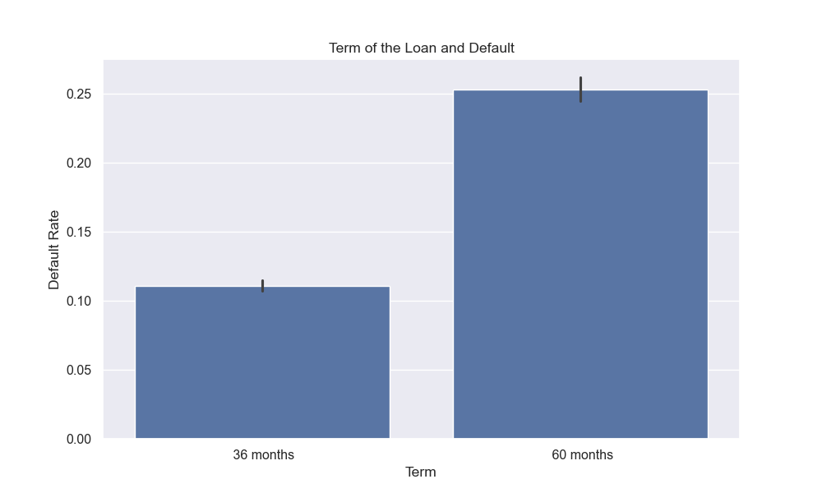
Term of the Loan and Default

Slide 18
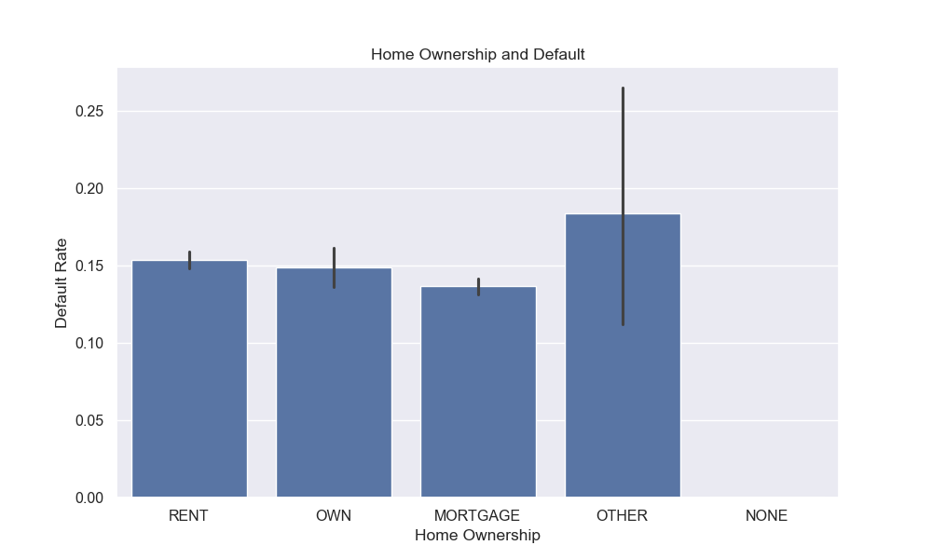
Home Ownership and Default

Slide 19
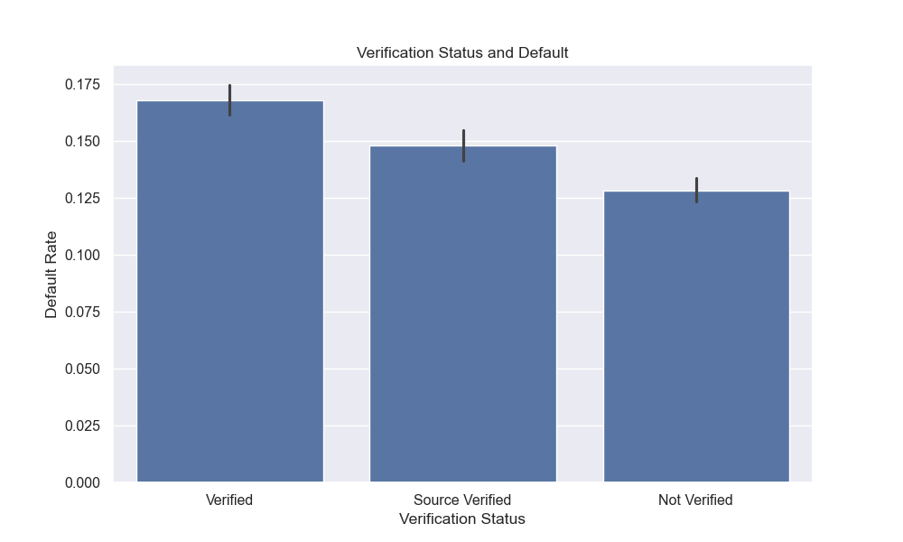
Verification Status and Default

Slide 20
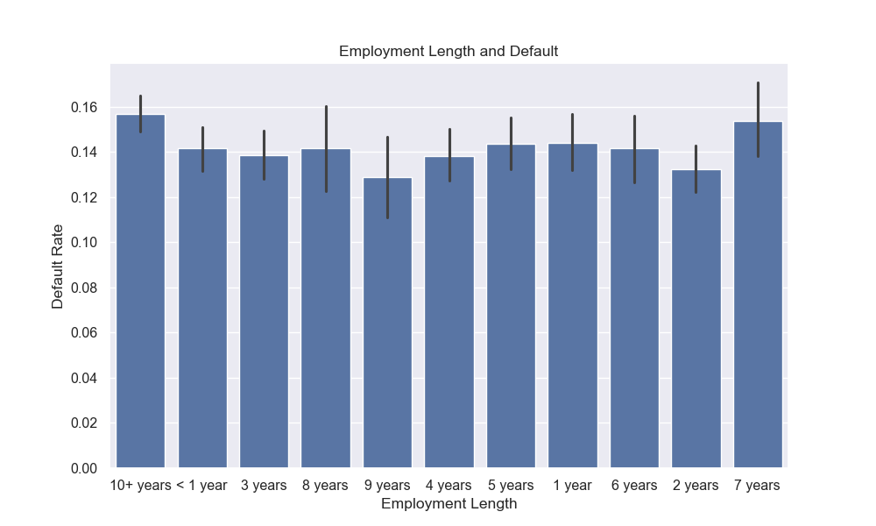
Employment Length and Default

Slide 21
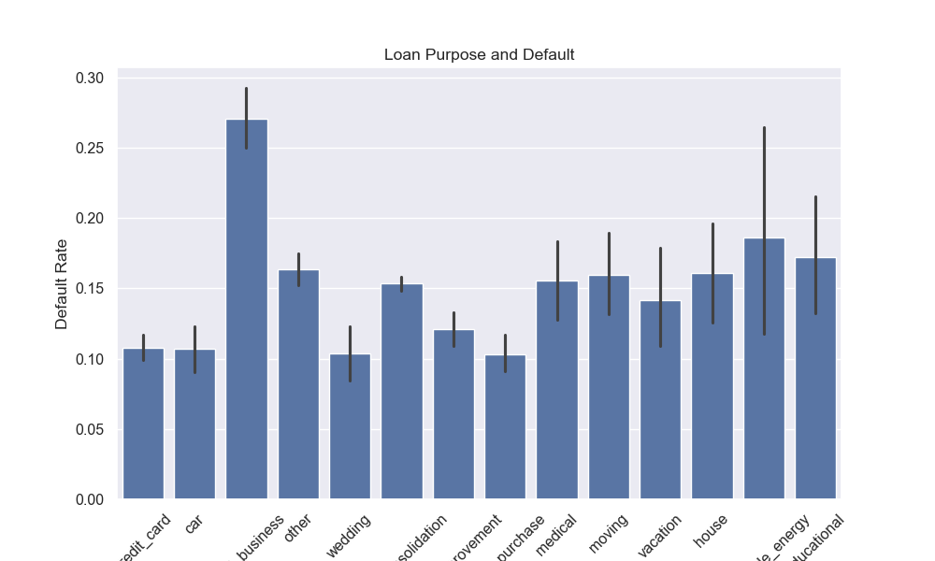
Loan Purpose and Default

Slide 22
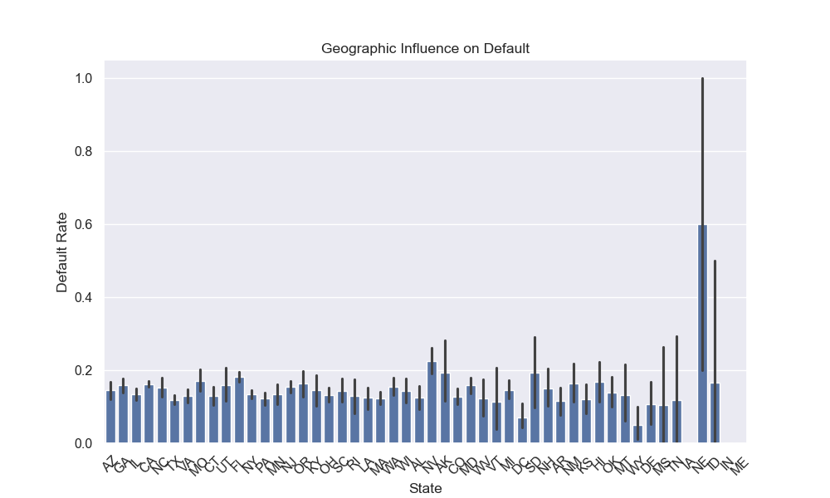
Geographic Influence on Default

Slide 23
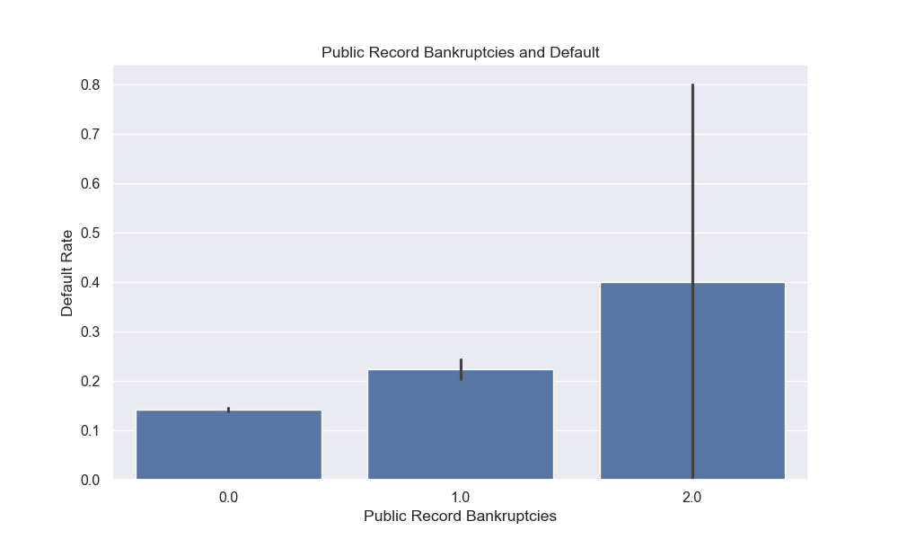
Public Record Bankruptcies and Default

Slide 24
Recommendations
Stop High Risk Loans
pub_rec_bankruptcy = 2
grade F
int_rate > 20%
Reduce Medium Risk Loans
pub_rec_bankruptcy = 1
state in (FL, NY, NV, CA, TX, NJ)
term = 60 months
Increase Low Risk Loans
pub_rec_bankruptcies = 0
grade 'A'
term = 36 months
purpose = credit card
lesser loan amount
lower dti
annual_inc < 15000
grade > 'C'
int_rate > 12.5%
int_rate 7.5-10%
Our recommendation is to modify the loan approval/grant process based on these factors.

