Slide 1
Using numbers without fear

Slide 2
Numbers in the news
One day of St. Petersburg Times: one-third of the 130 stories had numbers.
“Too many of the stories display numeric overkill, a deadening procession of figures that overwhelm the reader and rob the writer of the opportunity to use numbers in ways that explain and illuminate.”
“Avoiding numeric Novocain”, Chip Scanlan, Poynter Institute
Notes:
Most journalists got into this business because they don’t like math. Unfortunately, you’ll encounter numbers all the time. Just look at any day’s newspaper or TV broadcast and tally up how many stories involve numbers.
One guy did it for the St. Petersburg Times and found one-third of the 130 stories in that day’s paper involved numbers.
“Too many of the stories display numeric overkill, a deadening procession of figures that overwhelm the reader and rob the writer of the opportunity to use numbers in ways that explain and illuminate” – source: “Avoiding numeric novocain” by Chip Scanlan
These stories were from all sections of the paper:
Some examples:
Professional sports team purchase
Legislation to limit consumer lawsuits
Questions about local govt revenues from new baseball stadium
Presidential campaign donations
Drug money laundering
Prostate and breast cancer screenings
Antitrust settlements
Company mergers
Sports statistics
Feature on cystic fibrosis sufferer’s financial woes
We don’t need advanced calculus or algebra or any of the more advanced math classes to survive as journalists. Just some good middle school math basics and the power of logical thinking.

Slide 3
Sarah Cohen’s 7 tips
Keep the number of digits in a paragraph below eight
Memorize some common numbers on your beat
Round off – a lot
Learn to think in ratios
Use devices from everyday life
Envision your dream number and calculate it if it isn’t given to you
Learn from one another
Notes:
Most of what I know about working with numbers came from Sarah Cohen, a fellow data journalist who now heads up the data team at the New York Times. In her past life she was an economist – and she’s wicked smart when it comes to numbers. She wrote a book called Numbers in the Newsroom – you can get an e-book of the second edition for $10.
Here are her 7 tips for keeping your copy “number-free and fair”
Keep the number of digits in a paragraph below eight – we’re going to talk a lot more about this
Memorize some common numbers on your beat – The hardest part of dealing with numbers is answering the question, “is it big or small?”. Memorizing common numbers on your beat can help you put other numbers you encounter into context. (i.e. typical campaign war chest, teacher salaries, budget for a city or school district)
Round off – a lot – the numbers we use are far from exact. We’re also going to talk more about this
Learn to think in ratios – big numbers (really anything over 100) and really small numbers (below one-quarter) are hard to envision. So we need to think in ratios – percentages, percentage different, rate or a value per person. We’re going to talk about how to use many of these to also help our readers.
Use devices from everyday life– if you love shopping and can calculate what 20% off a price is in your head, or if you’re a baseball fan and you can calculate an earned run average – those are the kinds of devices that you should also be applying to news.
Envision your dream number and calculate it if it isn’t given to you – When it’s time to write about something, don’t just focus on the numbers that you have. Think about that ideal number you WANT to tell your readers and go looking for whatever you need to either get that number or get the numbers you’ll need to calculate that number.
Learn from one another – take advantage of your colleagues who work in different roles to learn how they deal with numbers. And don’t be afraid to ask for help from experts. I’ve hunted down math teachers and statistics experts in the past when I wasn’t sure how to proceed.

Slide 4
Using the right numbers
Find out how experts use the same data (i.e. traffic measurements, death rates)
Sometimes what you choose to publish will depend on the key point you’re trying to convey
Notes:
Picking the right numbers to use is the first thing we’re going to focus on. Sometimes you need to use a rate, sometimes you don’t. Do you need to adjust for inflation? Do you use an average or a median?
For some of these things, there are some rules to follow. For others – sometimes it depends what you are trying to convey in your story or graphic.
Regardless of the topic of the data, the one thing that will hold true is that somewhere you can find experts who can tell you what the experts in that field would use.

Slide 5
Rates
Use them to compare disparate groups
Use them to make very big or very small numbers comprehensible
Any ratio:
25:1,000
1 in a million
1 in 7
Percentage is a special ratio with 100 as the base. 25% = 25:100 or 25/100
Notes:
More often than not, we’re dealing with rates --- this could be a percentage, a ratio, a per person or per capita.
There are 2 main reasons for using rates:
--To compare disparate groups
--To make very big or very small numbers comprehensible.

Slide 6
Examples
Crimes in cities with different populations
Deaths from various diseases
Comparing deaths at different hospitals
Birth rates (number of births per number of women of child-bearing age)
Time-series change involving people
Notes:
Examples where rates are necessary:
--Crimes in cities with different populations (more people=more opportunity for crime)
--Deaths from various diseases (some diseases are more common in older people)
--Comparing deaths at different hospitals (some have more trauma patients)
--Number of births in different places (some cities have more younger people, others more older people)
--Time-series change involving people (because population changes over time)

Slide 7
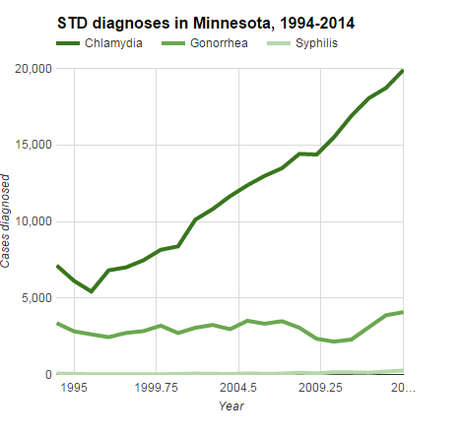
Notes:
Here’s an example. This is a chart showing the number of sexually transmitted diseases in Minnesota between 1994 and 2014. It’s a really dramatic chart – however, it doesn’t take into account the fact that our population has increased during that time, which would explain some of that growth.

Slide 8
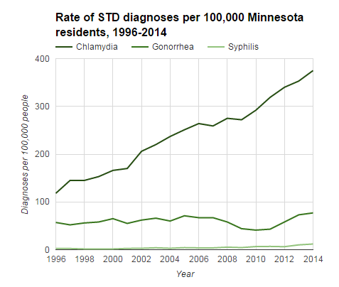
Notes:
So we need to eliminate that population growth as a factor --- so that we’re only showing the growth that CAN’T be explained by population change. We still have a very dramatic increase in chlamydia cases – but this is a much more accurate picture of the story we’re trying to tell about this dramatic rise in STD cases.

Slide 9
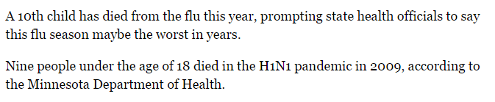
Raw numbers vs rates:
Notes:
Sometimes raw numbers are okay.
Murder is a good example. When talking about the total number of people killed in a given year, it would be okay to give the raw number because most people would agree that even 1 person killed is too many. But when comparing one city to another, a rate would be more appropriate because one city might have more people (more opportunities for deaths) than another.
This story from MPR about flu deaths is a good example of a situation where reporting the raw number is probably the preferred method. First of all, even a single death is newsworthy and unfortunate. It’s also simply saying the number of children who died. It’s not trying to say that the flu DISPROPORTINATEY affected children.

Slide 10

Percentage or raw numbers?
Notes:
Later in the story, however, they start talking about senior citizens. And they do mention that seniors accounted for “more than half” of all hospitalizations.
It would not be fair to say that there were 100 hospitalizations of seniors and 20 of children and use that to show disparity --- because those age groups contain differing numbers of people who could potentially be affected. You would want to calculate 100 divided by the total number of seniors and 20 divided by the number of children and then compare those two percentages.

Slide 11
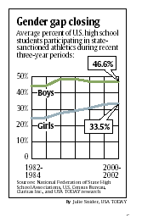
Comparing different groups
Sports participation:
Do you want to know what part of the overall pool is playing?
Or do you just care about total bodies?
Notes:
Sports participation data is one example where your decision about using the raw number or the rate really hinges on the point you’re trying to make. If you’re comparing boys and girls and trying to say that boys are more likely to play sports than girls, then you definitely need a rate. Or if you’re trying to say that boys are less likely now to be playing sports than they were a few years ago, then you need a rate (because the number of boys changes from year to year).
But if you’re writing a story about a high school team that has seen an enormous increase in the number of students wanting to play sports – and you’re making a point that this big influx means there aren’t enough resources (money, spots on teams, equipment, etc) -- then showing the change in the number of students would be fine. Saying that two years ago they had 100 student athletes and now they have 200 would be fine in that situation --- unless something strange occurred such as the school expanding its boundaries and suddenly having far, far larger student population between those two points in time.

Slide 12
How it was published:
In Hastings, which has a population of about 22,100, there were six heroin arrests in 2011, according to a report from the drug task force. That's compared with eight arrests in Burnsville, a city with 60,300 residents. Eagan, a city of 64,200, had seven arrests.
Notes:
Here’s a real example of a story that didn’t use rates. The graph is almost incomprehensible. What are they trying to say?

Slide 13
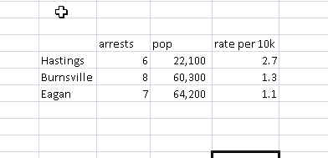
Better?
There were nearly 3 arrests per 10,000 people in Hastings, compared to about 1 arrest per 10,000 people in both Burnsville and Eagan, which are each nearly three times the size of Hastings.
Notes:
Let’s start by coming up with an arrest rate – number of arrests per 10,000 people – for each city. What does that show us? Clearly the arrest rate in Hastings is significantly greater than the arrest rates in the other cities --- even though Hastings is a one-third the size of the others. Isn’t that our main point? Using rates allow us to fairly compare – and then we can also do a better job of characterizing the findings and giving readers something that they can easily digest. We don’t want to make them “work” while reading our stories.

Slide 14
Pull extreme numbers into reach
… [California] carried a relatively small amount of debt . … Its $24.8 billion in debt in 2001 was equal to $733 per person compared with a national average of $820…
Notes:
Instead of just saying the state had $24.8 billion in debt – a number that is incomprehensible to almost everybody – the story calculated the per-person debt to come up with $733 per person. They went one step further and added context: how the state’s per person rate compares to the national rate.

Slide 15
Tiny numbers
America West and US Airways … each had about 32 passengers of every 10,000 voluntarily give up their seats in the first quarter.
[Note: Rate = 0.0032, percentage = 0.32%]
Notes:
When you do the actual math on this: number of passengers giving up seats divided by total number of passengers served you come up with 0.0032 or 0.32%. Another number nobody can understand? So instead, the paper multiplied the rate by a factor – in this case they used 10,000. You can use any factor you want – 1 out of 1000, 1 out of 1 million, etc.

Slide 16
When we don’t use rates…
“The Toyota Camry and Honda Accord, the best-selling cars in the USA recently, top the list of most stolen vehicles in 2000, as they have for several years.”
Notes:
Not using rates when you’re supposed to can be very misleading. The most widely-known example is about the “most stolen vehicles” list that gets put out each year by insurance industry groups.
Here’s an example from a major news story: “The Toyota Camry and Honda Accord, the best-selling cars in the USA recently, top the list of most stolen vehicles in 2000, as they have for several years.”
If you just get the police data on stolen vehicles and tally up how many were stolen, the ones at the top will almost certainly be the most popular cars in general.

Slide 17
Better….
DETROIT - The 1995 Saturn SL was the nation's most-stolen vehicle last year based on thefts versus the number of models registered … a new report shows. …One out of every 200 registered 1995 Saturn SLs was stolen in 2003 … according to Chicago-based CCC Information Services, an insurance industry tracker … .
Notes:
After much prodding from mathematicians and journalists refusing to publish these numbers – at least one group now adjusts the thefts based on the number of registered vehicles of each type (unfortunately, the only “easy” way to get this data is by paying a small fortune to a company called Polk that collects it from all state DMVs)

Slide 18
Use the right base
Highway death rate: “vehicle miles traveled.” Accounts for number of drivers and distance driven, which vary.
Tricky base: Age adjustment, risk adjustment, etc
Notes:
The examples I’ve given here are some of the more common ones that you’ll encounter, but you’ll certainly run into other cases.
Just remember to make sure you’re using the right base or denominator. In the stolen car example, the base was the total number of cars of a particular make/model that were registered.
Some others that are tricky: when looking at accident or deaths rates on highways you have to use “vehicle miles traveled” which accounts for the number of drivers and distance driven. Also death rates, when comparing hospitals or comparing different diseases, get kind of tricky -- it’s imperative to get guidance form an industry expert in those types of situations.

Slide 19
Percentage change
(New-old)/Old
Notes:
A “simple difference” is the result of subtracting one number from another. If you are measuring differences in time, it’s the newer number minus the older number. One time to think about using simple changes is when an event is rare, but there’s a consensus that it shouldn’t happen.a recent example would be the crashes attributed to GM’s faulty ignition switch
another time is when whatever you are talking about is understandable without putting it into perspective using percentage changes. Prices of common household goods and home prices are good examples.
And sometimes a raw number is more newsworthy.
Most of the time, though, we’re going to be using percentage change. Unfortunately, a lot of journalists don’t know how to do it . There’s one approach that is easy to remember and will get you the right number every time.
(new – old)/ old
If the number has fallen, you’ll get a negative number. If the number has risen, you’ll get a positive percentage.

Slide 20
Negatives
$20 >> $40 = 100% increase (double)
$40 >>$20 = 50% drop (one-half)
-$200 to $100 = impossible
Notes:
Remember that a number can grow many times, but it can only fall 100 percent to zero.
This is a rough concept until you think it through. If you double a price of $20, increasing it by 100%, it’s $40. If you triple it, it’s $60. But if you reduce the $40 back to $20, it’s a 50 percent drop – to one-half the level, not a 100 percent decrease. In other words, percent changes can’t be reversed.
It’s actually impossible to calculate the percent change of a number that changes signs – positive and negative. This comes up in earnings reports, in which a company lost money one year and made money the next.
For example, if earnings went from -$200 to $100, you’d get a 300% increase. But you’d also get a 300% increase if it went from 25 to 100, which is the only time that the answer is right. Going the other way, you’d get a -300% change – which is also impossible and wrong.

Slide 21
Less than 100 items
5 people increases to 100 people = 1,900% change (95 people)
10,000 people increases to 15,000 = 50% (5,000 people)
Notes:
It’s difficult to quote a percentage when you’re working with fewer than 100 items. That’s because a change in each represents more than one percentage point. We see this a lot when comparing population change in racial groups, especially when we’re looking at the change in a racial group in Minneapolis compared to a small suburb
Revert to raw numbers or round off a lot – so you’re describing “more than doubled” or “almost two-thirds”

Slide 22
Adjusting for inflation
Adjust when dollar values are five or more years apart (2005 salary vs. 2010 salary )
Adjust to current dollars, using the Consumer Price Index (CPI) from the Bureau of Labor Statistics
Notes:
Just like rates, you also need to think about adjusting for inflation when using currency figures. General rule of thumb is that you should adjust if you are comparing dollar values that are five or more years apart. There might be times when you want to adjust for a time period as little as three years apart.
This might include salaries, city budgets, property values, prices of goods or services

Slide 23
Inflation formula
(CPI Now/CPI Then) x Old value
Example: Teachers made about $9,000 in 1970. By 1996 they made $38,000. Is that a big raise or a little one?
CPI Now (156.9)/ CPI Then (38.8) = 4.0438
It took about $4 in 1996 to buy what people bought for $1 back in 1970
Answer: 4.0438 x $9,000 = $36,394. That means their raise was only $1,600 after inflation
Notes:
How this works: You adjust the old number(s) into today’s dollars using the Consumer Price Index – this is a number that is generated on a monthly basis by the Bureau of Labor Statistics and can easily be found on the Web.
You’ll need to get the most recent CPI number and any CPI numbers for the year(s) or points in time that you are adjusting into today’s dollars.
So here’s an example.

Slide 24
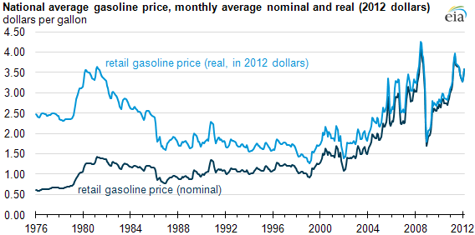
Gas prices: Adjusted vs Unadjusted
Notes:
Gas prices are a good example of how a picture can be distorted if you don’t use rates when you’re supposed to. If we want to say gas prices are at an all-time high or all-time low – or even the highest or lowest within the past decade or two decades, etc, this is the only way to go. This is also an example of a situation where you would want to adjust ALL of the prior years into today’s dollars (even the ones within the last five years) in order to get an accurate picture of the change over time.

Slide 25
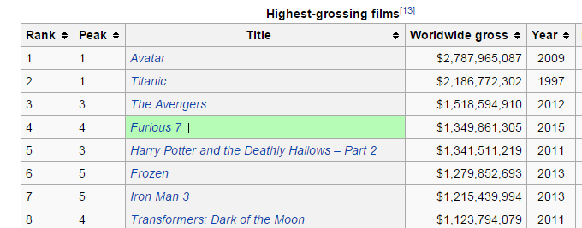
Context!
Notes:
Adjusting for inflation is also a way to put data into context. A glaring example of data that is often not adjusted for inflation – but should be -- is box office receipts. You frequently hear about a movie bringing in the “most money ever” – but did they adjust for inflation? Look on Wikipedia for “highest-grossing films” and you’ll find two lists – one showing “Avatar” made the most money ever with $2.7 billion worldwide

Slide 26
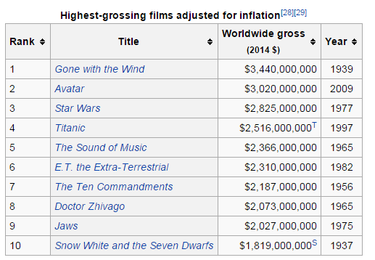
Notes:
. But then scroll down a bit and you’ll see that, adjusted for inflation, the oldie-but-goodie, “Gone with the Wind” still holds the title with $3.3 billion in today’s dollars. If you’re talking about the shear reach of the movie, clearly more people must have watched “Gone with the Wind” in the theater, while “Avatar” just charged more money per ticket.

Slide 27
Average vs Median
Rule: If average and median are different, use median. If they are very similar, use average.
Average: Sum of values divided by number of items
Median: Middle value
Home prices, salaries
Notes:
The general public probably doesn’t know what a “median” is, but they can grasp the idea of an average. Unfortunately, they are distinctly different when it comes to math.
The average (or mean) is the sum of values divided by the number of items.
The median is the middle value.
The big problem with an average is that it can be heavily influenced by “outliers” – one or two numbers that are extremely far above or below the rest of the numbers.
The general rule of thumb is to calculate both and if they are similar, you’re okay using the average (which is easier to explain to readers or viewers). If they are very different, you need to use the median

Slide 28
Simple example:
$40
$50
$45
$200
$250
$50
Average: $105
Median: $50
Notes:
Here’s a simple example. Imagine these are salaries of workers and you want to figure out what the “typical” salary is.
You have $40, $50, $45, $200, $250 and $50.
On the face of it, you would be inclined to say the “typical” worker makes something in the neighborhood of $50 – right?
If you calculate the average you come up with $105.
The median comes out at $50.

Slide 29
PLAYER | SALARY | POSITION
Joe Mauer | $23,000,000 | Catcher
Justin Morneau | $15,000,000 | First Baseman
Joe Nathan | $11,250,000 | Pitcher
Michael Cuddyer | $10,500,000 | Outfielder
Carl Pavano | $8,000,000 | Pitcher
Matt Capps | $7,150,000 | Pitcher
Delmon Young | $5,375,000 | Outfielder
Jason Kubel | $5,250,000 | Pitcher
Scott Baker | $5,000,000 | Pitcher
Francisco Liriano | $4,300,000 | Pitcher
Nick Blackburn | $3,000,000 | Pitcher
Tsuyoshi Nishioka | $3,000,000 | Second Baseman
Jim Thome | $3,000,000 | Designated Hitter
Kevin Slowey | $2,700,000 | Pitcher
Denard Span | $1,000,000 | Outfielder
Alexi Casilla | $865,000 | Shortstop
Glen Perkins | $700,000 | Pitcher
Jason Repko | $600,000 | Outfielder
Brian Duensing | $462,500 | Pitcher
Jose Mijares | $445,000 | Pitcher
Danny Valencia | $437,500 | Third Baseman
Drew Butera | $429,000 | Catcher
Dusty Hughes | $429,000 | Pitcher
Matt Tolbert | $425,000 | Second Baseman
Jeff Manship | $419,000 | Pitcher
Notes:
This is a roster from the Twins 2011 team – yes it’s a little old, but it shows what happens when you try to average salaries, especially in situations like this where you are very likely to have outliers. Out of 25 guys, there are 10 who make less than $1 million. 6 others who make between $1 and $5-ish million. But then we have Joe Mauer at $23 million and Justin Morneau at $15 million --- clear outliers above the others.

Slide 30
Which one is “ typical”?
Average: $4.5 million
Median: $3 million
Notes:
If we run an average, or mean, on these numbers we get -- $4.5 million. But then if we run a median, we get $3 million. Which one is more reflective of the “typical” pay on this team?

Slide 31
Comparing over time
Median home prices – each time that number if calculated, it’s based on a different universe of homes.
Notes:
Comparing average over time can be problematic because in many cases the averages are based on a different “mix” from one year to the next. Home prices are a good example – one year, the median home price might be based on lots of new construction; another year it might be a lot of foreclosed properties; another year it might reflect the popularity of a particular neighborhood or area of the country.
How to get around this? Report it as the ‘best available measure of the value of homes’ and include a sentence at the end of the story warning that the mix of homes changes each month, so the numbers can change even if no value has changed.

Slide 32
Average of an average
DEPARTMENT | PERCENT CHANGE
Fire Department | 41%
Police Department | 10%
Administration | 5%
Public Works | 150%
AVERAGE????? | 52%
Notes:
Sarah Cohen describes an average of a bunch of averages as like “overcooking a vegetable medley – you can’t really taste any of the flavors and you’re not sure what you’re eating when you’re done”. she says to stay away from this technique because it will not only be misleading, but it will be wrong.
Let’s say you’re writing about the city budget and you’ve got the percentage change for each department. If you try to average those percentage changes, you’re going to end up with a washed out number. In this case, the 52% doesn’t at all reflect the fact that there was very little change in administration, but a huge change in public works.
Better approaches – tell readers the changes in each department ranged from 5% to 150% -- and/or take the city’s total budget figures from this year and last year and calculate the percentage change on that.

Slide 33
Yardsticks
3 billion pounds of debris at WTC…
How many tons?
How many dump trucks full?
How many train cars full?
Enough to fill Great Pyramid?
A month of NYC’s garbage?
Notes:
Once you’ve made sure you’re using the right numbers, you’ve got another hurdle: making sure your readers will understand them.
Very big numbers or very small numbers – as we saw with rates – can be very tricky. The other problem is making sure you don’t bombard your readers with too many numbers.
Let’s first talk about some other ways – besides rates – to help readers understand really big numbers.
That’s called using “yardsticks.” This means that you find a way to compare your number to something that people will readily understand.
For example: When the cleanup was going on at the World Trade Center in New York after 9/11, they talked about hauling away 3 billion pounds of debris.
You can’t even fathom what 3 billion pounds would be. I know that 1 pound is about how much ground beef I put in when I make tacos, but what would a billion look like?
So maybe we could convert it to how many tons? But would that be good enough? Do you know what a ton of debris looks like?
How about how many dump trucks?
Or how many train cars?
Is it enough to fill the Great Pyramids? Or the Grand Canyon?
Is it equivalent to a month’s worth of NYC’s garbage?
Make sure the analogy makes sense for your topic and your readers.

Slide 34
Yardsticks
Only three percent of the world’s water is available for humans to drink…..most is locked in polar ice caps and glaciers or is embedded in layers of rock. How much is 3 percent?
“If a large bucket were to represent all the seawater on the planet, and a coffee cup the amount of freshwater frozen in glaciers, only a teaspoon would remain for us to drink.”
New Yorker, Oct. 23, 2006, page 64
Notes:
An article in the New Yorker magazine found a creative way to explain the quantity of available drinking water on earth to the quantity that is trapped in ways that we can’t obtain. First they told us that only 3 percent of the earth’s water is available for humans to drink.
Then they put it into a visual format:
“If a large bucket were to represent all the seawater on the planet, and a coffee cup the amount of freshwater frozen in glaciers, only a teaspoon would remain for us to drink.”

Slide 35
Compared to what?
“Travel in America claimed the lives of more than 44,000 people last year – roughly the population of Wilkes-Barre, Pa., Palatine, Ill, or Covina, Calif.”
Notes:
Another approach is to use “compared to what?” …compare the number to some other total. In this example, the writer compared the total number of people killed in travel-related accidents to the total populations of certain communities.
“Travel in America claimed the lives of more than 44,000 people last year – roughly the population of Wilkes-Barre, Pa., Palatine, Ill., or Covina, Calif.”

Slide 36
Think visually
“To put it another way, the crash of 7,000 aircraft would mean that every square mile of the state of New Jersey would have shaken to the impact of a downed plane”
Notes:
Something visual almost always helps: this example was used to explain the impact of the crash of 7,000 aircraft in the Netherlands during World War II – they showed that the whole state of New Jersey would have been affected.
“To put it another way, the crash of 7,000 aircraft would mean that every square mile of the state of New Jersey would have shaken to the impact of a downed plane.”
In addition to thinking visually in words – to include in your story – also work with your graphics department to figure out if there’s a way to display your quantitative information in graphics or maps that would help the reader visualize what you’re talking about.

Slide 37
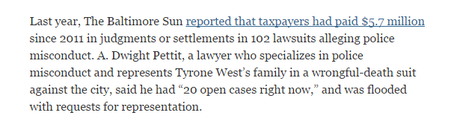
Context?
Notes:
We can also help readers understand numbers by putting them into context.
Both this clip from a New York Times and the Baltimore Sun story that it references talk about the city of Baltimore paying out $5.7 million in judgments or settlements over allegations of police misconduct since 2011. However, neither story puts this into context. Is that big or small? baltimore is a big city with a lot of police officers. What does that work out to per officer on the force? and what would be the comparable number for similarly-sized cities?

Slide 38
Numbers are not concrete
“The most important numerical fallacy is
that people tend to think of numbers as known, constant and having no variability,” said Donald Berry, a biostatistician at the University of Texas MD Anderson Cancer Center in Houston
Notes:
One of the other key things we need to keep in mind is that numbers are not as exact as we make them out to be.
“The most important numerical fallacy is that people tend to think of numbers as known, constant and having no variability” said Donald Berry, a biostatistician at the University of Texas MD Anderson Cancer Center in Houston.

Slide 39
Where do numbers come from?
Polls & Surveys are merely “samples”
Most datasets we use have some sort of flaw that make them imprecise
Even the most thorough data collection will have errors (i.e. decennial census)
Notes:
Think about where numbers come from. The majority that we, as journalists, use come from polls and surveys. Even census data, which we trust implicitly, is flawed. Every 10 years, the Census hires hundreds of thousands of people to knock on doors and hunt down homeless people in hopes of counting every head in the nation. They fail every time.
Nearly any dataset we use probably has flaws. Let’s say you get the city’s water billing records to see who is using the most water or what part of the city is using the most water – what if they accidentally have 2 records for the same person? Or what if they are missing a home or two?
This is why it’s imperative for us to “characterize” numbers, rather than imply that they are super precise.
It’s okay to round numbers (always up), avoid decimal places and to use words (like “one-third” or “half”) to avoid using numeric digits. These kinds of practices help avoid giving the reader the impression that the numbers you are citing are scientifically accurate.

Slide 40
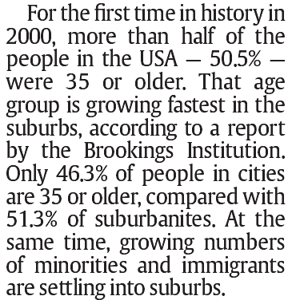
Over-precision
Notes:
The most common error for journalists is to use too many decimal points – or too much precision. There are a couple problems with this:
Each decimal point is another number that the reader has to “trip” over as they are reading or listening to your story. Numbers slow your story down considerably – this is a scientific proven fact.
and as we just discussed, precision usually isn’t necessary or might even be misleading.
Let’s start with a couple examples:
The first is from USA TODAY and talks about findings from a Brookings Institution report on the aging population. Note how they says 50.5% were age 35 or older. Does that .5 percent really matter? Isn’t that the same as saying “half”?
Then it goes on to say 46.3% of people in cities are 35 or older and 51.3% of suburbanites – they are trying to compare cities versus suburbs. In this case, the decimal points don’t matter. It’s still 46% versus 51%. The reader isn’t going to care.

Slide 41
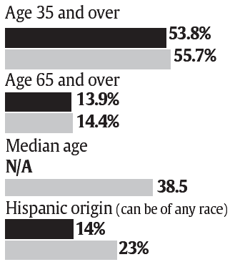
Over-precision
Notes:
The next example is similar, showing bar graphs of age 35 and over, age 65 and over , median age and Hispanic origin. There are a couple problems here. The first is that they are inconsistent in when they use decimal points. The second goes back to the same problem in the previous example – does it really matter. Finally, is this really worth a graphic? The differences in the age 65 and over population are non-existent – they are both 14%.
The bigger issue underlying both of these examples is the source of the information to start with. There are two aspects to this point:
If the source is a survey, it’s automatically flawed and therefore imprecise.
If the numerator and denominator used to calculate these percentages were whole numbers, it is also imprecise to start with.
In both those cases, using decimals implies a level of precision that is simply not there.

Slide 42
Using decimal points
“Decimal points are for meaning, not emphasis.” (Philip Meyer, Precision Journalism)
“Characterize” the numbers you are using.
Notes:
A lot of press releases and reports use decimal points to death. They want to prove that their work was rigorous and scientific. But do our readers really care? (okay, yes some of them do). But the vast majority do not.
Your job is to “characterize” the situation using numbers. In his book “Precision Journalism” Phil Meyer said “Decimal points are for meaning, not emphasis”. So you need to use them ONLY when they impart true meaning.

Slide 43
Too many numbers…
Pick one number to be the “star”
“Sprinkle in numbers”; same idea as quotes.
Keep the number of digits in a paragraph below eight. Others recommend no more than 2 numbers.
Don’t let two paragraphs with numbers bump up against each other.
Notes:
The second most common numeracy error among journalists is to use too many numbers. There are a couple reasons we should limit them ...the first is that numbers slow down a reader. Each digit that they have to read slows their pace. Try reading a sentence filled with numbers out loud and hear yourself slow down. the second is that most people are not very good at being able to understand the meaning of numbers...so if we throw a whole bunch of numbers at them, especially all jammed together, it just becomes a sea of numbers and they don’t take away the key point. So we need to focus on giving them the key number and leave it at that.
I’ve seen a couple different rules of thumb:
Keep the number of digits in a paragraph to no more than 8.
Use no more than 2 numbers in a paragraph.
I’m a big fan of really limiting the number of numbers in a story. I think of them more like quotes --- use only the best ones. Paraphrase when necessary.
When incorporating the results of my data analysis into a story, I also try to come up with a “star number.” What’s the one piece from my analysis that is most crucial to convey to my readers? What number really drives home our key point?
“Sprinkle in numbers” like you do quotes. Remember basic reporting is that you should only use quotes where the person is saying something so profound or unique that you can’t say it better in paraphrase — or it’s something that legally you’ve got to put in quotes. Because of this rule, quotes should be few and far between in your story – how many sources do you know who sound “quotable” all the time?
So treat numbers the same way. Few and far between.

Slide 44
Example
The Office of Redundancy’s budget rose 48 percent in 2001, from $700.3 million to $1.03 million.
Over the past year, the Office of Redundancy's budget grew by nearly half, to $1 billion.
Numbers in the Newsroom, Sarah Cohen
Notes:
The “eyes glazed over” version: “The Office of Redundancy’s budget rose 48 percent in 2001, from $700.3 million to $1.03 million”
A better way: “Over the past year, the Office of Redundancy’s budget grew by nearly half, to $1 billion.”

Slide 45
Eyes glazed over….
“Statewide, lending institutions rejected 18.8 percent of black applicants, 15.7 percent of Hispanic applicants and 11.4 percent of white applicants for conventional mortgage loans in 2004, the latest year for which complete data are available.”… (12 digits)
“Loan denial rates higher for minorities”, South Florida Sun-Sentinel, June 17, 2006
Notes:
The “eyes glazed over” version: “Statewide, lending institutions rejected 18.8 percent of black applicants, 15.7 percent of Hispanic applicants and 11.4 percent of white applicants for conventional mortgage loans in 2004, the latest year for which complete data are available…..” (source: South Florida Sun-Sentinel)
Notice there are 12 digits in this sentence, also they are just rattling off numbers. What are they really trying to convey to readers? The main point is that Black, and to a lesser extent, Hispanic, applicants are far more likely to be rejected than whites. So why not come up with a sentence that basically says that?

Slide 46
What?!?
“In a three-month investigation of water levels throughout the Coachella Valley, The Desert Sun found that the average depth of 70 existing wells across the valley in 1970 was 104.4 feet. As of this year, the average depth of 291 wells in the valley had dropped to 159.3 feet.”
Notes:
So what are they trying to say here?
Clearly they felt it necessary to explain that there are significantly more wells now than in the past – but does that need to be in the nut graph? Remember this is toward the top of the story, you’re still trying to lure the readers into the story and get them hooked. You need to keep it simple and make them want to know more.

Slide 47
Better
“The average loss of 55 feet of water depth reflects a significant depletion of the most precious resource in the California desert.”
Notes:
They did that in the next graph, but I think they could’ve eliminated a lot and just used this:
“The average loss of 55 feet of water depth reflects a significant depletion of the most precious resource in the California desert.”
Use graphics to help provide the details of trends that you’re writing about and then just use words in the story to say how that trend has changed over time.

Slide 48
An easier read…
“The oldest killer was 88; he murdered his wife. The youngest was 9; she stabbed her friend. The women were more than twice as likely as men to murder a current spouse or lover. But once the romance was over, only the men killed their exes. The deadliest day was July 10, 2004, when eight people died in separate homicides. Five people eliminated a boss; 10 others murdered co-workers. Males who killed favored firearms, while women and girls chose knives as often as guns. More homicides occurred in Brooklyn than in any other borough. More happened on Saturday. And roughly a third are unsolved.”
“New York Killers, and Those Killed, by Numbers,” New York Times, April 28, 2006,
Notes:
There are lots and lots of numbers crammed into these first few grafs of the story but it’s not as difficult to read as the previous examples. I wouldn’t necessarily recommend putting this many numbers in so few grafs, but this is an example of a particular style or voice that they were trying to achieve and the author does a really good job of mixing it up so that she isn’t always using actual numeric digits.

Slide 49
The “crap detector”
If your numbers don’t stand up to common sense, or if what you know contradicts it, it might actually be wrong
Notes:
Sarah Cohen reminds us that, over and above everything we’ve talked about here, you also need to make sure your “crap detector” is working. If your numbers don’t stand up to common sense, or if what you know contradicts it, it might actually be wrong.

Slide 50
Something’s missing…
The numbers don’t always tell the whole story.
Crime rates don’t take into account poverty, racial makeup, divorce rate, availability of ER medical care
Sometimes the way data is collected or compiled is insufficient
Notes:
We also need to keep in mind that it’s quite likely we’re going to encounter numbers that are skewed in some form or fashion and that we need to take something more into account. For example, we often compare murder rates from place to place – but one of the things we fail to take into account is that a place that has readily available trauma care in an emergency room is more likely to have a lower murder rate (but probably a higher attempted murder rate) than an area that doesn’t have a trauma center.
Let’s look at a few examples....

Slide 51
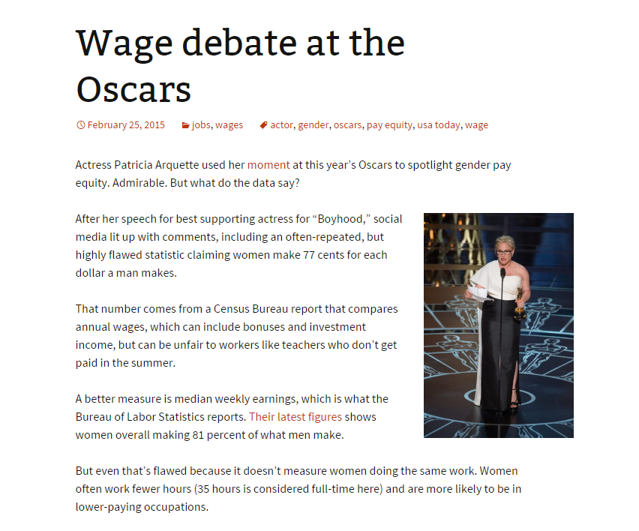
Gender pay gap
Notes:
There’s a statistic floating out there saying women make 77 cents for each dollar a man makes. The number is real and came from a real data source, but it isn’t the RIGHT number for comparing pay. The problem is that it comes from a Census Bureau report that compares annual wages – which includes bonuses and investment income. And comparing annual wages can be unfair to workers like teachers who aren’t paid in the summer. If you look at weekly earnings, then you get a number saying women make 81% of what men make. That number is also still flawed because women tend to work in professions that have fewer hours. Experts say the only really fair way to compare pay between genders is to compare men and women with the same educational attainment, the same occupation and industry and same years of experience.

Slide 52

How many civilians killed by cops?
Notes:
I’m sure you’ve heard a lot about this one the past year. Nearly every news organization – including ours – has been trying to quantify the number of civilians killed by police officers. The problem is that the only numbers we have to measure this are widely acknowledged to be incomplete for various reasons. I’m really glad that news organizations have been writing about this problem so that hopefully it will get corrected in the coming years. But in the meantime, we can use the existing data as long as we very clearly specify that this is a conservative count, at best.

Slide 53
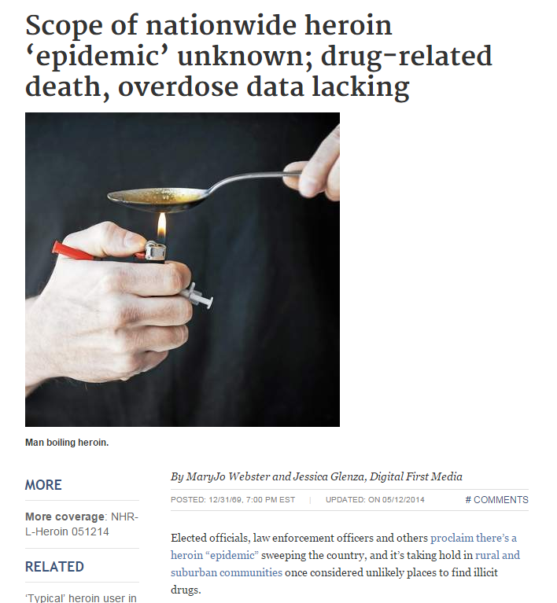
How many deaths from heroin?
Notes:
Last year when I was with Digital First Media, we wanted to see if we could compile data from every state on the number of people who had died from heroin overdoses. We quickly discovered that measuring those deaths is next to impossible due to several flaws in the data collection. The only comprehensive data source nationally are death certificate records that eventually end up with the CDC. However, we learned of a couple problems – the first being that some states have coroners and others have medical examiners and others have a mix of the two. Medical examiners are far more likely to do the expensive and time-consuming tests to confirm a heroin overdose, while many of the coroners simply call it a drug overdose. Also, heroin has some unique properties making it hard for those expensive and time-consuming tests to be accurate. the heroin metabolizes very quickly in the body and if the tests aren’t done in a very timely manner – like within hours – the test might be negative or inconclusive. Experts told us that many medical examiners won’t code it as a “heroin” death unless they have 100% positive test results. So as a result of all this – the total deaths that are routinely reported in the media are short to start with. Secondly, the national numbers show an increase over time, but we don’t know how much of that is due to coronoers and medical examiners becoming more conscious of this as a problem – and possibly running more tests. And finally, we truly can’t say which part of the country has more deaths than the other due to the inconsistency in how deaths are investigated.

Slide 54
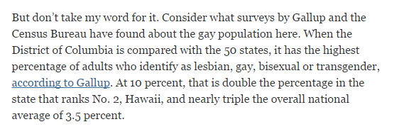
Apples to Apples?
“The gayest place in America?”, New York Times, Nov 15, 2013
Notes:
Should you compare Washington, D.C. with other states? Some argue that D.C. has demographics that are more like a central city, than a state. Carry that same idea to nearly every other comparison you want to make – is it fair to compare death rates at a hospital in an urban setting to one in a rural setting? (more gun violence in the city); Is it fair to compare the Minneapolis metro area with the New York metro area?

Slide 55
Know your data
What’s your database missing? (i.e. St Paul crime data only includes certain types of crimes)
Things you don’t understand or don’t make sense (i.e. SPPS spending data voided checks)
Notes:
Whether you’re doing your own data analysis or you’re relying on results from somebody else’s analysis, it’s really important to know what the underlying data included – and didn’t include. for example, the St. Paul police department puts out data files on its web site with crime incidents. However, you have to read the fine print to see that it’s only certain TYPES of crime. So we can’t use it to say anything about “all crimes” – only “major crimes.”
Also make sure you understand your data really well. Mila Koumpilova and I got data from the St Paul school district – essentially their checkbook register, showing all the payments they had made. As we analyzed the data we were puzzled by a bunch of records that appeared to be duplicates. And then we also had a spending total for a certain school that seemed unusually high. We contacted the district about it and they brushed it off, saying it was fine. After we published, we found out that the district had given us voided check entries, but had failed to flag them – so we didn’t even know they were there!

Slide 56
Be wary
Don’t assume stats in a press release – or even someone else’s publication -- will be correct. Do the math….think about whether it makes sense logically.
Be careful about translating someone else’s statement

Slide 57
Examples:
“The state received $2.5 million in federal funds to pay overtime costs for state troopers, sheriff’s deputies and city police officers throughout the state as part of the Highway Enforcement of Aggressive Traffic program….that should translate to about 1,400 hours of additional law enforcement during the next year…”
“State gets tough on drivers”, Pioneer Press, Sept. 27, 2005
Notes:
a reporter at the Pioneer Press published this paragraph in a front-page story – having pulled the numbers straight from a state patrol press release. He didn’t find out they were wrong until the next day when a reader called and pointed out the problem with the math.

Slide 58
Do the math!
$2.5 million / 1400 hours = $1,785 per hour
Notes:
If he had done the math, he could’ve avoided a correction. If he had taken $2.5 million divided by 1,400 hours, he would have seen that this would result in those state troopers being paid $1,785 per hour. Clearly something is wrong with those numbers.

Slide 59
Really?
“Every year since 1950, the number of American children gunned down has doubled”
1950: 1 child
1951: 2 children
1952: 4 children
1965: 32,768 (total of 9,960 homicides that year)
1970: 1 million
1980: 1 billion (4x the total US population)
Notes:
The second example is highlighted in the first chapter of a great book called “Damned Lies and Statistics”
A news organization published this sentence:
“Every year since 1950, the number of American children gunned down has doubled”
If we try to do the math on this, here’s what would happen:
Start with 1 child killed in 1950 and you “double” the number each year….
1951: 2 children
1952: 4 children
1965: 32,768 (total of 9,960 homicides that year)
1970: 1 million
1980: 1 billion (4x the total US population)

Slide 60
The real story…
“The number of children killed each year by guns has doubled since 1950”
Notes:
Turns out the reporter had messed with the wording of the original statistic.
It should have read: “The number of children killed each year by guns has doubled since 1950”
In other words, it has doubled between 1950 and current – not doubling every year.

Slide 61
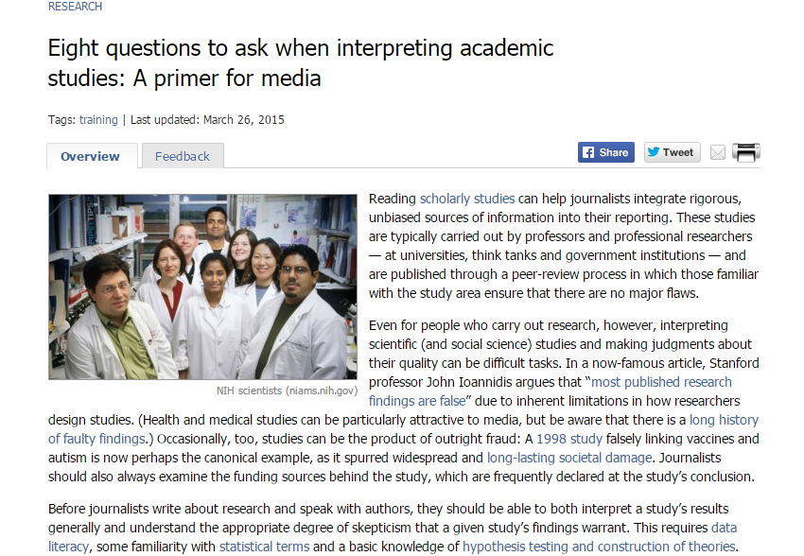
Vetting studies
Notes:
If you regularly write about academic studies or polling results or anything where someone else is doing the data analysis, it’s worth taking some time and learning how to interpret these and good questions you should be asking. There are quite a few primer’s out there on the Web, and I’ve linked to a few – including this one – in my handout.

Slide 62
Learn more...
“Numbers in the Newsroom,” By Sarah Cohen, e-book
Matt Waite: “How I overcame my fear of math”
More materials: mjwebster.github.io/DataJ

