Slide 1
Using numbers without fear

Slide 2
Numbers in the news
One day of St. Petersburg Times: one-third of the 130 stories had numbers.
“Too many of the stories display numeric overkill, a deadening procession of figures that overwhelm the reader and rob the writer of the opportunity to use numbers in ways that explain and illuminate.”
“Avoiding numeric Novocain”, Chip Scanlan, Poynter Institute

Slide 3
Numeracy
Using the right numbers so that you make fair comparisons (i.e. rates, average vs median)
Helping readers understand numbers better (i.e. yardsticks)
Writing with numbers (i.e. overprecision, number clutter)

Slide 4
Using the right numbers
Find out how experts use the same data (i.e. traffic measurements, death rates)
Sometimes what you choose to print will depend on the key point you’re trying to convey

Slide 5
Rates
Use them to compare disparate groups
Use them to make very big or very small numbers comprehensible
Any ratio:
25:1,000
1 in a million
1 in 7
Percentage is a special ratio with 100 as the base. 25% = 25:100 or 25/100

Slide 6
When to use rates
Crimes in cities with different populations
Deaths from various diseases
Comparing deaths at different hospitals
Birth rates (number of births per number of women of child-bearing age)
Time-series change involving people

Slide 7
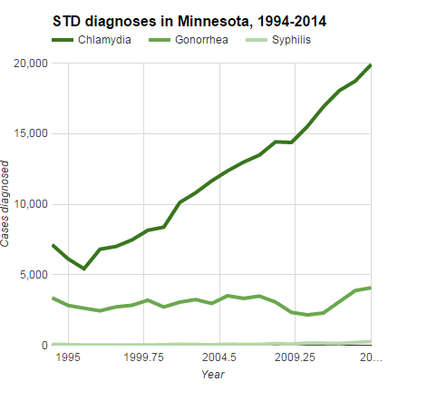

Slide 8
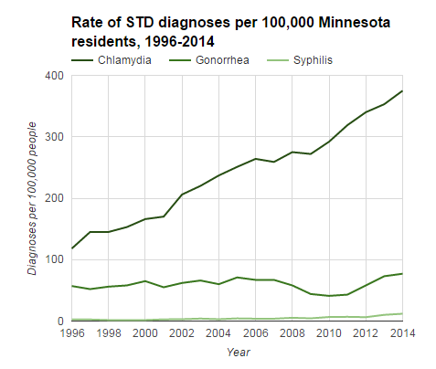

Slide 9
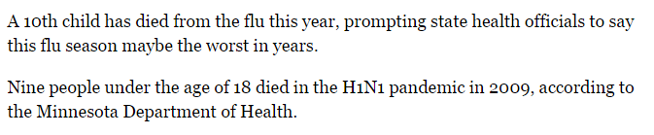
Raw numbers vs rates:
Notes:
This story from MPR about flu deaths is a good example of a situation where reporting the raw number is probably the preferred method. First of all, even a single death is newsworthy and unfortunate. It’s also simply saying the number of children who died. It’s not trying to say that the flu DISPROPORTINATEY affected children.

Slide 10

Percentage or raw numbers?
Notes:
Later in the story, however, they start talking about senior citizens. And they do mention that seniors accounted for “more than half” of all hospitalizations. This is a situation where you would want to use a percentage because it is implying that this group was hit harder than other age groups. It would not be fair to say that there were 100 hospitalizations of seniors and 20 of children and use that to show disparity because those age groups contain differing numbers of people who could potentially be affected. You would want to calculate 100 divided by the total number of seniors and 20 divided by the number of children and then compare those two percenages.

Slide 11
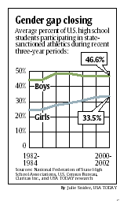
Comparing different groups
Sports participation: Do you want to know what part of the overall pool is playing? Or do you just care about total bodies?

Slide 12
How it was published:
In Hastings, which has a population of about 22,100, there were six heroin arrests in 2011, according to a report from the drug task force. That's compared with eight arrests in Burnsville, a city with 60,300 residents. Eagan, a city of 64,200, had seven arrests.

Slide 13
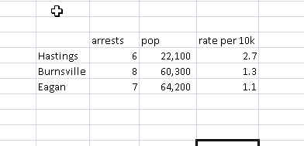
Better?
There were nearly 3 arrests per 10,000 people in Hastings, compared to about 1 arrest per 10,000 people in both Burnsville and Eagan, which are each nearly three times the size of Hastings.

Slide 14
Pull extreme numbers into reach
… [California] carried a relatively small amount of debt . … Its $24.8 billion in debt in 2001 was equal to $733 per person compared with a national average of $820…

Slide 15
Tiny numbers
America West and US Airways … each had about 32 passengers of every 10,000 voluntarily give up their seats in the first quarter.
[Note: Rate = 0.0032, percentage = 0.32%]

Slide 16
When we don’t use rates…
“The Toyota Camry and Honda Accord, the best-selling cars in the USA recently, top the list of most stolen vehicles in 2000, as they have for several years.”

Slide 17
Better….
DETROIT - The 1995 Saturn SL was the nation's most-stolen vehicle last year based on thefts versus the number of models registered … a new report shows. …One out of every 200 registered 1995 Saturn SLs was stolen in 2003 … according to Chicago-based CCC Information Services, an insurance industry tracker … .

Slide 18
Use the right base
Highway death rate: “vehicle miles traveled.” Accounts for number of drivers and distance driven, which vary.
Tricky base: Age adjustment, risk adjustment, etc

Slide 19
Percentage change
(New-old)/Old
When to use

Slide 20
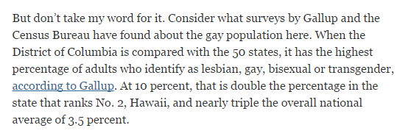
Apples to Apples?
“The gayest place in America?”, New York Times, Nov 15, 2013
Notes:
Should you compare Washington, D.C. with other states? Some argue that D.C. has demographics that are more like a central city, than a state. Carry that same idea to nearly every other comparison you want to make – is it fair to compare death rates at a hospital in an urban setting to one in a rural setting? (more gun violence in the city); Is it fair to compare the Minneapolis metro area with the New York metro area?

Slide 21
Gender pay gap

Slide 22
Adjusting for inflation
Adjust when dollar values are three or more years apart (2005 salary vs. 2010 salary )
Adjust to current dollars, using the Consumer Price Index (CPI) from the Bureau of Labor Statistics

Slide 23
Inflation formula
(CPI Now/CPI Then) x Old value
Example: Teachers made about $9,000 in 1970. By 1996 they made $38,000. Is that a big raise or a little one?
CPI Now (156.9)/ CPI Then (38.8) = 4.0438
It took about $4 in 1996 to buy what people bought for $1 back in 1970
Answer: 4.0438 x $9,000 = $36,394. That means their raise was only $1,600 after inflation

Slide 24
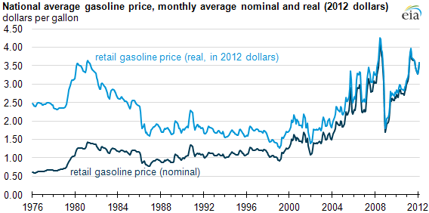
Gas prices: Adjusted vs Unadjusted

Slide 25
Average vs Median
Rule: If average and median are different, use median. If they are very similar, use average.
Average: Sum of values divided by number of items
Median: Middle value
Home prices, salaries

Slide 26
Simple example:
$40
$50
$45
$200
$250
$50
Average: $105
Median: $50

Slide 27
Picking your “star number”
In a three-month investigation of water levels throughout the Coachella Valley, The Desert Sun found that the average depth of 70 existing wells across the valley in 1970 was 104.4 feet. As of this year, the average depth of 291 wells in the valley had dropped to 159.3 feet.
The average loss of 55 feet of water depth reflects a significant depletion of the most precious resource in the California desert.
Notes:
These are the nut graphs to a story about water levels, http://www.mydesert.com/interactive/article/20130908/NEWS07/309080001/Our-declining-water-reserves?nclick_check=1
Note how the first graph requires the reader to do some math. The next graph has the “55 feet” which is the amount lost. Would it be more effective to give the reader the “55 feet” number first, then give the details later?

Slide 28
Yardsticks
3 billion pounds of debris at WTC…
How many tons?
How many dump trucks full?
How many train cars full?
Enough to fill Great Pyramid?
A month of NYC’s garbage?

Slide 29
Yardsticks
Only three percent of the world’s water is available for humans to drink…..most is locked in polar ice caps and glaciers or is embedded in layers of rock. How much is 3 percent?
“If a large bucket were to represent all the seawater on the planet, and a coffee cup the amount of freshwater frozen in glaciers, only a teaspoon would remain for us to drink.”
New Yorker, Oct. 23, 2006, page 64

Slide 30
Compared to what?
“Travel in America claimed the lives of more than 44,000 people last year – roughly the population of Wilkes-Barre, Pa., Palatine, Ill, or Covina, Calif.”

Slide 31
Think visually
“To put it another way, the crash of 7,000 aircraft would mean that every square mile of the state of New Jersey would have shaken to the impact of a downed plane”
Notes:
Work with graphics department to find ways to display quantitative information in graphics and/or maps.

Slide 32
Put numbers into context
Use percentages (i.e. instead of using points, say what percentage stock market increased)
Give comparisons (i.e. another time period, another city, another player)
Adjust for inflation (i.e. box office totals)

Slide 33
Numbers are not concrete
"The most important numerical fallacy is
that people tend to think of numbers as known, constant and having no variability," said Donald Berry, a biostatistician at the University of Texas MD Anderson Cancer Center in Houston

Slide 34
Where do numbers come from?
Polls & Surveys are merely “samples”
Even the most thorough data collection will have errors (i.e. decennial census)

Slide 35
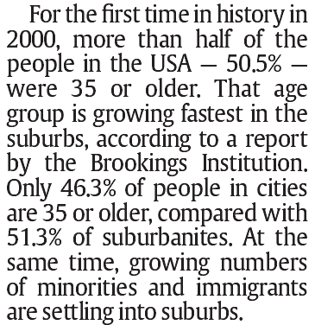
Over-precision

Slide 36
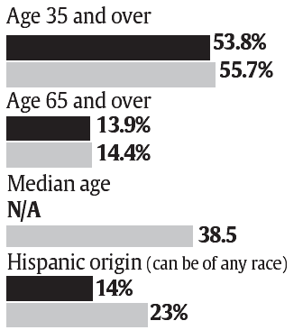
Over-precision

Slide 37
Using decimal points
“Decimal points are for meaning, not emphasis.” (Philip Meyer, Precision Journalism)
“Characterize” the numbers you are using.
Think about what the numbers are referring to: how precise is the original information?
A survey is a “sample” of people; any results from a survey are automatically imprecise

Slide 38
Too many numbers…
Pick one number to be the “star”
“Sprinkle in numbers”; same idea as quotes.
Keep the number of digits in a paragraph below eight. Others recommend no more than 2 numbers.
Don’t let two paragraphs with numbers bump up against each other.

Slide 39
Example
The Office of Redundancy’s budget rose 48 percent in 2001, from $700.3 million to $1.03 million.
Over the past year, the Office of Redundancy's budget grew by nearly half, to $1 billion.
Numbers in the Newsroom, Sarah Cohen

Slide 40
Eyes glazed over….
“Statewide, lending institutions rejected 18.8 percent of black applicants, 15.7 percent of Hispanic applicants and 11.4 percent of white applicants for conventional mortgage loans in 2004, the latest year for which complete data are available.”… (12 digits)
“Loan denial rates higher for minorities”, South Florida Sun-Sentinel, June 17, 2006

Slide 41
An easier read…
“The oldest killer was 88; he murdered his wife. The youngest was 9; she stabbed her friend. The women were more than twice as likely as men to murder a current spouse or lover. But once the romance was over, only the men killed their exes. The deadliest day was July 10, 2004, when eight people died in separate homicides. Five people eliminated a boss; 10 others murdered co-workers. Males who killed favored firearms, while women and girls chose knives as often as guns. More homicides occurred in Brooklyn than in any other borough. More happened on Saturday. And roughly a third are unsolved.”
“New York Killers, and Those Killed, by Numbers,” New York Times, April 28, 2006,

Slide 42
Something’s missing…
The numbers don’t always tell the whole story.
Debate about crime rates not taking into account poverty, racial makeup, divorce rate, availability of ER medical care
Need to make sure your reporting looks for any of these pitfalls

Slide 43
How many civilians killed by cops?

Slide 44
How many deaths from heroin?

Slide 45
Data analysis
What’s your database missing? (i.e. St Paul crime data only includes certain types of crimes)
Things you don’t understand or don’t make sense (i.e. SPPS spending data voided checks)

Slide 46
“Numbers in the Newsroom,” By Sarah Cohen, e-book
More materials: mjwebster.github.io/DataJ

Slide 47
Mutant statistics
Don’t assume stats in a press release – or even someone else’s publication -- will be correct. Do the math….think about whether it makes sense logically.
Be careful about translating someone else’s statement

Slide 48
Examples:
“The state received $2.5 million in federal funds to pay overtime costs for state troopers, sheriff’s deputies and city police officers throughout the state as part of the Highway Enforcement of Aggressive Traffic program….that should translate to about 1,400 hours of additional law enforcement during the next year…”
“State gets tough on drivers”, Pioneer Press, Sept. 27, 2005

Slide 49
Examples:
Do the math:
$2.5 million / 1400 hours = $1,785 per hour

Slide 50
Examples:
“Every year since 1950, the number of American children gunned down has doubled”
1950: 1 child
1951: 2 children
1952: 4 children
1965: 32,768 (total of 9,960 homicides that year)
1970: 1 million
1980: 1 billion (4x the total US population)

Slide 51
The real story…
“The number of children killed each year by guns has doubled since 1950”

Slide 52
Marriage and terrorism
Quote: a 40-year-old single woman was "more likely to be killed by a terrorist“ than to ever marry.
"The popular media have invented a national marital crisis on the basis of a single academic experiment ... of dubious statistical merit…" (Susan Faludi, San Jose Mercury News)

Slide 53
The real story…
“Some demographers immediately doubted the dire odds. Within months Census researchers did their own study and concluded that a 40-year-old single woman really had a 17 to 23 percent probability of eventually marrying, not 2.6 percent.” (Newsweek, June 2006)

Slide 54
Caught red-handed:
“The claims were eye-popping: Minnesota has the nation's highest percentage of teens home alone each afternoon. It has more young children taking care of themselves after school than any state in the country. Half its kids aren't part of any structured after-school activity.”
“Home alone data debatable”, Pioneer Press, July 10, 2005

Slide 55
Caught red-handed:
The report originally said: "Minnesota is home to 950,000 young people and has the highest percentage in the country of children ages 12 and older alone at home every single afternoon.“ But the commission could not provide data to back it up.
The report found it "troubling" that when its researcher visited some Minnesota communities, she found "an estimated 50 percent of young people were not participating in any structured after-school programs." The researcher, though, went to only nine sites, talking to an unscientific sample of 101 kids.

Slide 56
Caught red-handed:
The panel said Minnesota has the nation's highest rate of 10- to 12-year-olds in self-care. That came from a report by the Washington, D.C.-based Urban Institute that looked at 1997 data in 13 states and estimated 40 percent of those Minnesotans cared for themselves regularly compared to 24 percent nationally.

