Slide 1
Analyzing jobs in your community: Quarterly Census of Employment and Wages (QCEW) NICAR Atlanta 3/5/15
1. QCEW Basics
2. Hurricane Maps
3. QCEW Data Viewer
4. Open Data Files
Notes:
Happy to be at NICAR
QCEW wants to connect with IRE community.
Available Thurs and Friday for one-on-ones, mini-workshops.
See end for my contact info during the conference.

Slide 2
QCEW Basics:
BLS/State cooperative program using administrative data
Quarterly census of employers: 9.4 million establishments
Publication: industry by county, 6 months after quarter
Geocoded: Latitude/longitude, based on physical address or zip
Matching: Many products possible using EIN and other fields.
Notes:
QCEW annual data comes out 10 months ahead of County Business Patterns.
When CBP releases 2013 data in April, QCEW will have released data through the third quarter of 2014.
QCEW is working on new matching projects using our universe file.
QCEW is an underused data source. Welcome to the secret club!

Slide 3
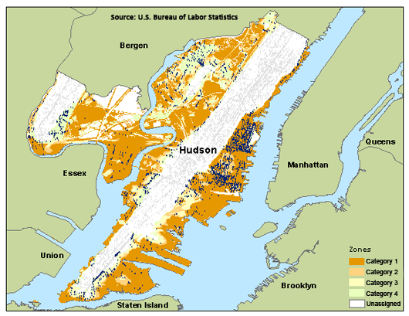
Hurricane Evacuation Zones: Hudson (Hoboken), New Jersey
Notes:
As part of the process of creating maps after Sandy, QCEW staff learned that the Corps of Engineers maintains evacuation zone shape files.

Slide 4
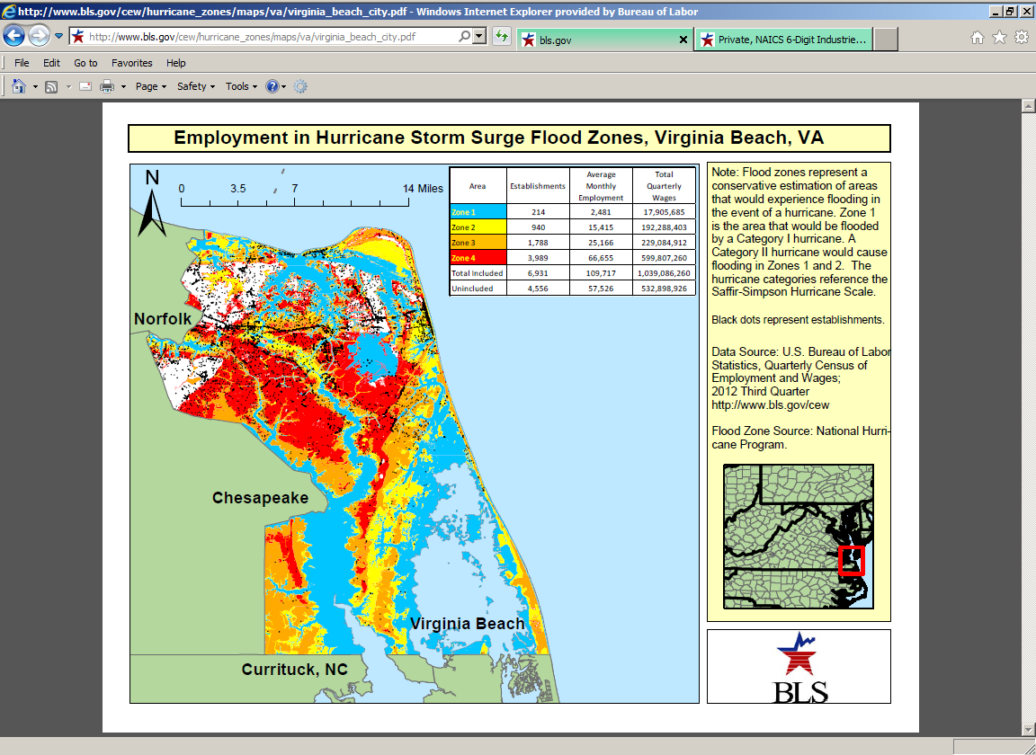
Notes:
Hurricane Maps and Tables are available for all Gulf and Atlantic counties with defined evacuation zones.
More to say about this in tipsheet section.

Slide 5
QCEW Data Viewer
Front end: provides 100% of QCEW data for 2012-forward Input: QCEW Open Data CSV files
Technology: Javascript
Outputs: Tables by area or industry
Frame: designed to provide additional outputs in future

Slide 6
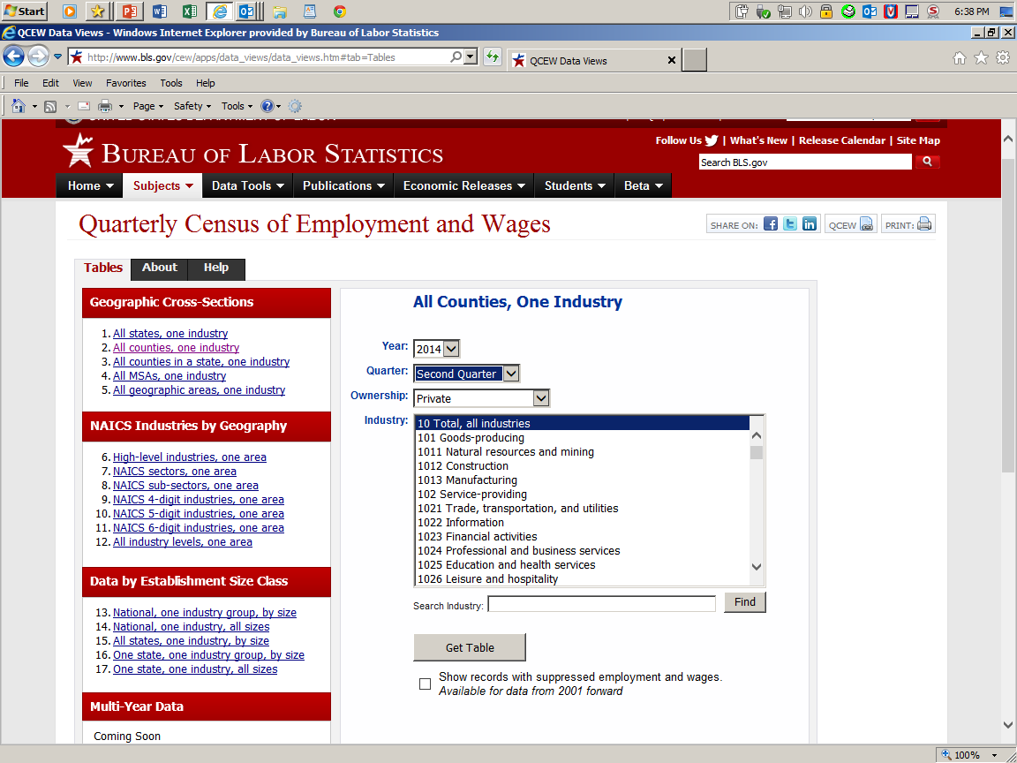
Notes:
This is the QDV main page.

Slide 7
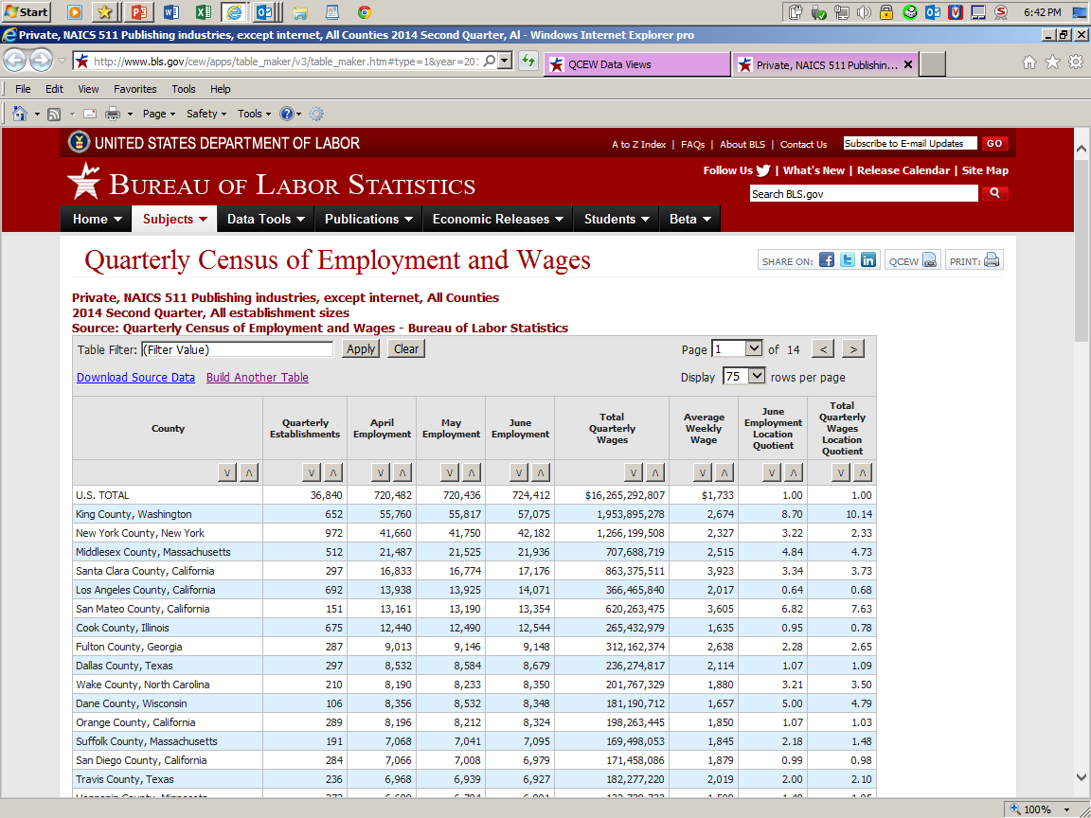
Notes:
Here is the publishing job and pay table! More in tipsheet section

Slide 8
QCEW Data Viewer—coming soon
County Tables: released 6/14
Location Quotients by employment and wages: released 1/15
Establishment Size Tables: released 1/15
Data for 1975-2011: released______________
Multi-period Tables : released______________
Data Graphics : released______________
Notes:
We are now on Version 3 of this application.

Slide 9
QCEW Open Data Files
1. Past: BLS Oracle front end and flat files
2. Present: 2012-14 Open Data/QCEW DataViewer
3. Future: All years, more functionality

Slide 10
BLS Oracle front end and flat files
QCEW scale issue: 5% of data in BLS Oracle database
QCEW publishes national CES equivalent for every county
More than 3,000 counties, more than 190 MSAs
BLS Oracle would have to be redesigned to host all of QCEW
Flat files historically provided access to all QCEW data
Notes:
Bottom line: QCEW was too big for traditional approaches.
We came up with a new way.

Slide 11
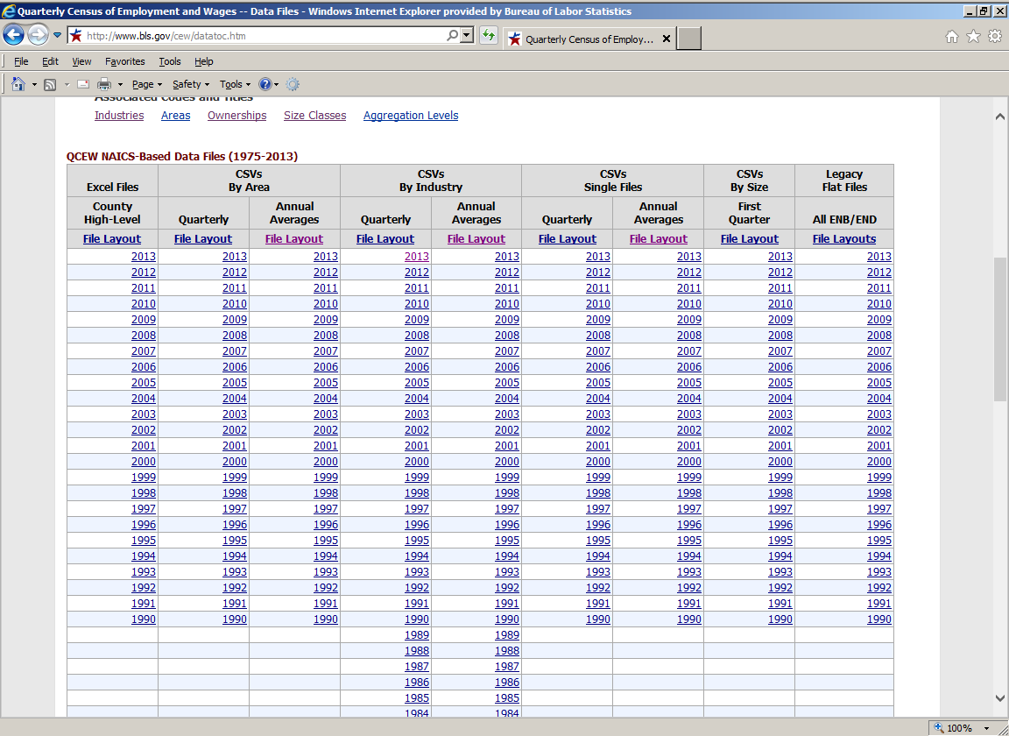
Notes:
Use this page to access the entire QCEW history. This is a stopgap until we get all the data published in the open data resource. We will maintain it as a legacy product.

Slide 12
QCEW Open Data Files
QCEW response to May 2013 Open Data directive
CSV format: 33,400 tiny files per year
Sliced by area: US, State, MSA, County
Sliced by industry: Every industry, every level
Directly addressable: Slices can be read directly by apps
Code samples: R, SAS, VBA/XL, JS, PHP, Perl, Python, C#
Notes:
The new way forward.
This is where all future QCEW data services will originate.
Slices serve as a database, indexed by area and industry.

Slide 13
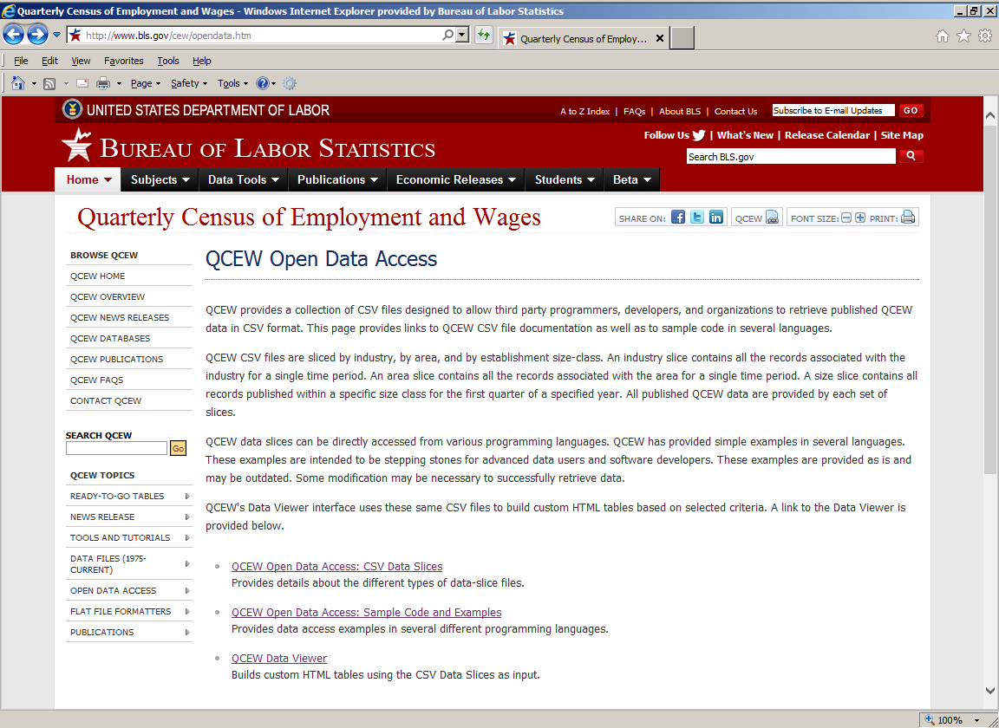
Notes:
The Open Data Access page is the place to start your piece of this revolution.

Slide 14
QCEW: How to stay current?
QCEW is in a period of innovation.
Keep up by joining the QCEW NOTE list.
QCEW Note List
Quarterly reminders before each release
Special notices of new products or improvements
To join, send email to qcewinfo@bls.gov
Notes:
See the QCEW reporter’s guide tipsheet for more examples.

Slide 15
QCEW Links
Homepage: http://www.bls.gov/cew
Release schedule: http://www.bls.gov/cew/releasecalendar.htm
Zipped data files: http://www.bls.gov/cew/datatoc.htm
Hurricane Maps and Tables: http://www.bls.gov/cew/hurricane_zones/home.htm
QCEW Data Viewer: http://www.bls.gov/cew/apps/data_views/data_views.htm#tab=Tables
QCEW Open Data: http://www.bls.gov/cew/opendata.htm
BLS Regional Press Offices: http://www.bls.gov/regions/contacts.htm
Notes:
Regional press offices are a great resource for putting together data from different BLS programs.
The program office people l(ike me) know a lot about our programs, but less about others. Lke departments in liberal arts colleges.

Slide 16
Questions?
BLS Quarterly Census of Employment and Wages
http://www.bls.gov/cew/
Richard Clayton: Program Manager
Clayton.Rick@bls.gov
202-691-6515
David Hiles: Publications Branch Chief
Hiles.David@bls.gov (At NICAR—use hilesd@me.com)
202-691-6561 (At NICAR—use 240-381-0050)
Notes:
Happy to be at NICAR
QCEW wants to connect with IRE community.
Available Thurs and Friday for one-on-ones, mini-workshops
On to the tipsheet review if we have time.

