Slide 1

No title slide
I have only 5 minutes!

Slide 2


Slide 3


On the one hand …
Software: Excel, Access, Refine, GIS, SNA, SPSS …
Data sets: crime, census, education, budgets …
File formats: xls, csv, html,dbf, pdf, fixed width …
Other skills: online searching, Web scraping …

Slide 4

On the other hand …
numbers ≠ story
data ≠ story

Slide 5

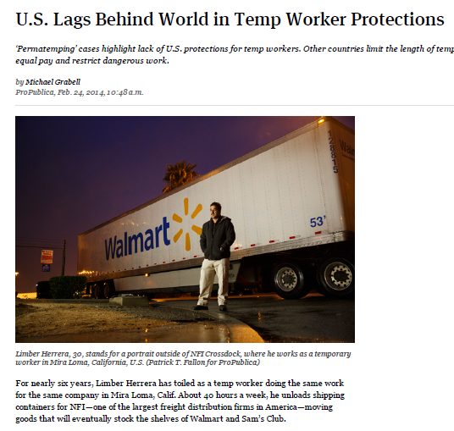
interviewing
writing
rewriting
more reporting
rewriting
self-editing
almost giving up
Done!

Slide 6


Slide 7
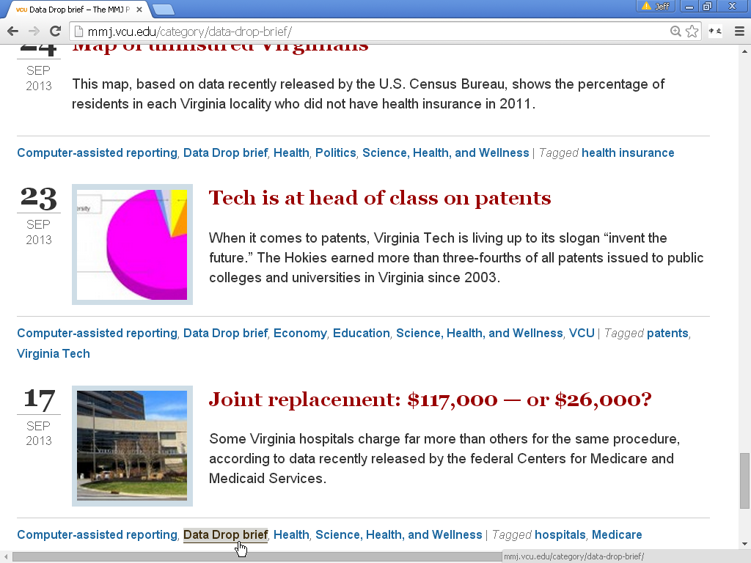

Slide 8
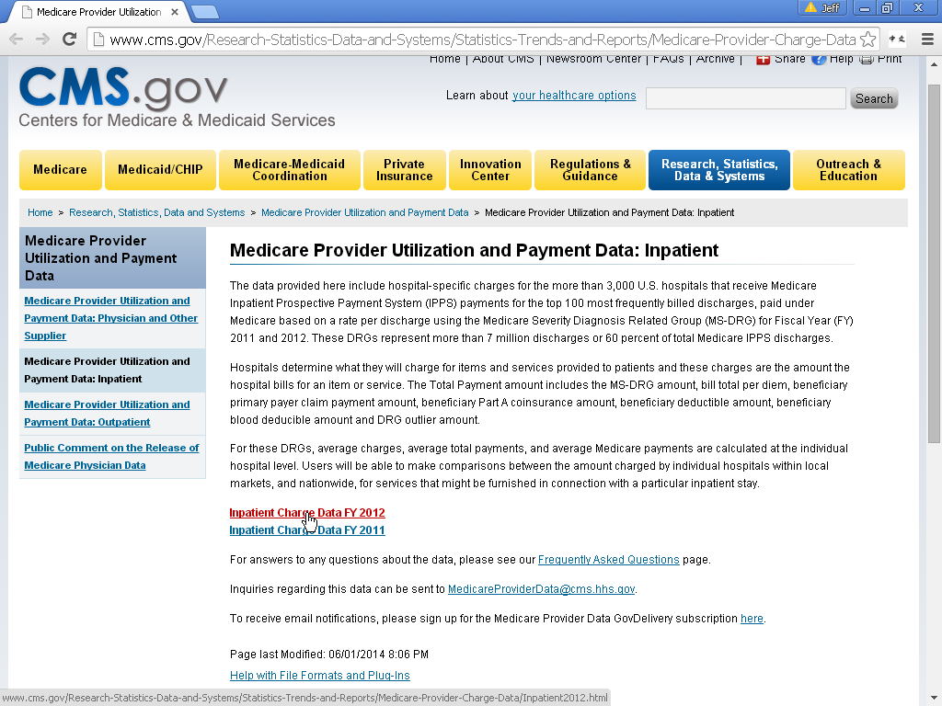

Slide 9
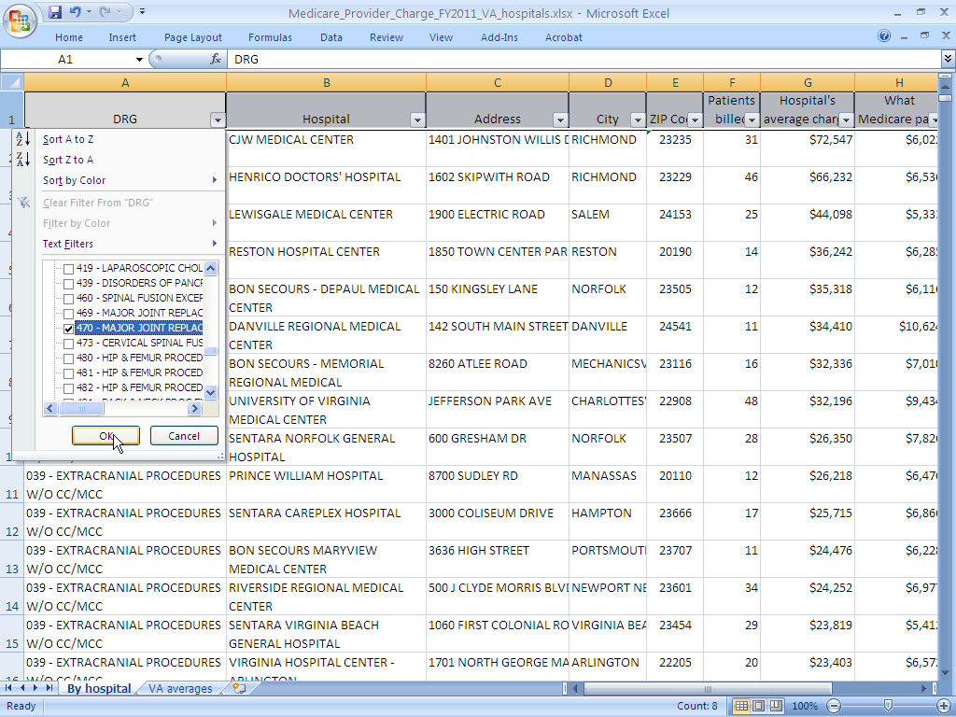

Slide 10
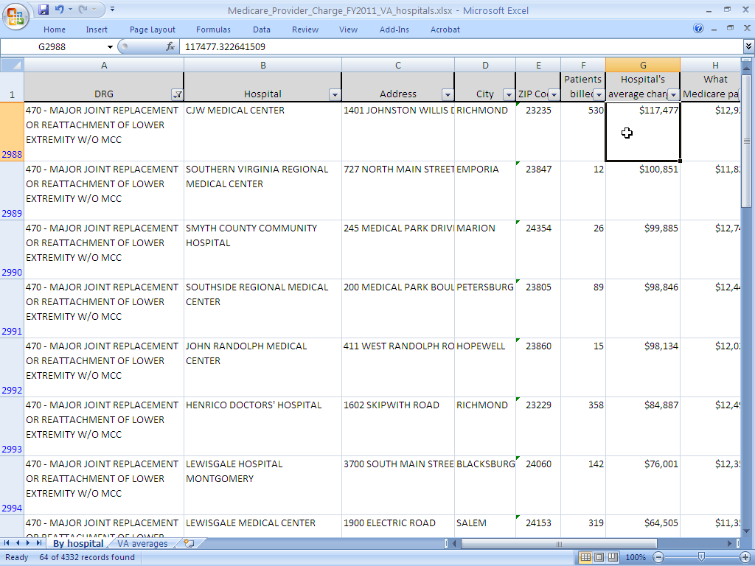

Slide 11
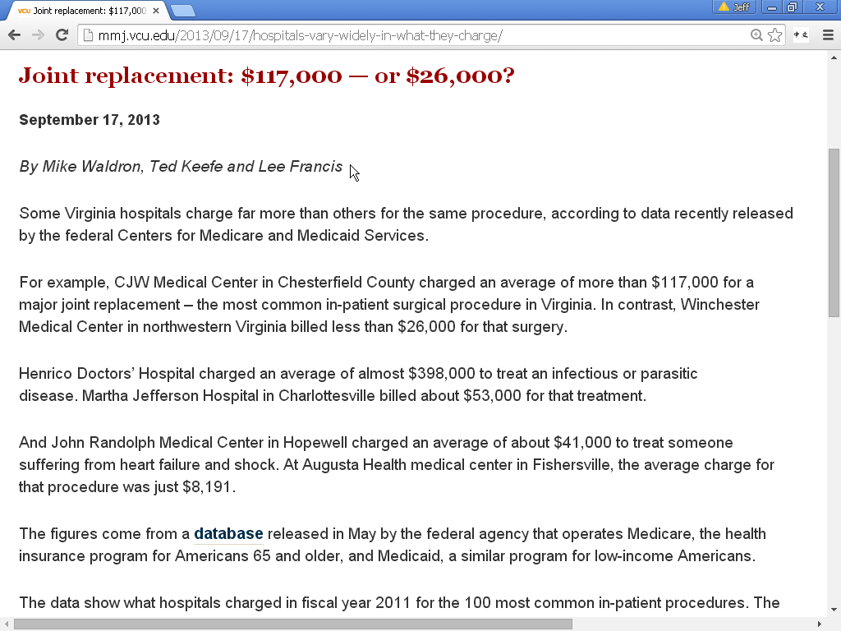

Slide 12
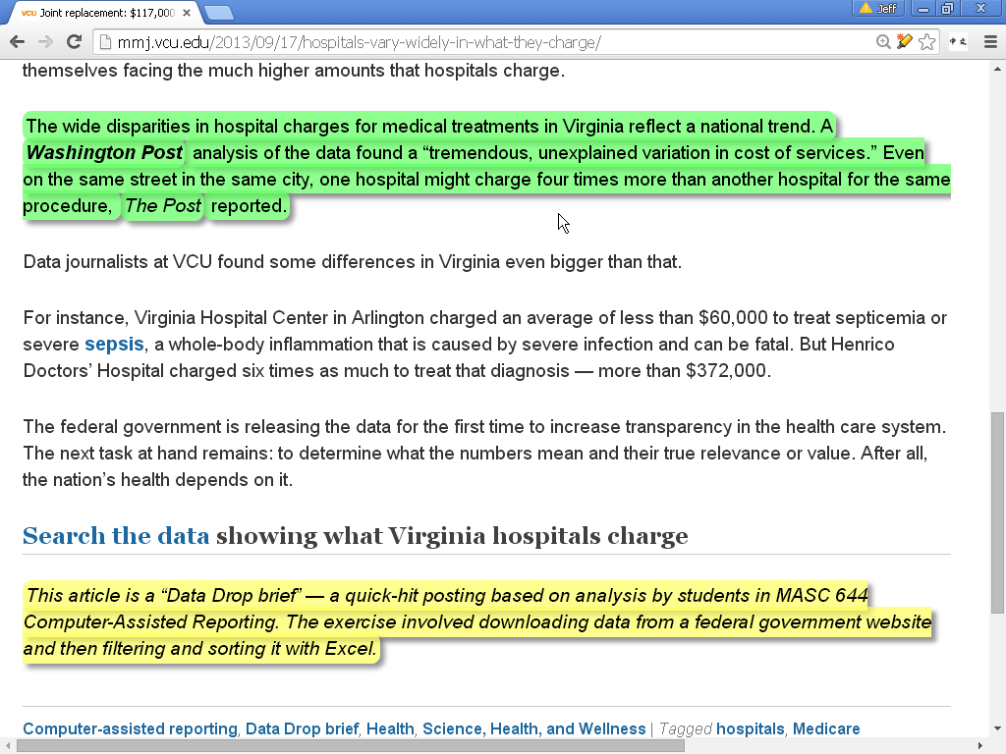

Slide 13
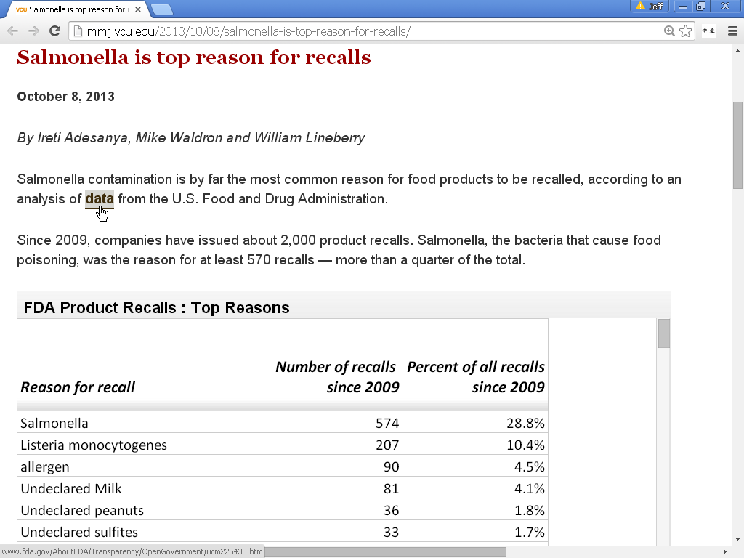

Slide 14
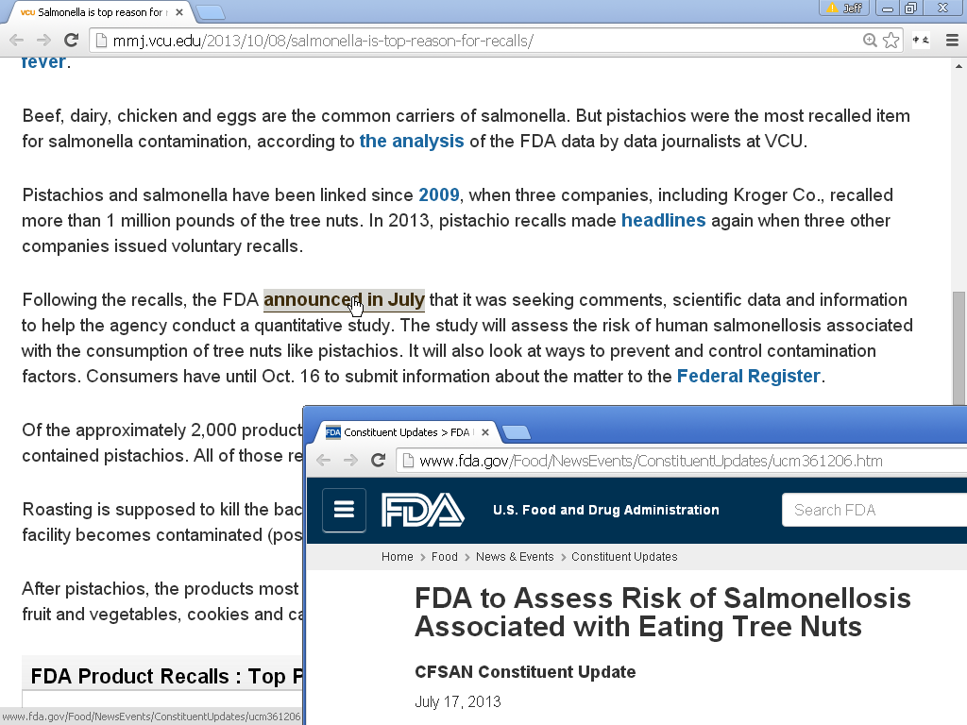

Slide 15
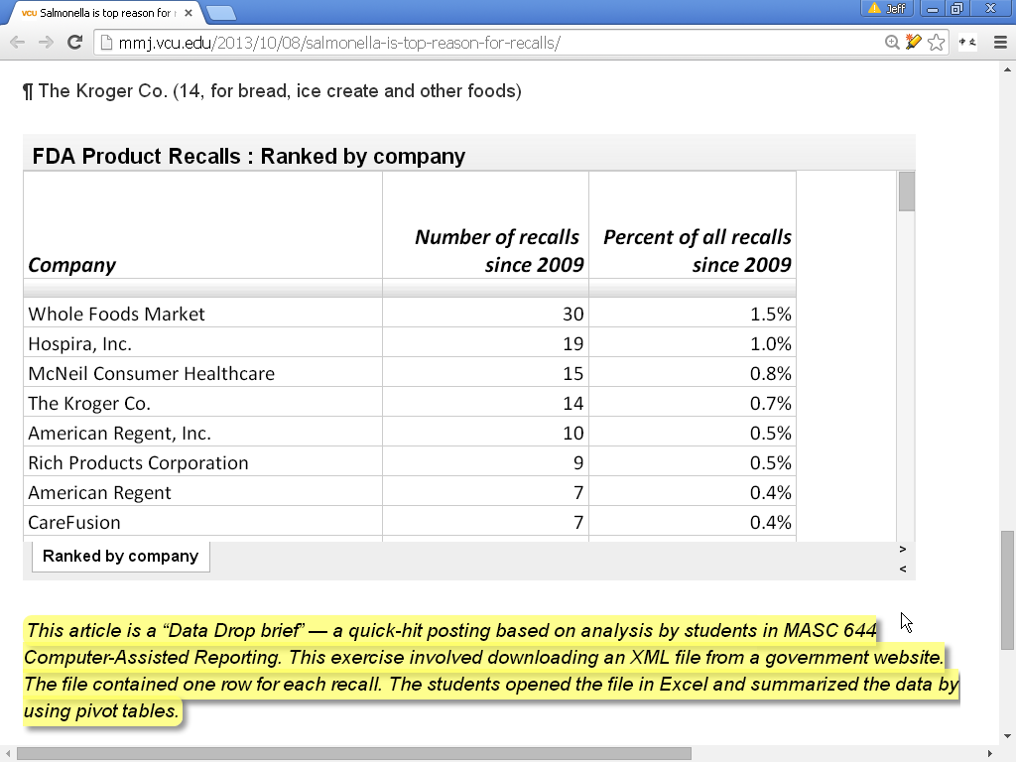

Slide 16
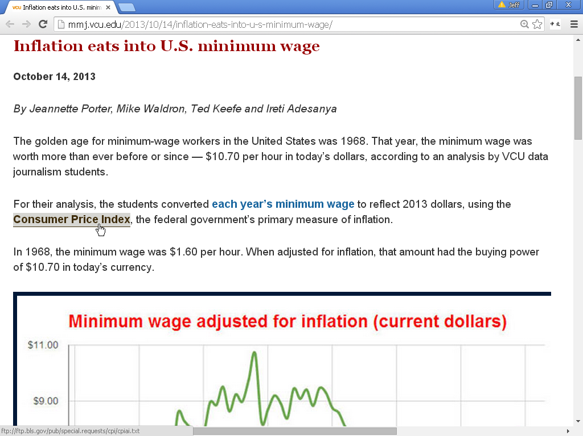

Slide 17
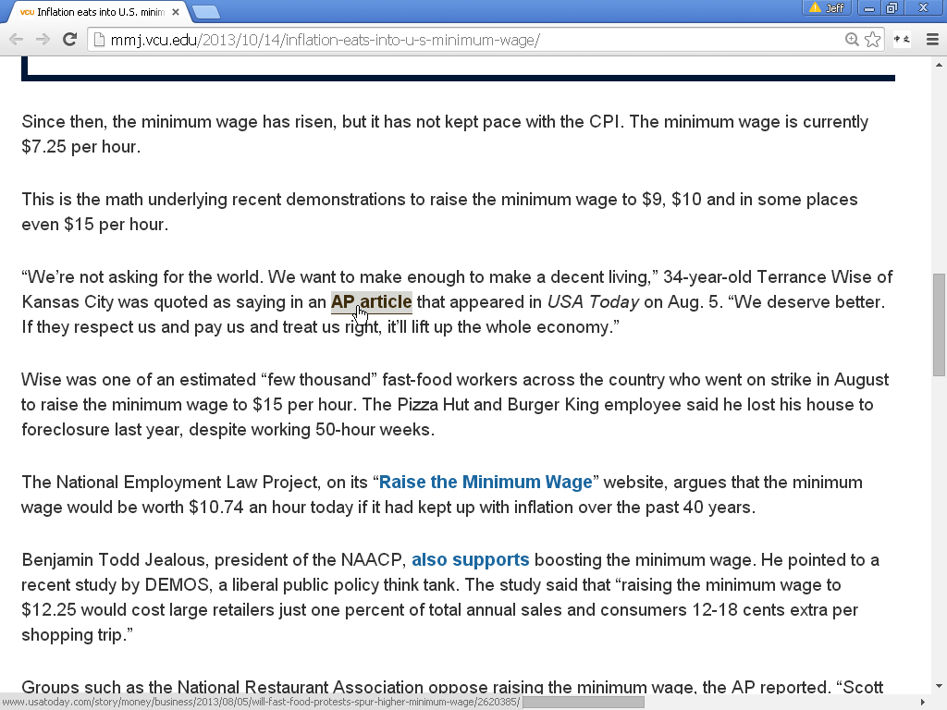

Slide 18
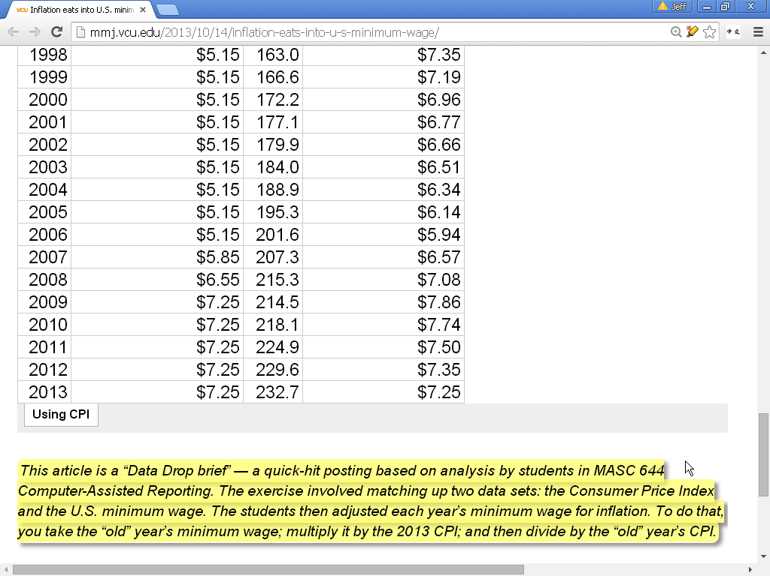

Slide 19
Bottom line
Students got experience analyzing and writing about various data sets and formats
Students got recognition on our website
Big help in full-fledged story assignments
For more info: Jeff South | jcsouth@vcu.edu

Slide 20
