Slide 2
Data is a source

Slide 3

Data should not be your only source

Slide 4

If you ask wrong question, you’ll get wrong answer

Slide 5
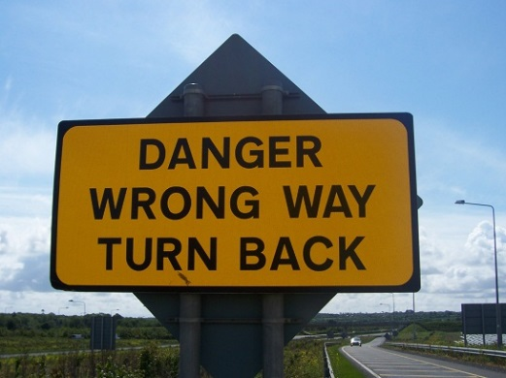
If something doesn’t seem quite right, check it out

Slide 6
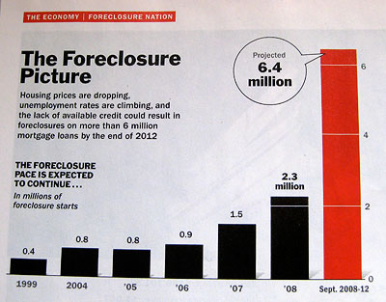
Data can be misleading….

Slide 7

Data can only tell you what it knows

Slide 8

It will often lead you to more questions…

