Slide 1
UPDATED ICT POLICIES AND PROCEDURES
CTICT618 | Manage IP, ethics and privacy in ICT environments
Manuel - 08 July 2026
Milestones IC | Advanced Dip of IT

Slide 2

Purpose of Today’s Session
Present updated policies and procedures for IT Biz Solutions.
Highlight changes made to copyright, privacy, and conduct.
Interactive Focus
This presentation is designed as a structured roundtable discussion. Staff are invited to share their views, ask questions, and provide constructive feedback on technical operations.
Connect compliance requirements to practical daily ICT workflows.
Support team understanding before intranet publication.

Slide 3
Policies and procedures U&D
Mandatory software whitelisting checks
Role-Based Access Control (RBAC) and data masking protocols
Strict ethical guidelines regarding the use of administrative privileges
Handle confidential reporting of ethical violations
Replaced routine USB-based with approved systems
Copyright policy and procedures
Privacy policy and procedures
Staff code of conduct
Grievance procedure for ethical breaches
Digital Security Procedure

Slide 4



Why These Policies Needed Review
Identified Issues
Regulatory Alignment
Existing IT policies were out of date and didn't cover modern diagnostic tools, remote terminals, cloud software licensing, and logs. This exposed IT Biz Solutions to compliance risks.
New policies update system requirements to align with current Australian standards, technical best practices, internal protocols, and proper corporate documentation workflows.

Slide 5






Key Compliance Requirements
Copyright & IP
Privacy Security
Professional Ethics
Adherence to the Copyright Act 1968. Protecting third-party proprietary systems, scripts, diagnostic utilities, and documentation.
Compliance with the Privacy Act 1988, Australian Privacy Principles (APPs), and logs under interception legislation.
Guided by standard ICT industry codes of conduct, including the ACS and ITPA professional codes of ethics.

Slide 6
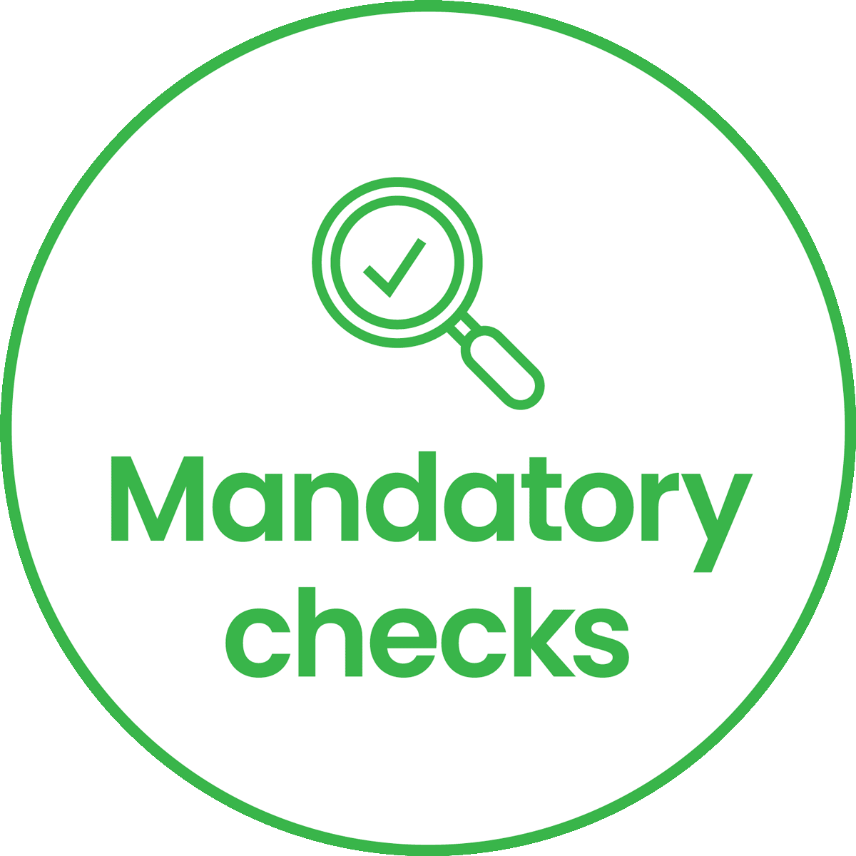

Copyright Policy and Procedures
Whitelisting Mandate
A mandatory check is now required before installing or executing any utility, diagnostic script, or external application on corporate systems and servers.
Unauthorised developer tools, unapproved open-source scripts, or unlicenced utilities are strictly prohibited from execution.
"Check the corporate whitelist repository prior to any installation workflow."

Slide 7


Copyright Compliance in IT Work
Practical ICT Workflows
Compliance Outcomes
Check license requirements for all diagnostic scripts.
Mitigates copyright infringement risks entirely.
Validate vendor terms before server installations.
Ensures standard vendor agreements remain valid.
Ensure only approved manuals and training assets are distributed.
Secures company digital IP and assets properly.
Maintains operational security across servers.
Confirm third-party codes/libraries are properly referenced.

Slide 8




Privacy Policy and Procedures
Technical Safeguards
Secure Log Handling
Role-Based Access Control (RBAC) enforces the principle of least privilege. Data masking is mandatory when troubleshooting enterprise databases or viewing customer profiles.
Support diagnostic logs must be handled securely, kept confidential, and promptly sanitised or purged immediately after the troubleshooting ticket is marked resolved.

Slide 9
Digital Security Procedure
Must not USB drives
Approved encrypted corporate backup systems
Out of control
SSO, MFA and role-based permissions
Must be logged and reviewed periodically
Lost, stolen or damaged
Malware
Out of control
No aligned with RBAC, SSO, MFA

Slide 10

Protecting Data in IT Support
Enforce strict RBAC protocols across systems.
Mask database screenshot records to protect privacy.
Purge support diagnostics files post-ticket resolution.
Store system evidence only in official ticketing files.
Avoid browsing live personal tables without business needs.

Slide 11

Staff Code of Conduct
Admin Credentials: Privileged logins must only be used for approved and logged tasks.
Trust Focus
Remote Control: Clear, documented user consent is mandatory before starting any remote terminal session.
Access privileges are an administrative trust. Misuse of domain admin credentials will lead to immediate review and disciplinary actions.
Ethical Limits: Accessing personal database entries out of curiosity is strictly banned.

Slide 12


Ethical Use of Privileges
Ethical Principles
Unethical Work Examples
The values that drive our ICT operations:
Specific prohibited technical behaviours:
Respect for others and user trust
Browsing personal folders without authorization
Professional integrity and honesty
Using client databases for personal testing
Diligence in technical designs
Deploying unapproved monitoring scripts
Operational economy and efficiency
Sharing system documentation externally

Slide 13




Grievance Procedure: Ethics
Scope & Purpose
Reporting Channels
To establish a safe, confidential, and highly structured mechanism for any staff member or contractor to report observed ethical and policy violations.
Secure Internal Portal
Encrypted compliance intake tool
Compliance Officer Email
Reportable incidents include: Unauthorised access to data, abuse of domain privileges, privacy leaks, and software licensing infringements.
Direct encrypted mailbox access

Slide 14


Managing Ethical Breaches
Audit Evidence Required
Response SLA Timeline
Valid investigations rely on hard technical facts:
1. Acknowledge: Within 48 hours of initial filing.
AD & system access audit logs
2. Investigate: Technical audit of system logs and roles.
Active network diagnostic trace files
3. Right of Reply: Interview process for staff member.
Support ticketing records & timestamps
4. Resolution: Case resolved inside 14 calendar days.
Desktop screenshots showing data leaks
Outcomes: Retraining, access suspension, warning, or termination.

Slide 15





Policy Distribution and Access
Intranet Push
All finalised guidelines will be hosted directly within the secure Staff Portal for easy 24/7 technical lookup.
Backup location
Active Directory
Approved backup systems must follow the same security approach.
Backup access must be restricted by role-based permissions.
Backup and restoration activities must be logged.
Role assignments managed dynamically via AD. Only current, authorised personnel can access files.
MFA Safeguard
Read access will be tightly bound to company active accounts. Single Sign-On (SSO) and MFA are mandatory.

Slide 16





Implementation Action Plan
Sprint 1
Sprint 2
Sprint 3
Sprint 4
Reviewed IP, privacy legislation and existing policies.
Drafted updates, grievance procedure v1.0. & Reviewed the USB-based backup procedure
In Progress: Staff presentations & roundtable reviews.
Intranet upload, staff training, & bi-annual audit review.

Slide 17

What Staff Need to Do
Read and fully understand the updated policies.
Verify software against the whitelist before installing.
Strictly follow RBAC and least privilege rules.
Secure explicit user consent before remote access.
Mask sensitive data in ticket evidence logs.
Fully document technical work in tickets.
Do not use USB drives for routine business data backups.
Report suspected privacy or software license breaches.
Use only approved encrypted backup/storage systems
Report lost, stolen or suspicious USBs immediately.

Slide 18


Key Takeaways
IP Security
Client Trust
Accountability
Copyright compliance defends critical corporate assets and respects third-party scripts and utilities.
Dynamic privacy masking and log purging protocols guarantee alignment with Australian APPs.
Standardized grievance workflows protect reporters and maintain ACS operational ethics.

Slide 19
Thanks!

