Slide 1

BSBXCS402 · ASSESSMENT TASK 2
Cybersecurity Awareness Program v1.0
Protecting our people, our data, our customers.

Slide 2


02 · INTRODUCTION
Why cybersecurity matters for our organisation
Customer trust, legal obligations, and operational continuity all sit on the line.
Three reasons this room matters
Privacy Act 1988
Customer trust
Legal exposure
Reputational risk
01
You are the first line of defence — most incidents start with a human click.
Notifiable Data Breach obligations apply to incidents involving customer information.
A single breach can erode years of brand confidence and customer loyalty.
02
Our survey shows real, fixable gaps we will walk through today.
03
New BYOD and PACT controls only work if every one of us applies them.
BSBXCS402 · Cybersecurity Awareness Program
2

Slide 3
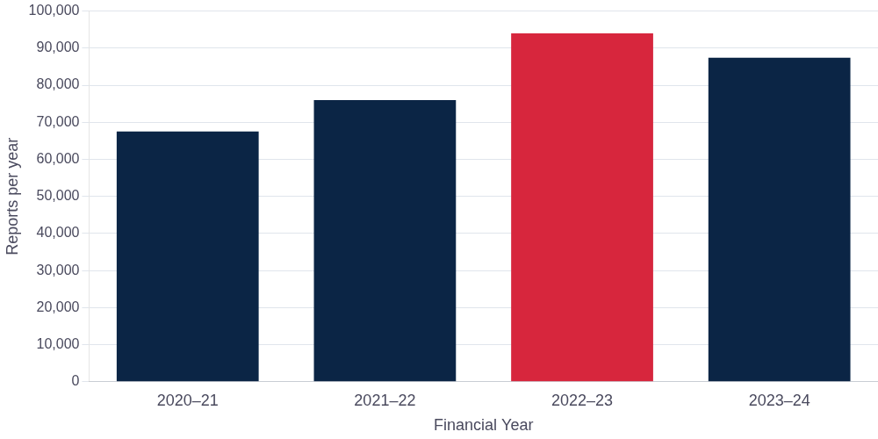



03 · THREAT LANDSCAPE
Australia is being targeted — and the pace is accelerating
ACSC Annual Cyber Threat Report data
~94,000
cybercrime reports lodged in a single year
Average cost to a medium business: ~$97k per incident
State-based actors increasingly targeting critical infrastructure
Small businesses are the fastest-growing victim segment
Source: ACSC Annual Cyber Threat Report
1 in 5
6 min
+23%
Australian businesses hit by a cyber incident
Average time between reports to ACSC
Year-on-year rise in cyber incidents
BSBXCS402 · Cybersecurity Awareness Program
3

Slide 4
THREAT 01
Ransomware — Double Extortion
Attackers encrypt your data, then threaten to publish it.
Two ransoms, not one
Even with backups, the attacker still holds your customer data — and uses public exposure as leverage. Paying once no longer ends the incident.
01
Initial Access
Phishing email or stolen credentials
02
Data Exfiltration
Australian examples include Medibank (2022) and Optus — attackers published data after payment negotiations stalled.
Sensitive data quietly copied out before encryption
03
Encryption
Systems locked, first ransom demanded to decrypt
04
Public Threat
AU$2.59M
Pay a second ransom or stolen data is publicly leaked
Average ransomware recovery cost for an Australian mid-sized business
BSBXCS402 · Cybersecurity Awareness Program
4

Slide 5



THREAT 02
Phishing & Session Hijacking
The credential is no longer the only thing attackers want — they want your live session.
Phishing 2.0
Session Hijacking
AI-generated emails that mimic tone, branding, and context with frightening accuracy.
Attackers steal active session tokens — bypassing both passwords AND MFA.
Urgency or fear language designed to bypass critical thinking
Your browser
Token stolen
Attacker logs in as you
Unexpected attachments or fake login pages with near-identical URLs
Unexpected sign-in alerts from unknown locations
Mismatched sender domains hidden behind display names
Browser extensions you did not install appearing suddenly
Active sessions from unfamiliar devices or countries
BSBXCS402 · Cybersecurity Awareness Program
5

Slide 6
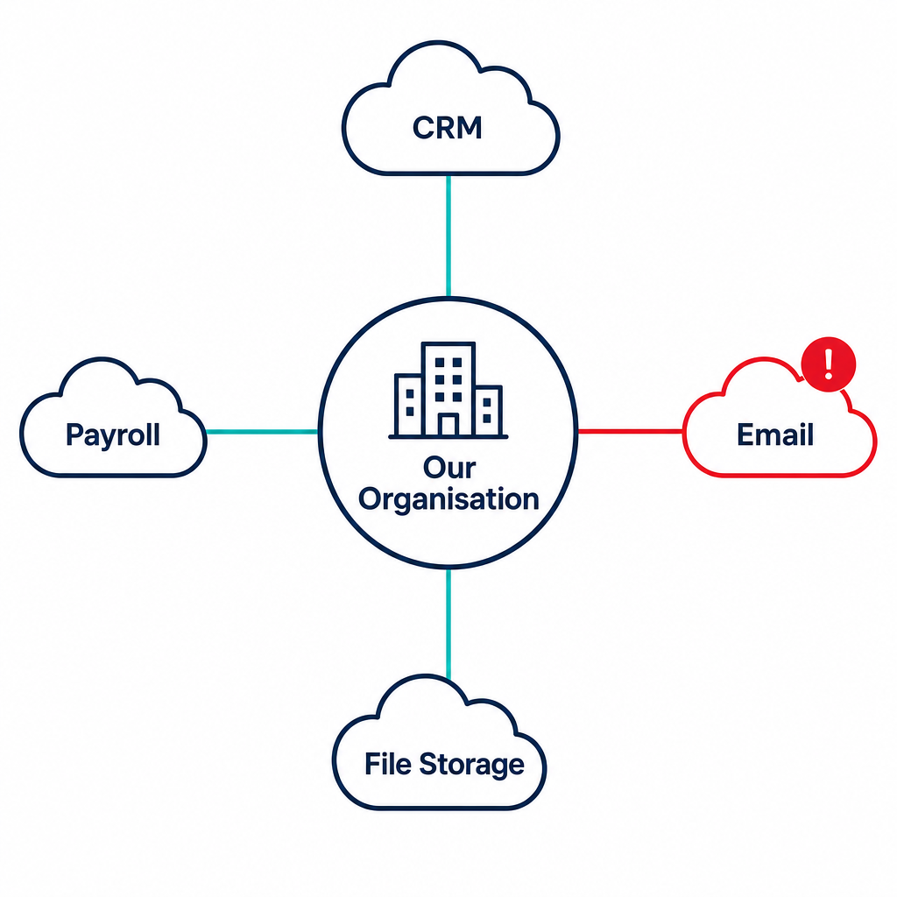
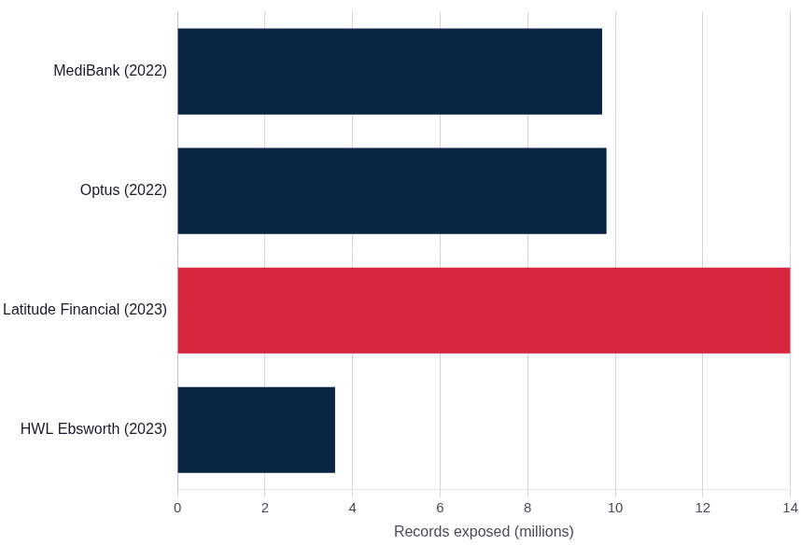
THREAT 03
Third-party cloud vulnerabilities
You are only as secure as the weakest vendor connected to your data.
Notable Australian breaches via third-party vectors
BSBXCS402 · Cybersecurity Awareness Program
6

Slide 7



04 · INTERNAL SURVEY
What our own team told us
A baseline assessment of awareness, habits, and confidence across the organisation.
6
12
5
Employees surveyed
Questions asked
Key risk areas covered
Password management
Phishing detection
Incident reporting
Policy knowledge
Training & tools
BSBXCS402 · Cybersecurity Awareness Program
7

Slide 8
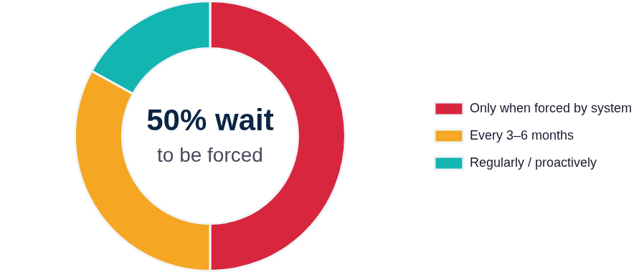
FINDING 01
Password management is in crisis
Half the team only changes passwords when the system forces them to.
3 in 6 wait for a system prompt before changing a password.
01
Reused passwords across personal and work accounts reported by multiple respondents
02
Browser-saved passwords still common despite policy
03
Password manager adoption inconsistent across the team
A single credential breach could cascade across our systems.
BSBXCS402 · Cybersecurity Awareness Program
8

Slide 9


FINDING 02
A phishing detection confidence gap
Only two of our six staff feel confident identifying a phishing attempt.
Confident
Confident
Not confident
Not confident
Not confident
Not confident
2 / 6
staff confident identifying phishing
What this means
Why it matters
Four colleagues are guessing — and AI-crafted phishing now bypasses the visual cues they were taught to look for.
Phishing remains the #1 initial access vector for ransomware. One wrong click is enough to compromise the entire network.
BSBXCS402 · Cybersecurity Awareness Program
9

Slide 10
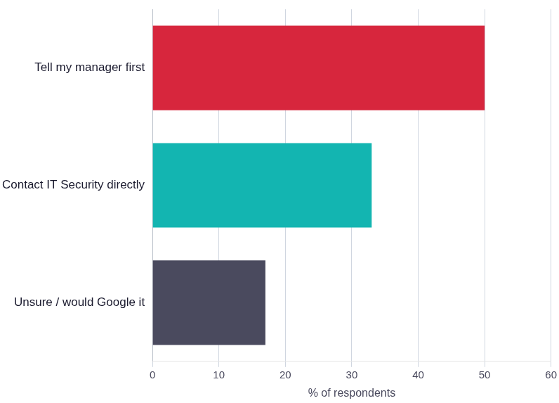

FINDING 03
Incident reporting routes are unclear
Half the team would tell their manager first — losing critical response time.
Where would you report an incident?
The correct path
01
Notice or suspect an incident — stop and do not touch anything
02
Contact IT Security team immediately — any hour, any day
03
IT contains, investigates, and remote-wipes if necessary
04
OAIC notified if customer data is at risk under the NDB scheme
Every minute of delay can trigger Notifiable Data Breach obligations under the Privacy Act 1988.
BSBXCS402 · Cybersecurity Awareness Program
10

Slide 11
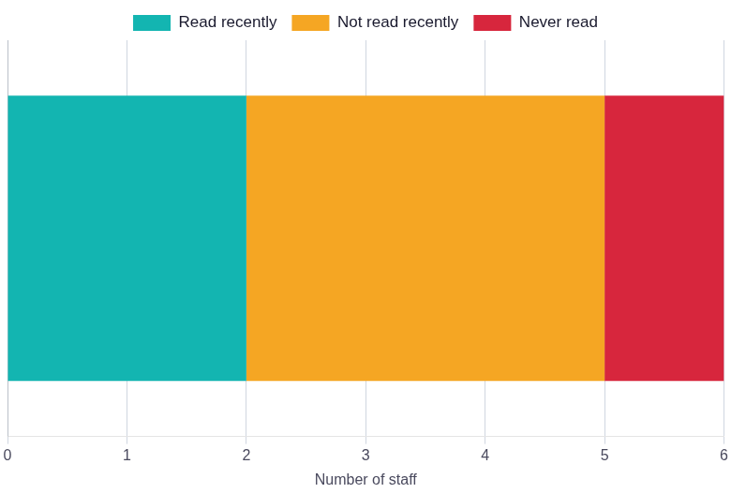
FINDINGS 04 & 05
Policy gaps and a clear ask for better support
Most staff haven't read the policy recently — and they're telling us what would help.
Finding 04 · Policy knowledge
Finding 05 · What staff want
"Give us practical, scenario-based training — not slides."
Practical training
"The current MFA tools are clunky across multiple systems."
Simpler tools
"We need clearer guidance on personal devices."
BYOD clarity
Only 2 of 6 have read the policy recently · 1 has never read it
BSBXCS402 · Cybersecurity Awareness Program
11

Slide 12
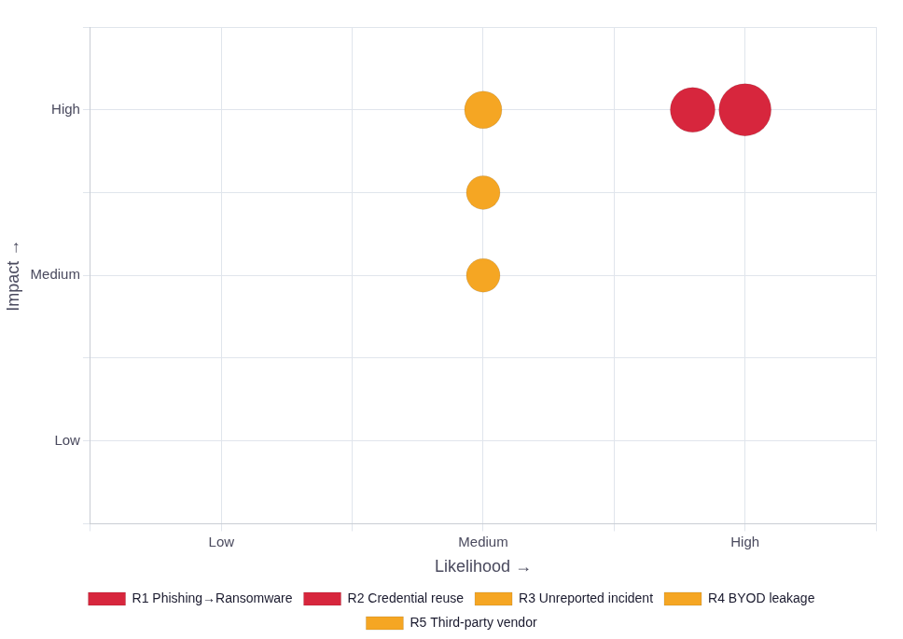
05 · PRIORITISATION
Our top risks — ranked
Where the external threat landscape meets our internal gaps.
01
Phishing → ransomware
Risk matrix — Likelihood vs Impact
Critical
02
Credential reuse & weak passwords
Critical
03
Delayed / misrouted incident reports
High
04
BYOD data leakage
High
05
Third-party cloud vendor compromise
High
BSBXCS402 · Cybersecurity Awareness Program
12

Slide 13
06 · MITIGATION FRAMEWORK
PACT — a four-step reflex against phishing
Introduced by ANZ Bank during the pandemic to keep staff safe under pressure.
P
A
C
T
Pause
Activate MFA
Call to verify
Turn on updates
Stop. Don't click. Re-read the message slowly before acting on any request.
Confirm multi-factor authentication is enabled on every work account on this device.
Phone the sender via a known, trusted number — never the one in the email or SMS.
Ensure automatic OS and app updates are enabled on your device at all times.
Apply PACT to every suspicious email, SMS, or login prompt — on any device, work or personal.
BSBXCS402 · Cybersecurity Awareness Program
13

Slide 14






07 · BYOD POLICY
Using your personal device for work — the rules
From the organisation's BYOD Cybersecurity Policy 1.0
01
02
03
04
05
Device Registration
Security Requirements
Acceptable Use
Incident Reporting
Remote Wipe
Approved apps only, accessed via VPN
IT can wipe the work container only
Submit BYOD enrolment request via IT portal
Supported OS with full-disk encryption enabled
Report loss or theft to IT Security immediately
MFA and approved password manager required
Personal photos and messages remain untouched
IT installs MDM work container on device
Screen lock with biometric or strong PIN
Do not attempt self-recovery — preserve evidence
No local storage of customer or sensitive data
Triggered on loss, resignation, or compromise
Sign BYOD Acknowledgement Form
No jailbroken or rooted devices permitted
Submit Incident Report Form within 24 hours
Non-compliance may result in revoked access, formal disciplinary action, or legal liability under the Privacy Act 1988.
BSBXCS402 · Cybersecurity Awareness Program
14

Slide 15
08 · NEXT STEPS
From awareness to action
What we each do this week to close the gaps.
TODAY
Sign the BYOD Acknowledgement Form and enrol any personal devices used for work.
One click can cost millions.
BY DAY 2
Move all work credentials into the approved password manager. Enable MFA everywhere.
BY DAY 5
Complete the practical phishing recognition exercise and learn the PACT reflex.
One pause can prevent it.
BY DAY 7
Re-read the BYOD Cybersecurity Policy 1.0 and confirm your reporting contact in IT Security.
Questions or incidents — contact IT Security
Internal intranet → IT Security portal
Available 24/7 — never wait for business hours
Thank you — let's PACT up.
BSBXCS402 · Cybersecurity Awareness Program
15

Slide 16
Thanks!

