Slide 1
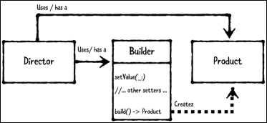
Builder Pattern

Slide 2
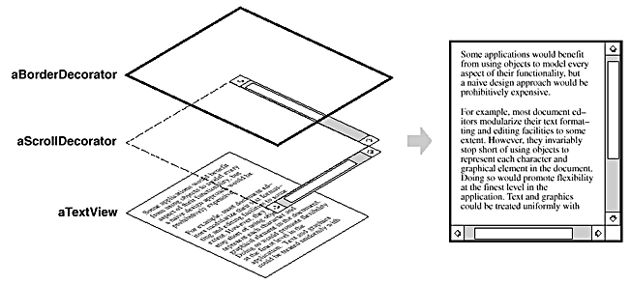
Decorator Pattern

Slide 3

Command Pattern

