Slide 1




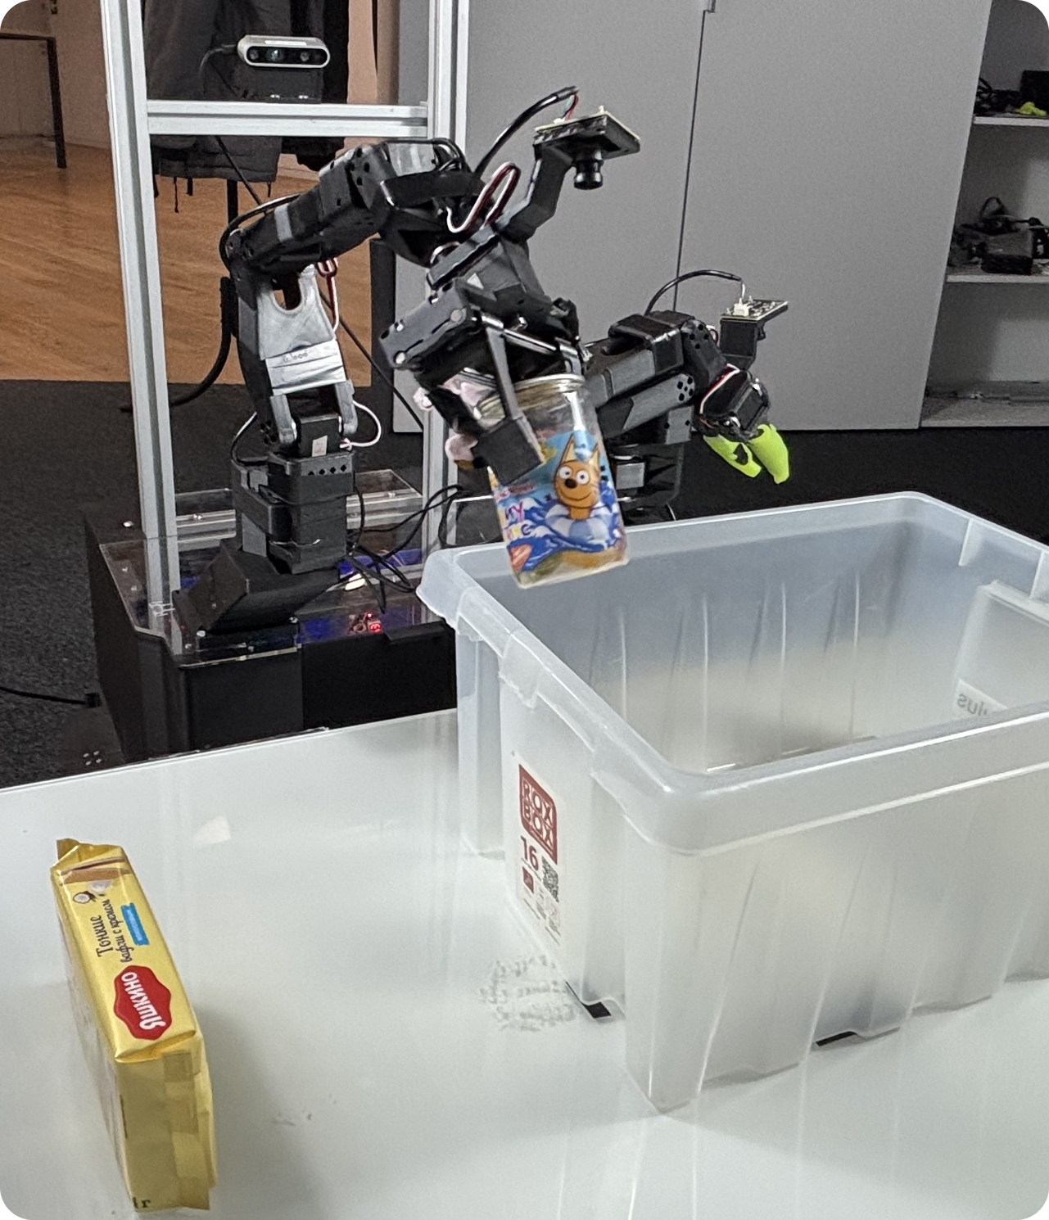
IEEE/RSJ IROS 2026 · PITTSBURGH
HapticVLA
Contact-Rich Manipulation via
Vision-Language-Action Model without
Inference-Time Tactile Sensing
Konstantin Gubernatorov*, Mikhail Sannikov*, Ilya Mikhalchuk*, Egor Kuznetsov, Makar Artemov, Ogunwoye Faith Oluwatobi, Marcelino Julio Fernando, Artem Asanov, Ziang Guo, Dzmitry Tsetserukou
Intelligent Space Robotics Laboratory, Skoltech · *equal contribution
arXiv:2603.15257
Notes:
MEMORY MAP — spell T·O·U·C·H (one letter per slide; the tiles top-right show where you are):
T = Trouble · O = One idea · U = Use touch as a reward · C = Cut the sensors · H = Hold the egg
Story thread: you open with an egg and you close with the egg.
TIMING: 2:50 total, including the chair's intro. 30-second warning at 2:20 → you should be on H (the egg slide) by then. Hard cut at 3:00.
SAY (~10 s):
"Hand a robot an egg. Will it crack it? Our robot learned to be gentle — and at deployment, it doesn't even need to feel the egg."
BRIDGE → T: "Here's the trouble…"

Slide 2





T · THE TROUBLE
T
O
U
C
H
Robots see. They don't feel.
Camera-only VLAs
Tactile sensors
See where the egg is
Feel every contact
Can't feel how hard they squeeze
Costly, and tied to special hardware
Crushed eggs, crumbled waffles
Hard to put on every robot
What if a robot could learn the feel… and leave the sensors behind?
HapticVLA · IROS 2026 · Pittsburgh
Notes:
T — TROUBLE (≈ 0:10 → 0:30)
CUE: two cards = two bad options. Left: cameras can't feel. Right: sensors cost.
SAY:
"Here's the trouble. Vision-language-action models only see. A camera shows where the egg is — not how hard you're squeezing it. So they crush fragile things. The classic fix is tactile sensors — but they're expensive, and they tie your policy to special hardware."
KEYWORDS: see, not feel → crush · sensors → cost + special hardware
BRIDGE → O: just read the bottom line: "What if a robot could learn the feel — and leave the sensors behind?"

Slide 3





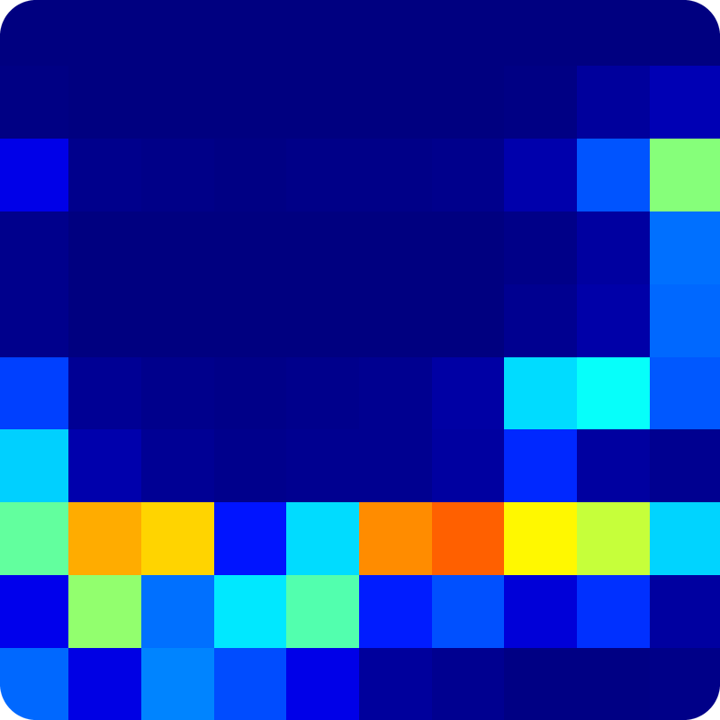

O · ONE IDEA
T
O
U
C
H
Touch in training. Not in deployment.
TRAINING · IN THE LAB
DEPLOYMENT · ANYWHERE
The robot can feel
Cameras are enough
Vision
Language
Touch
Vision
Language
No touch
200 taxels on two fingertips score every grasp
Any camera-only robot runs the same small model
Touch becomes a teacher, not a part you have to install.
HapticVLA · IROS 2026 · Pittsburgh
Notes:
O — ONE IDEA (≈ 0:30 → 0:50)
CUE: left panel = the lab (robot feels), right panel = anywhere (cameras only). Point left, then right.
SAY:
"That's our one idea: touch at training time, not at deployment. We learn on a robot that can feel — then ship a policy that needs only cameras. Touch becomes a teacher, not a part you have to install."
KEYWORDS: lab → anywhere · touch = teacher
BRIDGE → U: "It takes two steps. Step one…"

Slide 4
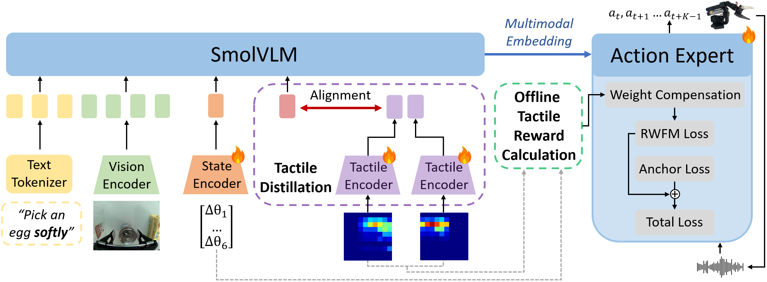
U · USE TOUCH AS A REWARD
T
O
U
C
H
Use touch as a reward.
1
Score. Fingertips rate every moment of 310 real demos.
2
Penalize. Too hard, too loose, or slipping loses weight.
3
Reward. Gentle, successful moves count more.
HapticVLA · IROS 2026 · Pittsburgh
Notes:
U — USE TOUCH AS A REWARD (≈ 0:50 → 1:25)
CUE: the figure is the whole architecture. Big blue bar = SmolVLA's vision-language model; right box = action expert (outputs the motions). GREEN dashed box = the tactile reward (this slide). PURPLE dashed box = distillation (next slide).
Then read the three chips left → right: Score → Penalize → Reward.
MEMORY HOOK: Goldilocks grip: not too hard, not too loose, no slipping.
SAY:
"Step one: use touch as a reward. We start from SmolVLA — a small vision-language model plus an action expert that outputs motions. Offline, the fingertip sensors score every moment of every demo. Too hard, too loose, or slipping — penalty. Gentle and successful — bonus. We even recorded failures on purpose, so it learns what 'too hard' looks like. The action expert then learns more from the gentle moves, and less from the crushing ones."
OPTIONAL NAME-DROP: "We call it Safety-Aware Reward-Weighted Flow Matching."
FROM THE PAPER: 310 demos = 240 successful + 70 deliberate failures (object damaged by too much force). The failures get negative reward and "sharpen" what safe looks like.
BRIDGE → C: "The purple box is step two…"

Slide 5




C · CUT THE SENSORS
T
O
U
C
H
Cut the sensors. It gets better.
TEACHER
MEAN SUCCESS · 3 REAL-WORLD TASKS
SmolVLA + touch
Feels. Labels all the data once, offline.
learns from 50 / 50: human demos + teacher actions
STUDENT = HapticVLA
Same SmolVLA, no touch
Cameras + joint angles only. Still 0.45B.
The student that can't feel beats the teacher that can.
86.7% vs 75.0%
HapticVLA · teacher = SmolVLA + SA-RWFM with tactile input · student = Tactile Distillation
Notes:
C — CUT THE SENSORS (≈ 1:25 → 1:55)
CUE: top card = teacher → arrow → bottom card = student. Chart climbs grey → blue → orange.
MEMORY TRICK: 57 → 75 is the same two digits flipped. Then +12 more → 87.
SAY:
"Step two: cut the sensors. The touch-trained teacher labels the data once, offline. The student — the same small model, with no tactile input — learns from a 50/50 mix of demos and teacher actions. And here's the twist: the student that can't feel beats the teacher that can — 86.7 versus 75 percent."
PAUSE for a beat after the twist.
ONE-LINER IF ASKED WHY: "It learns to act as if it could feel. The teacher's actions already carry the touch."
BRIDGE → H: click, then open with "And yes — it holds the egg."

Slide 6
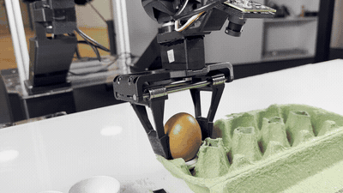
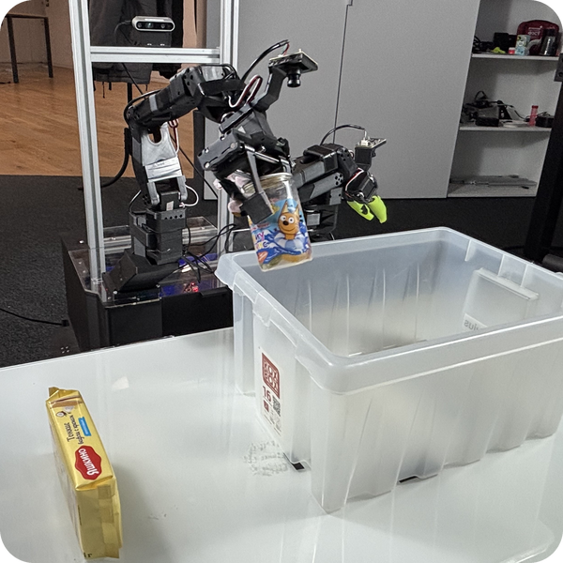

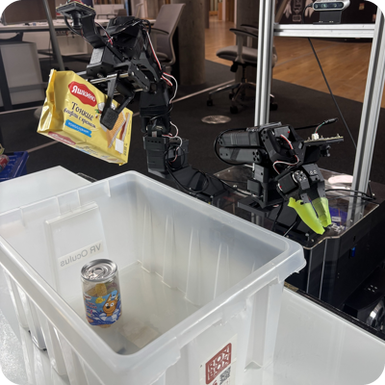
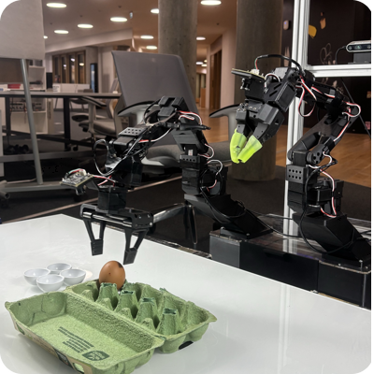
H · HOLD THE EGG
T
O
U
C
H
Hold the egg.
Jar
75%
50%
Deformable, keep its shape
Waffles
90%
70%
Fragile, no cracks or crumbs
Egg
95%
50%
REAL ROBOT · EGG TASK
Out of the carton, onto the tray
86.7%
HapticVLA, mean success
+30 pts
vs. the base model
0
tactile sensors at deployment
20 real-robot trials per task · success = object intact and on target
Notes:
H — HOLD THE EGG (≈ 1:55 → 2:25) ← the 30-second warning lands around here
CUE: rows climb 75 → 90 → 95 top to bottom, ending on the egg. Bottom tiles: 86.7 · +30 · 0.
SAY:
"And yes — it holds the egg. Real robot, three delicate tasks, 20 trials each. Jar: 50 to 75 percent. Waffles: 70 to 90. And the egg: 50 to 95. That's plus 30 points on average — with zero tactile sensors and no extra compute at deployment."
IF SHORT ON TIME: say only "Egg: 50 to 95. Plus 30 points on average, zero sensors." and move on.
BRIDGE → close: "So…"

Slide 7



THE TAKEAWAY
Train with touch.
Deploy without it.
Project page
Video
Code + data
Touch can be a training-time modality. The distilled policy runs on any camera-only robot, at no extra inference cost.
PAPER
arXiv:2603.15257
CODE + DATASET + DIGITAL TWIN
github.com/Advanced-Robotic-Manipulation/crab
MODELS
huggingface.co/armteam
Come see the robot at our poster
Supported by RSF grant No. 24-41-02039
Tactile sensors: Prof. H. Kajimoto, UEC Tokyo
Notes:
CLOSE (≈ 2:25 → 2:35) — stop talking by 2:45 at the latest.
SAY:
"Train with touch — deploy without it. Code, data and models are open: scan the QR codes, and come see the robot at our poster. Thank you!"
(If you know your poster board number, say it here.)
────────
POSTER Q&A PREP (not for the stage):
• Other VLAs: X-VLA (0.9B, big cross-embodiment pretraining) and VLA-0 (bigger; beat SmolVLA on SO-101 before) were fine-tuned on the same data and scored 0% on all three tasks. The paper reads this as a failure to generalize to high-precision, contact-rich tasks.
• Tactile at inference: the best teacher variant (async) reached 81.7%, still below the sensor-free student's 86.7%. Async hurts because tactile readings and actions drift out of sync (latency).
• Reward terms: over-force, under-force while holding, peak pressure, pressure concentration, left/right pad asymmetry, slip (centre-of-pressure jump or sudden force drop). Episode reward = step reward + success − drop − damage − risk. Thresholds are calibrated from dataset quantiles.
• Weighting: advantage A = 0.7·episode + 0.3·chunk score (robust z-scores); weight = exp(0.25·A) clipped to [0.25, 4]; an L2 anchor keeps weights near the imitation model to avoid drift.
• Distillation: the student is initialised from the teacher minus the tactile encoder (state projection sliced 134 → 6); it trains on 0.5·demo + 0.5·teacher action chunks; no architecture change.
• Data: 310 real episodes (Jar and Waffles: 70 good + 20 failed each; bimanual Egg: 100 + 30).
• Hardware: two LeRobot SO-101 arms; right arm has 12 V servos and a parallel gripper with a 10×10 taxel array per finger (200 taxels, 1–9 N, 120 Hz; sensors from Prof. Kajimoto's lab). RealSense D435 + IMX335 wrist cams, 640×480. Everything runs on a Jetson Orin NX 16 GB.
• Closest prior work: FD-VLA distils FORCE (from joint/force sensors) into a token; Gano et al. pre-train with low-fidelity tactile, then drop it (not a VLA). HapticVLA does it for TOUCH, inside a VLA, with a safety reward.

