Slide 1


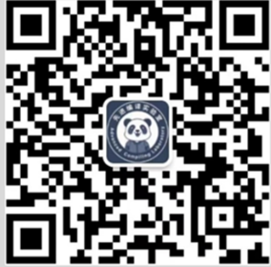
先进编译实验室
Advanced Compiler
Triton源码结构
先进编译实验室
Advanced Compiler
先进编译实验室
Advanced Compiler
嘉宾：刘灿
先进编译实验室
Advanced Compiler
https://github.com/triton-lang/triton

Slide 2
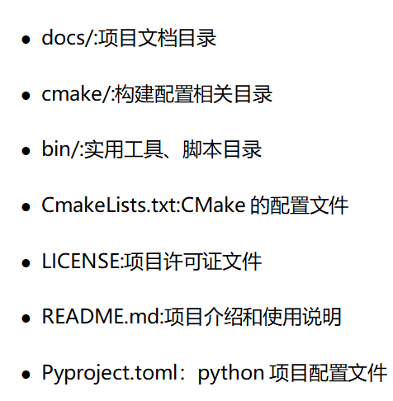
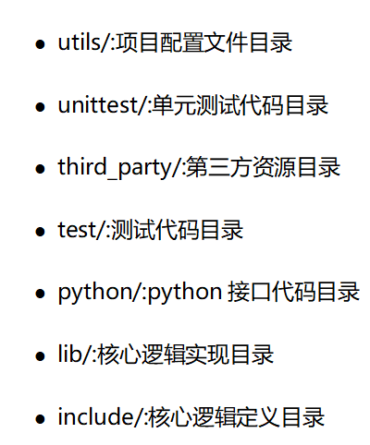
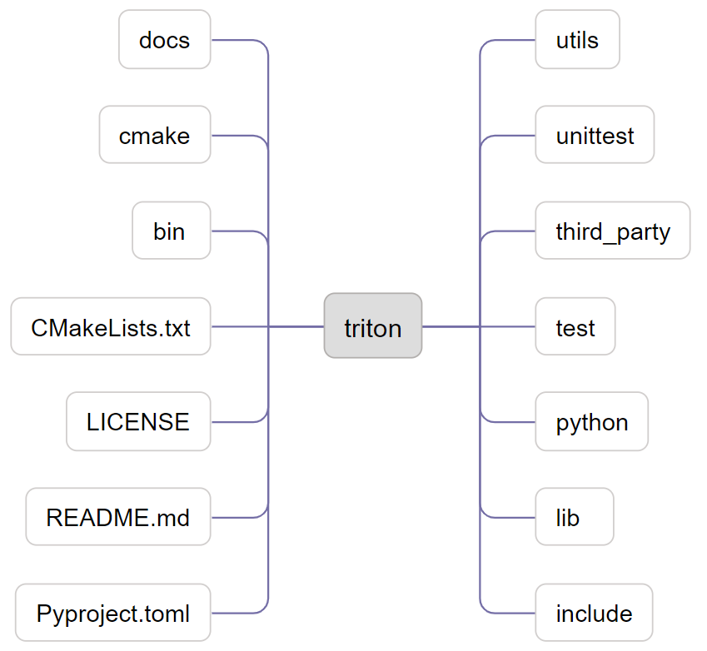
一级目录
https://github.com/triton-lang/triton

Slide 3
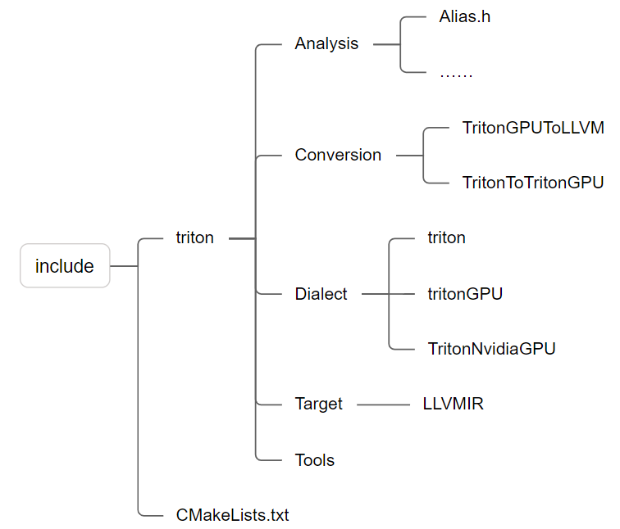
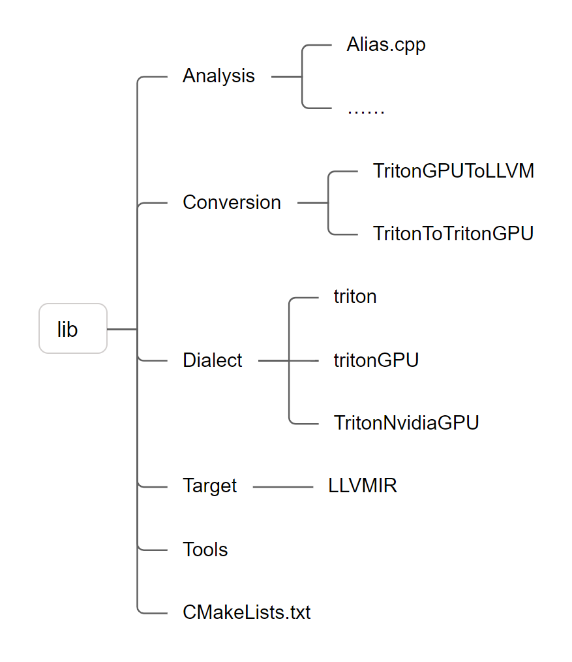
include & lib目录
https://github.com/triton-lang/triton

Slide 4
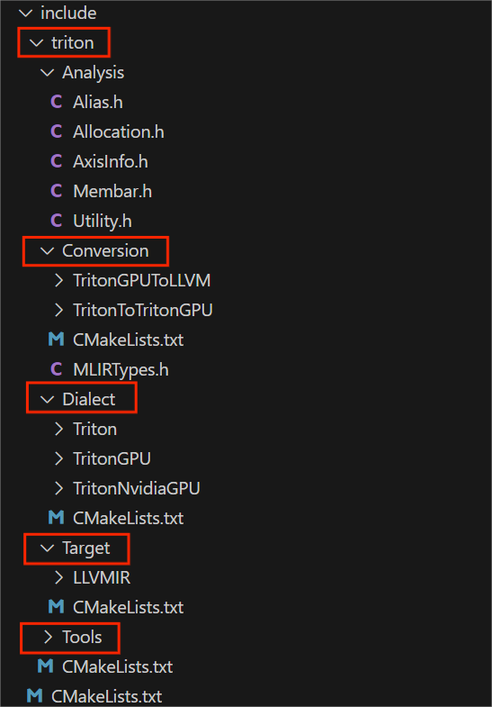
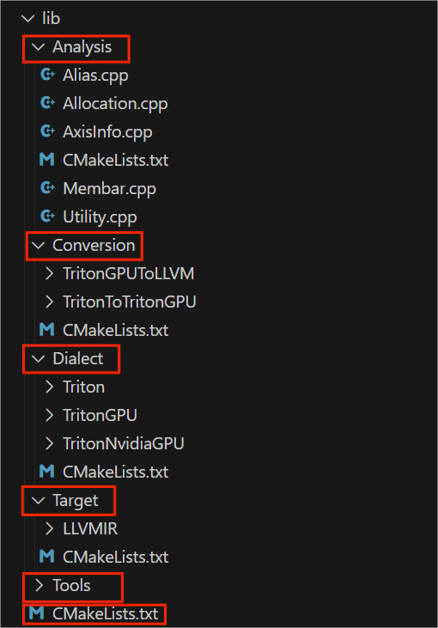
include & lib目录文件
https://github.com/triton-lang/triton

Slide 5
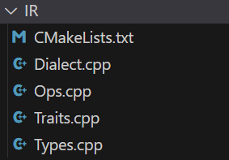
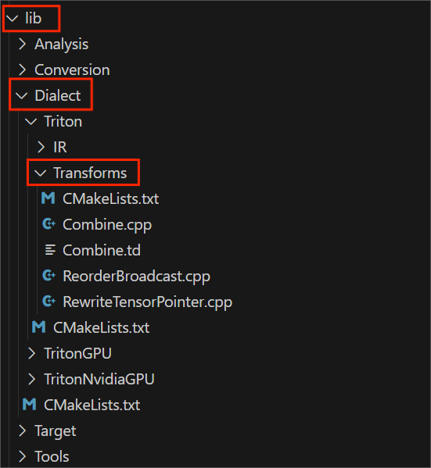
Dialect目录
https://github.com/triton-lang/triton

Slide 6
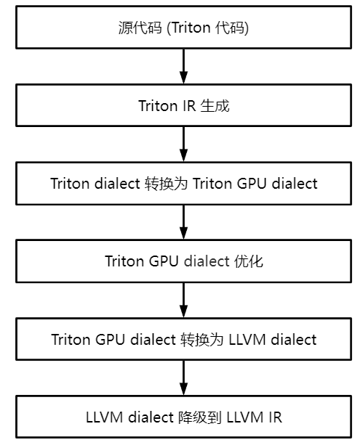

编译流程对应源码位置
https://github.com/triton-lang/triton
lib/Dialect/Triton
lib/Conversion/TritonToTritonGPU
lib/Dialect/TritonGPU
lib/Conversion/TritonGPUToLLVM
lib/Target/LLVMIR

Slide 7
常用文件源码位置
https://github.com/triton-lang/triton
Triton Dialect
Op定义：/include/triton/Dialect/Triton/IR/TritonOps.td
tt.call、tt.func、tt.return、tt.load、tt.store、tt.dot等Op
优化Pass: /lib/Dialect/Triton/Transforms
CombineOpsPass、ReorderBroadcastPass、RewriteTensorPointerPass、LoopUnrollPass
Triton Dialect → TritonGPU Dialect
转换Pass：lib/Conversion/TritonToTritonGPU/TritonToTritonGPUPass.cpp

Slide 8
常用文件源码位置
https://github.com/triton-lang/triton
TritonGPU Dialect
Op定义：/include/triton/Dialect/TritonGPU/IR/TritonGPUOps.td
async_wait、alloc_tensor、insert_slice_async、convert_Layout等Op
Layout属性定义：/include/triton/Dialect/TritonGPU/IR/TritonGPUAttrDefs.td
Blocked Layout、MMA Layout、DotOperand Layout、Slice Layout、Shared Layout
优化Pass: /lib/Dialect/TritonGPU/Transforms
AccelerateMatmul、Coalesce、CombineTensorSelectAndIf、OptimizeAccumulatorInit、OptimizeDotOperands、OptimizeThreadLocality、Pipeline、Prefetch、ReduceDataDuplication、RemoveLayoutConversions、ReorderInstructions、AllocateSharedMemoryPass

Slide 9
相关资料
源码链接：https://github.com/triton-lang/triton
Notes:
（二）结果分析：
1、说明结果的正确性【重要】（输出的是什么值，该值是怎么得到的）
2、对比优化前后的时间（到 s 级别）

Slide 10


