Slide 1
Lesson 3: Imaging in amplitude modulation
AFM
Sergio Santos
Institute Center for Future Energy (IFES),
Abu Dhabi PO BOX 54224, United Arab Emirates
Telephone (Spain): | 0034 663489175
Mobile: | 00971 (0) 509071490
Email: | santos_en@yahoo.com

Slide 2

Relationship to last class with S Santos
If the e. Below is the model of the AFM cantilever:
Do you know how the Q factor is obtained?
What is the solution of this equation?
What are the experimental observables in AFM?
How can we estimate the energy irreversible lost in the tip-sample
interaction (relate to dissipation models Lesson 5) via observables?
5. Is there an equation that relates conservative interactions to
The experimental observables?

Slide 3
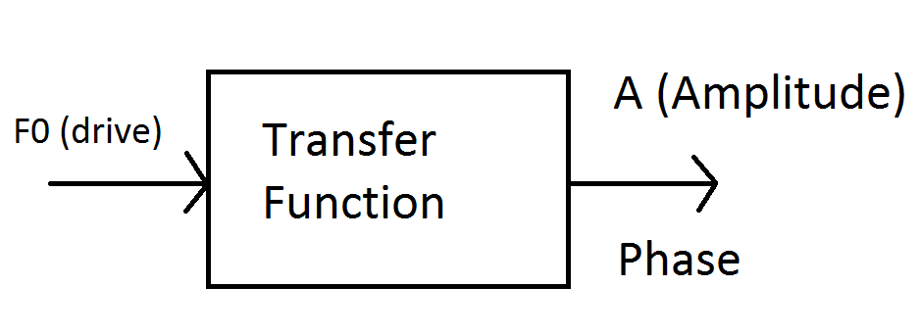
Relationship to last class with S Santos
Can you write the transfer function of the AM AFM?
Linear system with no tip-sample interaction and non-linear system

Slide 4
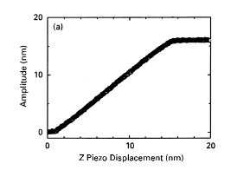
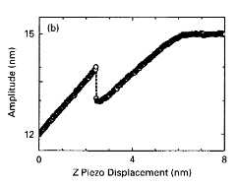
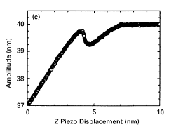
1. Operating regimes
Garcia, R. & San Paulo, A. Amplitude curves and operating regimes
in dynamic atomic force microscopy. Ultramicroscopy 82, 79-83 (2000).

Slide 5
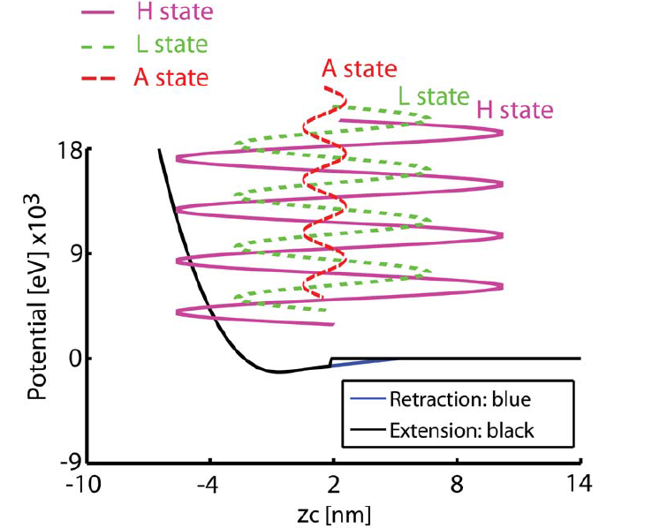
2. Operating regimes and forces

Slide 6
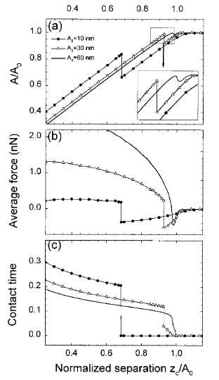
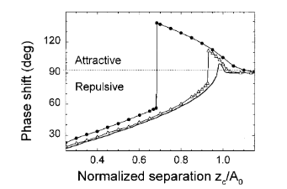
2. Operating regimes and forces
Garcia, R. & San Paulo, A. Attractive and
repulsive tip-sample interaction regimes in tapping mode
atomic force microscopy Physical Review B 60, 4961-4967 (1999).

Slide 7
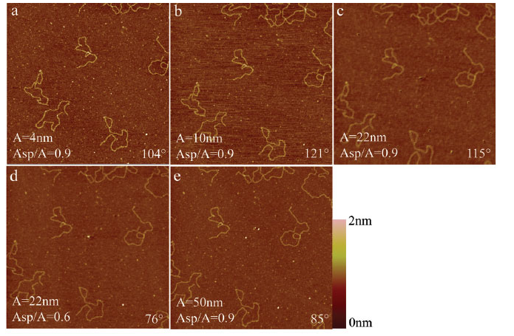
2. Free amplitude A0

Slide 8
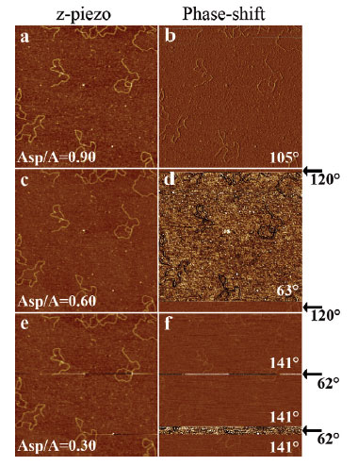
2. Set point A/A0
Santos, S., Barcons, V., Font, J. & Thomson,
N. H. Bi-stability of amplitude modulation AFM
in air: deterministic and stochastic outcomes
for imaging biomolecular systems. Nanotechnology
21, 225710 (2010).

Slide 9
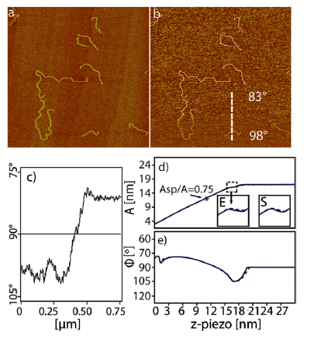
3. Smooth force transition
Santos, S., Barcons, V., Font, J. & Thomson,
N. H. Cantilever dynamics in amplitude
modulation AFM: continuous and discontinuous
transitions. J. Phys. D: Appl. Phys. 43,
275401-275407 (2010).

