Slide 1
Lesson 3: Types of forces and control
PhD level course: Intermolecular and surfaces forces
Sergio Santos
Institute Center for Future Energy (IFES),
Abu Dhabi PO BOX 54224, United Arab Emirates
Telephone (Spain): | 0034 663489175
Mobile: | 00971 (0) 509071490
Email: | santos_en@yahoo.com

Slide 2
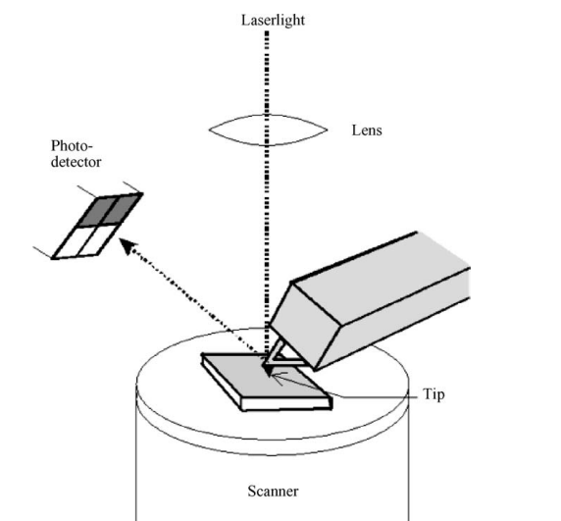
1. The AFM set-up
1.1. The approaching and the sensing
Butt, H.-J. r., Cappella, B. & Kappl, M. Force measurements with the atomic force
microscope: Technique, interpretation and applications. Surface Science Reports
59, 1-152 (2005).

Slide 3
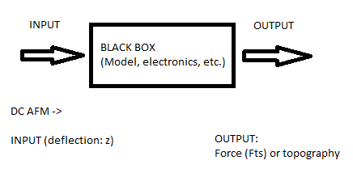
The AFM set-up
Controls and Models
Binnig, G., Quate, C. F. & Gerber, C. Atomic Force Microscope. Physical Review Letters 56, 930-933 (1986).

Slide 4
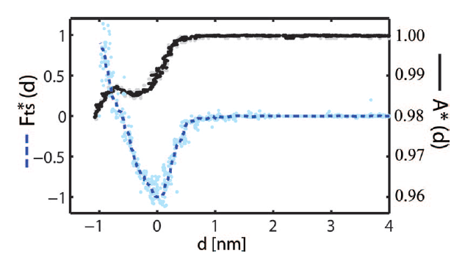
Surface-Forces
1.2 Abservables and output
Experimental force (blue) as a function of distance. The black line is an
Experimental observable.
Amadei, C. A., Tang, T. C., Chiesa, M. & Santos, S. The aging of a surface and the evolution of conservative
and dissipative nanoscale interactions. The Journal of Chemical Physics 139, 084708 (2013).

Slide 5
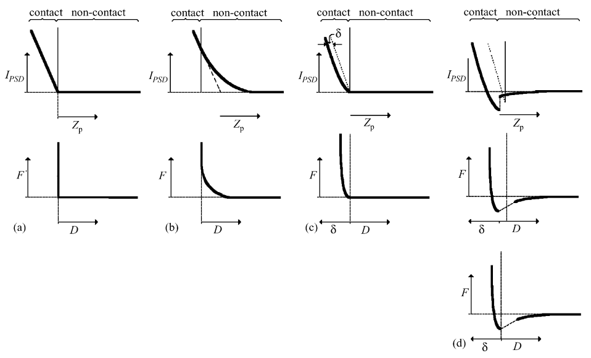
2. Surface forces
2.1. Models and outcome
Butt, H.-J. r., Cappella, B. & Kappl, M. Force measurements with the atomic force
microscope: Technique, interpretation and applications. Surface Science Reports
59, 1-152 (2005).

Slide 6
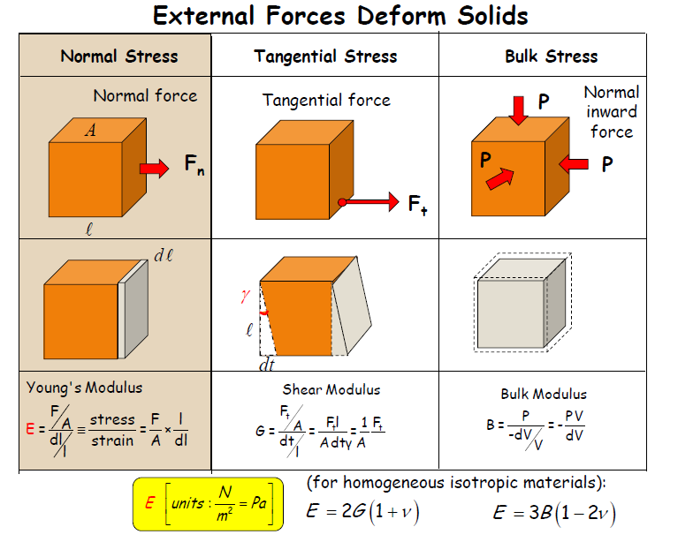
3. Contact Mechanics
3.1. Repulsive forces: Models
Reifenberger, R. & Raman, A. Fundamentals of Atomic Force Microscopy:
Part 2: Dynamic AFM Methods (Fall 2012). https://nanohub.org/resources/9598 (2012).

Slide 7
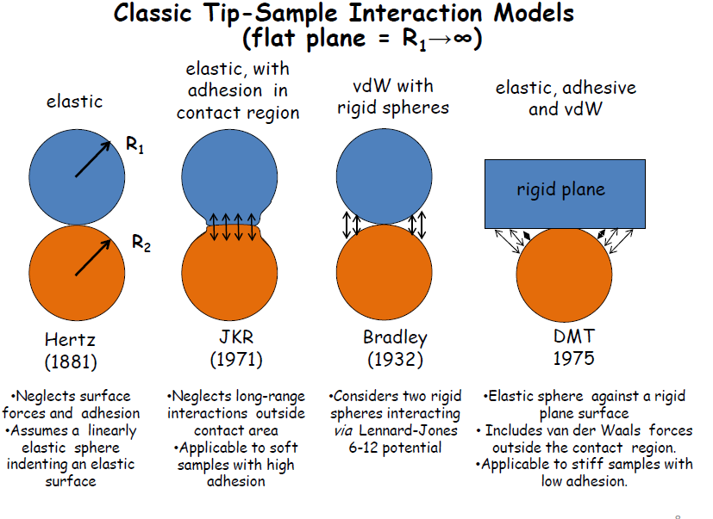
3. Contact Mechanics
3.2. Repulsive forces: Models
Reifenberger, R. & Raman, A. Fundamentals of Atomic Force Microscopy:
Part 2: Dynamic AFM Methods (Fall 2012). https://nanohub.org/resources/9598 (2012).

Slide 8
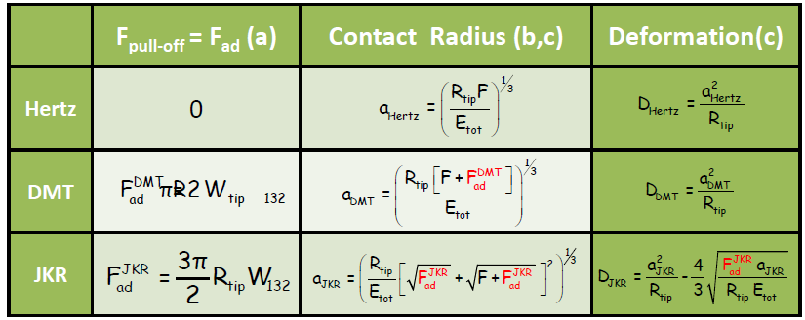
3. Contact Mechanics
3.3. Repulsive forces: Models
Reifenberger, R. & Raman, A. Fundamentals of Atomic Force Microscopy:
Part 2: Dynamic AFM Methods (Fall 2012). https://nanohub.org/resources/9598 (2012).

Slide 9
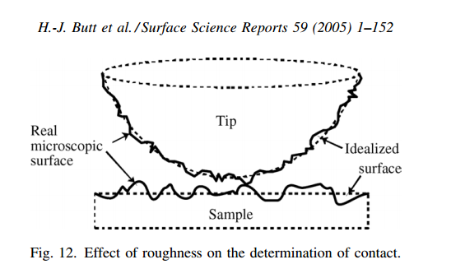
3. Contact Mechanics
3.4. Real experiments

Slide 10
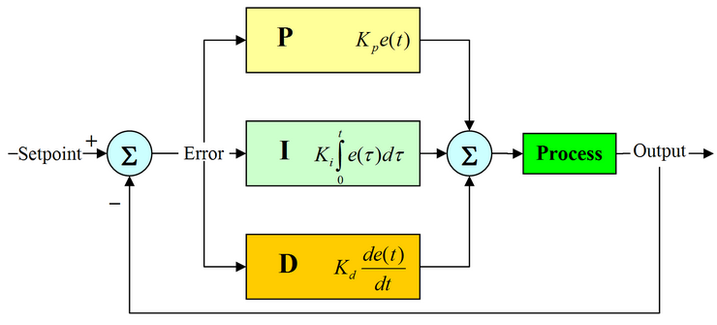
4. Imaging
Control, methods and models

Slide 11
4. Imaging
Question: how do you think an image is taken?

Slide 12
4. Imaging
Equation of the cantilever. What is it?

