Slide 1
Workshop 1: Titanic Kaggle Dataset
Presented by: Saffian Asghar and Emilio Espinosa S.
Last update: October 2022

Slide 2
Table of contents
Objective
The Titanic challenge.
Conclusion
Appendix

Slide 3
Objective

Slide 4
Objective
Understand the process of data extraction, coding, cleaning by using a real dataset.

Slide 5
Titanic’s data

Slide 6
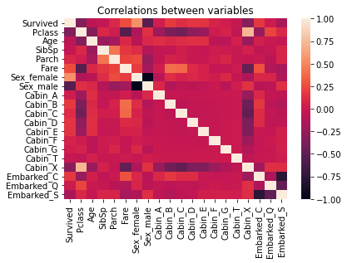
Correlation Matrix
1
Gender survival.
Age survival.
Hypothesis.

Slide 7
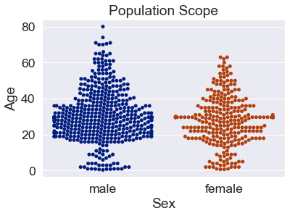
Population
1
Majority of male population.
Most people within 20’s and 30’s.
Small senior and children population.

Slide 8
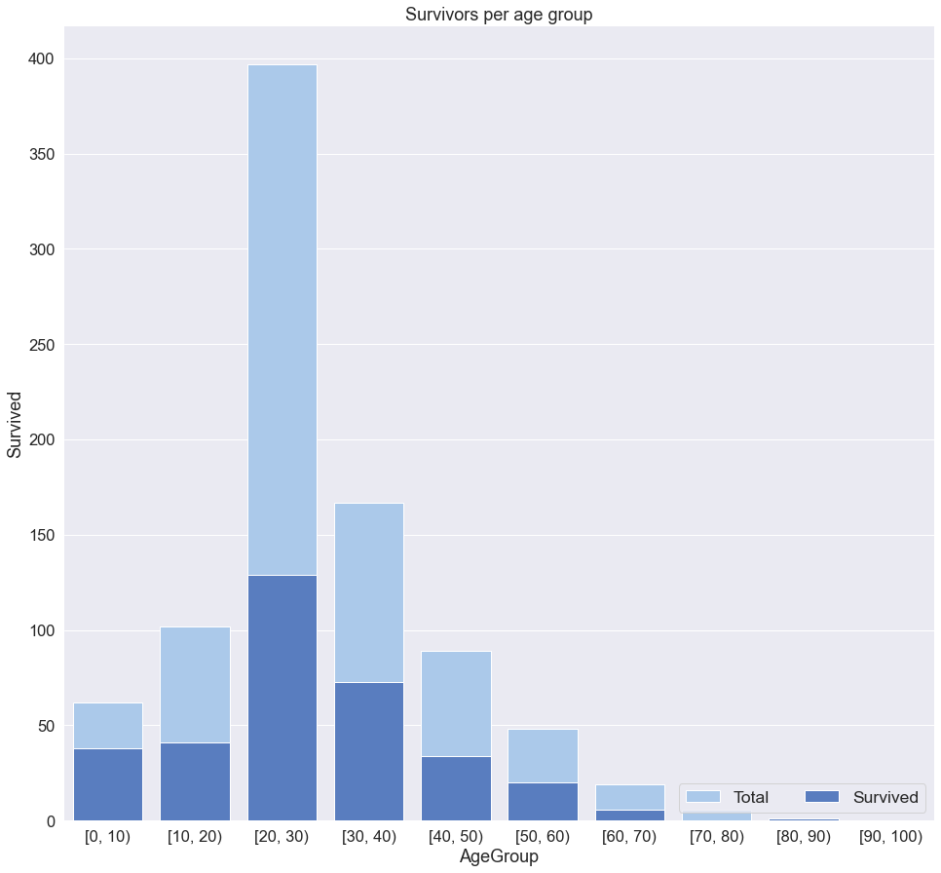
Survivors
1
Biggest group is in range: 20-30.
Lowest groups are in range 70-80 and 60-70.
Low number of survivors in early years.
Notes:
Sex
Survived
Total
Survival_Rate
0
female
233
314
0.742038
1
male
109
577
0.188908

Slide 9
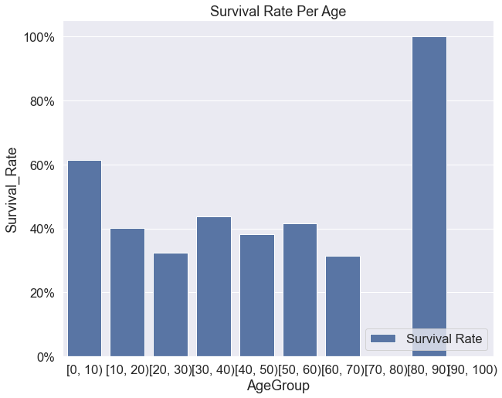
Survival
Rate
1
Biggest rate at range 80-90.
60% of kids survived.
Similar outcome for the other groups.

Slide 10
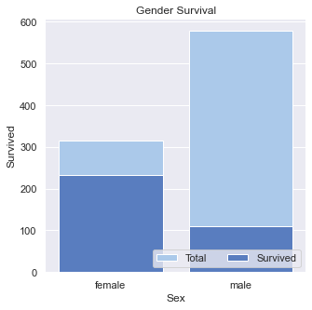
Gender
Survival
1
More than 230 female survivors.
Less than 110 male survivors.
Comparison vs total population.

Slide 11
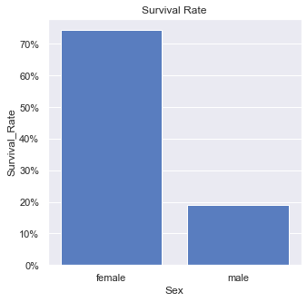
Gender
Survival
Rate
1
More than 74% of female population survived.
Less than 20% of male population survived.

Slide 12
Conclusions

Slide 13
Conclusions
Age and gender mattered when deciding survivors.
Positive correlation between being female and surviving.

Slide 14
Questions?

Slide 15
References
https://www.kaggle.com/c/titanic

