Slide 1
Workshop: Social Network Analysis
Saffian Asghar
Emilio Espinosa Sanchez

Slide 2
WORKFLOW
Dataset
Overview of data.
Bipartite graph
Bipartite analysis between most common comic and heroes by order by
Unipartite graphs
Unipartite heroes and comics analysis (most connected, distribution, scale free graph and centrality measure)
Communities
Louvain algorithm

Slide 3
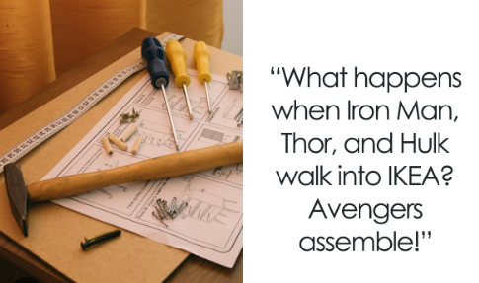
Dataset
Data:
edges.csv:
Hero and comic names
96 104 rows
nodes.csv:
Node and type (hero or comic)
19 090 rows
hero-network.csv:
Hero1 and Hero2: network of heroes working together.
574 467 rows

Slide 4
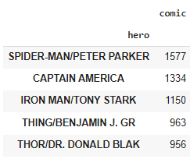
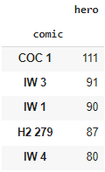
Top 5 comics and heroes
Most frequent by group by and count.

Slide 5
Bipartite graphs

Slide 6
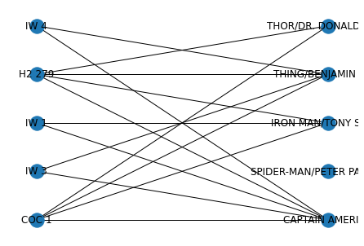
Bipartite graph
Connections between five most popular
Note: Spider-man has no connections. Hypothesis: mistake in the spelling (Peter Parkerker)
Complete network:
Nodes: 19 090
Edges: 96 104

Slide 7
Unipartite graphs

Slide 8
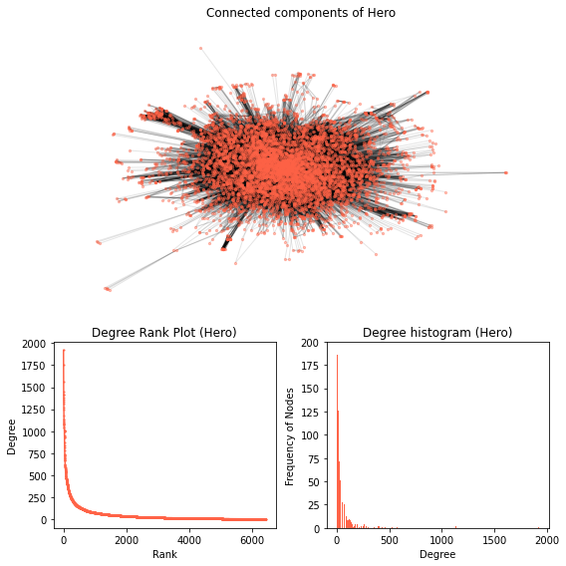
Unipartite graph

Slide 9
Unipartite graph

Slide 10
Centralities for heroes
Centrality: importance of nodes
HEROES | DEGREE CENTRALITY | HEROES | EIGENVECTOR CENTRALITY
CAPTAIN AMERICA | 0.30 | CAPTAIN AMERICA | 0.1168
SPIDER-MAN/PETER PAR | 0.27 | IRON MAN/TONY STARK | 0.1023
IRON MAN/TONY STARK | 0.24 | SCARLET WITCH/WANDA | 0.1008
THING/BENJAMIN J. GR | 0.22 | THING/BENJAMIN J. GR | 0.1008
MR. FANTASTIC/REED R | 0.21 | SPIDER-MAN/PETER PAR | 0.1002

Slide 11
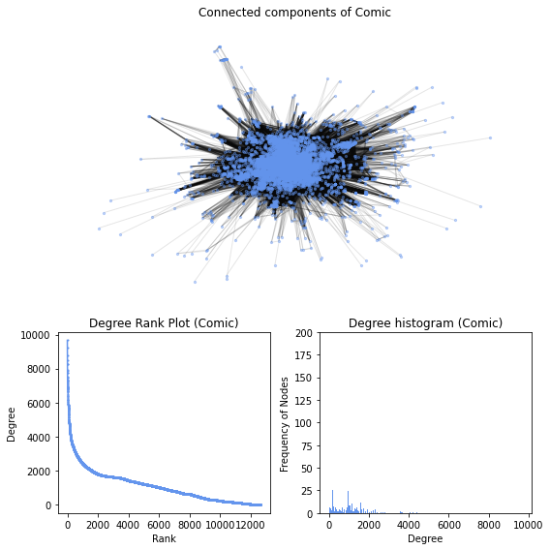
Unipartite graph

Slide 12
Unipartite graph

Slide 13
Centralities for comics
COMICS | DEGREE CENTRALITY
COC 1 | 0.76
H2 279 | 0.73
M/GN 1 | 0.69
H2 278 | 0.67
IW 2 | 0.65

Slide 14
Communities

Slide 15
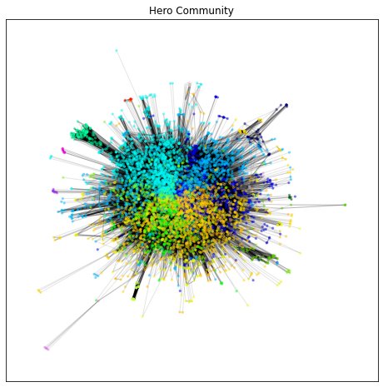
Communities
Modularities: 0.0553
No. of communities: 23
TOP communities (Hero):
Community
11 1390
17 998
1 858

Slide 16
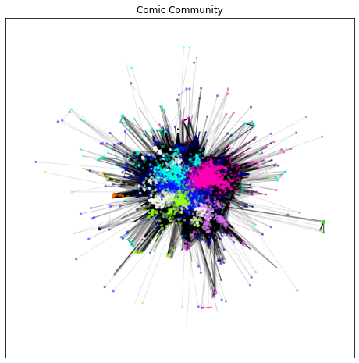
Communities
Modularities: 0.0032
No. of communities: 9
TOP communities (Comic):
Community
1 3426
4 3077
0 1967

Slide 17
Conclusion
Captain America is the most connected heroe.
Coc 1 is the most connected comic.
It would be an interesting analysis if we could go further into each community and understand how they differ from each other.

Slide 18
THANK YOU
Saffian
Emilio

