Slide 1
Workshop 9
Saffian Asghar
Emilio Espinosa Sanchez

Slide 2
WORKFLOW
EDA
Dataset analysis
Simple recommender
Analyze the data and provide recommendation.
Content based recommender
Analyze the data and provide recommendation.

Slide 3
Movies dataset

Slide 4
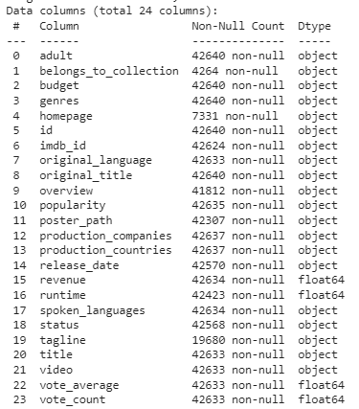
EDA
movies_metadata.csv: info. of +40,000 movies.
keywords.csv: movie plot keywords.
credits.csv: cast and crew info.
links_small.csv: containing the TMDB and IMDB of 9,000 movies.
ratings_small.csv: containing 100,000 ratings from 7,000 users on 9,000 movies.

Slide 5
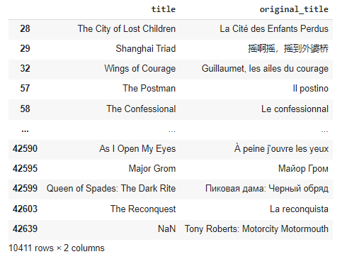
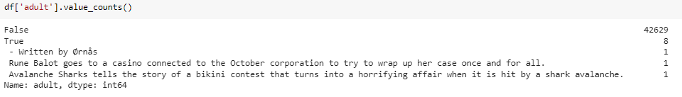
EDA - Distributions
Drop original title, poster, adult columns.
Replace rest of columns with either 0 or None.

Slide 6
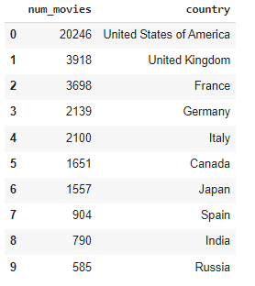
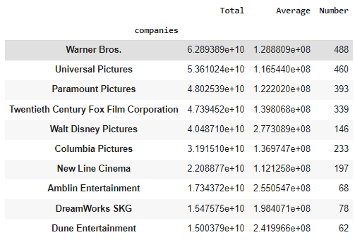
EDA
Top 10: Movies production
Top 10: Companies by movies (#)

Slide 7
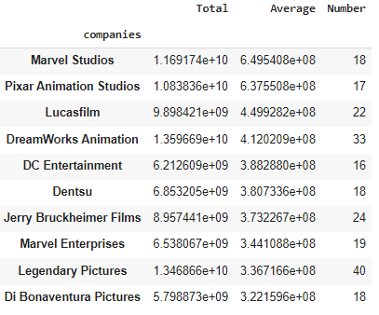
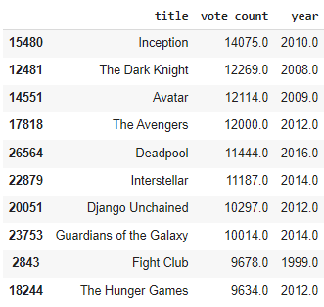
EDA
Top 10: Movies by avg revenue
Top 10: Critically acclaimed movies (#)

Slide 8
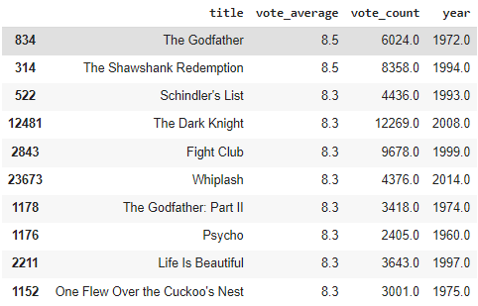
EDA
Top 10: Critically acclaimed movies (rating)

Slide 9
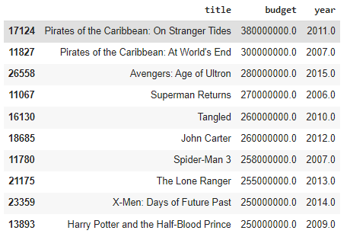
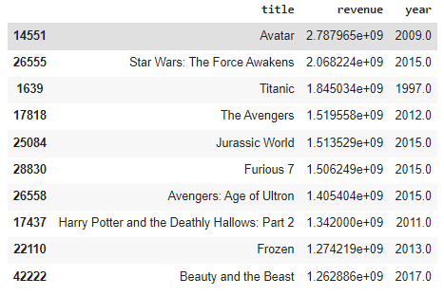
EDA
Top 10: By budget
Top 10: By revenue

Slide 10
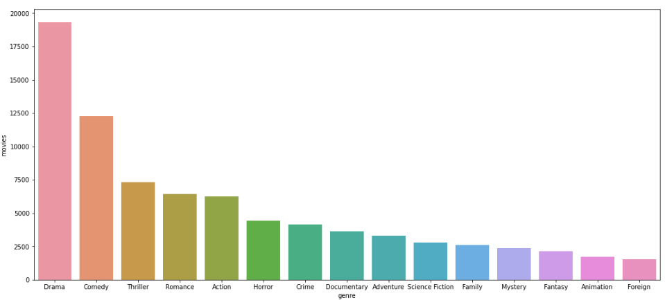
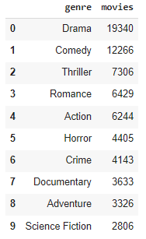
EDA
Top 10: Genres

Slide 11
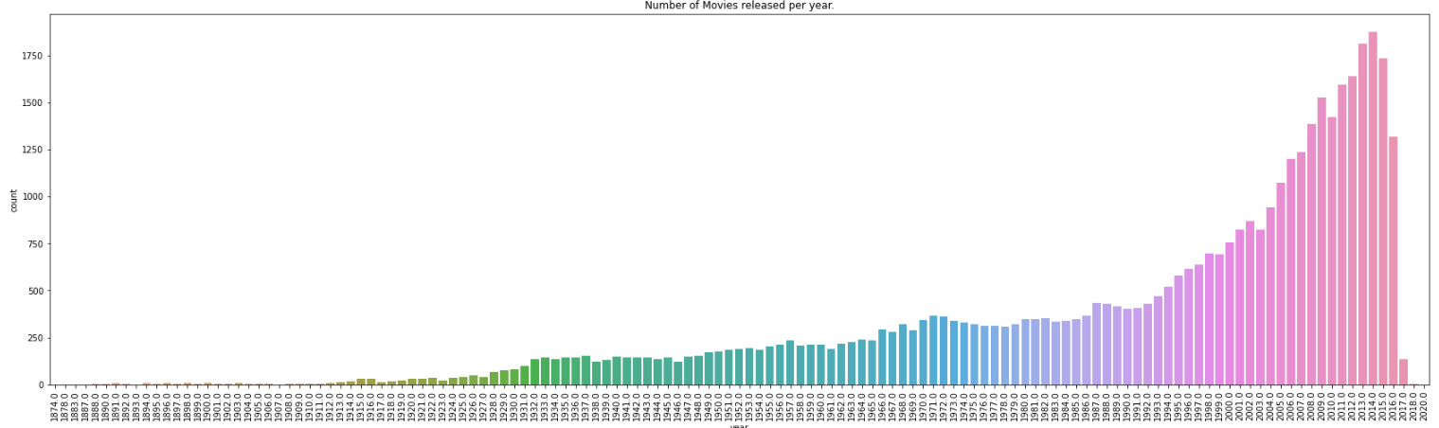
EDA

Slide 12
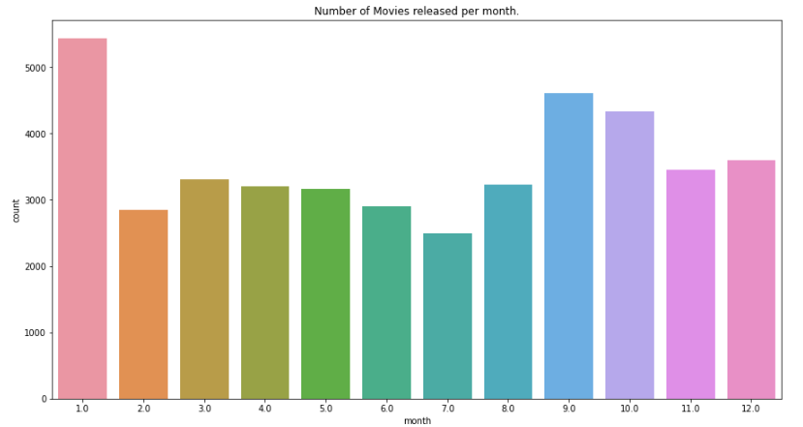
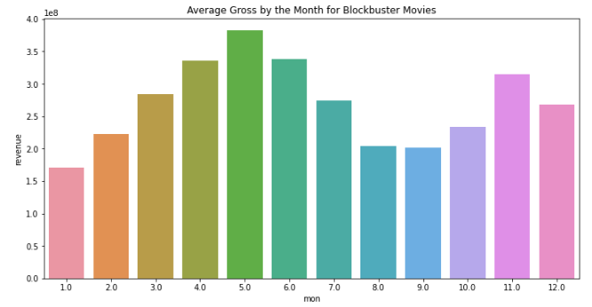
EDA

Slide 13
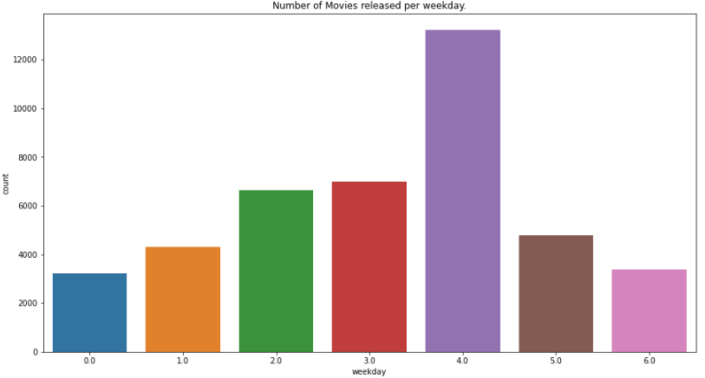
EDA

Slide 14
Basic Recommender

Slide 15
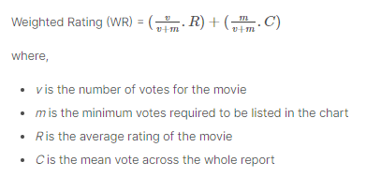
Basic Recommender
Recommendation based on popularity and genre.
> popularity and > critically acclaimed = + probability.
95% percentile.
C = 5.24 avg rating out of 10
m = 434 votes
total movies that qualify = 2 274
Notes:
# Accuracy: how good we were in recognizing positive and negative
# Precision: how correct the classifier is
# Recall: how complete the classifier is
# F-Score: combination of presition and recall

Slide 16
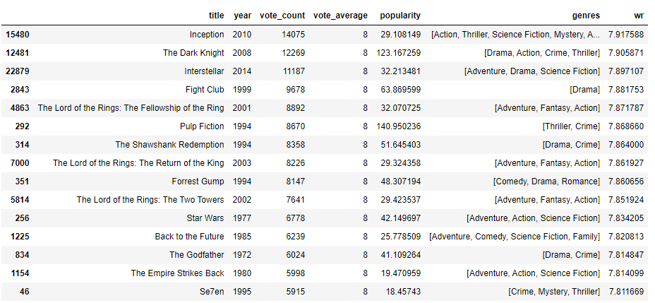
Basic Recommender
Top 10 movies with this criteria
Notes:
# Accuracy: how good we were in recognizing positive and negative
# Precision: how correct the classifier is
# Recall: how complete the classifier is
# F-Score: combination of presition and recall

Slide 17
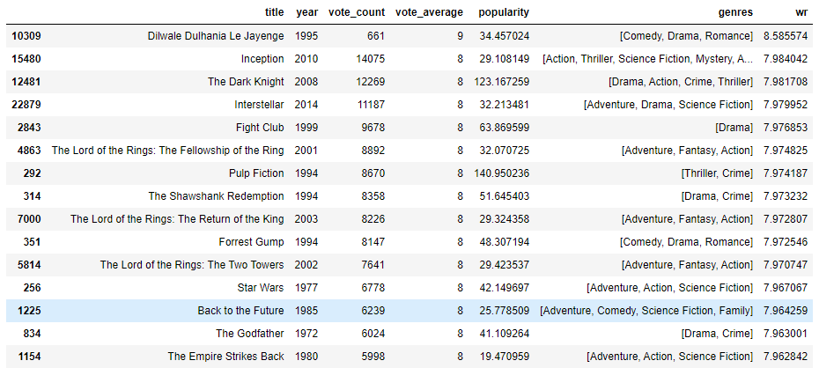
Basic Recommender
Top 10 movies with this criteria with 85% percentile.
Notes:
# Accuracy: how good we were in recognizing positive and negative
# Precision: how correct the classifier is
# Recall: how complete the classifier is
# F-Score: combination of presition and recall

Slide 18
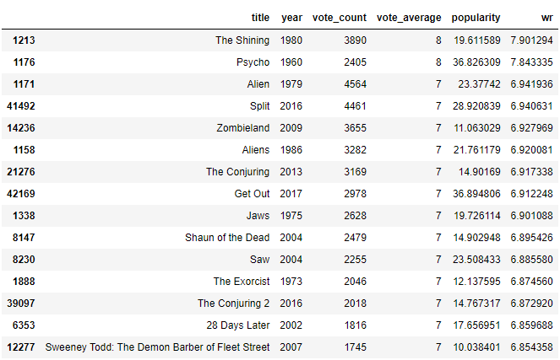
Simple Recommender
Horror genre recommendations
Notes:
# Accuracy: how good we were in recognizing positive and negative
# Precision: how correct the classifier is
# Recall: how complete the classifier is
# F-Score: combination of presition and recall

Slide 19
Limitations of Our Basic Recommender
Same recommendation to every user
No consideration of cast
Notes:
# Accuracy: how good we were in recognizing positive and negative
# Precision: how correct the classifier is
# Recall: how complete the classifier is
# F-Score: combination of presition and recall

Slide 20
Content Based Recommender

Slide 21

Content Based Recommender
Movie Description and Tags
Cast, Director, Keywords, Genre
Cosine Similarity
Measure of similarity between two sequences of numbers
The sequences are viewed as vectors in an inner product space
Similarity is defined as the cosine of the angle between them
Linear Kernel is equivalent to cosine similarity if vectors are normalized using tf-idf (Faster)

Slide 22


TF-IDF
Short term for frequency–inverse document frequency
How important a word is to a document in a collection
Term Frequency
Inverse Document Frequency
Numerator is the number of times that term t occurs in document d
Denominator is simply the total number of terms in document d
N : total number of documents in the sample
Denominator is the number of documents where the term t appears

Slide 23
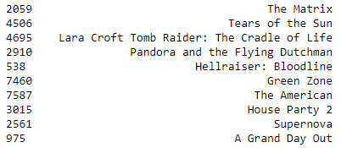
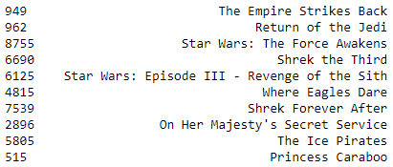
Description - Content Recommender
Recommendations for: Avatar
Recommendations for: Star Wars

Slide 24
Cast and Keywords based Content Recommender

Slide 25
Feature Selection
Crew : Pick the director
Cast : Pick only the top 3 actors appeared
Assign more weightage to Director to get more similarity
Director x3
Movies
Count Vectorizer
Cosine Similarity
Stemmer
Remove spaces

Slide 26
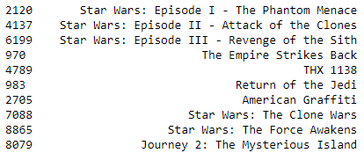
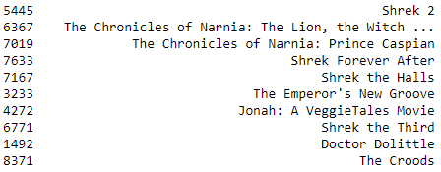
Vectorizer
Recommendations for: Shrek
Recommendations for: Star Wars

Slide 27
Conclusion
Basic Recommender:
This system used overall TMDB Vote Count and Vote Averages to build Top Movies Charts, in general and for a specific genre.
Content Based Recommender:
We built two content based engines; one that took movie overview and taglines as input and the other which took metadata such as cast, crew, genre and keywords to come up with predictions.

Slide 28
THANK YOU
Saffian
Emilio

