Slide 1
Adiabatic PFR Design
Math Project-2
Advay Shirwalkar

Slide 2

AGENDA
Introduction
Mathematical Model
Assumption
Model Fitting
Sensitivity Analysis
Bifurcation analysis

Slide 3
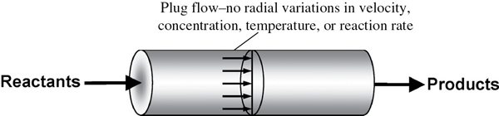
INTRODUCTION
The aim is to design an adiabatic plug flow reactor (q=0) and determining the molar flowrate of each constituent in the stream and temperature profile over the length of the reactor.

Slide 4
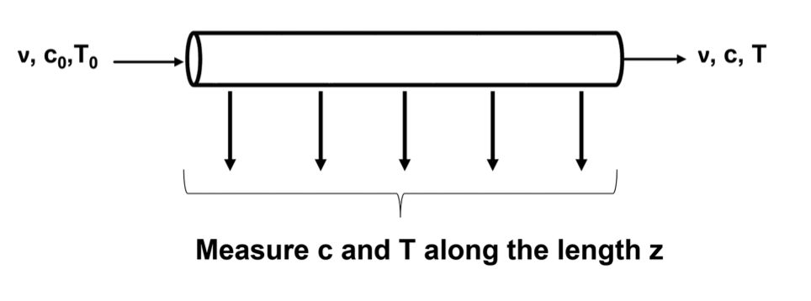
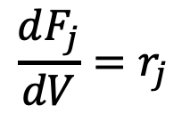
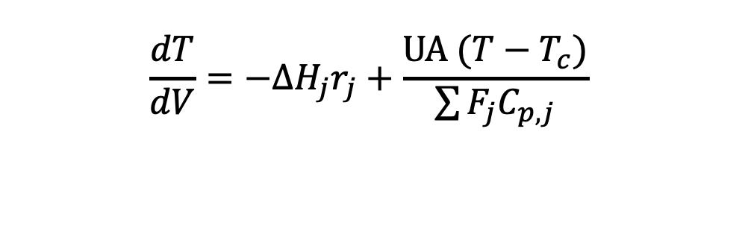
Mathematical Model
Mole balance equation of species j
$$\frac{dF_{j}}{dV}=r_{j}$$
Heat balance equation for the reactor
$$\frac{dT}{dV}={−ΔH_{j}r}_{j}+\frac{UA (T−T_{c})}{\sum{F_{j}C_{p,j}}}$$

Slide 5

Assumptions.​
Perfect Plug flow reactor is assumed.
Heat Capacities is assumed constant.
Heat of reaction is assumed constant.

Slide 6
PRIMARY GOALS
Model fitting
Sensitivity Analysis
Bifurcation analysis

Slide 7
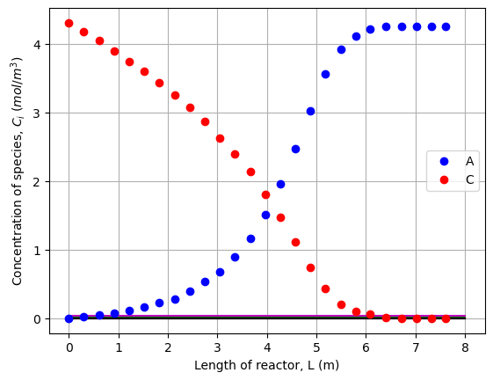
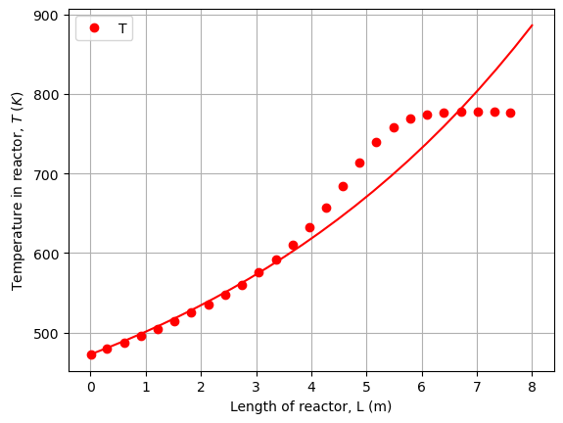
Model Fitting

Slide 8
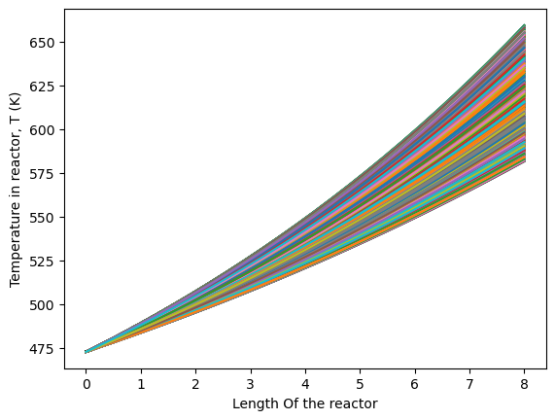
Sensitivity Analysis
Change in U-value affects T largely
T in reactor is function of U (Heat transfer coefficient of coolant)

Slide 9
Bifurcation Analysis
Great U, more fast the T profile will drop
This bifurcation analysis validates T in reactor is function of U (Heat transfer coefficient of coolant)

Slide 10
Conclusion
It would be more essential to have a control over the temperature in reactor (T) as it can help maximize the conversion in the given reactor volume.
It’s also important to control temperature, when the product is temperature sensitive and can degrade at high T.

Slide 11
THANK YOU
Advay Shirwalkar
ads288@pitt.edu

