Slide 1
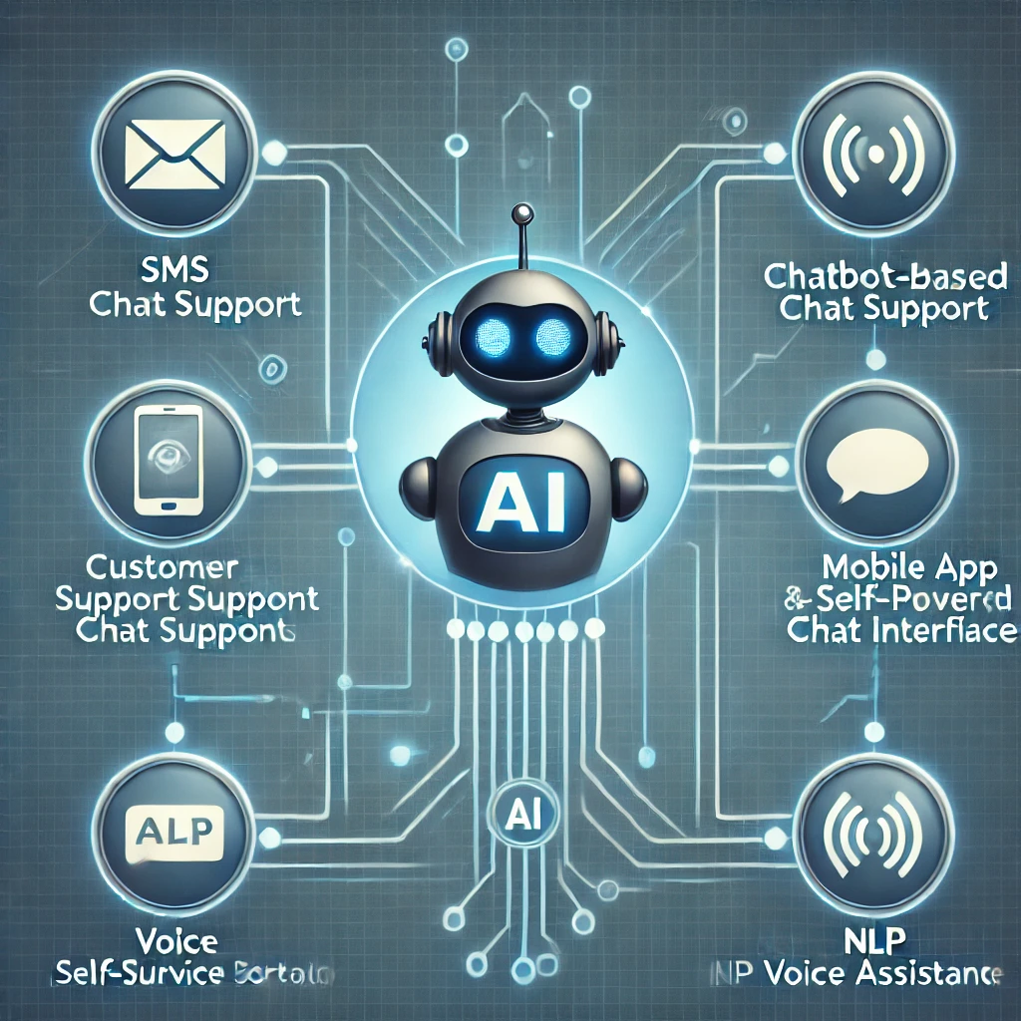
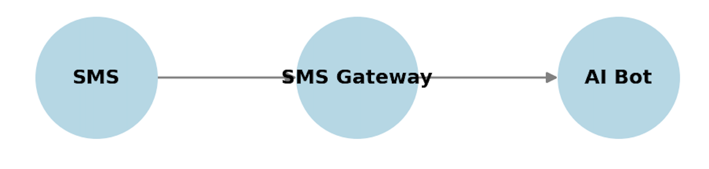
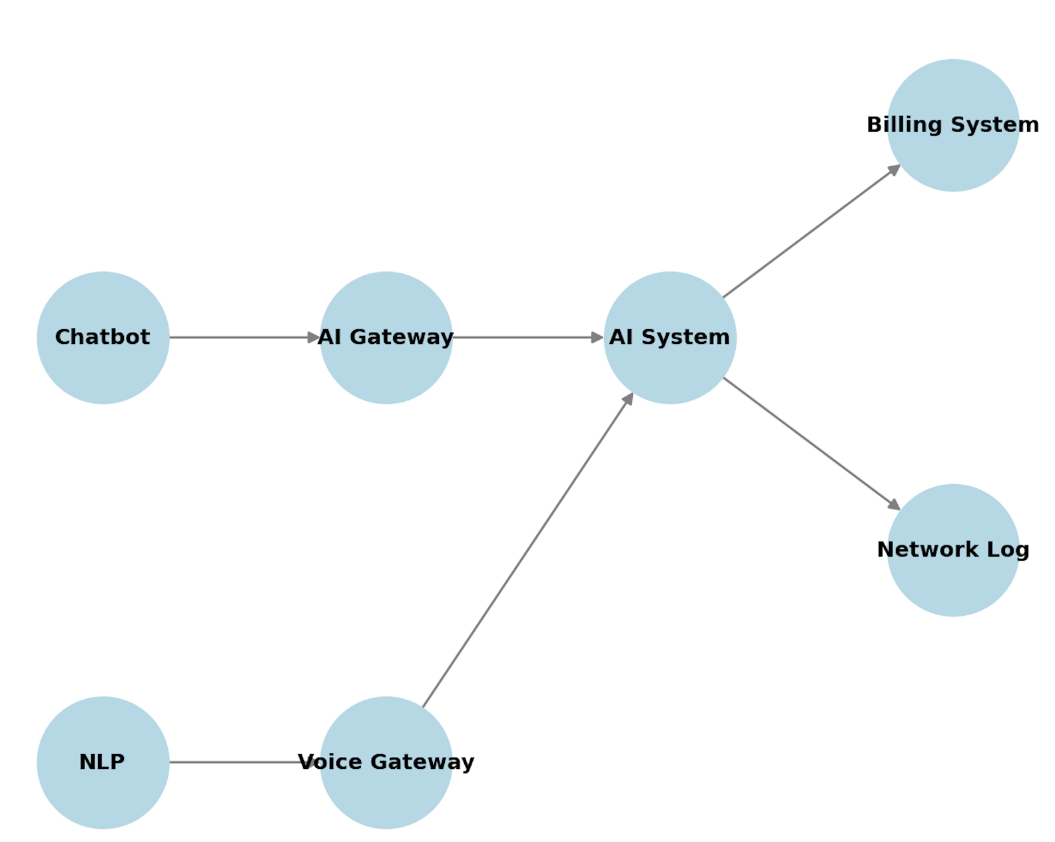
Transforming Telco Customer Support in Sub-Saharan Africa with AI
Problem to be Addressed:
Long wait times and lack of 24/7 support
High cost human agents
Minimize human errors
Key Areas of Improvement:
Technical troubleshooting
Billing inquiry resolution
Service plan recommendations
Network performance reporting
Proposed AI Solutions:
AI Chatbots for Self-Service Support (available via WhatsApp, SMS, and mobile apps)
Natural Language Processing (NLP) Voice Assistants (handling vernacular/local language queries)
Automation of SIM Activation, KYC Verification & Balance Inquiries
Notes:
Billing inquiry – pay as you go vs monthly subscription
Service plan recommendations when someone’s contract is ending.

Slide 2
Business Impact:
24/7 customer support availability
Lower operational costs by reducing dependency on human agents
Faster issue resolution and improved customer satisfaction
Use Cases:
AI-Powered Chatbots: Handle billing issues, plan upgrades, and troubleshooting (e.g., Vodafone’s TOBi bot)
Personalized Plan Recommendations: Based on user behavior & data usage (e.g., Airtel’s AI assistant auto-resolving 50%+ of customer queries)
Key Benefits:
Enhanced customer experience & reduced response times
Personalized interaction pathways & consistent communication standards
Multi-channel support capabilities (WhatsApp, SMS, Web, Apps)
Operational efficiency & reduced support costs
Scalable service capabilities & intelligent ticket prioritization
Competitive market differentiation & continuous performance improvement
Key Performance Indicators (KPIs):
Service Level & Net Promoter Score (NPS) Improvement
Reduction in Customer Support Operational Costs
Increase in First-Contact Resolution Rates
Higher Customer Satisfaction Scores
Lower Cost per Customer Interaction
Improved Customer Retention Metrics

Slide 3
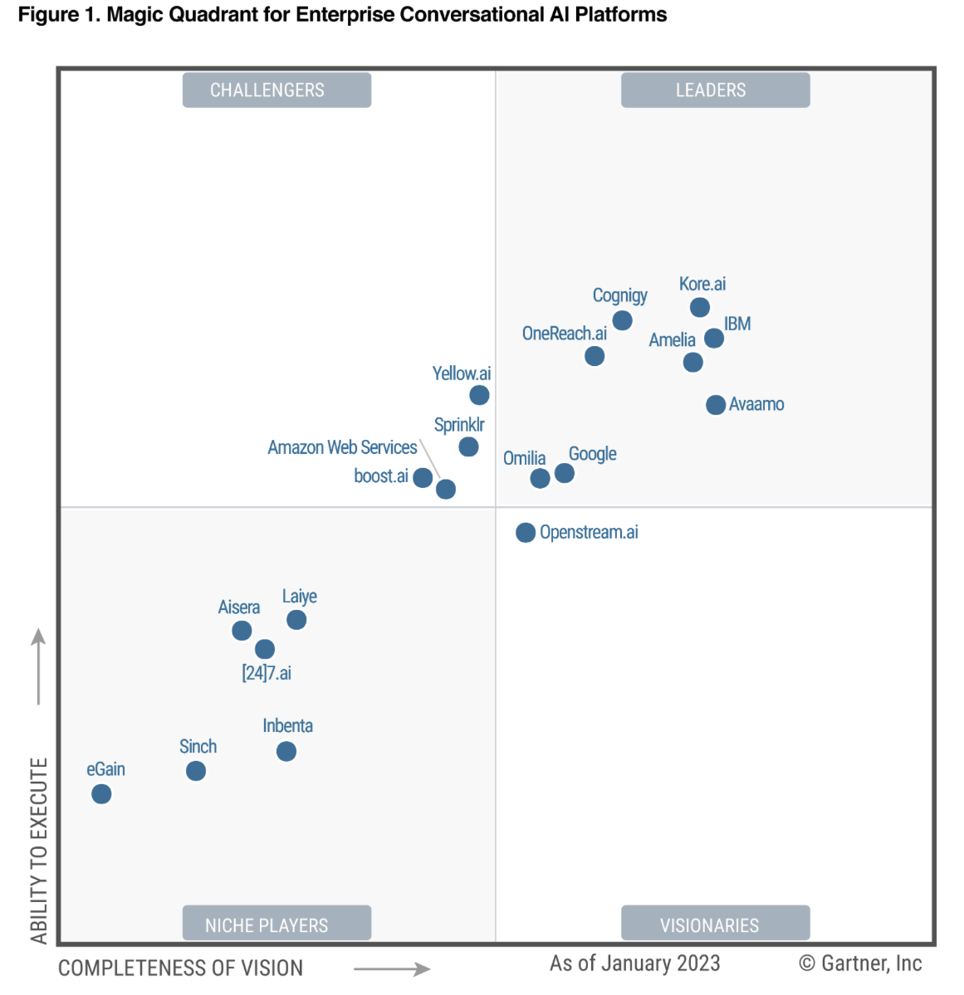
Implementation Strategies:
Conduct a comprehensive needs assessment
Select adaptable and scalable AI solutions
Ensure seamless integration with existing telco infrastructure
Implement continuous learning mechanisms for AI improvement
Maintain human oversight and intervention where necessary
Conduct pilot programs for AI customer support before full deployment
Train support personnel to enhance AI-human collaboration

