Slide 1
Cross-Site Harmonization for Kidney Transplant Outcome Prediction

Slide 2
Problem
• Donor renal biopsy whole-slide images (WSIs) yield quantitative pathomics features that can predict transplant outcomes.
• Data is collected across multiple clinical sites ( UC Davis, Coimbra, Mayo Clinic ) each with different scanners, tissue processing, and staining protocols.
• These site-level differences create batch effects that confound features and degrade model generalization across institutions.
• Models trained on one site often fail to transfer to another, limiting clinical utility of pathomics-based prediction.

Slide 3
Methods
• Goal: build models that predict transplant outcomes and generalize across clinical sites.
• Outcomes: eGFR at 12 months (regression) and delayed graft function / DGF (binary classification).
• Approach: apply and compare batch harmonization methods (Z-Score, RAVEL, CORAL, CovBat, ComBat) before model training.
• Critical test: leave-one-out (LOO) cross-cohort validation — train on 2 sites, harmonize and evaluate on a held-out 3rd site, simulating deployment to a new institution.
• Models compared: Elastic Net, Lasso, Ridge, Random Forest, XGBoost.

Slide 4
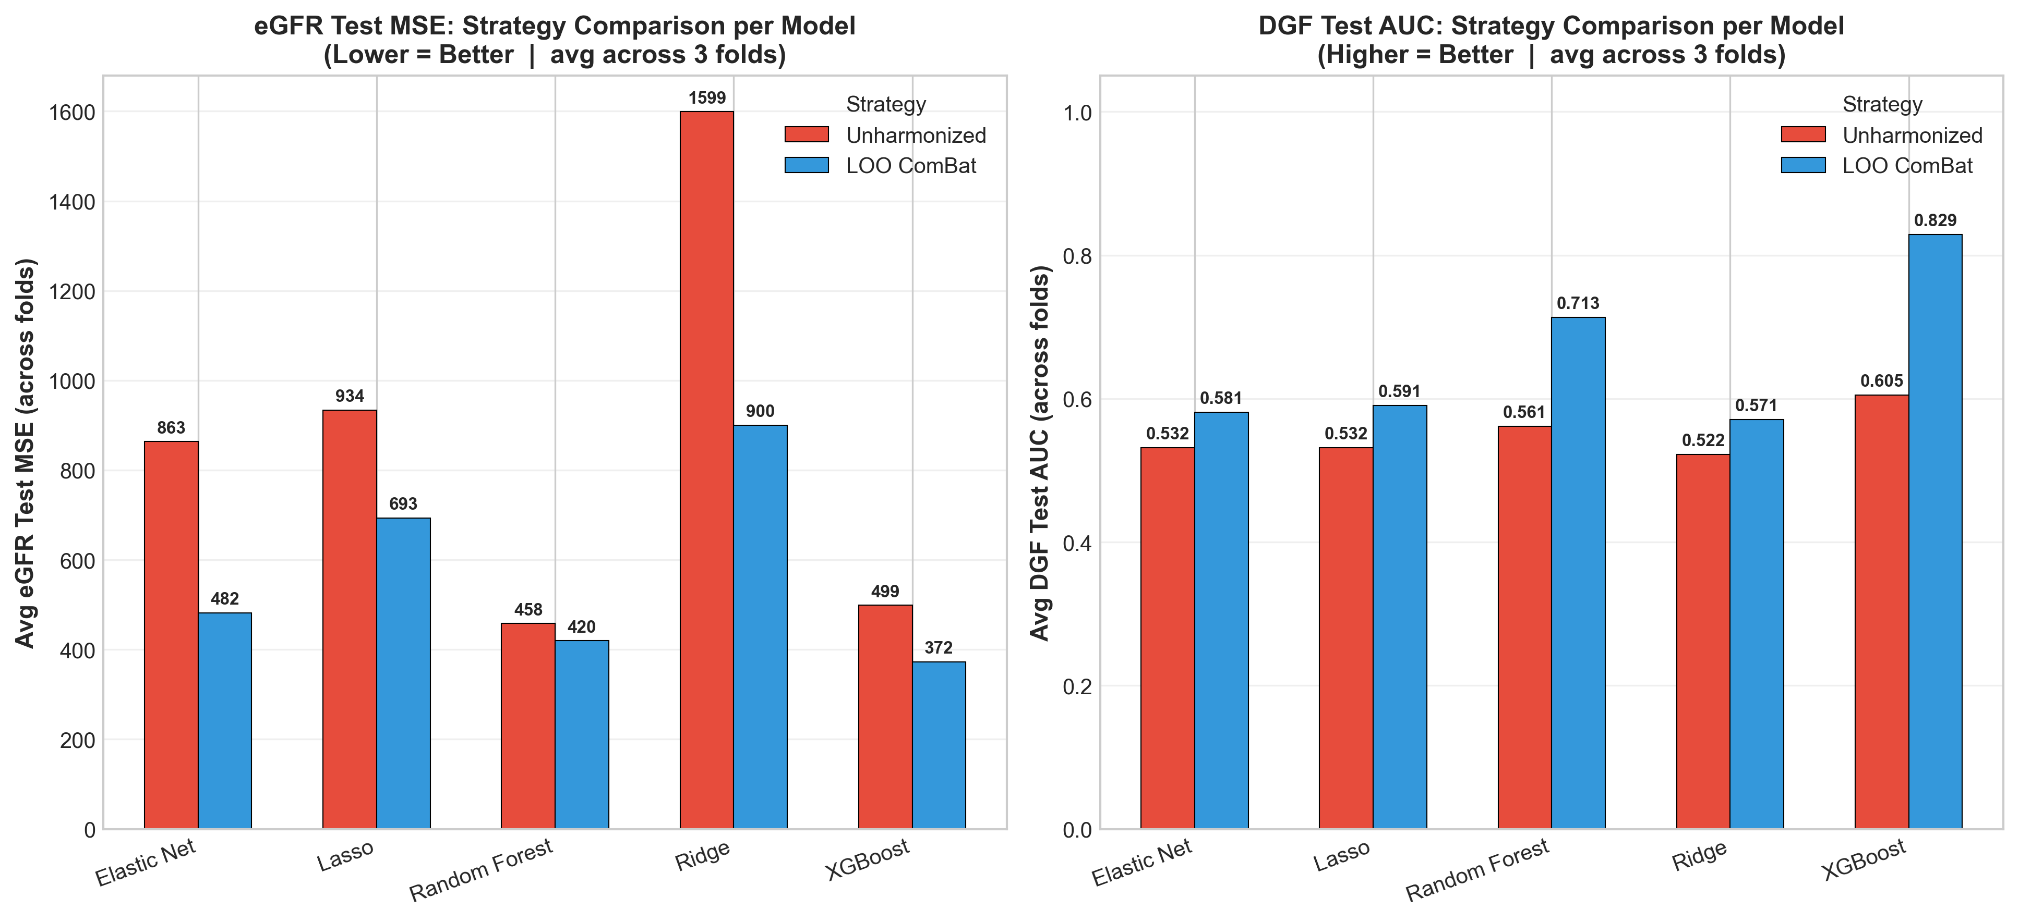
LOO Cross-Cohort Performance
LOO ComBat improves every model. Best: XGBoost — eGFR MSE 372, DGF AUC 0.829.

Slide 5
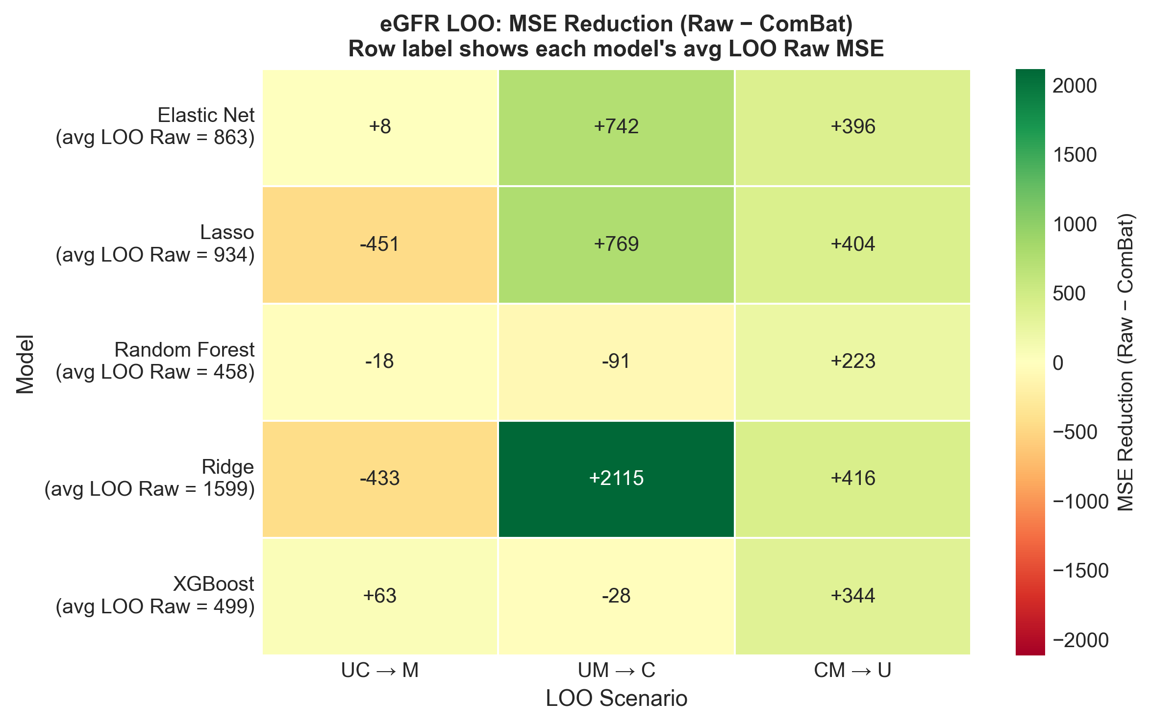
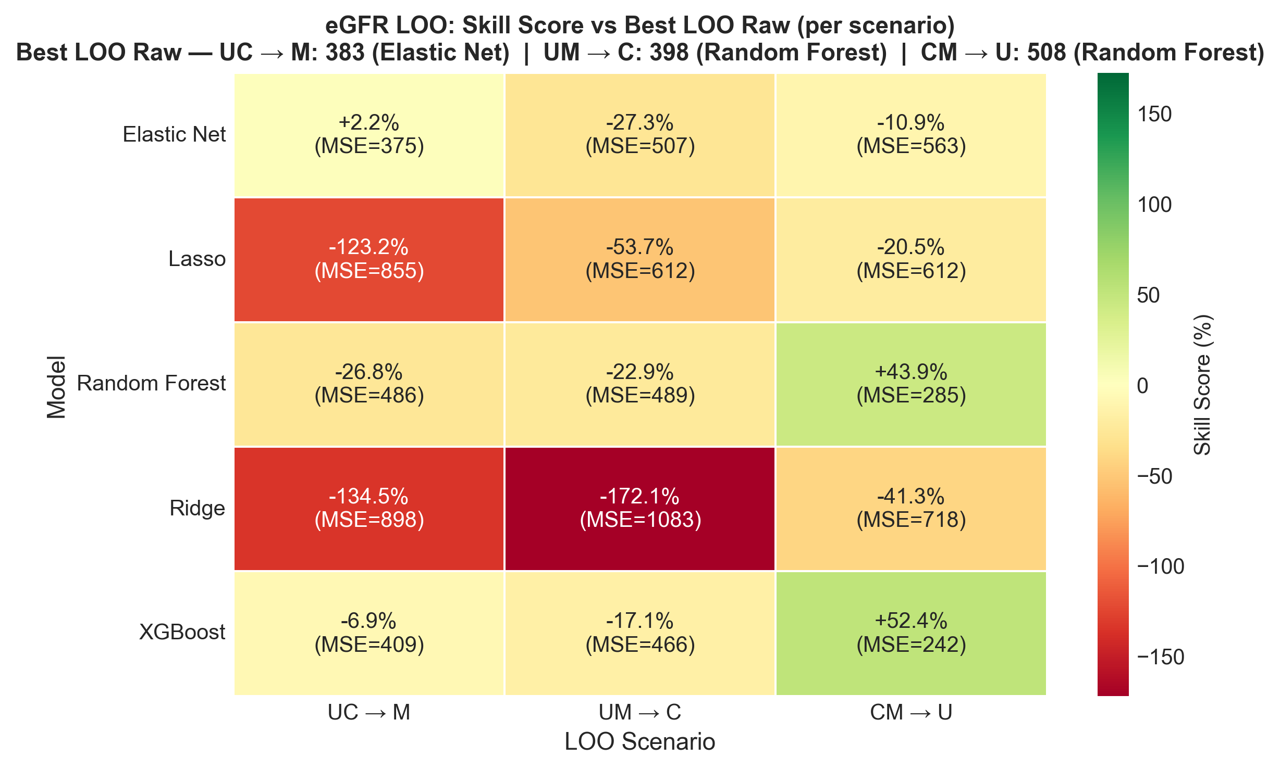
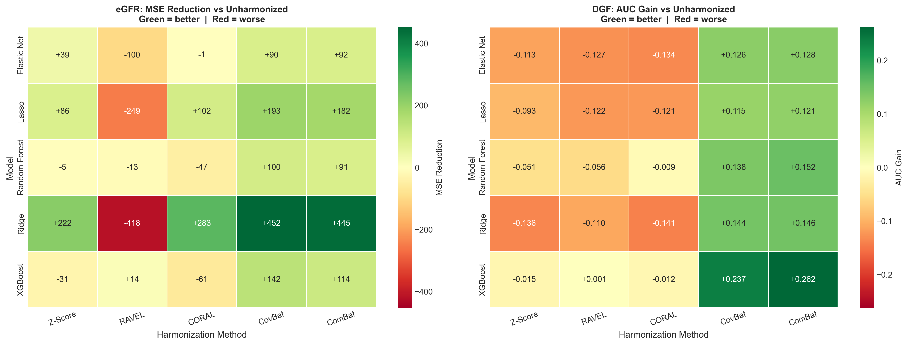
eGFR Per-Model Improvement — Two Baseline Views
Left: per-model baseline (each row labeled with its avg LOO Raw MSE). Right: skill score vs best LOO Raw model in each scenario (single shared baseline).

Slide 6
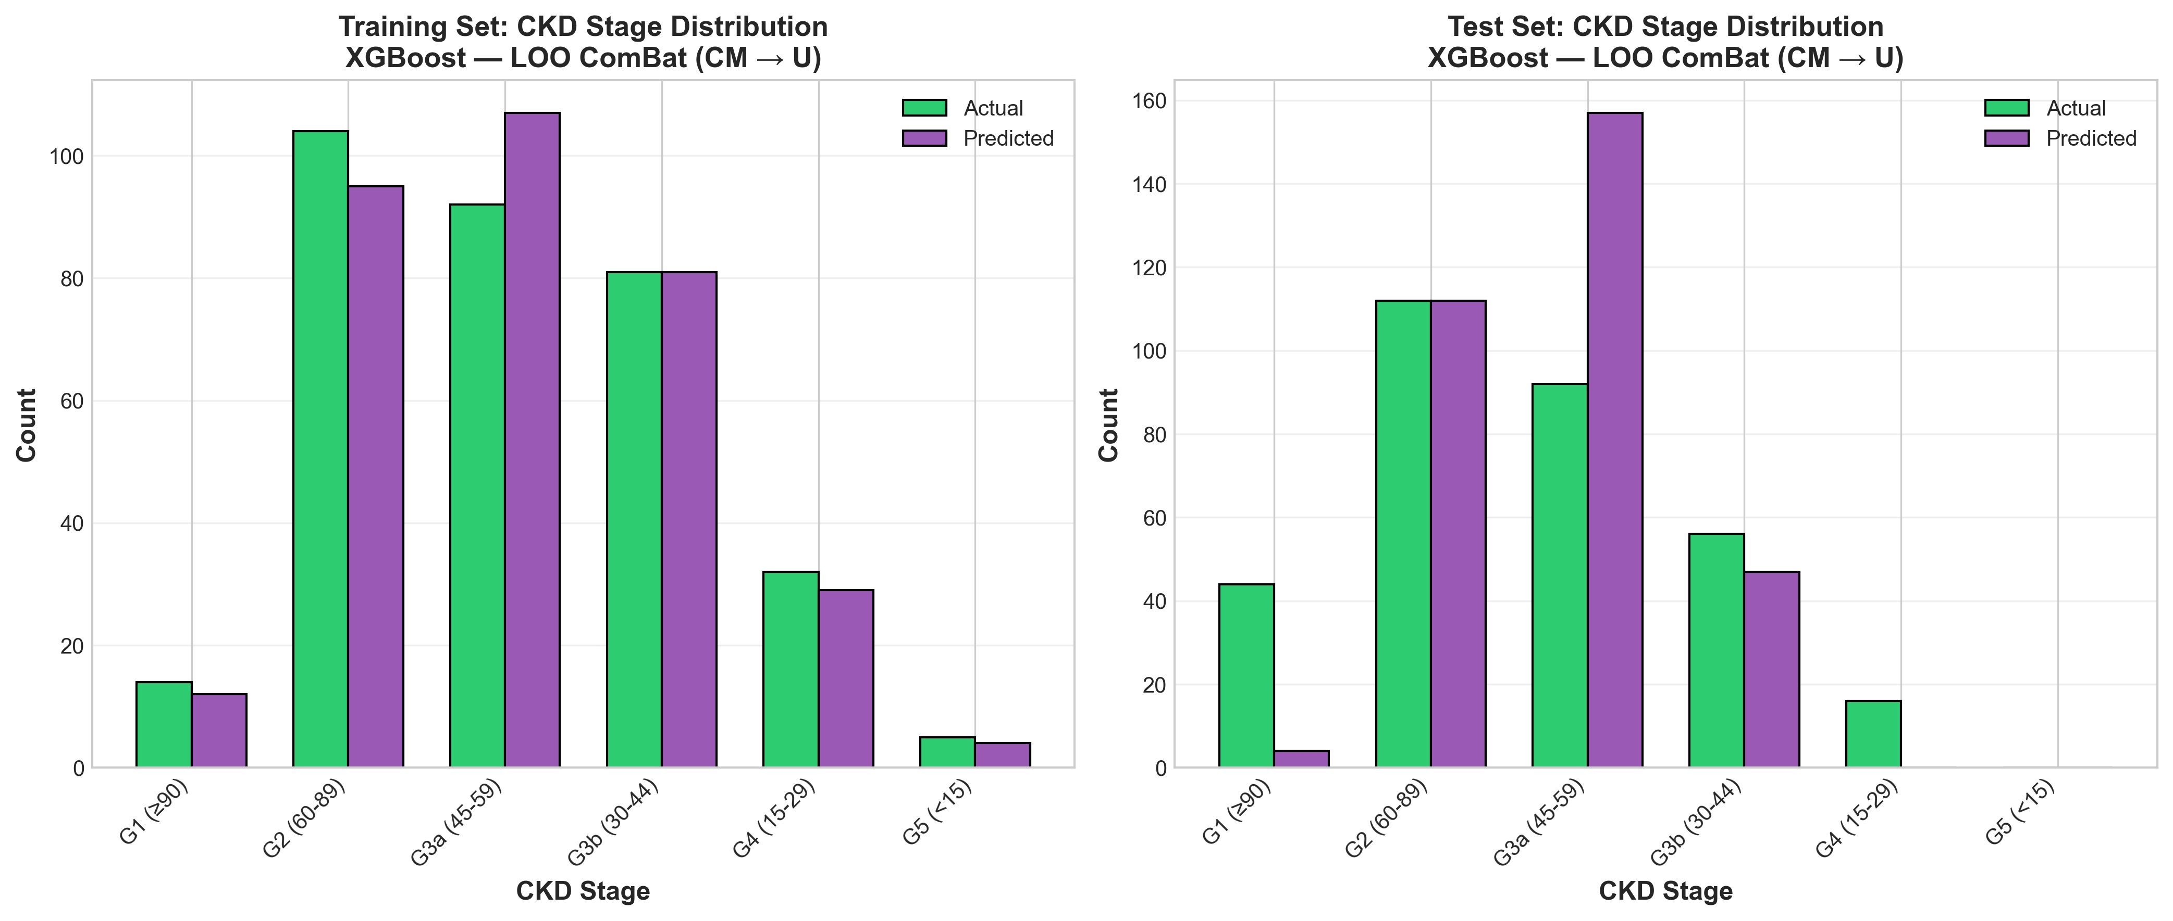
CKD Distribution
Distribution of CKD stages across UC Davis, Coimbra, and Mayo Clinic cohorts.

Slide 7
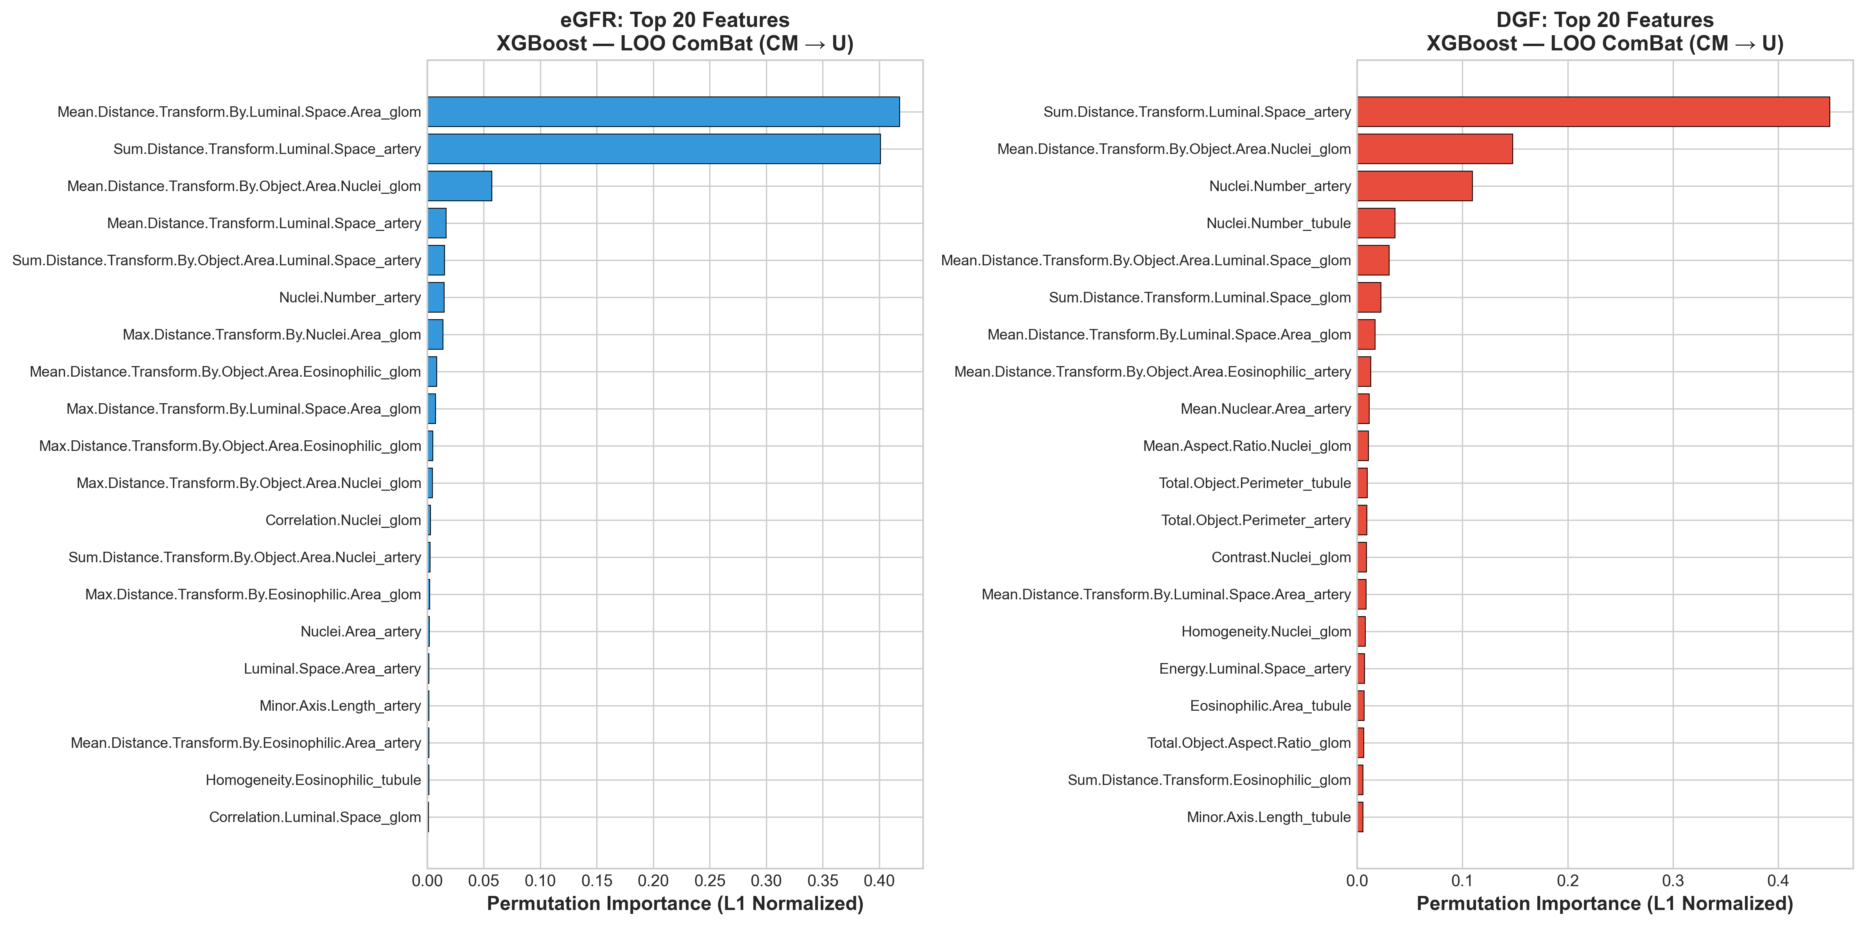
Feature Importance

