Slide 1

CODESTRATA
THEME 01 • TEAM CODESTRATA
CodeStrata
Code has
a memory.
v1 / HOLDS
connectDevice
await policyCheck();
v2 / AWAIT REMOVED
pairDevice
Find where behavior changed.
Keep the evidence. Watch what comes next.
policyCheck();
v3 / RESTORED
pairDevice
await policyCheck();
CPU ONLY
JAVASCRIPT + JSX
SOURCE + HISTORY
Vellore Institute of Technology (VIT University)
Advay Vivek / 24BCT0136
Kaavish Gogia / 24BCT0103
advay.vivek2024@vitstudent.ac.in
kaavish.gogia2024@vitstudent.ac.in
CODESTRATA / AGENTIC CODE INTELLIGENCE
01 / 18
Notes:
CodeStrata investigates how code behavior changes across versions. Our focus is a small change with a large effect on the evidence: a function moves, is renamed, and loses a direct await. We retrieve the relevant version, show the source that explains it, and save a repeatable behavior check. The default workspace runs locally on CPU.

Slide 2
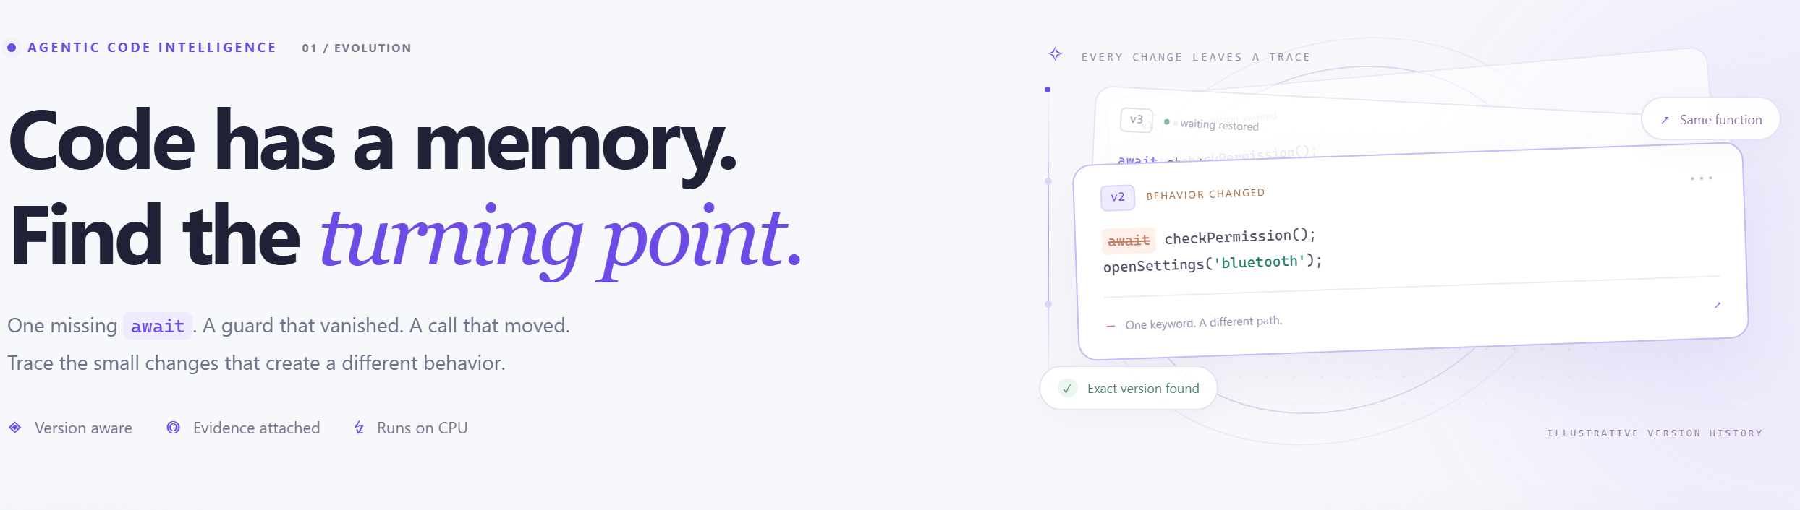
CODESTRATA
THEME • PROBLEM STATEMENT
The right code can be in the wrong version.
Names move, behavior shifts, and a near-identical result can hide the change that matters.
PROBLEM STATEMENT
“Where did device pairing stop waiting for policyCheck?”
Search may find a familiar name in the wrong version. One removed await can change the answer while the surrounding code stays similar.
THE ACTUAL WORKSPACE
Ask a behavior question. Inspect evidence across versions. Save the result as a rule.
A useful answer needs the version, the exact source, and a neighboring counterexample.
RETRIEVE → EXPLAIN → WATCH
CODESTRATA / AGENTIC CODE INTELLIGENCE
02 / 18
Notes:
The problem is not just finding a matching function name. After a refactor, a nearby version can be nearly identical while one direct await is removed. A useful answer should show the correct snapshot, exact source lines, and the nearby version that disagrees with the requested pattern. The screenshot on the right is the actual light workspace. CodeStrata turns this investigation into a saved behavior watch.

Slide 3
CODESTRATA
EXISTING SOLUTIONS & GAPS
One token can change the answer.
The gap we target: connecting a behavior question to the correct implementation in history.
01
Names can change
A moved or renamed function is harder to follow by symbol alone.
SAME CALL • DIFFERENT VERSION
v1 / devices/connect.js
02
Similar code can disagree
await policyCheck(device);
Two near-identical versions may differ in their direct await or call order.
v2 / flows/pair.js
03
A diff still needs context
policyCheck(device);
Reviewers need the source, version, and evidence behind an answer.
A removed direct await is inspectable evidence,
not proof of a runtime race.
CODESTRATA / AGENTIC CODE INTELLIGENCE
03 / 18
Notes:
Code search, version control, and investigation tools already exist. Our differentiation is their integration around behavior evidence. A symbol can move and change name while a one-token difference changes the answer. We show why a nearby version conflicts with the question, without claiming that static syntax proves a runtime race.

Slide 4
CODESTRATA
OUR ANSWER
A complete evidence loop for code history.
A question becomes an inspectable finding, then a rule the reviewer can run again.
01
02
03
Find the right snapshot
Explain the difference
Keep the finding
Search across indexed versions, even when a function moved or changed its name.
Show source lines, static evidence, the linked version, and a counterexample.
Pin a structural rule and recheck the same conservative lineage later.
QUESTION → VERSION-AWARE SEARCH → SOURCE-BACKED ANSWER → BEHAVIOR WATCH
CODESTRATA / AGENTIC CODE INTELLIGENCE
04 / 18
Notes:
Our proposed answer joins four jobs that are usually separate: retrieve across versions, inspect evidence from source, compare the nearby conflicting version, and save a rule for later review. Each finding keeps the version and file location visible. The system is a local JavaScript and JSX analysis workflow, not a code execution or automatic repair engine.

Slide 5
CODESTRATA
OUR SOLUTION & ARCHITECTURE
From Git history to behavior evidence.
Cached analysis feeds a bounded search policy and a repeatable watch workflow.
Git snapshots
Babel AST facts
Cached index + graph
01 INDEX
Exact source + versions
Calls, awaits, guards
BM25 + CPU vectors • lineage + imports
Question → plan
Retrieve → refine
Inspect → explain
02 INVESTIGATE
Supported constraints
Bounded local agent
Source, counterexample, decision trace
Pin a static rule
Follow one lineage
Review states → export
03 WATCH
Anchor ID + source hash
Check linked snapshots
Holds • broken • unknown • unlinked
CODESTRATA / AGENTIC CODE INTELLIGENCE
05 / 18
Notes:
Indexing extracts functions and facts, builds cached lexical and vector representations, and constructs conservative lineage and import links. The deterministic policy parses supported constraints, retrieves candidates, inspects evidence, and expands within a budget. The default budget is three rounds and 120 candidates. Counterexamples are checked after ranking. Watches follow the pinned lineage and export evidence; they do not run background monitoring.

Slide 6
CODESTRATA
METHOD • INDEXING
Read the source once. Reuse the evidence.
The index preserves executable facts separately from the text used for retrieval.
1
2
3
Load snapshots
Parse functions
Build candidates
Read the working tree or selected Git history and retain version, path, and exact source.
Babel records calls, direct awaits, guards, literals, imports, and source locations.
Cache lexical postings, CPU vectors, import links, and conservative lineage.
Trust boundary: repository code is read and analyzed; it is never executed during indexing.
CODESTRATA / AGENTIC CODE INTELLIGENCE
06 / 18
Notes:
Indexing is a deterministic preprocessing stage. Babel extracts exact function source and supported static facts. Search text includes names and leading documentation, but evidence about awaits, guards, calls, and order comes from syntax. Cached analysis includes analyzer identity, while vector caches include model identity and exact input. Reindexing refreshes the evidence. The repository is not executed.

Slide 7
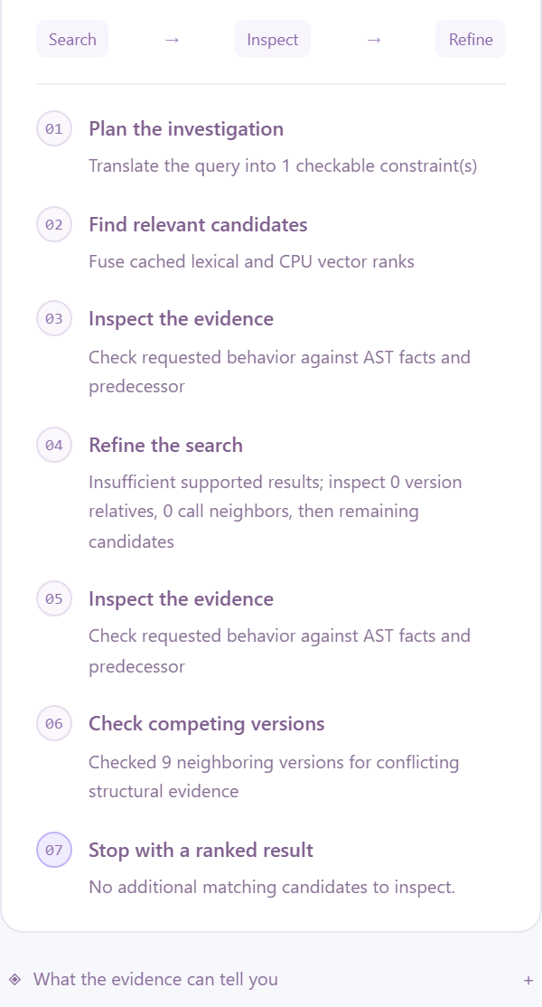
CODESTRATA
METHOD • BOUNDED AGENT
The agent decides what to inspect next.
It records a real search policy instead of generating an unsupported answer.
1
PLAN
Parse the supported structural question; warn when phrasing exceeds the analyzer.
2
RETRIEVE
Fuse cached BM25 and CPU vector ranks to form a candidate list.
3
INSPECT
Test candidates for support, contradiction, or uncertainty from source facts.
4
EXPAND
Follow linked versions or resolved imports when the first pass is insufficient.
5
STOP
Return evidence when sufficient, exhausted, canceled, or over budget.
Budget: 3 rounds • 120 candidates.
CODESTRATA / AGENTIC CODE INTELLIGENCE
07 / 18
Notes:
The agent here is a deterministic bounded policy, not a hosted language model. It parses the question, fuses BM25 and vector ranking, inspects static facts, expands to historical or imported neighbors when needed, and stops under a fixed budget. The screenshot is its live decision trace. Counterexamples are inspected within the candidate budget; they explain the output but do not select or rerank it.

Slide 8
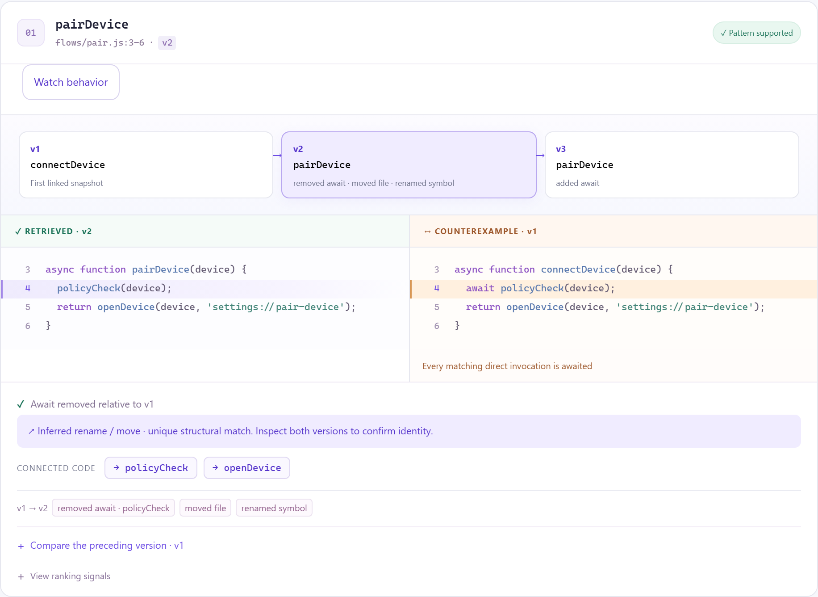
CODESTRATA
DEMO & PRODUCT WALKTHROUGH
An answer you can inspect.
The agent retrieves a version, checks its static facts, then shows the source that supports and contradicts it.
1
Find pairDevice @ v2
Open exact source and line numbers.
2
Compare connectDevice @ v1
Inspect the inferred rename / move.
3
Follow policyCheck
Navigate the resolved imported helper.
VIDEO URL: [TEAM TO ADD AFTER RECORDING · 5 MIN MAX]
CODESTRATA / AGENTIC CODE INTELLIGENCE
08 / 18
Notes:
In the live application, click Investigate the refactor. The top result is pairDevice at v2. Point to the removed direct await and compare connectDevice at v1. The relationship is labelled an inferred rename or move. Open the imported policyCheck helper, then return to the result. This screenshot is captured from the actual application. Insert the final recording link in the reserved field.

Slide 9
CODESTRATA
METHOD • LINEAGE
Follow a refactor without inventing identity.
A rename or move is linked only when the structural match is strong and unambiguous.
v1 / connectDevice
v2 / pairDevice
v3 / pairDevice
await policyCheck(device);
policyCheck(device);
await policyCheck(device);
HOLDS
DIRECT AWAIT ABSENT
HOLDS
How links are proposed
When we refuse a link
Same-file identity first; unmatched functions use normalized AST structure and call-target overlap.
Competing matches, copies, deletion gaps, and major refactors remain unresolved rather than guessed.
CODESTRATA / AGENTIC CODE INTELLIGENCE
09 / 18
Notes:
The demonstration links v1 connectDevice to v2 pairDevice despite a move and rename, then to v3 where the direct await is restored. Matching uses conservative evidence from normalized AST structure and call targets. It intentionally omits the await wrapper for identity matching, so the behavior change can remain visible in evidence inspection. In ambiguous cases CodeStrata leaves history unlinked. An inferred link is not a formal proof of identity.

Slide 10
CODESTRATA
TOOLS & TECH STACK
How the investigation actually runs.
A deterministic local policy records its search, inspection, expansion, and stop decisions.
01 SOURCE ANALYSIS
Babel parser
Extract functions, direct awaits, calls, guards, literals and exact source locations.
LIVE AGENT TRACE
02 CANDIDATE SEARCH
BM25 + vectors
Use cached lexical postings and CPU vector rank fusion to retrieve likely functions.
03 EVIDENCE CHECK
Bounded agent
Inspect supported, contradicted, or uncertain patterns; expand when needed.
04 REVIEWABLE OUTPUT
Node.js + browser
Stream the real decision trace, show source, and follow linked helpers.
Default: offline feature hashing • Optional: BGE / Jina Code / MiniLM q8
CODESTRATA / AGENTIC CODE INTELLIGENCE
10 / 18
Notes:
Babel extracts supported static facts with exact locations. BM25 and vector ranks retrieve candidates, and the deterministic policy checks evidence, expands linked versions or imports within a budget, and stops. The screenshot is a real trace of those decisions. The default representation is deterministic feature hashing; quantized BGE, Jina Code, and MiniLM are optional CPU encoders. No hosted model or repository execution is required for the default workspace.

Slide 11
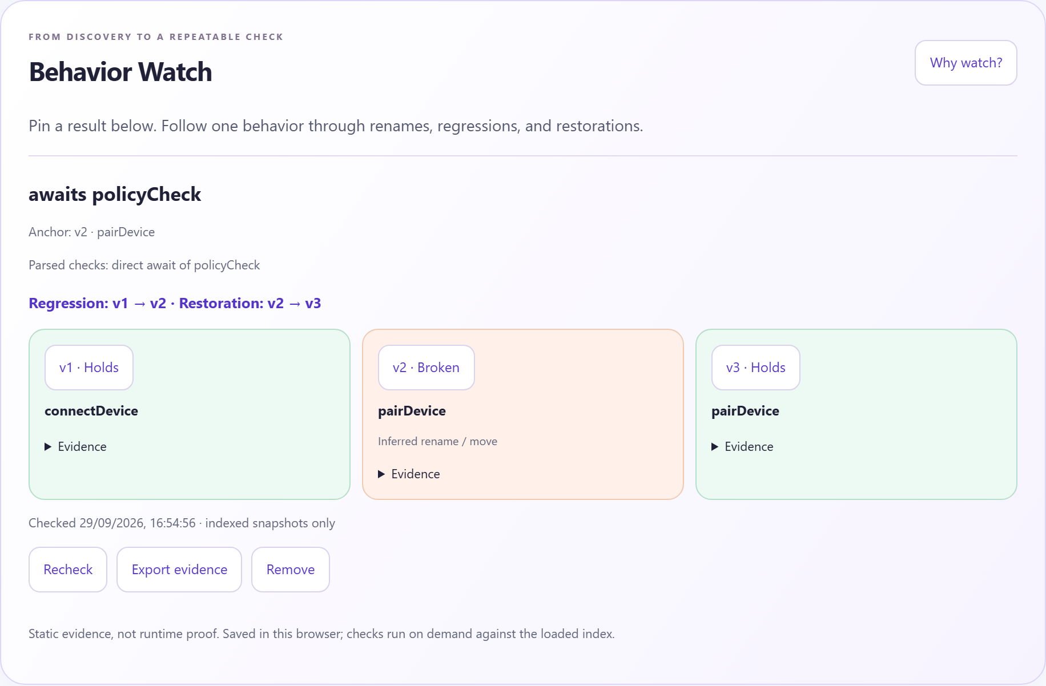
CODESTRATA
DIFFERENTIATION • BEHAVIOR WATCH
A discovery becomes a saved rule.
Pin “awaits policyCheck” and follow the same function through its linked history.
One pinned lineage
The check stays attached to the function through supported links.
Uncertainty stays visible
Ambiguous history and unsupported syntax remain unverified.
Evidence you can export
Save source, versions, parsed checks, and lineage confidence as JSON.
CODESTRATA / AGENTIC CODE INTELLIGENCE
11 / 18
Notes:
Behavior Watch is the distinguishing follow-through. Pin the result, save awaits policyCheck, and show v1 holds, v2 broken, v3 holds. Broken means the static rule is contradicted, not that a runtime failure is proved. Watches save in this browser and run on demand against the loaded index. Reindex and restart to include new source. Export the report to retain the evidence.

Slide 12
CODESTRATA
DIFFERENTIATOR • BEHAVIOR WATCH
A saved rule tells a longer story.
The same static question is checked across linked snapshots, with gaps kept visible.
v1
v2
v3
HOLDS
BROKEN
HOLDS
The direct await is present in the source.
The pinned static rule is contradicted.
The direct await is present again.
Unknown and unlinked are first-class outcomes.
Ambiguous gaps stay unresolved. Recheck on demand and export the source-backed report.
CODESTRATA / AGENTIC CODE INTELLIGENCE
12 / 18
Notes:
Behavior Watch is the project’s follow-through. The pinned anchor has a version, ID, and content hash. The rule is checked over its supported lineage, up to 200 snapshots, and each point retains source and evidence. Holds, broken, unknown, and unlinked are distinct. The v1-v2-v3 example shows regression and restoration only because adjacent points have explicit support or contradiction. Watches are browser-stored and checked on demand, not a background service. A failed recheck discards stale exportable evidence.

Slide 13
CODESTRATA
IMPACT & USE CASES
Less history to reconstruct by hand.
Designed for reviewers investigating a specific behavior change.
01
02
03
Refactor review
Regression triage
Version migration
Follow a function after a rename or move.
Inspect whether its await pattern changed.
Locate a changed guard or invocation order.
Compare the neighboring source version.
Pin a rule before moving versions.
Recheck it across the loaded history.
DISCOVER → INSPECT → PIN A RULE → RECHECK
CODESTRATA / AGENTIC CODE INTELLIGENCE
13 / 18
Notes:
These are intended workflows, not measured productivity claims. A reviewer can follow refactored code, a developer can inspect a changed static pattern, and a migration review can retain a saved behavior rule. The value is that locations, versions, and uncertainty remain attached to the finding.

Slide 14
CODESTRATA
INNOVATION, RESULTS & LIMITATIONS
Three evaluations. Three different claims.
Measured results are presented with their scope and raw artifacts.
CONTROLLED VERSIONS
REAL REPOSITORIES
FULL APPSRETRIEVAL
8 / 8
0.67 / 0.86
0.1571
Correct top result
NDCG@10 · Async / Express
NDCG@10 · Jina Code q8
25 demo snippets + 1,000 distractors.
Synthetic development queries.
BGE hybrid; 60 source-reviewed,
AI-assisted labels.
3,765 queries / 8,765 Python items.
Independent encoder evaluation.
Full-test BGE baseline: 0.0505 NDCG@10 | Jina MRR@10: 0.1337
Limits: JS/JSX analysis • restricted query phrasing • heuristic lineage • no runtime proof.
AppsRetrieval does not evaluate version reranking. Scores across these sets are not comparable.
CODESTRATA / AGENTIC CODE INTELLIGENCE
14 / 18
Notes:
The controlled challenge shows 8 of 8 correct top results on development examples. The separate Async and Express queries use partial, AI-assisted labels. The full AppsRetrieval test is independent encoding of Python tasks and solutions: Jina achieved NDCG at ten of 0.15711 versus BGE at 0.0505, with Jina MRR of 0.133675. It does not validate historical reranking. Raw outputs are in docs/results; avoid presenting the controlled score as broad accuracy.

Slide 15
CODESTRATA
EVALUATION • WHAT EACH RESULT PROVES
Three tests answer three different questions.
The strongest claim is specific: inspectable version discrimination in a controlled example.
Controlled history
8 / 8 top-1
Does evidence reranking choose the intended version in development queries?
Pinned real repos
0.6717 / 0.8577
Can BGE hybrid retrieve source-reviewed targets in Async / Express?
Official AppsRetrieval
0.15711 NDCG@10
How does independent Jina code encoding rank Python task solutions?
Do not combine these scores or describe static evidence as runtime proof.
CODESTRATA / AGENTIC CODE INTELLIGENCE
15 / 18
Notes:
The evaluations are deliberately separate. Eight of eight is the correct top result for controlled synthetic development queries, not an independent accuracy estimate. Async and Express are pinned single-snapshot repositories with partial AI-assisted labels; their BGE hybrid NDCG is 0.6717 and 0.8577. The official MTEB AppsRetrieval score of 0.15711 evaluates independent Jina encoding on Python questions and solutions, not historical evidence reranking. The BGE baseline there was 0.0505. These scores are not comparable as a single metric, and we do not claim runtime proof.

Slide 16
CODESTRATA
WHAT’S NEXT
The next evidence to earn.
A focused roadmap from the current prototype to broader use.
01
02
03
Independent evaluation
Broader code coverage
Measured scale
Human-labelled questions across real multi-commit histories.
Test rename ambiguity and missed links.
Extend parsing beyond JavaScript / JSX.
Improve paraphrase matching and supported static patterns.
Benchmark larger histories and repositories.
Add approximate retrieval only when justified.
Current boundary: bounded static analysis, local indexes, and explicit uncertainty.
CODESTRATA / AGENTIC CODE INTELLIGENCE
16 / 18
Notes:
Next we need independent labels on real multi-commit histories. Then we can broaden language and query coverage. Larger repositories need measured latency and memory budgets before changing the retrieval architecture. These are future directions, not completed capabilities.

Slide 17
CODESTRATA
CHECKLIST • VERIFIED IMPLEMENTATION
Built, tested, and ready to demonstrate.
Published commit 0d23fdc • verification completed 29 September 2026
92
9
Working prototype + public repository
READY
README + reproducible setup
Node tests passed
Browser checks passed
READY
Presentation + measured results
READY
CI: Linux + Windows + Docker
Chromium + Firefox + mobile
Python / Node encoder bridge
Demo video, maximum 5 minutes
LINK PENDING
github.com/AdvayV/AgenticIntelligence
CODESTRATA / AGENTIC CODE INTELLIGENCE
17 / 18
Notes:
The current implementation passed 92 Node tests and nine browser checks. The latest verified workflow passed on Linux and Windows, including Docker and the encoder bridge. The final audit covered constructor queries, computed awaits, nested branches, malformed options, and empty indexes. The public repository and setup are ready. The deck reserves the video URL for the team; the disclosure still requires human review and signature.

Slide 18
CODESTRATA
THANK YOU
Find the change.
Explain why.
Keep watch.
QUESTION
↓
EVIDENCE
↓
WATCH
CodeStrata makes code behavior
reviewable across versions.
github.com/AdvayV/AgenticIntelligence
Advay Vivek + Kaavish Gogia / Team CodeStrata
CODESTRATA / AGENTIC CODE INTELLIGENCE
18 / 18
Notes:
Close with the workflow: ask where behavior changed, inspect the source-backed explanation, and retain a repeatable watch. We welcome questions about the conservative lineage rules, the static evidence boundary, and the independent retrieval evaluations.

