Slide 1

有损压缩算法 Lossy Compression Algorithms

Slide 2
Outline
Introduction to Lossy Compression （有损压缩）
Distortion Measures （失真度量）
Quantization （量化）
Transform Coding （变换编码）

Slide 3
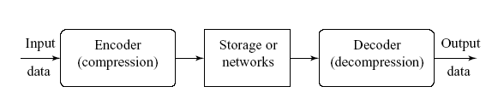
Introduction to Lossy Compression
What is lossy compression ?
The compressed data is not the same as the original data, but a close approximation of it.
Yields a much higher compression ratio than that of lossless compression.

Slide 4
Outline
Introduction to Lossy Compression （有损压缩）
Distortion Measures （失真度量）
Quantization （量化）
Transform Coding （变换编码）

Slide 5

Distortion Measures
Distortion Measures
– mean square error (MSE,均方差 ) σ ²,
where xn, yn, and N are the input data sequence, reconstructed data sequence, and length of the data sequence respectively.
– signal to noise ratio (SNR,信号噪声比 ), in decibel units (dB),
_{σ}2
SN R = 10 log₁₀
x
_{σ}2
d
σ² is the MSE.
均方
d
σ² is the average square value of the original data sequence
x
– peak signal to noise ratio (PSNR，峰值信噪比),
_{x}2
P SN R = 10 log₁₀
peak
_{σ}2
d

Slide 6
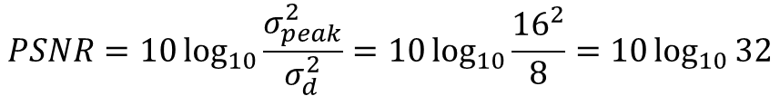
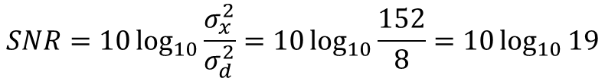
Distortion Measures
Example
A set of codes before compression are: 12, 16, 16, 12, 12, 8, 8, 12
After compression: 8, 12, 12, 12, 12, 8, 12, 12
Please give the MSE, SNR, PSNR
MSE
$σ_{d}^{2}=\frac{{(12−8)}^{2}+{(16−12)}^{2}+{(16−12)}^{2}+{(12−12)}^{2}+{(12−12)}^{2}+{(8−8)}^{2}+{(8−12)}^{2}+{(12−12)}^{2}}{8}$ =8
SNR
$σ_{x}^{2}=\frac{{(12)}^{2}+{(16)}^{2}+{(16)}^{2}+{(12)}^{2}+{(12)}^{2}+{(8)}^{2}+{(8)}^{2}+{(12)}^{2}}{8}$ =152
$$SNR=10\log_{10}{\frac{σ_{x}^{2}}{σ_{d}^{2}}=10\log_{10}{\frac{152}{8}}=10\log_{10}{19}}$$
$$PSNR=10\log_{10}{\frac{σ_{peak}^{2}}{σ_{d}^{2}}=10\log_{10}{\frac{{16}^{2}}{8}=10\log_{10}{32}}}$$
PSNR

Slide 7
The Rate-Distortion Theory
Provides a framework for the study of tradeoffs between Rate and Distortion.
R(D) 比率失真函数

Slide 8
Outline
Introduction to Lossy Compression （有损压缩）
Distortion Measures （失真度量）
Quantization （量化）
Transform Coding （变换编码）

Slide 9
Quantization
Quantization is the main source of the “loss” in lossy compression scheme
Reduce the number of distinct output values to a much smaller set
Original: { 0,1,2, … 64 … 128 … 192 … 255 }
Smaller set: {16,48, 80, 112,144,176,208,240}
Two different forms of quantization
Uniform scalar quantization : equally spaced intervals
Nonuniform scalar quantization: unequally spaced intervals

Slide 10
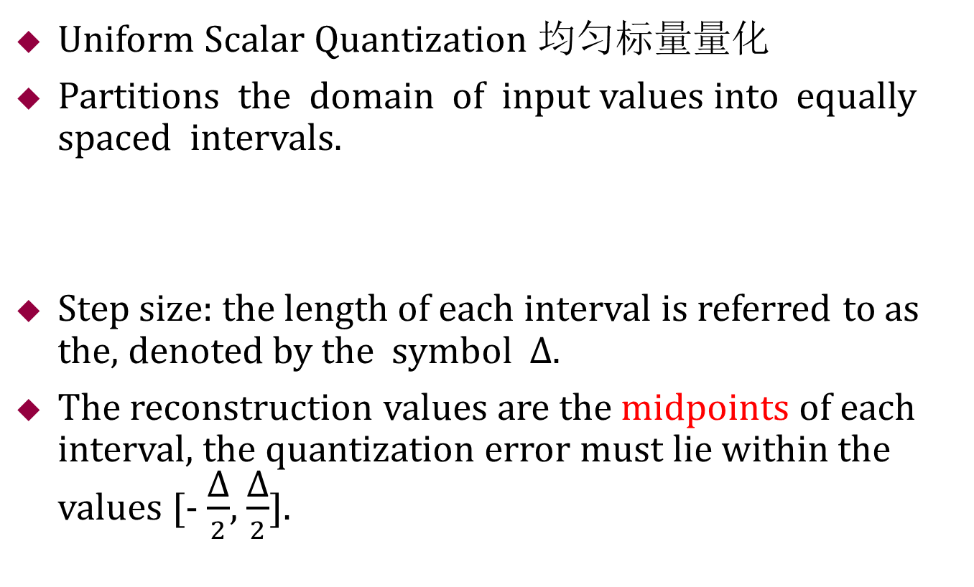
Quantization
Uniform Scalar Quantization 均匀标量量化
Partitions the domain of input values into equally spaced intervals.
Step size: the length of each interval is referred to as the, denoted by the symbol ∆.
The reconstruction values are the midpoints of each interval, the quantization error must lie within the values [- $\frac{\text{∆}}{2}$, $\frac{\text{∆}}{2}$].
∆
0 32 64 96 128 160 192 224 256

Slide 11
Quantization
Nonuniform Scalar Quantization非均匀标量量化
Partition the domain of input values into unequally spaced intervals.
Concentrate the bits to where is most need.
Lloyd-Max quantization and companded quantization.
^
X
Uniform quantizer
X
G
_{G} −1
Companded quantization.
压缩扩展量化

Slide 12
Outline
Introduction to Lossy Compression （有损压缩）
Distortion Measures （失真度量）
Quantization （量化）
Transform Coding （变换编码）

Slide 13
Transform Coding
Example of transform coding
Original data X: {100 101 100 99 100 100 100 100}
Transform coding T: di-di-1 and d1 = 100;
Transformed vector Y: {100 1 -1 -1 1 0 0 0}
Y is the result of a linear transform T of the input vector X , the components of Y are much less correlated.
If most information is accurately described by the first few components of a transformed vector, then the remaining components can be coarsely quantized.
Y’: {100}

Slide 14
Transform Coding
Frequency domains can be obtained through the transformation from one (time or spatial) domain to the other (frequency) via
Fourier Transform (FT，傅里叶变换), MPEG Audio .
Discrete Cosine Transform (DCT，离散余弦变换) ——Heart of JPEG and MPEG Video, MPEG Audio.
Fourier transform
Sine transform
Cosine transform

Slide 15



1D DCT and IDCT with 8 numbers
Given an input function f(i) over an integer variables i, the 1D DCT transforms it into a new function F(u), with integer u running over the same range as i .
Consider a data sequence with 8 numbers
1D DCT
1D IDCT
The constants C(u) are determined by

Slide 16
1D DCT and IDCT with 8 numbers
1D DCT basis function

Slide 17
1D DCT and IDCT with 8 numbers
1D DCT basis function
The 4th basis function (u = 4)
The 5th basis function (u = 5)
1.0
0.5
0
−0.5
−1.0
1.0
0.5
0
−0.5
−1.0
0 1 2 3 4 5 6 7
0 1 2 3 4 5 6 7
i
i
The 6th basis function (u = 6)
The 7th basis function (u = 7)
1.0
0.5
0
−0.5
−1.0
1.0
0.5
0
−0.5
−1.0
0 1 2 3 4 5 6 7
0 1 2 3 4 5 6 7
i
i

Slide 18
Example of Compression Scheme for 1D DCT
Matlab code of 1D DCT (see DCT1D.m)
Original data X: { 60 36 21 21 17 12 21 38 }
Transformed vector Y: 80 20 32 2 16 1 0 0

Slide 19
2D DCT and 2D IDCT
Consider an image block with 8 ×8 numbers
2D DCT
2D IDCT
The constants C(u) are determined by

Slide 20
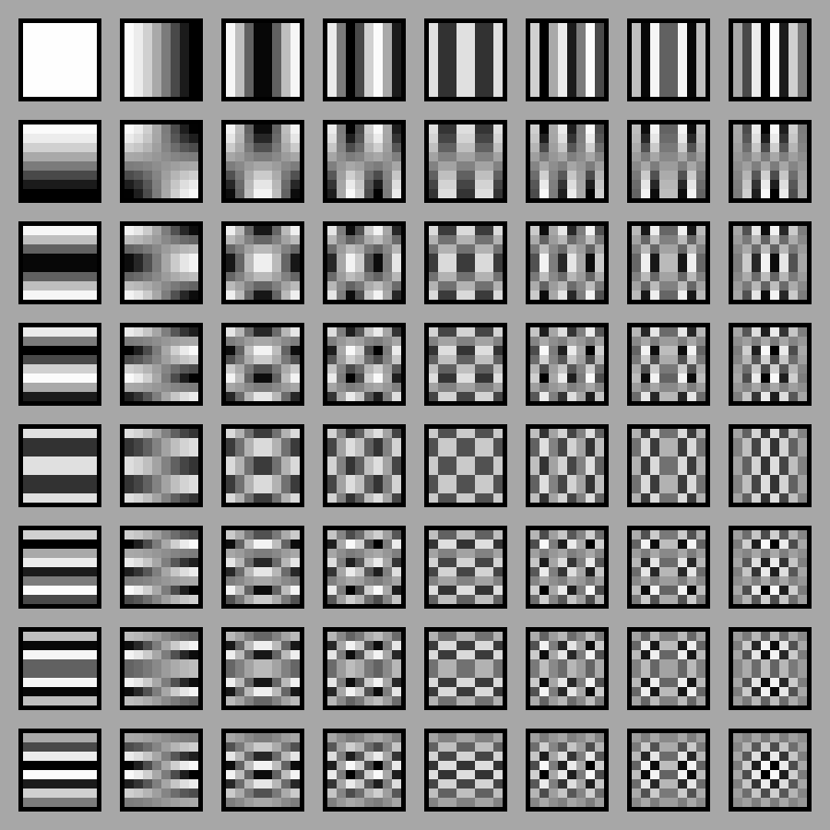
2D DCT and 2D IDCT
DCT 2D Basis Functions
Matlab code of 2D DCT (see DCT2Dbasis.m):

Slide 21
2D DCT and 2D IDCT Matlab
See demoDCT2.m
I = imread('Lena.jpg');
I=imresize(I,[400 400]);
I = rgb2gray(I);
I = im2double(I);
T = dctmtx(8);
dct = @(block_struct) T* block_struct.data*T';
B = blockproc(I,[8 8],dct);
mask = [1 1 1 0 0 0 0 0
1 1 1 0 0 0 0 0
1 1 1 0 0 0 0 0
0 0 0 0 0 0 0 0
0 0 0 0 0 0 0 0
0 0 0 0 0 0 0 0
0 0 0 0 0 0 0 0
0 0 0 0 0 0 0 0];

Slide 22
2D DCT and 2D IDCT Matlab
B2 = blockproc(B,[8 8],@(block_struct) mask .* block_struct.data);
invdct = @(block_struct) T' * block_struct.data * T;
I2 = blockproc(B2,[8 8],invdct);
figure
subplot(2,2,1);
imshow(I)
title('Original Grayscale Image ');
subplot(2,2,2);
imshow(I2)
title('Recovered from F(0,0) ~ F(2,2) ');
subplot(2,2,3);
imshow(B)
title('2D DCT result');

Slide 23
2D DCT and 2D IDCT Matlab

