Slide 1
Database Design
E-R Modeling

Slide 2
Database Design
The idea behind database design：
1）Mapping the Real World information to some Abstract concepts and relations between concepts
2）Changing those concepts and relations to some forms of data that we can manipulate.
E-R Modeling is a way to fulfill the task.

Slide 3
E-R Modeling
In this Chapter you will learn:
  The steps to design a database
  The concepts of E-R modeling
  Techniques of drawing E-R diagram
  Mapping E-R Diagram to Relations
How does it related to the contents that we have learn?---Normal Form，RDB Theory
  To compare
  To validate

Slide 4
Phases of Database Design:
Requirement collection and analysis
Database and functional requirements
Conceptual design
System independent conceptual schema
Logical design
System dependent conceptual schema
Physical design Internal schema

Slide 5
Requirement Collection & Analysis (1)
Conduct surveys of potential users to find the following information:
Static structuring requirements
  What information needs to be present?
  What names should be used to refer to it?
  What relationships exist among different data?
  What constraints need to be imposed?

Slide 6
Requirement Collection & Analysis (2)
Dynamic processing requirements
  What types of transactions (operations) are expected against the database?
  How frequently each transaction is expected to be run?
Output: A document that contains concise descriptions of the requirements.

Slide 7
Example: A Hospital Database (1)
The hospital database contains information about patients, doctors, nurses and doctors' prescription to patients.
Each patient is described by his/her SSN, Name, Age, Sex, Weight, Height, Insurer, Address, Phone.
Each doctor is described by his/her SSN, Name, Age, Sex, Phone, Specialty, Years_of_experience.

Slide 8
Example: A Hospital Database (2)
Each nurse is described by his/her SSN, Name, Age, Sex, Years_of_experience, Phone.
Each prescription is described by Dr_SSN, Dr_Name, Patient_SSN, Patient_Name, Medicine_Name, Dosage, Date.
Each doctor can be the primary physician of at most 20 patients.
Each nurse can care at most 5 patients.

Slide 9
Example: A Hospital Database (3)
The following operations are expected to be used against the database:
Insert new patient. Frequency: 20%.
Delete existing patient. Frequency: 20%.
Find doctor of patient. Frequency: 40%.
Find nurse of patient. Frequency: 5%.
Find prescription to patient: Frequency: 15%.

Slide 10
Entity-Relationship Model
ER model was proposed by Peter Chen in 1976.
Many extensions have been made (Extended Entity-Relationship model or EER model).
There is a dedicated International Conference on ER Approach.
ER model has become a standard tool for conceptual schema design.

Slide 11
Entity and Entity Set (1)
Definition: An entity is an object/concept with two properties:
it exists
it is distinguishable
Examples: a person, an organization, an airplane, a course.

Slide 12
Entity and Entity Set (2)
Two types of entities:
Strong entity: can exist independently (or can uniquely identify itself).
Weak entity: existence depends on the existence of other (strong) entity or entities.
Note: whether an entity is strong or weak largely depends on the way the data is modeled.

Slide 13
Entity and Entity Set (3)
Examples:
An employee is a strong entity but the dependents of the employee could be weak entities.
An account in a bank is a strong entity but a transaction could be a weak entity.
Definition: An entity set is a collection of entities of the same type.
Examples: all students at SZU, all cities in the US.

Slide 14
Attributes
Definition: The properties of an entity set are called attributes of the entity set.
Students: SSN, Name, Address, GPA, Status, ...
Books: Title, ISBN, Authors, Publisher, Year, ...
For a given application, only a limited number of attributes of an entity set are of interest.

Slide 15
Types of Attributes (1)
Simple (or atomic) attributes: take a single and indivisible value for each entity.
Examples: SSN, GPA, Status of Students.
Composite attributes: take values that can be further divided into subparts.
Examples: Name: First_Name
Middle_Name Last_Name
Address: Street_Address City State
Zipcode

Slide 16
Types of Attributes (2)
Single-valued attributes: take a single value (simple or composite) for each entity.
Multi-valued attributes (set attributes): take a set of values for each entity.
Example: Authors of Books
Stored-attributes: whose values are actually stored in the database.

Slide 17
Types of Attributes (3)
Derived-attributes: whose values are computed from other attributes.
Examples: Age from Birthdate
Annual Salary from Monthly Salary
Other concepts: Domain, Superkey, Candidate key, Primary key

Slide 18
Relationships (1)
Definition: A relationship is an association among entities.
Example: Given a student s and a course c, there may be a relationship between them: s takes c.
Definition: All relationships of the same meaning among entities of a given set of entity sets are collectively called a relationship set among the entity sets.

Slide 19
Relationships (2)
Example: s1 takes c1
s1 takes c2
s2 takes c1
...…
Students Takes Courses
Takes is a relationship set between Students and Courses.

Slide 20
Relationships (3)
Definition: Let R be a relationship set among entity sets E1, E2, ..., En. An entity e1 in E1 participates in R if a tuple in R contains e1.
Overload term relationship: relationship and relationship set.
Several relationships may exist among the same set of entity sets.
Works_in
Employees
Departments
Manages

Slide 21
Relationships (4)
R is a relationship between entity sets E1 and E2 every entity in E1 or E2 participates in R.
Example: Not every employee is a department manager.
If every entity in E1 participates R, then we say E1 has total participation.
Example: Departments has total participation in Manages.

Slide 22
Degree of a Relationship (1)
Definition: The degree of a relationship is the number of entity sets participating the relationship.
Unary relationship (degree = 1)
Examples:
Supervises on Employees
is_prerequisite_of on Courses
is_classmate_of on Students

Slide 23
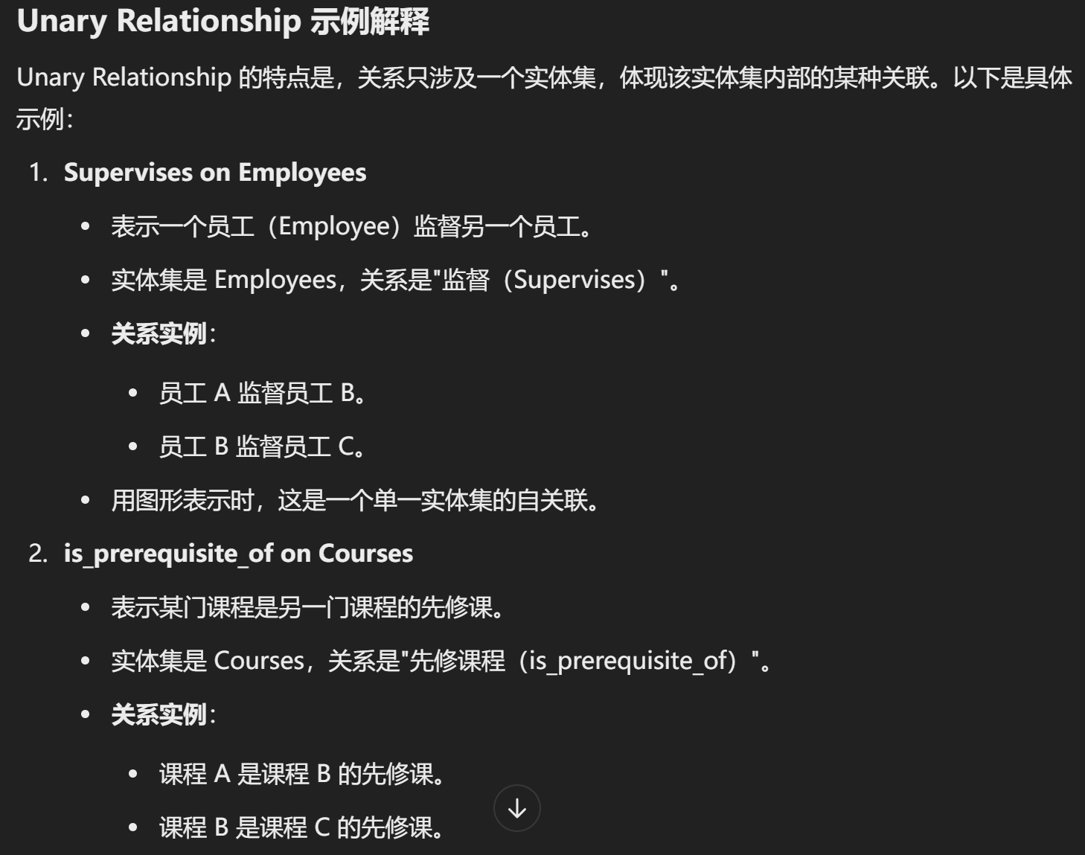
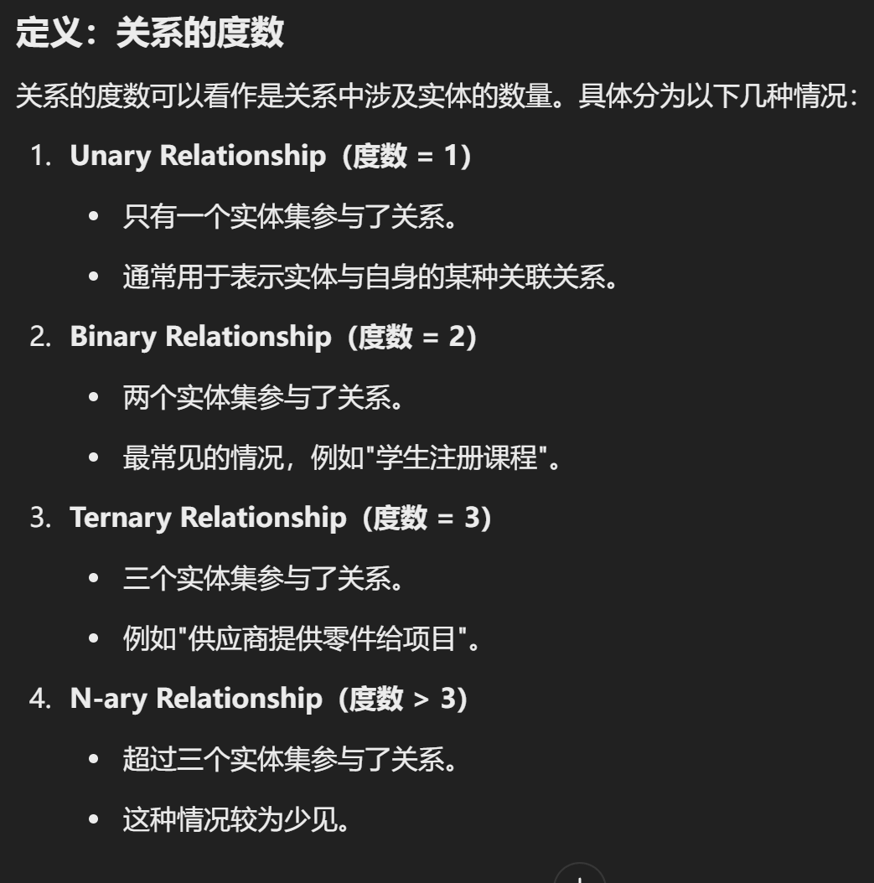
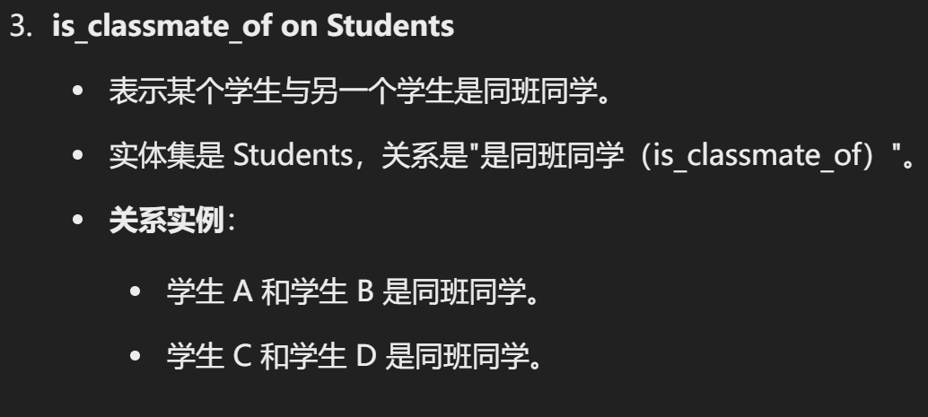

Slide 24
Degree of a Relationship (2)
Binary relationship (degree = 2)
Examples:
takes between Students and Courses
owns between Persons and Cars

Slide 25
Degree of a Relationship (3)
Ternary relationship (degree = 3)
Examples:
orders among Customers, Parts and Suppliers
skill_used among Engineers, Skills and Projects

Slide 26
Connectivity (1)
The connectivity of a relationship specifies the mapping between the entity sets participating the relationship.
One-to-one (1-to-1) relationship between E1 and E2: for each entity in E1, there is at most one associated entity in E2, and vice versa.

Slide 27
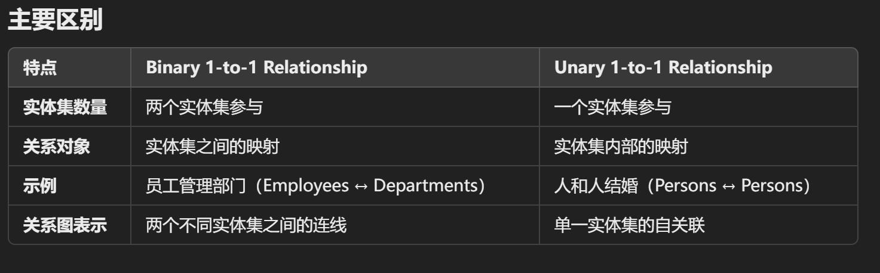
Connectivity (2)
Examples of 1-to-1 relationships:
binary 1-to-1 relationship: manages between Employees and Departments
unary 1-to-1 relationship: is_married_to on Persons

Slide 28
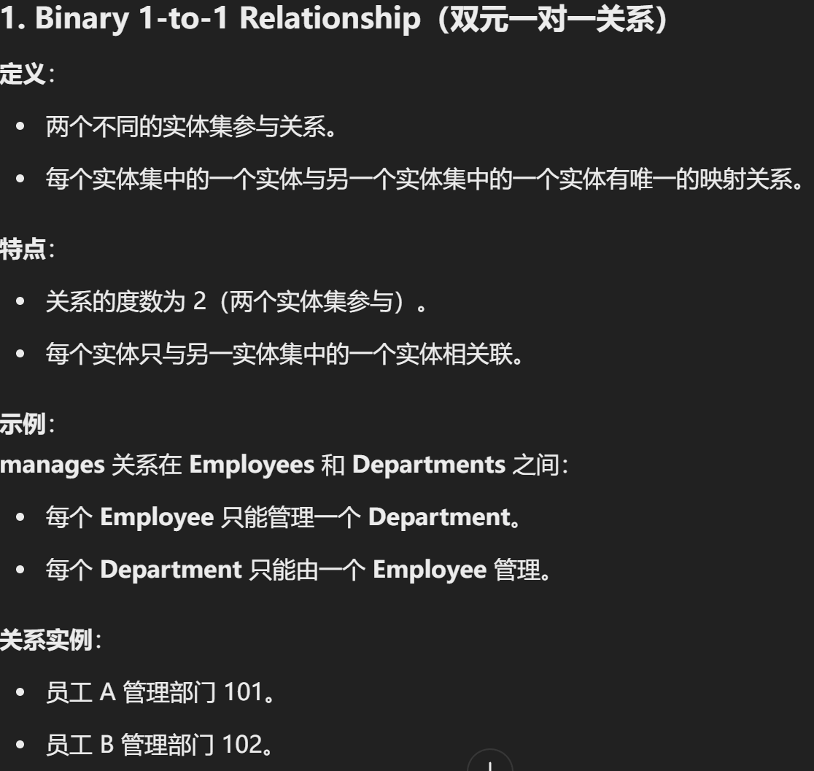
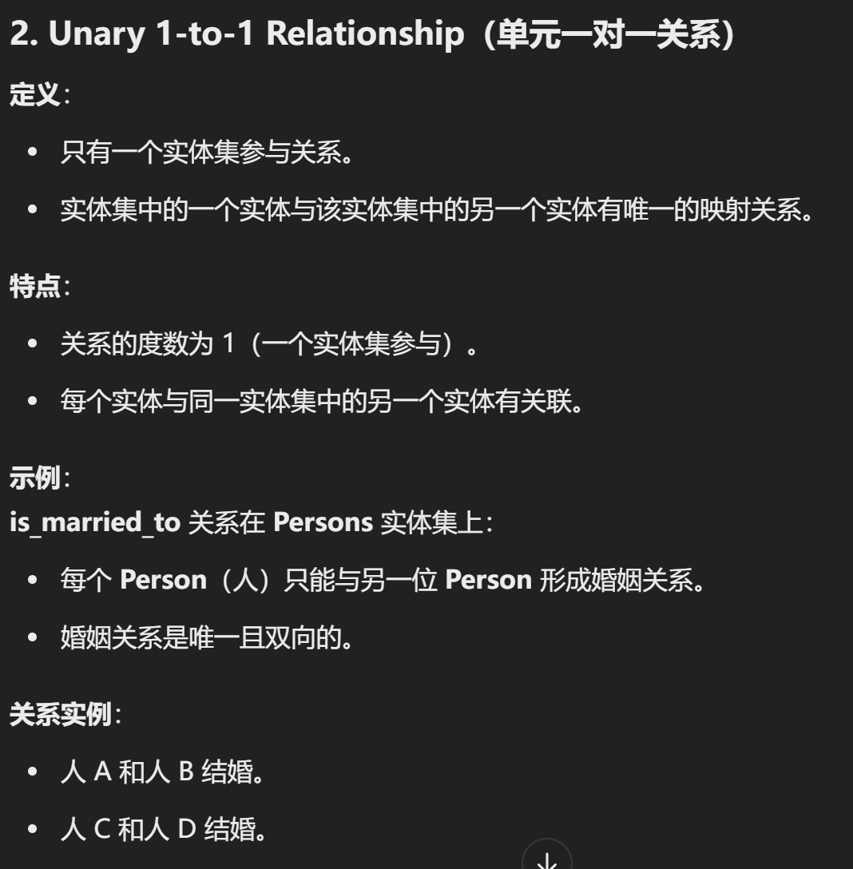

Slide 29
Connectivity (3)
One-to-many (1-to-m) relationship from E1 to E2: for each entity of E1, there are zero or more associated entities of E2, but for each entity of E2, there is at most one associated entity of E1.
binary 1-to-m relationship: advises between Professors and Students
unary 1-to-m relationship: is_mother_of on Persons

Slide 30
Connectivity (4)
Many-to-one (m-to-1) relationship from E1 to E2: same as 1-to-m relationship from E2 to E1.

Slide 31
Connectivity (5)
Many-to-many (m-to-m) relationship between E1 and E2: for each entity in E1, there are zero or more associated entities in E2, and vice versa.
binary m-to-m relationship: takes between Students and Courses
unary m-to-m relationship: is_component_of on Parts

Slide 32
ER Diagram Notations (1)
entity set
weak entity set
attribute
primary key attribute
partial key attribute

Slide 33
ER Diagram Notations (2)
multivalued attribute
composite attribute
derived attribute
relationship

Slide 34
ER Diagram Notations (3)
identifying relationship
x
connection with
connectivity x
x
total participation
connection

Slide 35
ER Diagram (1)
unary relationship
is_married_to
1
1
Persons
SSN
Name
Age

Slide 36
ER Diagram (2)
binary relationship
Professors
1
advises
m
Students
SSN
Name
Age
SSN
Name
Age

Slide 37
ER Diagram (3)
ternary relationship
Engineers
Skill_used
Skills
Projects

Slide 38
ER Diagram (4)
Another example:
Branches
CAB
Customers
Accounts

Slide 39
ER Diagram (5)
Rule for determining connectivity of an entity set in an n-ary relationship.
Suppose R is an n-ary relationship among entities sets: E1, …, En.
The connectivity of Ei is
one, if given a combination of entities from all other entity sets, there is at most one associated entity in Ei;
many, otherwise.

Slide 40
Role of an Entity Set (1)
Definition: The role of an entity set in a relationship is the function it performs in the relationship.
Case 1: Role can be determined from properly chosen names.
takes
m
n
Students
Courses
is_TA_of
1
1

Slide 41
Role of an Entity Set (2)
Case 2: Roles need to be explicitly given.
is_married_to
supervises
1
1
1
m
wife
husband
supervisor
supervisee
Persons
Employees

Slide 42
Attribute of Relationship (1)
Where to keep the grade information?
Students
m
takes
n
Courses

Slide 43
Attribute of Relationship (2)
Another example:
Suppliers
m
Quantity
orders
n
r
Parts
Projects

Slide 44
Extended ER Model (EER Model)
Various extensions to ER model exist.
We introduce two extensions:
  More accurate connectivity description.
  Generalization/specialization hierarchy.
Notes:
Te hua , fan hua

Slide 45
Cardinality Constraint (1)
One in ER model means zero or one.
Many in ER model means zero or more.
Cardinality constraints make them more precise.
Students
(5, 60)
takes
(1, 5)
Courses

Slide 46
Cardinality Constraint (2)
General format:
0 <= min_card <= max_card Interpretation: Each entity in E may involve between min_card and max_card relationships in R.
(min_card, max_card)
E
R

Slide 47
Cardinality Constraint (3)
Definition: If every entity in E involves at least one relationship in R (i.e., min_card >= 1), E is said to have total (or mandatory) participation in R. If min_card = 0, E is said to have partial (or optional) participation in R.

Slide 48
Cardinality Constraint (4)
Employees has a partial participation.
Departments has a total participation.
Employees
(0, 1)
manages
(1,1)
Departments

Slide 49
Representing 1-to-1, 1-to-m, m-to-m
Relationships
one-to-one:
(0, 1)
(0, 1)
E
R
F
many-to-many:
(0, m)
(0, n)
E
R
F
one-to-many:
(0, m)
(0,1)
E
R
F

Slide 50
Generalization (1)
Definition: Generalization is the process of defining a generalized entity set from a given set of semantically related entity sets.
GPA
GPA
SSN
Name
GRE
SAT
SSN
Name
G_Students
UG_Students

Slide 51
Generalization (2)
SSN
Name
GPA
Students
G_Students
UG_Students
GRE
SAT

Slide 52
Generalization (3)
Students is a super entity set (supertype)
G_Students and UG_Students are sub entity sets (subtypes)
Super entity set has only and all common attributes of sub entity sets.
Inheritance Principle: A sub entity set inherits all properties (attributes and relationships) from the super entity set.

Slide 53
Specialization
Definition: Specialization is the process of defining a specialized entity sets from a given entity set.
IS_A semantics: every entity in a sub entity set is also an entity in the super entity set.
Generalization and specialization hierarchies are called IS_A hierarchies.

Slide 54
An IS_A Hierarchy
SSN
Name
Salary
Persons
GPA
Rank
Students
Faculty
G_Students
UG_Students
GRE
SAT

Slide 55
Using IS_A Hierarchy to Improve Modeling Quality
SSN
Name
GPA
Course#
Title
Students
takes
Courses
G_Students
UG_Students
GRE
SAT
TAs
assists
Office
Salary

Slide 56
Flexibility in ER Modeling (1)
Entity set versus attribute
SSN
Name
City
Persons
SSN
Name
Name
Persons
m
lives_in
1
Cities

Slide 57
Flexibility in ER Modeling (2)
Engineers
Assume each engineer uses at most one skill for any given project.
Engineers
m
Skill
m
skill_used
participates
1
n
n
Skills
Projects
Projects

Slide 58
Flexibility in ER Modeling (3)
Entity set versus relationship set
Banks
Banks
1
Balance
m
Acct#
CAB
account
1
1
Customers
Accounts
n
Customers
Acct#
Balance

Slide 59
Flexibility in ER Modeling (4)
ternary relationship vs. binary relationship
A ternary relationship may not be represented by multiple binary relationships.
m
Suppliers
Suppliers
supply_to
m
r
n
supply
can -supply
Projects
n
r
s
u
Parts
t
Projects
Parts
use

Slide 60
Flexibility ER Modeling (5)
Ternary relationship usually provides more accurate information.
supply supply_to can-supply uses
s1 p1 j1 s1 j1 s1 p1 j1 p1
s1 p2 j1 s2 j1 s1 p2 j1 p2
s2 p1 j1 s2 j2 s2 p1 j2 p2
s2 p2 j2 s2 p2
(s2, p2, j1) may be incorrectly derived from the binary relationships.

Slide 61
An Example EER Diagram
C_name
Proj#
Name
Cities
1
Population
Projects
r
live_in
Emp#
Name
Age
work_on
m
n
Hours
Employees
use
Hobbies
Managers
Programmers
Languages
Budget
years_of_experience
L_name

Slide 62
Transform EER Diagram to Relations (1)
EER Concept Relational Concept
Strong entity Tuple
Weak entity ???
Strong entity set Relation
Weak entity set ???
Attribute Attribute
Key Key
Composite attribute ???

Slide 63
Transform EER Diagram to Relations (2)
EER Concept Relational Concept
Set attribute ??
Unary 1-1 relationship ???
Unary 1-m relationship ???
Unary m-m relationship ???
Binary 1-1 relationship ???
Binary 1-m relationship ???
Binary m-m relationship ???

Slide 64
Transform EER Diagram to Relations (3)
EER Concept Relational Concept
Ternary relationship ???
IS_A hierarchy ???
Cardinality constraint ???
Foreign key is rarely used in ER model but is widely used in relational model!

Slide 65
Basic Ideas of the Transformation
Entity ====> Tuple
Entity set ====> Relation
Attribute ====> Attribute
Key ====> Key
Relationship ====> Tuple or foreign key
value(s)
Relationship set ====> Relation or
foreign key(s)

Slide 66
An Example (1)
Professors Advise Students
p1: 123, Jack, Prof. p1 advises s1 s1: 456, John, 3.4
p2: 234, Ann, Prof. p1 advises s2 s2: 567, Carl, 3.2
p3: 345, Bob, Prof. p3 advises s3 s3: 678, Ken, 3.5
一对多 关系放在m
Professors
1
advise
m
Students
SSN
Name
Rank
SSN
Name
GPA

Slide 67
An Example (2)
Transform the ER diagram into three relations:
Professors Advise Students
SSN Name Rank PSSN SSSN SSN Name GPA
123 Jack Prof. 123 456 456 John 3.4
234 Ann Prof. 123 567 567 Carl 3.2
345 Bob Prof. 345 678 678 Ken 3.5

Slide 68
An Example (3)
Two relations are sufficient:
Professors Students
SSN Name Rank SSN Name GPA PSSN
123 Jack Prof. 456 John 3.4 123
234 Ann Prof. 567 Carl 3.2 123
345 Bob Prof. 678 Ken 3.5 345

Slide 69
Transform Binary Relationship (1)
Case 1: one-to-many relationship: x = 1 and y = m (or x = (?, m) and y = (?, 1))
===> E(A, B), F(C, D, A)
Relationship R is transformed to a foreign key.
A
B
C
D
x
y
E
R
F

Slide 70
Transform Binary Relationship (2)
==> Depts(Name, Location)
Employees(SSN, Name, Age, Dept_name)
Renaming is useful for understandability.
SSN
Name
Age
Name
Location
m
1
Employees
work_in
Depts

Slide 71
Transform Binary Relationship (3)
Case 2: one-to-one relationship
Case 2.1: x = (1, 1) and y = (1, 1)
===> E(A, B), F(C, D, A) or
===> E(A, B, C), F(C, D)
A
B
C
D
x
y
E
R
F

Slide 72
Transform Binary Relationship (4)
SSN
Age
==> Depts(Name, Location)
Managers(SSN, Name, Age, Dept_name)
==> Depts(Name, Location, Manager_SSN)
Managers(SSN, Name, Age)
Name
Name
Location
(1, 1)
(1, 1)
Managers
work_in
Depts

Slide 73
Transform Binary Relationship (5)
Case 2.2: x = (0, 1) and y = (0, 1)
(or x = 1 and y = 1, and both E and F are partial participation)
Use the same transformation rule for Case 2.1.

Slide 74
Transform Binary Relationship (6)
Case 2.3: x = (0, 1) and y = (1, 1)
===> E(A, B), F(C, D, A)
The entity set with the total participation is transformed to a relation with a foreign key.
A
B
C
D
x
y
E
R
F

Slide 75
Transform Binary Relationship (7)
==> Depts(Name, Location, Manager_SSN)
Employees(SSN, Name, Age)
Why not let Employees have the foreign key?
SSN
Name
Age
Name
Location
(0, 1)
(1, 1)
Employees
manages
Depts

Slide 76
Transform Binary Relationship (8)
Case 2.4: x = (1, 1) and y = (0, 1)
===> E(A, B, C), F(C, D)
A
B
C
D
x
y
E
R
F

Slide 77
Transform Binary Relationship (9)
Case 3: many-to-many relationship:
x = m and y = n
Case 3.1: R has no attribute
===> E(A, B), F(C, D), R(A, C)
Transform the m-to-m relationship to a separate relation.
R has two foreign keys.
The key of R consists of the foreign keys.

Slide 78
Transform Binary Relationship (10)
SSN
Age
==> Students(SSN, Name, Age)
Courses(Course#, Title)
Takes(SSN, Course#)
Case 3.2: R has attribute Z
===> E(A, B), F(C, D), R(A, C, Z)
Name
Course#
Title
m
n
Students
takes
Courses

Slide 79
Transform Ternary Relationship
A
B
Z
C
D
==> E1(A, B), E2(C, D), E3(G, H),
R(A, C, G, Z)
E1
R
E2
E3
G
H

Slide 80
Transform Unary Relationship (2)
Create a shadow entity set and transform the unary relationship into a binary relationship.
Apply the rules for transforming binary relationships.
After the transformation, remove one redundant relation, or if there is no redundant relation, remove the relation with fewer attributes.

Slide 81
Transform Unary Relationship (3)
Course#
Title
Courses(Course#, Title)
Prereq(Course#, Prereq_Course#)先修课程
Course#
Title
Courses
m
Courses
prereq
m
n
n
Course#
prereq
Courses
Title

Slide 82
Transform Unary Relationship (4)
Name
Name
SSN
Persons(SSN, Name, Age, Spouse_SSN)
SSN
Age
Age
Persons
(0,1)
Persons
mar_to
(0,1)
(0,1)
(0,1)
married_to
Persons

Slide 83
Transform Unary Relationship (5)
Name
Name
SSN
Persons(SSN, Name, Age, Mother_SSN)
SSN
Age
Age
Persons
1
Persons
mo_of
1
mother
m
child
m
mother_of
Persons

Slide 84
Transform Multi-valued Attribute (1)
Create a separate relation for each multi-valued attribute.
E_C.A should be defined to be a foreign key referencing E.A
A
B
C
E(A, B), E_C(A, C)
E

Slide 85
Transform Multi-valued Attribute (2)
==> Books (ISBN, Title, Publisher)
Book_Authors (ISBN, Author)
Define Book_Authors.ISBN as a foreign key referencing Books.ISBN
ISBN
Title
Publisher
Authors
Books

Slide 86
Transform Composite Attribute (1)
Method 1: Use only simple attributes and ignore the composite attribute.
==>
D
H
A
B
C
E(A, D, H, C)
E

Slide 87
Transform Composite Attribute (2)
Method 2: Transform the composite attribute to a separate relation.
==>
D
H
E(A, C),
E_B (A, D, H)
A
B
C
E

Slide 88
Transform Composite Attribute (3)
An Example using method 2:
Format
Bitmap
Height
Width
SSN
Name
Picture
Age
Salary
Employees
Employees (SSN, Name, Age, Salary)
Emp_Pic (SSN, Bitmap, Format, Height, Width)

Slide 89
Transform Weak Entity Set
==> E (A, B, C), F(A, D, G, H)
The key of F consists of the key of E and the partial key of F.
F.A is a foreign key referencing E.A
A
B
C
D
G
H
1
m
E
R
F

Slide 90
Transform IS_A Hierarchy (1)
A
B
C
E
E1
E2
D
F
G
H

Slide 91
Transform IS_A Hierarchy (2)
*************************
Method 1: ==> E(A, B, C), E1(A, D, F),
E2(A, G, H)
Only the key is explicitly inherited from the super entity set.
A tuple in E either corresponds to an entity in E or an entity in a sub entity set.
E1.A and E2.A are defined to be foreign keys referencing E.A.

Slide 92
Transform IS_A Hierarchy (3)
Method 2: ==> E(A, B, C),
E1(A, D, F, B, C), E2(A, G, H, B, C)
All attributes are explicitly inherited from the super entity set.
Tuples in E correspond to entities that are in E but not in any sub entity set.
If relation E will always be empty, discard it.

Slide 93
Transform IS_A Hierarchy (4)
SSN
Name
Age
Persons
Students
Faculty
GPA
Rank

Slide 94
Transform IS_A Hierarchy (5)
Real world information:
SSN Name Age GPA Rank
stud: 123456789 John 27 3.5
facul: 234567891 Bill 43 Prof.
staff: 345678912 Mary 37

Slide 95
Transform IS_A Hierarchy (6)
Method 1:
Persons Students
SSN Name Age SSN GPA
123456789 John 27 123456789 3.5
234567891 Bill 43 Faculty
345678912 Mary 37 SSN Rank
234567891 Prof.

Slide 96
Transform IS_A Hierarchy (7)
Method 2: Persons
SSN Name Age
345678912 Mary 37
Students
SSN Name Age GPA
123456789 John 27 3.5
Faculty
SSN Name Age Rank
234567891 Bill 43 Prof.

Slide 97
Transform a Complex EER Diagram (1)
General guidelines:
Transform each entity set into a relation (exclude multi-valued and composite attributes).
  Transform each IS_A hierarchy in a top-down manner.
  Transform each multi-valued attribute into a separate relation.

Slide 98
Transform a Complex EER Diagram (2)
  Transform each composite attribute.
  Specify the key for each relation.
Transform each relationship set.
  For a unary or binary 1-to-1 or 1-to-m relationship, transform it by adding a foreign key to appropriate relation(s) obtained previously.

Slide 99
Transform a Complex EER Diagram (3)
  For any m-to-m or high degree (degree > 2) relationship, transform it by creating a separate relation. Specify key and foreign key carefully.
  Pay special attention to relationships inherited from super entity set(s). The method used to transform IS_A hierarchy has a big impact on this.

Slide 100
Transform a Complex EER Diagram (4)
C_name
Proj#
Name
Cities
1
Population
Projects
r
live_in
Emp#
Name
Age
work_on
m
n
Hours
Employees
use
Hobbies
Managers
Programmers
Languages
Budget
years_of_experience
L_name

Slide 101
Transform a Complex EER Diagram (5)
Use method 1:
Employees(Emp#, Name, Age, C_name)
Employee-Hobby(Emp#, Hobby){+原表主键}
Managers(Emp#, Budget)
Programmers(Emp#, Years_of_experience)
Cities(C_name, Population)
Projects(Proj#, Name)
Languages(L_name)
Work_on(Emp#, Proj#, Hours)
Use(Emp#, Proj#, L_name)

Slide 102
Transform a Complex EER Diagram (6)
Use method 2:
Employees(Emp#, Name, Age, C_name)
Employee-Hobby(Emp#, Hobby)
Managers(Manager-Emp#, Name, Age, Budget, C_name)
Manager-Hobby(Manager-Emp#, Hobby)
Programmers(Programmer-Emp#, Name, Age, Years_of_experience, C_name)
Programmer-Hobby(Programmer-Emp#, Hobby)

Slide 103
Transform a Complex EER Diagram (7)
Cities(C_name, Population)
Projects(Proj#, Name)
Languages(L_name)
Work_on(Emp#, Proj#, Hours)
Manager-Work_on(Manager-Emp#, Proj#, Hours)
Programmer-Work_on(Programmer-Emp#, Proj#, Hours)
Use(Programmer-Emp#, Proj#, L_name)

