Slide 1


SEQUIN: Sequential N-k Attacks in Electric Power Grids
CS637 Project
A
B
C
D
E
F
Notes:
To use this title animation slide with a new image simply 1) move the top semi-transparent shape to the side, 2) delete placeholder image,
3) click on the picture icon to add a new picture, 4) Move semi-transparent shape back to original position, 5) Update text on slide.

Slide 2
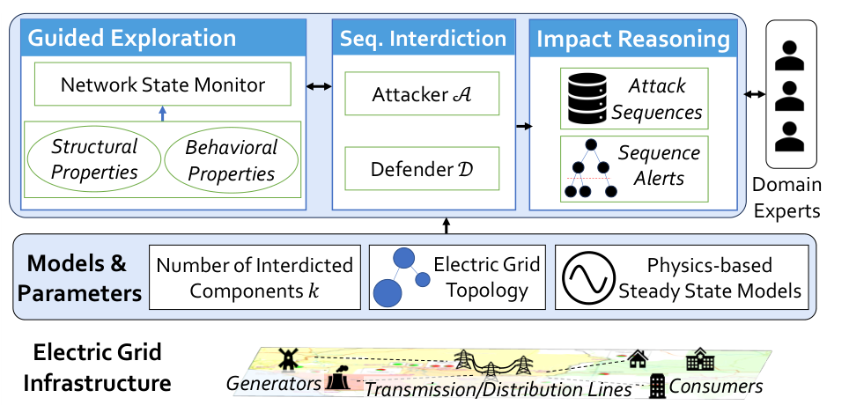
SEQUIN
A Network Science and Physics-based Approach
to Identify Sequential N-k Attacks in Electric
Power Grids
ICCPS
2025
• Andrew Chio • Russell Bent
• Kaarthik Sundar • Nalini Venkatasubramanian
02
Notes:
Read the paper’s title once, then explain its two ingredients. Network science identifies promising components. Physics-based optimization evaluates how the grid responds. SEQUIN stands for the sequential interdiction framework. The small figure is the authors’ architecture, included here to preview the full system. The publication is the ACM/IEEE International Conference on Cyber-Physical Systems, held in May 2025.
Sources: Chio et al., ICCPS 2025. DOI: 10.1145/3716550.3722029. https://ics.uci.edu/~achio/publication/2025-sequin/SEQUIN-paper.pdf Figure 1 reproduced from the authors’ paper, CC BY-SA 4.0.

Slide 3
CONTEXT
Modelling Power Grid as Network
G = (𝒩, 𝓔)
Paper Symbols
θᵢ
voltage phase angle
B1
B3
pᵢᵍ
generator output
G
B2
pᵢᵈ
load demand
pᵢˢ
load shed
L
pᵢⱼ
actual line power flow
L
B5
bᵢⱼ
inverse reactance / susceptance
tᵢⱼ
thermal rating / capacity
node / bus
generator
load
δᵢ
generator ramp bound

Slide 4
CONTEXT
Physics Constraints
01
Bus balance
pᵍᵢ − pᵈᵢ + pˢᵢ = Σ pᵢⱼ − Σ pⱼᵢ
Power cannot appear or disappear at a bus.
02
DC line flow
pᵢⱼ = bᵢⱼ(θᵢ − θⱼ)
|pᵢⱼ| ≤ tᵢⱼ
Line 7
Line 3
Capacity tᵢⱼ bounds the flow pᵢⱼ.

Slide 5
MOTIVATION
FOR SEQUIN
Traditional vs Sequential
Simultaneous N-k
Sequential N-k
cut
state
Failures unfold
while the grid
is responding.
cut
Fail a set of k components
Then solve one response
Fail a component
Respond before the next failure
Hurricane Harvey, 2017
Moore County attack, 2022
A + B + C
≠
A → B → C
CPS intuition: the plant is changing while the adversary is still acting.

Slide 6
MOTIVATION
FOR SEQUIN
Because
P(m, k) = m! / (m − k)!
Why Not Try Every Sequence?
Case39: 46 lines, k = 3
  91,080.
Case240 : 448 lines, k = 8
  38.2 Trillion

Slide 7
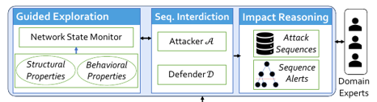
SEQUIN
SEQUIN = Search + Physics + Interpretation
Guided Exploration
  Which failures are worth exploring?
  Attacker
Sequential interdiction
  What physically happens after each failure?
  Defender
Impact reasoning
  What dangerous patterns appear across sequences?
  Build a Attack tree
  Analysis by Domain Experts

Slide 8
SEQUIN Core
Algorithm
ATTACKER 𝒜
DEFENDER 𝒟
maximize final disruption
maximize load served
01
Solve healthy
steady state
Algorithm 1 Guided Exploration
Compute PF / criticality /
TW–LD
Input: G=(N,E), k, expl
02
Output: attack sequences S
03
Take top expl
starting candidates
1 σ ← SolveSteadyState(G)
2 props ← flow, criticality, TW/LD
3 starts ← top expl values from props
4 S ← ∅
5 for x₀ in starts:
6 x ← [x₀]
7 for r = 2 ... k:
8 σ ← PlayInterdictionModel(G, x, σ)
9 nextcomps ← UpdateTopValues(σ, props)
10 x′ ← argmax CutImpact(nextcomps, σ)
11 append x′ to x
12 add x to S
13 return S
04
Attack one
candidate
05
Defender solves
new state
06
Update candidate
set
07
Cut Impact picks
next attack
08
Repeat until k
failures
Not one greedy path: several promising first lines create a set S of sequences.

Slide 9
SEQUIN
How Does SEQUIN Shortlist Attacks?
1
2
3
4
5
Power Flow
Is this line carrying a lot of power right now?
Criticality
How little operating margin remains?
Transmission Width
How easily can a node be isolated?
Load Density
How easily can a high-load region be isolated?
Cut Impact
If this candidate is cut now, how much load is shed after response?
cheap metrics
shortlist
Cut Impact
next line

Slide 10
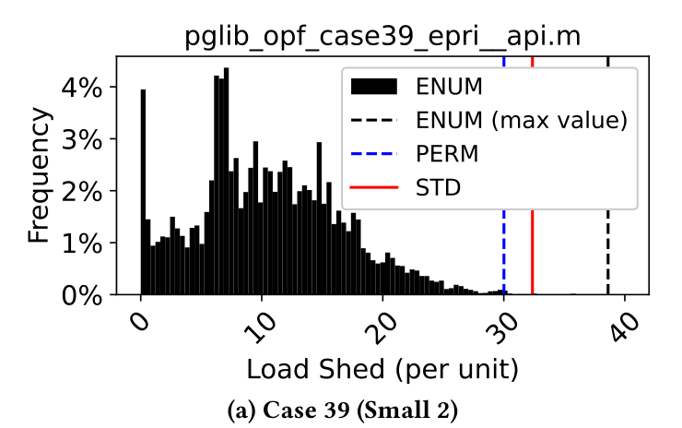
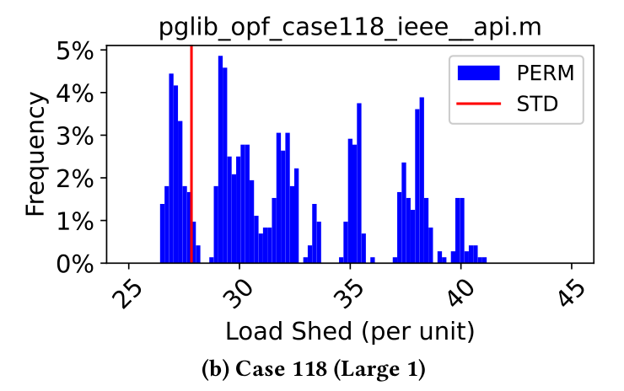
SEQUIN
How Did the Authors Test SEQUIN?
Benchmark networks
Case 14
Case 39
Case 60
Case 118
Case 162
Case 240
20 branches
46 branches
88 branches
186 branches
284 branches
448 branches
5 generators
10 generators
23 generators
54 generators
12 generators
143 generators
Compared against
STD
PERM
ENUM
FLOW
SHED
CRIT
SEQUIN
simultaneous
reorder STD
all orderings
highest flow
largest impact
criticality
guided
Case39:
best ENUM
above STD
Case118: best PERM
above STD
+19.3%
+47%

Slide 11
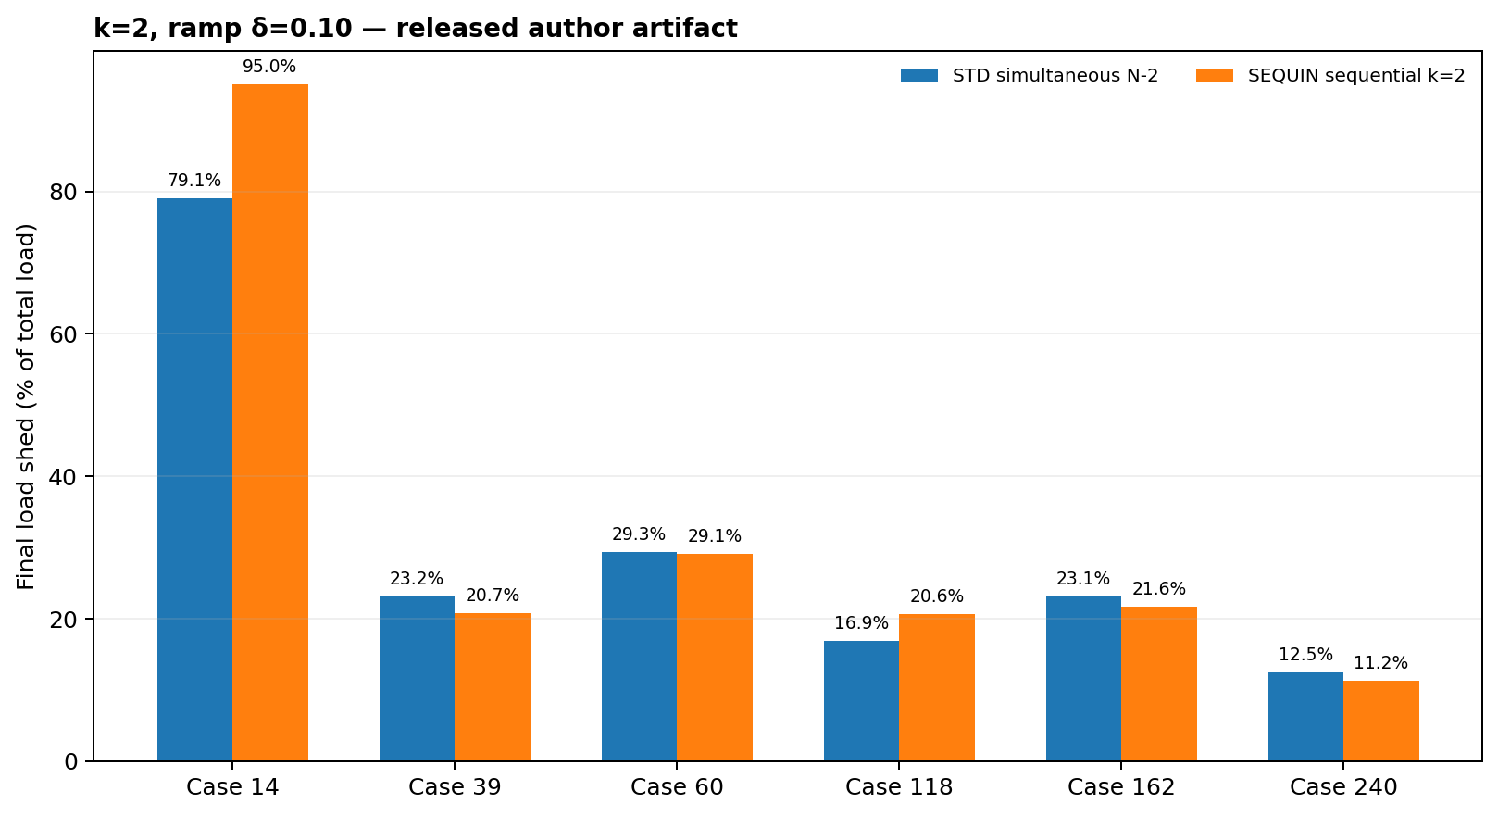
Reproduction
Results from executing Authors’ Artifacts
authors’ official reproduction pipeline
$ python src/experiments/
REP_make_plots.py cache-authors
Case 14 ✓ exp1 / ramp plots
Case 39 ✓ exp0 / exp1 / ramp
Case 60 ✓ exp1 / ramp plots
Case 118 ✓ exp0 / exp1 / ramp
Case 162 ✓ exp1 / ramp plots
Case 240 ✓ exp1 / ramp plots
✓ 6 / 6 benchmark networks
✓ official figures regenerated
sequin_rep — bash
1 $ cd /iccps-sequin
2 $ julia --project=. src/REPmain.jl \
3 --use_separate_budgets --rerun \
4 --case pglib_opf_case14_ieee.m \
5 --problem SEQUIN -l 2 -k 2
6
7 [ Gurobi ] Optimizing model ...
8 [ status ] OPTIMAL
9 [ attack ] [[7], [1]]
10 [ load shed ] 2.531
11
12 ✓ Julia environment
13 ✓ PowerModels / JuMP
14 ✓ licensed Gurobi
15 ✓ fresh SEQUIN path

Slide 12
Implementation
Scratch Python implementation — model, search, and solver
What we built from scratch
Core guided-search loop
grid_model.py
for line in candidates:
cand = defend(case, failed + [line],
state, ramp)
impact[line] = shed_pu(case, cand)
next_line = max(impact, key=impact.get)
failed.append(next_line)
state = defend(case, failed, state, ramp)
MATPOWER parser • DC balance/flow • thermal + angle limits
load shedding • islands • ramping • generator on/off
search_methods.py
exact simultaneous / sequential • FLOW • IMPACT • PERM
SEQUIN-style top-flow shortlist + cut-impact lookahead
network_metrics.py
criticality • branch margin • load density
transmission-width heuristic
Input
Solver
Experiments
Defender: maximize served load subject to DC physics + recourse
6 PGLib / MATPOWER cases
SciPy MILP / HiGHS
k • ramp • sequence • perturbation
pᵢⱼ = bᵢⱼ(θᵢ−θⱼ) • |pᵢⱼ| ≤ tᵢⱼ • ramp + on/off
Independent implementation: no PowerModels/JuMP/Gurobi dependency.
12

Slide 13
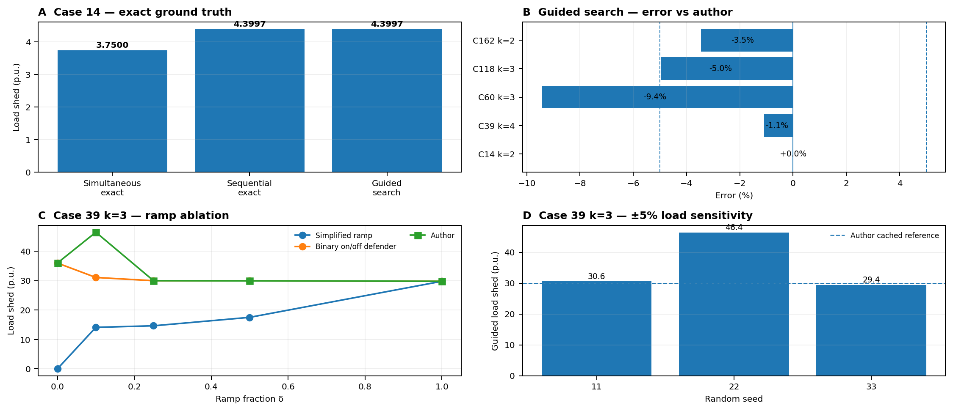
Results
Independent Python results — verification, sensitivity, and failure modes
Four checks answer four different questions
• Exact optimum recovered on Case14 • Case39 guided ≈ 0–1.1% error • binary generator recourse matters • ±5% loads can swing damage from 29.4 → 46.4 p.u.
13

Slide 14
Impact
From sequential-attack analysis to practical grid-resilience use cases
CPS problem: every decision changes the physical state seen by the next decision
Attack / contingency
Power-flow response
Control / redispatch
New grid state
Next decision
Grid operator / planner
Security / preparedness
• screen dangerous ordered N-k contingencies
• rank corridors for hardening / redundancy
• test emergency redispatch + load-shed limits
• compare short vs long recovery intervals
• identify critical attack prefixes, not only line sets
• prioritize protection of high-consequence assets
• build red-team stress tests and operator drills
• explain why the same failures in another order differ
CPS relevance
Discrete adversarial events + continuous network physics + feedback control form a closed loop. Sequence, timing, and controller limits jointly determine resilience.
14

Slide 15
CRITIQUE
Limitations and three extensions
01
02
03
Line protection
Response timing
Critical services
No investment selection
Fixed response epochs
All megawatts valued equally
Which few lines should we protect?
What changes when failures arrive closer together?
Which services should retain power first?
Three implemented studies on the group repository’s SciPy defender
15
Notes:
The paper explicitly proposes ruggedization and variable epochs as future work in Section 6. Priority service is a realistic course-project extension with synthetic labels. Do not claim these general research ideas are invented here.
Source: group-sequin/results/extensions/; 67cc294651c518a56c9ffbee8975e3c1aa1582e72a8af3478aa7bbf75be86d80. Group upstream e03e8495fb67af50f00c52daa75908e34960f151.

Slide 16
EXTENSION 1
Scenario-aware line protection
The attacker adapts after protection
Protection budget
01
Build complete attack tables
Every eligible ordered pair, for each design demand.
q = 0–3
02
Choose the next protected line
Equal cost per protected line
Minimize the worst loss across design scenarios.
03
Search again after protection
Protected lines become ineligible for the modeled failure.
Re-evaluate every pair that remains eligible.
Perfect hardening is a modeling assumption. Greedy selection has no general global guarantee.
16
Notes:
Protection changes outage eligibility only. It leaves physical response on an eligible sequence unchanged, so filtering complete tables is valid. Exact outer protection enumeration for q<=2 is a separate small-instance oracle. Greedy has no general global guarantee.
Source: group-sequin/results/extensions/; 67cc294651c518a56c9ffbee8975e3c1aa1582e72a8af3478aa7bbf75be86d80. Group upstream e03e8495fb67af50f00c52daa75908e34960f151.

Slide 17
EVALUATION
Protection evaluation protocol
Design / test split
Case 14
380
Design seeds 0, 1, 2; test seeds 100–104. Demand varies by ±5%.
ordered failure pairs
Six baseline families
Random ×20, flow, betweenness, single-scenario, simultaneous design and exact outer design (q ≤ 2).
Case 39
2,070
Independent replay
ordered failure pairs
Fresh exhaustive post-protection searches. Test outcomes never choose the plan.
Attack order matters: (A, B) and (B, A) can produce different physical responses
17
Notes:
Protection: results/extensions/protection.csv, defense_designs.json and validation.json. Exact attack search and exact outer protection enumeration are different checks.

Slide 18
RESULTS
Protection on unseen demands
84.87% vs 93.32%
20.47% vs 20.35%
Scenario design vs flow, q = 2
Flow is slightly better at q = 2
Lower loss is better. Points average the worst eligible attack in each held-out demand scenario.
18
Notes:
Lower loss is better. Each point averages held-out scenario worst losses, not a fixed common attack. At q=2 the scenario design helps substantially. At q=1 it fails to improve held-out worst loss, while the single-scenario plan does improve it. This is an important generalization caveat.
Source: group-sequin/results/extensions/; 67cc294651c518a56c9ffbee8975e3c1aa1582e72a8af3478aa7bbf75be86d80. Group upstream e03e8495fb67af50f00c52daa75908e34960f151.
Initial-flow protection slightly outperforms the robust design on held-out seeds at q=2. The scenario design improves more at q=3. Training-objective optimality does not establish the best unseen-scenario performance. Include both outcomes in the presentation.
Source: group-sequin/results/extensions/; 67cc294651c518a56c9ffbee8975e3c1aa1582e72a8af3478aa7bbf75be86d80. Group upstream e03e8495fb67af50f00c52daa75908e34960f151.

Slide 19
ROBUSTNESS
Protection under shifted conditions
10 / 36
Feasible comparisons where scenario design loses to flow
35.48 pp
Largest excess loss against flow
Plans stay fixed. 36 policy rows have infeasible intact starts and remain separate from attack losses.
19
Notes:
A cell is a case, demand seed, ramp, demand spread and budget combination. Unperturbed seeds duplicate the same demand. Infeasible starting cases have no fabricated attack loss. The line plan remains frozen during stress evaluation.
Source: group-sequin/results/extensions/; 67cc294651c518a56c9ffbee8975e3c1aa1582e72a8af3478aa7bbf75be86d80. Group upstream e03e8495fb67af50f00c52daa75908e34960f151.

Slide 20
EXTENSION 2
Variable response windows
Three decisions each
Sequential: one new failure in each window.
Simultaneous: all failures in the first window, then two more responses.
Longer windows allow more generator adjustment. Sensitivity horizons: 7.5, 15 and 30 minutes.
20
Notes:
The simultaneous policy loses the whole set in the first window, then can respond twice more. Each window uses alpha Pmax times duration/5. Horizons are 7.5/15/30 minutes. Rates are derived assumptions, not equipment measurements.
Source: group-sequin/results/extensions/; 67cc294651c518a56c9ffbee8975e3c1aa1582e72a8af3478aa7bbf75be86d80. Group upstream e03e8495fb67af50f00c52daa75908e34960f151.

Slide 21
TIMING
Final loss and the energy proxy
26.3% to 35.4%
16.0% to 7.1%
Sequential final loss: even vs late
Sequential snapshot proxy: even vs late
Case 118, H = 15 min. Mean per-seed cohort maxima. The proxy does not integrate continuous ramps.
21
Notes:
The final-loss maximum and proxy-energy maximum may use different sequences. The snapshot proxy sums endpoint loss times duration, normalized by initial demand times horizon. It is not physical integration of continuous ramping. A worse final loss can still have a smaller proxy when it appears late.
Source: group-sequin/results/extensions/; 67cc294651c518a56c9ffbee8975e3c1aa1582e72a8af3478aa7bbf75be86d80. Group upstream e03e8495fb67af50f00c52daa75908e34960f151.

Slide 22
EXTENSION 3
Critical-service operating objectives
Total-tight
Weight 2
Weight 10
Critical-first
Every MW counts equally
Critical MW counts twice
Critical MW counts ten times
Maximize critical service first
Matched 10⁻⁸ solver precision
A moderate service preference
A stronger service preference
Then maximize total service
Synthetic groups of positive-demand buses. All policies share initial dispatch and attack sequences.
22
Notes:
Group seed 17 selects positive-demand buses. Fractions are bus counts, not MW fractions, and assignments need not be nested. One group assignment per size is a limitation. The original total-service policy is retained as an extra comparison.
Source: group-sequin/results/extensions/; 67cc294651c518a56c9ffbee8975e3c1aa1582e72a8af3478aa7bbf75be86d80. Group upstream e03e8495fb67af50f00c52daa75908e34960f151.

Slide 23
PRIORITY
Critical service at the nominal setting
67% to 100%
Case 39 critical service retained
77% to 100%
Case 118 critical service retained
25% of positive-demand buses, ramp 0.1. Larger cases use a shared sampled cohort, not all attacks.
23
Notes:
Higher retention is better. Each policy is evaluated on exactly the same sequence set within a scenario. Case 14 is exhaustive. Cases 39/118 are sampled worst-found results, including critical-loss-targeted attacks. Rounded 100% retention is not a guarantee against unsearched attacks.
Source: group-sequin/results/extensions/; 67cc294651c518a56c9ffbee8975e3c1aa1582e72a8af3478aa7bbf75be86d80. Group upstream e03e8495fb67af50f00c52daa75908e34960f151.

Slide 24
TRADE-OFFS
Priority gains and adverse cases
Selected positive case
Selected adverse case
Case 39, attack [39, 14]
Case 14, attack [4, 2]
+1,573 MW
−240 MW
more critical demand preserved
critical service lost versus baseline
+121 MW total loss
+323 MW total loss
Selected extremes against total-tight. Current-step priorities can create a worse state after a later failure.
24
Notes:
Give the full scenario and attack from priority_examples.json if asked. A negative gain means critical-first harmed later critical service. Myopic optimization maximizes service now, not across all future outages. Extra total loss can reflect a deliberate sacrifice of ordinary load.
Source: group-sequin/results/extensions/; 67cc294651c518a56c9ffbee8975e3c1aa1582e72a8af3478aa7bbf75be86d80. Group upstream e03e8495fb67af50f00c52daa75908e34960f151.

Slide 25
SENSITIVITY
Critical service across response speeds
Faster response changes the result. Group sizes also vary over 10%, 25% and 50% of load buses.
25
Notes:
Source: results/extensions/priority_precision_summary.csv. Group fraction 0.25, three demand seeds. Each curve averages per-seed minima over shared attack cohorts, not a guarantee against every possible attack. One synthetic assignment per group size.

Slide 26
VERIFICATION
Correctness and boundaries of the results
16
26
Exact replay
Extension tests pass
State probes match untouched group code
Saved protection maxima agree with fresh exhaustive searches
Evaluation boundaries
Original benchmark: case 162 at k = 8 is missing after an infeasible response.
Shared attack cohorts support fair comparisons. Small protection cases use exhaustive search.
The full paper benchmark remains incomplete.
Numerical checks support these measured studies. They do not remove the search and model limitations.
26
Notes:
Sources: results/extensions/validation.json, default_compatibility.json and original_benchmark_status.json. Unchanged original checker fails missing case162 k=8 after an infeasible eighth response. Passing extension tests and reproducing every paper result are separate claims.

Slide 27
CODE
Where the extensions are implemented
grid_model.py
Same physical defender
Physical response, optional service weights and critical-first floors
extensions.py
Attack tables, protection selection and timed traces
run_extensions.py
Scenarios, common cohorts, sweeps and summaries
audit_extensions.py
Fresh replay and matched-precision comparisons
New experiments wrap the group implementation’s existing response model.
Code and results: group-sequin/EXTENSIONS_README.md
27
Notes:
Files: grid_model.py, extensions.py, run_extensions.py, audit_extensions.py. Full ordered prefixes form cache keys. Source architecture figure reproduced from the uploaded deck, originally Chio et al., ICCPS 2025. All extension responses use the group SciPy defender.

Slide 28
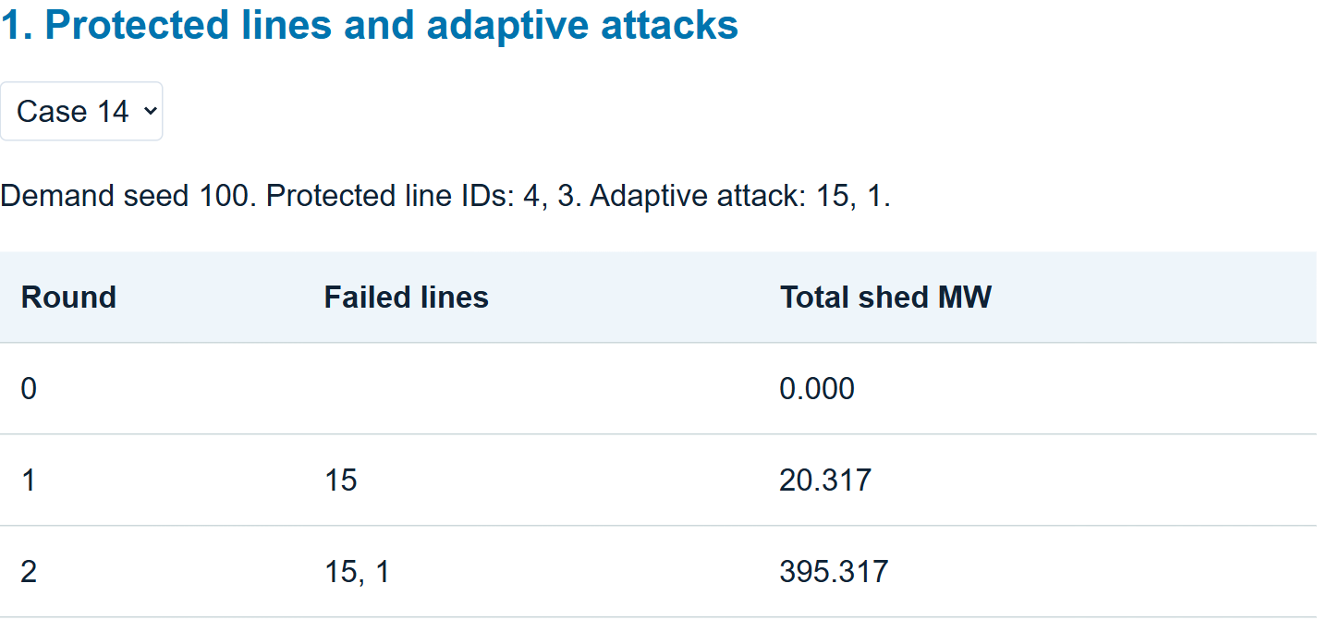
DEMONSTRATION
Demonstration and interpretation
Protection
Protected lines and the replacement worst attack
Timing
The same attack under even, early and late windows
Priority
One selected gain and one selected harm
Open output/demonstration.html. Selectors replay saved traces; CSV and JSON retain the detailed evidence.
28
Notes:
The screenshot is the local output/demonstration.html with recorded SciPy traces. It selects saved data, with no optimizer in the browser. The priority panel includes both selected positive and adverse cases.

Slide 29
CONCLUSIONS
Improvement, mixed evidence and failure
Protection
Timing
Critical service
Useful gains
Different outcomes
Benefits with costs
Case 14 improves; held-out and stress failures remain.
Failure spacing changes final loss and the energy proxy.
Selected service improves; other loss and later harm can increase.
The contribution is a measured investigation of when these choices help, tie or fail.
29
Notes:
Report improvement, inconclusion and failure honestly. None of these studies establishes broad real-world safety. The work completes the bounded second-part course-project scope.
Source: group-sequin/results/extensions/; 67cc294651c518a56c9ffbee8975e3c1aa1582e72a8af3478aa7bbf75be86d80. Group upstream e03e8495fb67af50f00c52daa75908e34960f151.

Slide 30
FUTURE WORK
Next steps motivated by the results
01
Stress failures
Train protection across demand and response-speed uncertainty.
02
Sampled larger cases
Search more strongly for attacks against critical demand. Vary priority groups.
03
Model assumptions
Compare restart rules and dispatch ties. Add lookahead, continuous ramps, restoration, storage and AC checks.
The strongest next experiments follow the failures and uncertainties already observed.
30
Notes:
Prioritize joint robust protection because stress failures were measured, and targeted critical search because the larger cohorts are small. Operator lookahead can test whether myopic choices explain adverse priority cases.
Source: group-sequin/results/extensions/; 67cc294651c518a56c9ffbee8975e3c1aa1582e72a8af3478aa7bbf75be86d80. Group upstream e03e8495fb67af50f00c52daa75908e34960f151.

Slide 31
POWERFUL PRESENTATIONS!
THANK YOU
Neal Creative | click & Learn more

