Slide 1
System Design II
DSD 2020-1-4
Rui ZHANG

Slide 2
Contents
Project Management
Requirement Analysis

Slide 3
Project Management

Slide 4
Team and Duty
6 component, 1 for each;
Algorithm 1
Server
Android Client
Algorithm 2
Algorithm 3
Web (B/S) Client
Assignment
Valhalla
Happiness
nu
Popcorn
LuckyDog
Gourd Island

Slide 5
Gantt
We are HERE!
Role | Task | Week 1 | Week 2 | Week 3 | Week 4 | Week 5 | Week 6 | Week 7 | Week 8
P.M. | Team Construction
 | Progress Control
 | Iteration Evaluation
Liason | Team Communication
 | A.S.M.
R.A. | Customer Communication
 | Requirement Analysis
Arch. | System Design
 | Technique Route
Coder | Implementation
 | Functional Testing
Tester | Test Case Design
 | System Testing

Slide 6
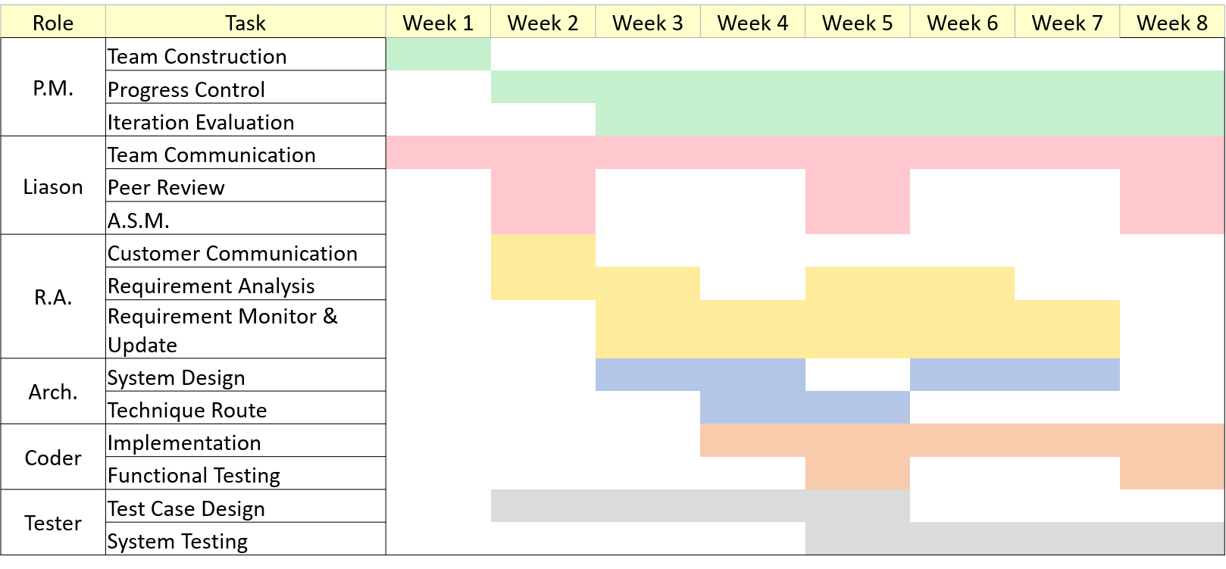
Gantt of Dog-ray

Slide 7
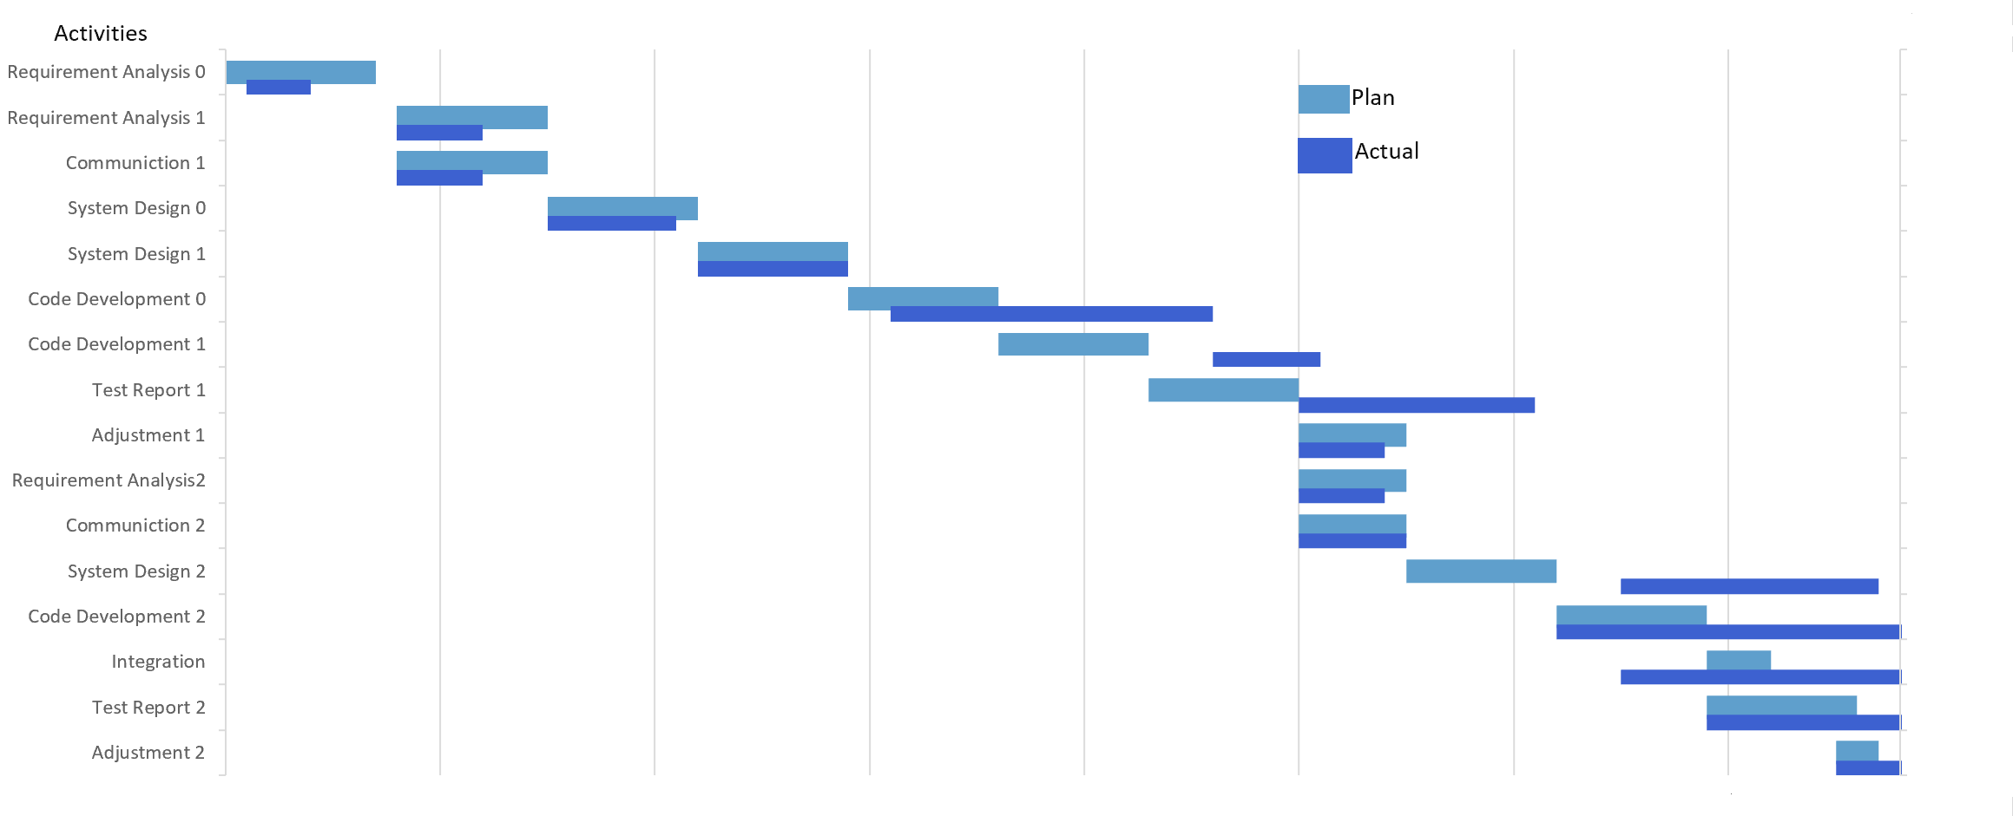
Gantt of Lengends

Slide 8
Remarks Re-visited
Two iterations for the project
Week 1 - Week 5
Week 6 – Week 8
All Sites Meeting (A.S.M.)
3??? times planned, on Week 2, 5 and 8,
for interview, midterm and final presentation
Major tasks are listed but not??? restricted.
Coder and testers are not left till the last minute.

Slide 9
Requirement Analysis
Project Description
Use Case Diagram

Slide 10
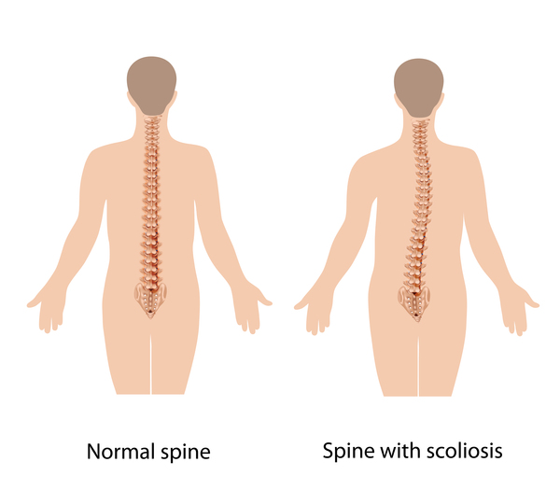
Project Description: Scoliosis Detection
Reference
https://ghr.nlm.nih.gov/condition/adolescent-idiopathic-scoliosis
Requirements
Functionality
Angle calculation
Scoliosis classification
Model migration
Interfaces
Figure import
Figure display
Cobb angle display
Scoliosis class display

Slide 11
Use Case Diagram
Node
Actor
Use Case
Edge
Association/Dependancy
Generalization
Composition/Aggregation
Realization

Slide 12
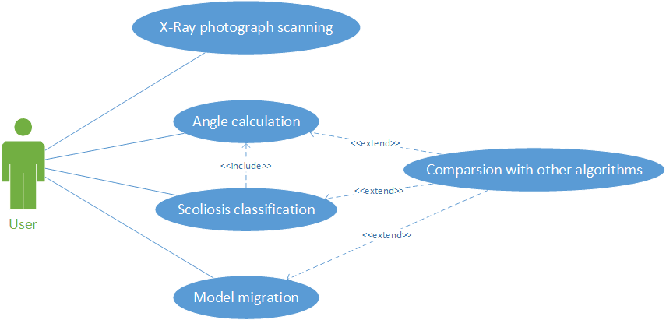
RA Dog-ray

Slide 13
Lengends
1、Users upload X-ray pictures via mobile phones.
2、Users view the analysis results.

Slide 14
Happiness
Case 1: User Log in
Case 2: User Log out
Case 3: User Sign up
Case 4: User Wants to Call the Algorithm
Case 5: Store X-ray Photo data to database
Case 6: Store results data to database
Case 7: Modify relevant results

Slide 15
HappyDogs
Case 1: Server submit the X-Ray photograph
Case 2: Server Wants to do an angle calculation
Case 3: Server Wants to classify the case of scoliosis
Case 4: Server wants to migrate the model

Slide 16
Thanks!

