Slide 1
Coding
DSD 2020-1-5
Rui ZHANG

Slide 2
Contents
Requirement Analysis
System Design
Coding
Management

Slide 3
Requirement Analysis
Project Description
Use Case Diagram

Slide 4
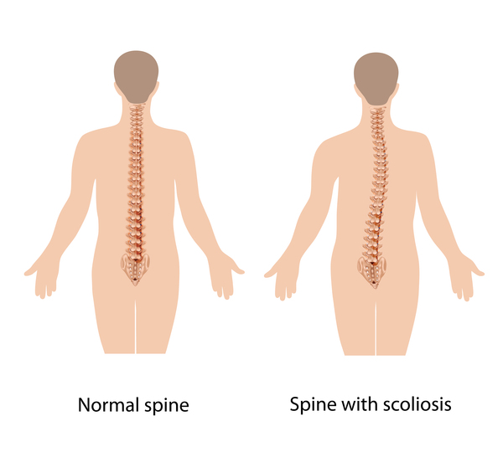
Project Description: Scoliosis Detection
Reference
https://ghr.nlm.nih.gov/condition/adolescent-idiopathic-scoliosis
Requirements
Functionality
Angle calculation
Scoliosis classification
Model migration
Interfaces
Figure import
Figure display
Cobb angle display
Scoliosis class display

Slide 5
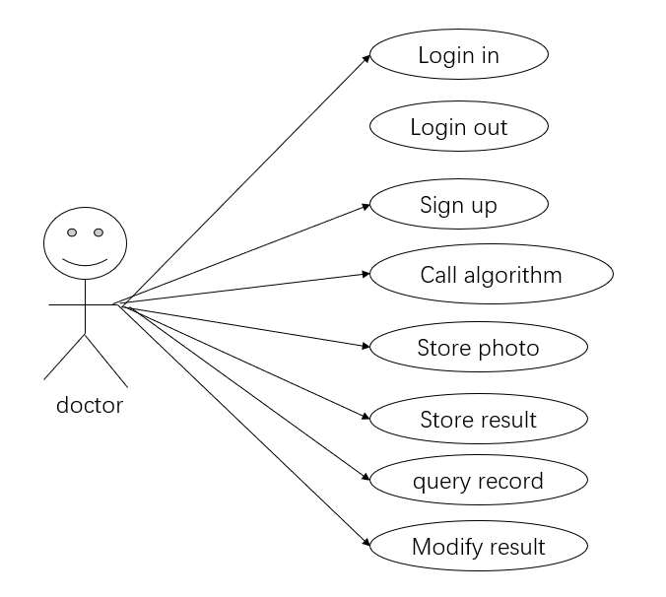
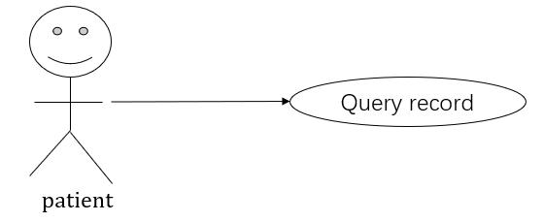
Use Case Diagram (HT)

Slide 6
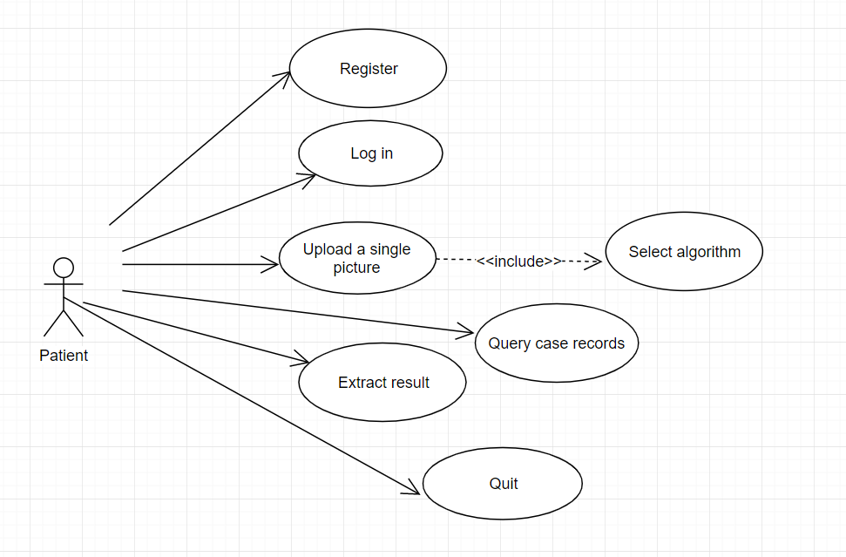
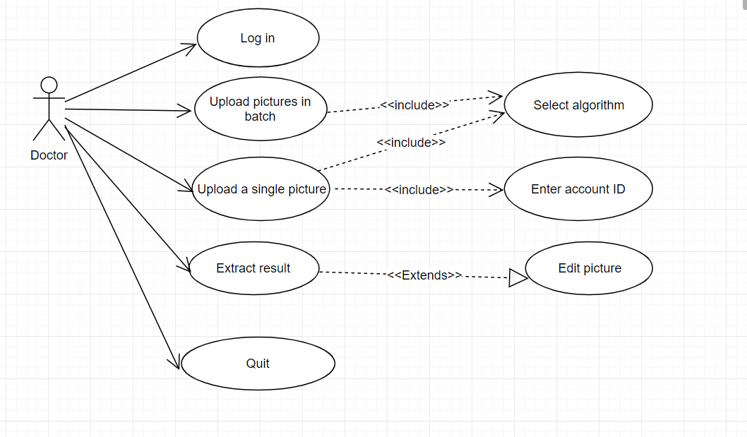
UCD Ctn. (GI)

Slide 7
2. System Design
???

Slide 8
3. Coding
???

Slide 9
Project Management
Gantt
Evaluation

Slide 10
Gantt
We are HERE!
Role | Task | Week 1 | Week 2 | Week 3 | Week 4 | Week 5 | Week 6 | Week 7 | Week 8
P.M. | Team Construction
 | Progress Control
 | Iteration Evaluation
Liason | Team Communication
 | A.S.M.
R.A. | Customer Communication
 | Requirement Analysis
Arch. | System Design
 | Technique Route
Coder | Implementation
 | Functional Testing
Tester | Test Case Design
 | System Testing

Slide 11
Updates on Team Sites
GI: Schedule? The same as Document
DR: https://chenkaima.github.io/DSD-1-Server/ N/A
HT: Sept. 18
LE: https://sailgaosai.github.io/ALC-device/ N/A
PC: incomplete?
LD: incomplete?
No team gantts
No latest news
No complete contact
No intrigue ad.
No interest to read…

Slide 12
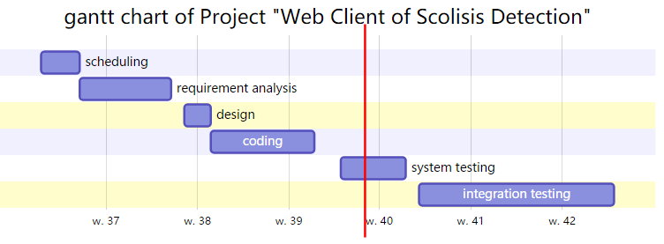
Gourd Island

Slide 13
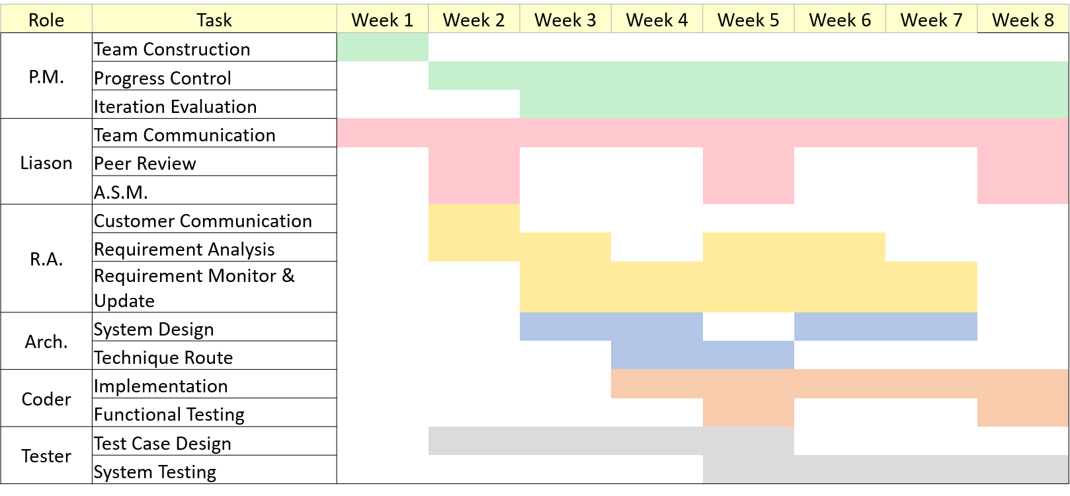
Gantt of Dog-ray ?

Slide 14
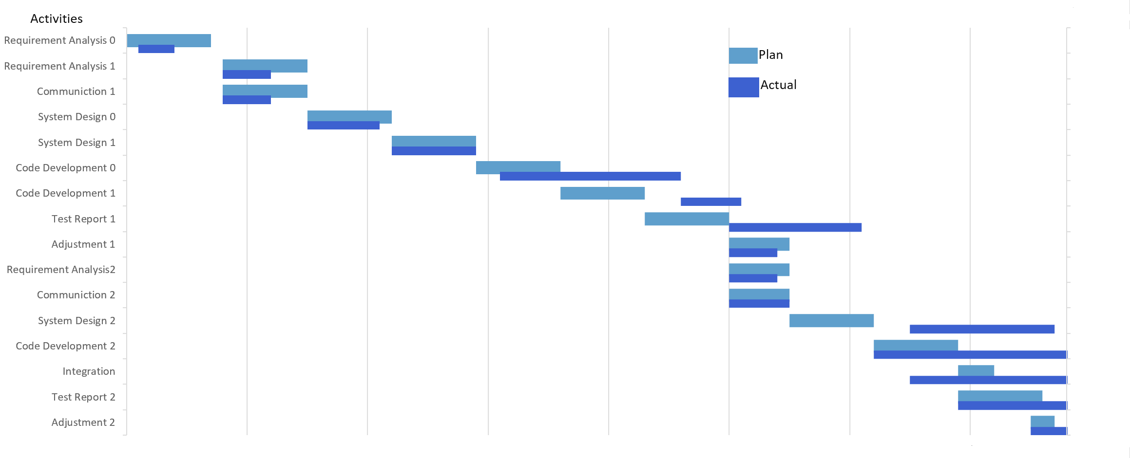
Gantt of Lengends ?

Slide 15

Poll
1 answer(s) at most
When do we have the 1st all-sites-meeting?
A
This weekend
B
Next weekend
C
The weekend after next
D
Never
Submit

Slide 16
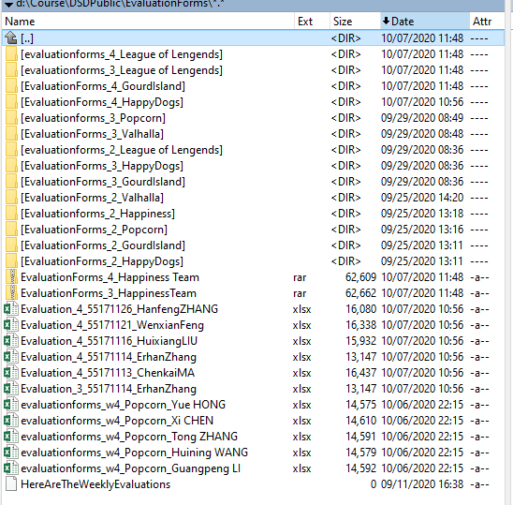
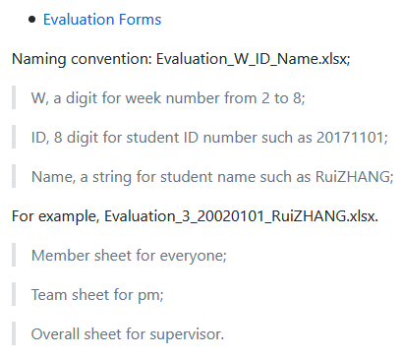
Evaluation

Slide 17
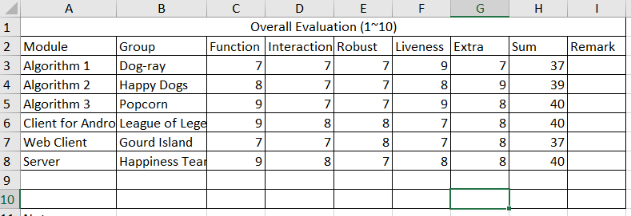
Data
-_-|||

Slide 18
Thanks!

