Slide 1
Testing II
DSD 2020-1-6
Rui ZHANG

Slide 2
Contents
System Design
Coding
Testing
Management

Slide 3
1. System Design

Slide 4
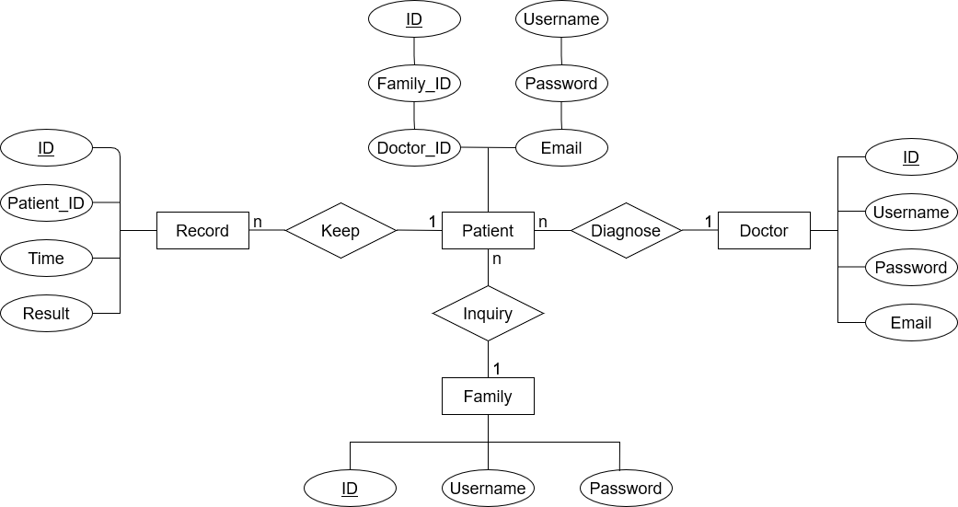
System Design from HT

Slide 5
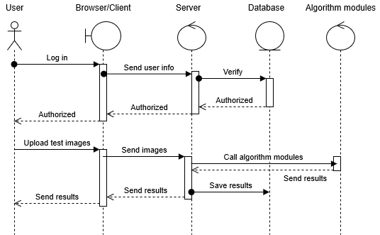
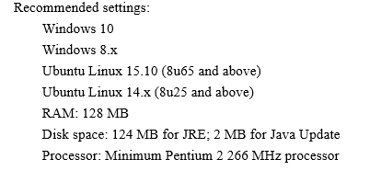
System Design from HT ctn.

Slide 6
System Design from HT —— IS
Services Provided
ID | Service Description | Provided By | Tested By
1 | User Verification (for log-in) | checkUserInfo | T1
2 | User information storage (for registration) | saveUserInfo | T2
3 | Calling algorithm modules | getCobb | T1
4 | Diagnosis record storage | saveDiagnosis | T1
5 | Data retrieval | getPatientHistory getDiagnosisResults | T3
Services Required
ID | Service Description | Provided By | Tested By
1 | Cobb Calculation | calCobb
2 | Test image uploading | getTestImg getBatch
Methods
Method Name | Parameter name | Parameter type | Description
checkUserInfo | userinfo | array of String | check the validity of the user information
saveUserInfo | account | array of String | save the user’s personal information
getCobb | img | Image object | call the algorithm module to get the Cobb angle.
saveDiagnosis | result | array of string | save the result of diagnosis
getPatientHistory | PatientID | Integer | return information of a specific patient
getDiagnosisResults |  |  | return the diagnosis results

Slide 7
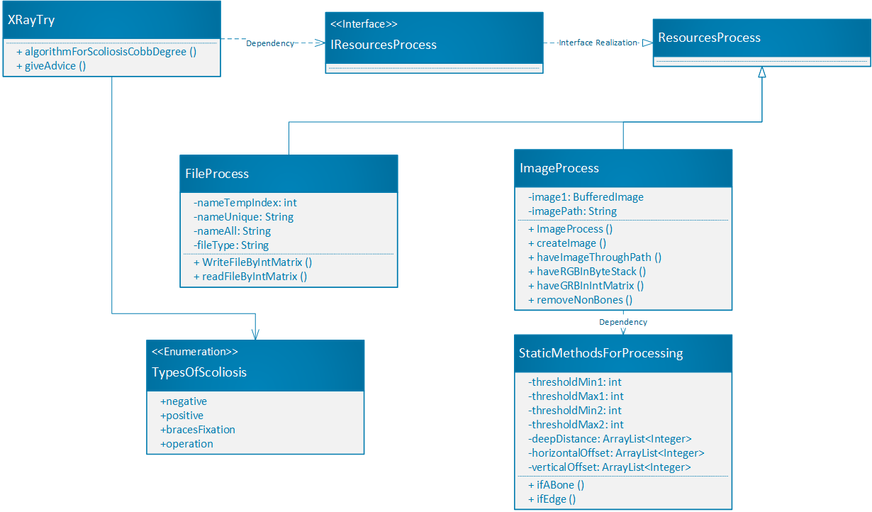
SDS Dog-ray

Slide 8
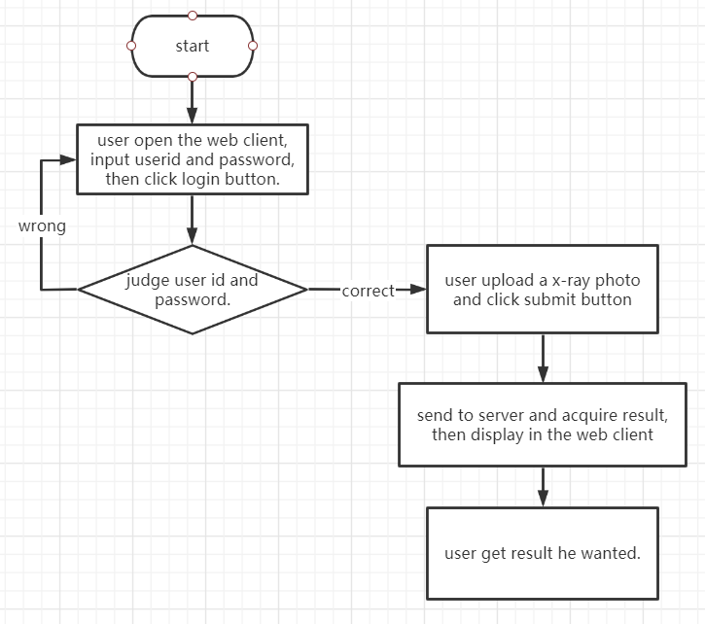
System Design from GourdIsland
Client Detailed Design
1. Register page
2. Login page
3. Doctors use page
4. Patients and their family members page
The patient USES the same interface function as the doctor.Their common function is to upload individual images and display the results.The doctor's interface also has batch photo upload, display results can be edited and patient data search and other functions.The patient interface has a historical view of photos you have uploaded in the past.
NO Updates

Slide 9
System Design from Popcorn
4.4 Algorithm design
4.4.1 Convolutional Neural Network
Convolutional neural network(CNN) is a specially designed artificial neural network with multiple hidden layers based on the study of cells in the visual cortex of cats by Hub and others. Convolutional layer, pooling layer, and activation function are important components of convolutional neural networks.
…
4.4.2 Object detection problem
…
4.4.3 Curve fitting and calculating angle
…
NO Updates

Slide 10
2. Coding
???

Slide 11
3. Testing

Slide 12
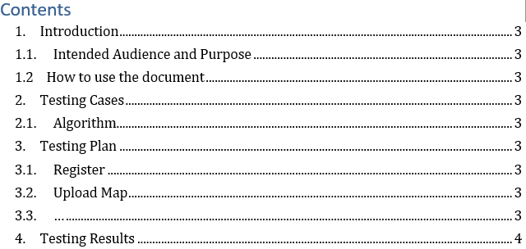
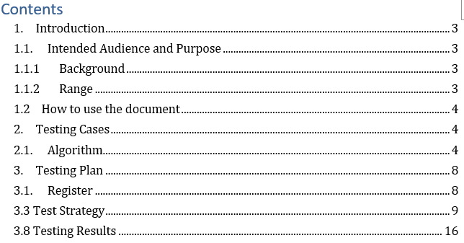
TR-Lucky Dogs

Slide 13
TR Dog-ray
Testing Cases
Algorithm for Edge Detection
We will process the pictures which were given to us and try to detect their edges.
Algorithm for the Degree of the Cobb
This content of this section will be wrote in the future, for the testing of it is not complete.
Testing Plan
Upload Pictures
The pictures which will be processed will be uploaded by the Server Team.
Process Pictures
The pictures will be processed, and the Cobb Degree will be obtained.
Give Advice
The advice will be given according to the Cobb Degree.
Test Case No. | Module | Result | Corresponding Requirement
0001 | Algorithm for Edge Detection | Have some significant problems that need to be solved. | Detecting the edges of the bones.

Slide 14
4. Project Management
Gantt
Evaluation

Slide 15
Gantt
We are HERE!
Role | Task | Week 1 | Week 2 | Week 3 | Week 4 | Week 5 | Week 6 | Week 7 | Week 8
P.M. | Team Construction
 | Progress Control
 | Iteration Evaluation
Liason | Team Communication
 | A.S.M.
R.A. | Customer Communication
 | Requirement Analysis
Arch. | System Design
 | Technique Route
Coder | Implementation
 | Functional Testing
Tester | Test Case Design
 | System Testing

Slide 16
Thanks!

