Slide 1
System Design
DSD 2020-1-3
Rui ZHANG

Slide 2
Contents
Project Management
Requirement Analysis

Slide 3
Project Management

Slide 4
Team and Duty
5 students for each team;
6 teams in all;
6 component, 1 for each;
Algorithm 1
Server
Android Client
Algorithm 2
Algorithm 3
Web (B/S) Client
Assignment 1：
Update team web sites for
component distribution

Slide 5
Gantt
We are HERE!
Role | Task | Week 1 | Week 2 | Week 3 | Week 4 | Week 5 | Week 6 | Week 7 | Week 8
P.M. | Team Construction
 | Progress Control
 | Iteration Evaluation
Liason | Team Communication
 | A.S.M.
R.A. | Customer Communication
 | Requirement Analysis
Arch. | System Design
 | Technique Route
Coder | Implementation
 | Functional Testing
Tester | Test Case Design
 | System Testing

Slide 6
Remarks Re-visited
Two iterations for the project
Week 1 - Week 5
Week 6 – Week 8
All Sites Meeting (A.S.M.)
3??? times planned, on Week 2, 5 and 8,
for interview, midterm and final presentation
Major tasks are listed but not??? restricted.
Coder and testers are not left till the last minute.

Slide 7
Requirement Analysis
Project Description
Use Case Diagram

Slide 8
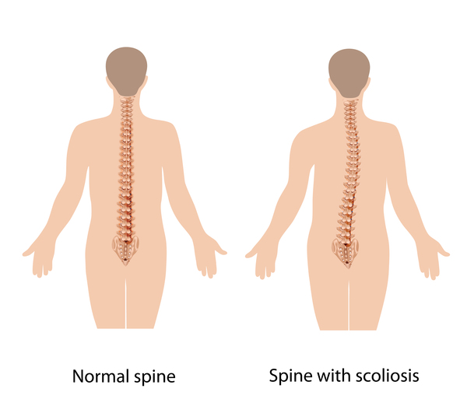
Project Description: Scoliosis Detection
Reference
https://ghr.nlm.nih.gov/condition/adolescent-idiopathic-scoliosis
Requirements
Functionality
Angle calculation
Scoliosis classification
Model migration
Interfaces
Figure import
Figure display
Cobb angle display
Scoliosis class display

Slide 9
Use Case Diagram
Node
Actor
Use Case
Edge
Association/Dependancy
Generalization
Composition/Aggregation
Realization

Slide 10
Thanks!

