Slide 1
Requirement Analysis
DSD 2020-1-2
Rui ZHANG

Slide 2
Contents
Team construction
Project Plan
Self-Evaluation
Requirement Analysis

Slide 3
Team Construction

Slide 4
Plan
5 students for each team;
6 teams in all;
Each team take one component of a project proposed.

Slide 5
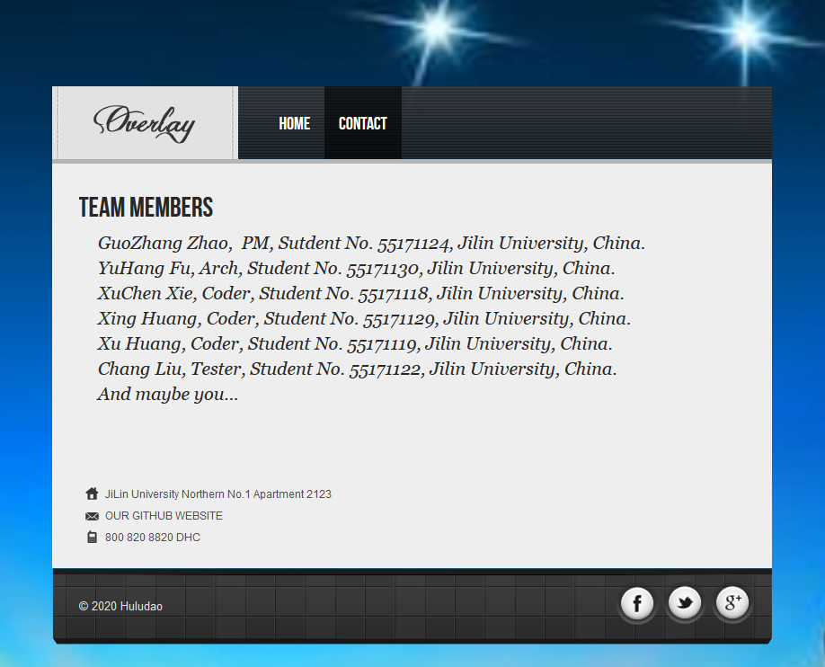
Gourd Island???
Huludao???
https://adventurousdream.github.io/index.html
Members???
GuozhangZHAO
YuhangFU
XuchenXie
XingHUANG
XuHUANG
ChangLIU
Assignments
Indoor Positioning via Wi-Fi Fingerprint???

Slide 6
Valhalla
Name
https://chenkaima.github.io/DSD-1-Server/
Members
ChenkaiMA
HanfengZHANG
HuixiangLIU
WenxianFENG
ErhanZHANG
Assignments

Slide 7
?
Name
Members
GuangpengLI
张桐 陈希 王惠宁和洪乐
Assignments

Slide 8
??
Name
Members
陈宇哲 杜维康 刘世喆 修可栋 安迪
Assignments

Slide 9
???
Name
Members
Assignments

Slide 10
????
Name
Members
Assignments

Slide 11
Project Plan

Slide 12
Gantt
Role | Task | Week 1 | Week 2 | Week 3 | Week 4 | Week 5 | Week 6 | Week 7 | Week 8
P.M. | Team Construction
 | Progress Control
 | Iteration Evaluation
Liason | Team Communication
 | A.S.M.
R.A. | Customer Communication
 | Requirement Analysis
Arch. | System Design
 | Technique Route
Coder | Implementation
 | Functional Testing
Tester | Test Case Design
 | System Testing

Slide 13
Remarks
Two iterations for the project
Week 1 - Week 5
Week 6 – Week 8
All Sites Meeting (A.S.M.)
3 times planned, on Week 2, 5 and 8,
for interview, midterm and final presentation
Major tasks are listed but not restricted.
Coder and testers are not left till the last minutes.

Slide 14
Self Evaluation
Evaluate your performance last week

Slide 15
Requirement Analysis
Requirement Specification
Use Case Diagram

Slide 16
Project List
1. Indoor Positioning via Wi-Fi Finger Print (IP)
2. Intelligent Light Control in Classrooms (IL)
3. Scoliosis Detection via X-ray Photo Recognition (SD)
4. Online Medicine Sales Management System (MS)

Slide 17
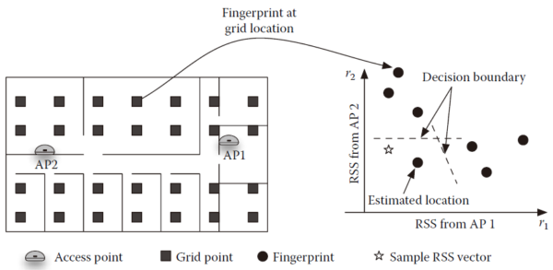
Project 1: Indoor Positioning
Reference
https://www.cnblogs.com/rubbninja/p/6120964.html
Requirements
Mobile device application
Fingerprint collection
Wi-Fi position fixing
Runtime positioning
Desktop application
Statistics
Access control
History based position prediction

Slide 18
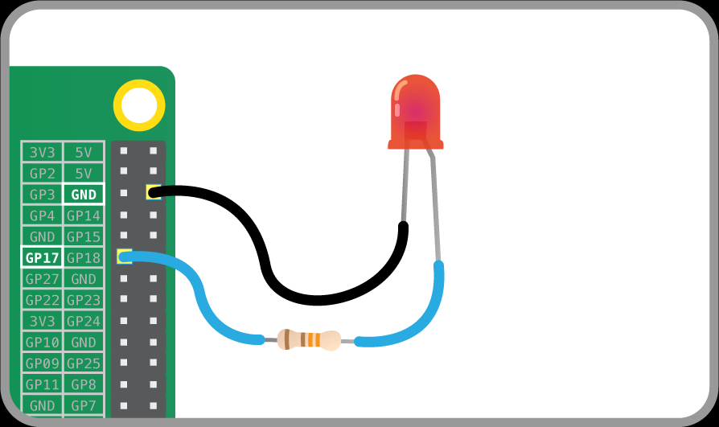
Project 2: Intelligent Light Control
Reference
CSDN
Requirements
Daylight detection
Raspberry Pi sensor
Signal processing and transmission
Remote light control
Rule based light control algorithm
Electricity saving oriented strategy
Authority distribution

Slide 19
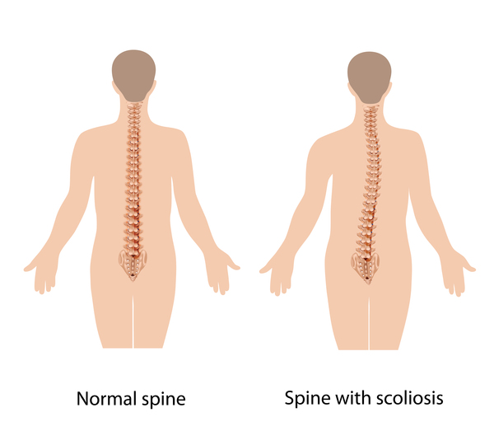
Project 3: Scoliosis Detection
Reference
https://ghr.nlm.nih.gov/condition/adolescent-idiopathic-scoliosis
Requirements
Functionality
Angle calculation
Scoliosis classification
Model migration
Interfaces
Figure import
Figure display
Cobb angle display
Scoliosis class display

Slide 20

Project 4: Online Medicine Shop
Reference
yibangyi
Requirements
Different interface for aged people
Stable services with simultaneous accesses

Slide 21
Thanks!

