Slide 1
Requirement Analysis Iteration 2
DSD 2020-1-8
Rui ZHANG

Slide 2
Contents
Summary of 1st ASM
Testing
RA-II
Management

Slide 3
1. Summary of 1st ASM

Slide 4
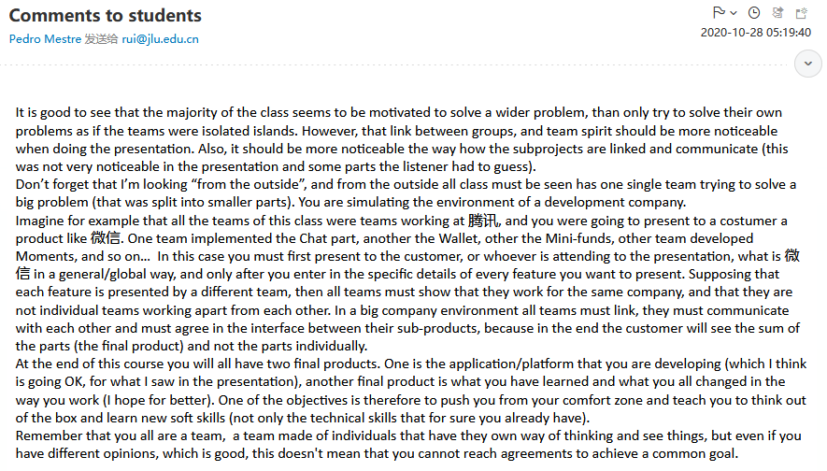
Comments to Students

Slide 5
More Details from Prof. Mestre
Team spirit should be more noticeable in the presentation.
Overall design and component interaction not clearly specified.
Failed to simulate the presentation to the customer, from a software development company.
Imagine for example that all the teams of this class were teams working at 腾讯, and you were going to present to a costumer a product like 微信. One team implemented the Chat part, another the Wallet, other the Mini-funds, other team developed Moments, and so on… In this case you must first present to the customer, or whoever is attending to the presentation, what is 微信 in a general/global way, and only after you enter in the specific details of every feature you want to present.
Supposing that each feature is presented by a different team, then all teams must show that they work for the same company, and that they are not individual teams working apart from each other. In a big company environment all teams must link, they must communicate with each other and must agree in the interface between their sub-products, because in the end the customer will see the sum of the parts (the final product) and not the parts individually.

Slide 6

Open Question
Points: 10
`At the end of the course, you will all have two final products’ said Prof. Mestre.
Can you guess what are they?
Open Question is only supported on Version 2.0 or newer.
Answer

Slide 7
The reference answer
what you have learned and what you all changed in the way you work (I hope for better).
One of the objectives is therefore to push you from your comfort zone and teach you to think out of the box and learn new soft skills (not only the technical skills that for sure you already have).
Remember that you all are a team, a team made of individuals that have they own way of thinking and see things, but even if you have different opinions, which is good, this doesn't mean that you cannot reach agreements to achieve a common goal.​

Slide 8
Summary from Students (Partial)
How to serve for European patients? How to make sure that our product follows the regulations like GDPR? How to make the translation more precise?
Enterprise development is multi-person collaborative development
Proud of the achievement of our team
Coding/testing progress is not fast enough
The risk of potential overfitting in the future
Utilization rate of documents is not high, and the role of documents in the project process is not fully utilized.
Lack of adequate testing.
First time to know each other’s detailed work.
Lack of picture, lack of angle info, lack of coordination
Lack of testing, supervision and communication (inner/between), responsibility
Communicate with other teams to clarify customers' needs
Preparations as thoroughly as possible

Slide 9
Summary from Students (Partial)
when you want to show the function of a neural network, it’s better to put a few of pictures in the ppt.
The requirement analysis needs to be modified repeatedly, and the division of use cases is not clear.
There was little communication between groups and that some of the expected tasks were not actually completed.
performance of the algorithm
delay in contact with the doctor
There are many problems in the communication with other groups.
Progress delayed, not strictly according to the documentation
more attention to the user experience
not paying attention to requirements analysis, inter-group discussions and testing work

Slide 10

What is good?
We made it.
Ordered
Responsibility
Working demo

Slide 11

What is …
Contents
Naïve demo
Not well-prepared presentation
There should be an overall RA, SD document presentation
Each team should present all the phases of his/her own component
Each team should have his/her contribution, maybe plus his/her photo and name
Testing results should be presented
Presentation
Unstable laptops
Unstable microphone
Not connected content

Slide 12
2. Testing
Show time

Slide 13
3. RA-II

Slide 14
`New Requirements’
English and Chinese translations
Automated /semi-automated algorithm shift
Lunke classification

Slide 15
4. Project Management

Slide 16
Gantt
We are HERE!
Role | Task | Week 1 | Week 2 | Week 3 | Week 4 | Week 5 | Week 6 | Week 7 | Week 8
P.M. | Team Construction
 | Progress Control
 | Iteration Evaluation
Liason | Team Communication
 | A.S.M.
R.A. | Customer Communication
 | Requirement Analysis
Arch. | System Design
 | Technique Route
Coder | Implementation
 | Functional Testing
Tester | Test Case Design
 | System Testing

Slide 17
Thanks!

