Slide 1
Testing
DSD 2020-1-6
Rui ZHANG

Slide 2
Contents
System Design
Coding
Management
Testing

Slide 3
0. Before SD

Slide 4
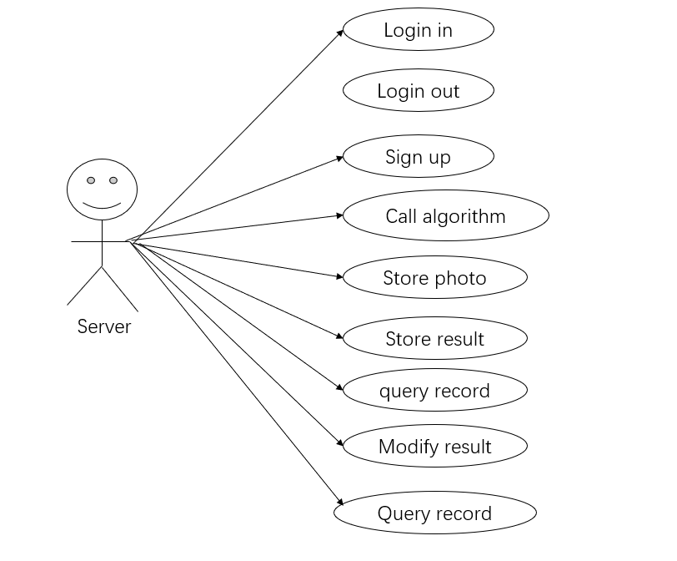
Use Case Diagram from Happiness

Slide 5
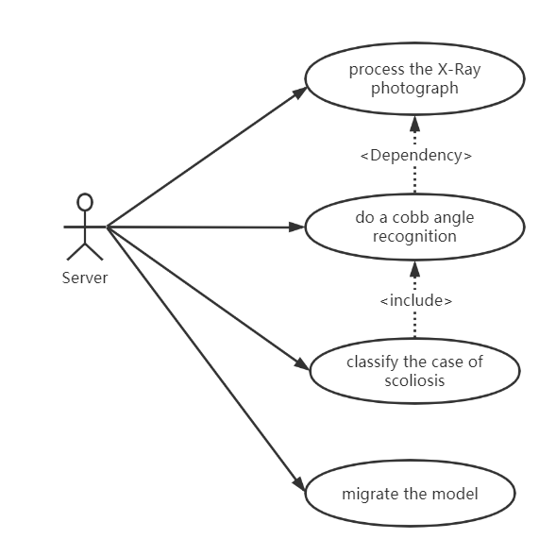
Use Case Diagram from HappyDogs

Slide 6
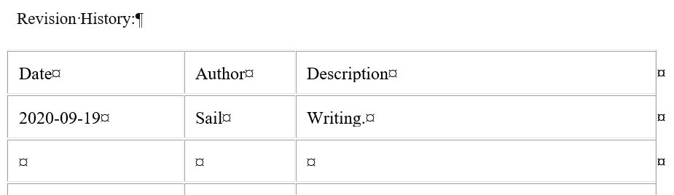
Use Case Diagram from Lengends

Slide 7
Use Case Diagram from DogRay

Slide 8
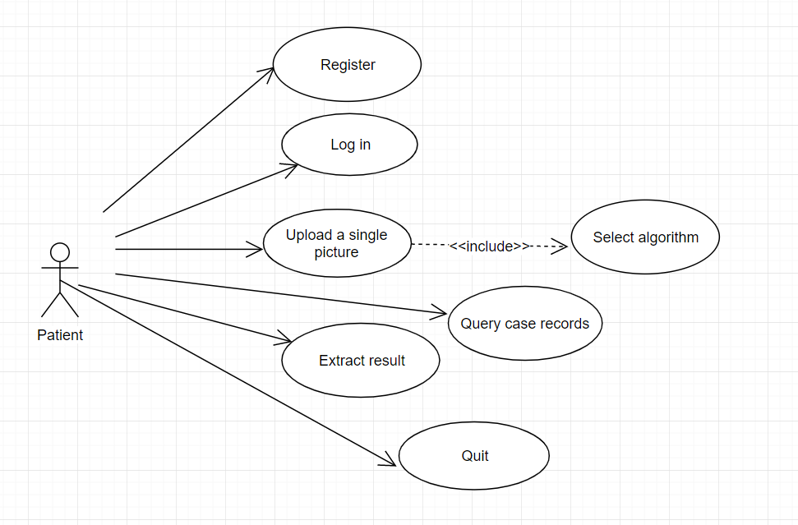
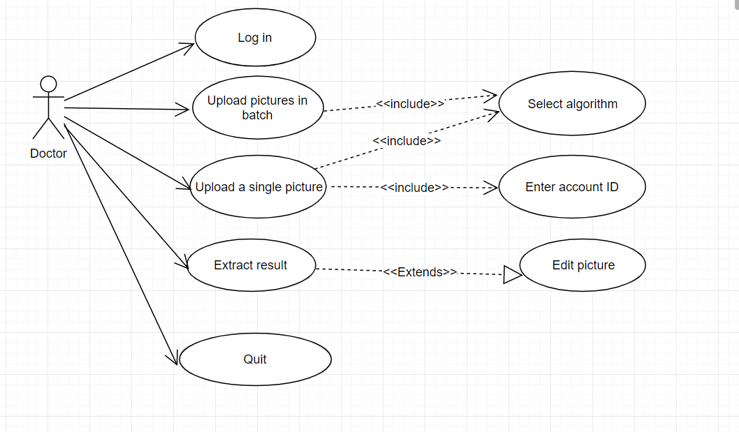
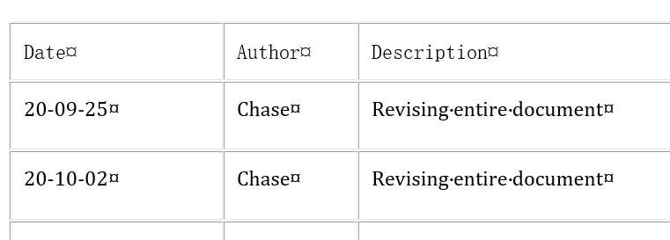
Use Case Diagram from GourdIsland

Slide 9
2. System Design

Slide 10
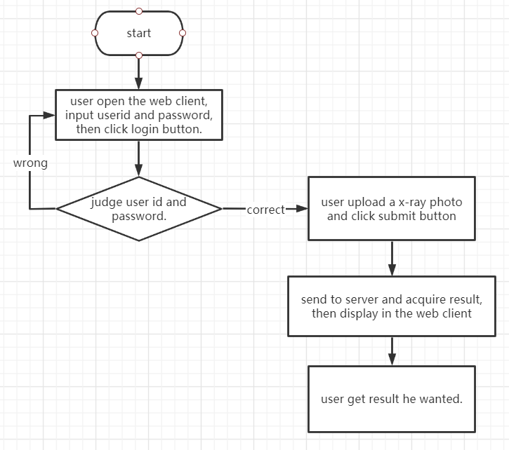
System Design from GourdIsland Ctn.
Server Detailed Design
1. Register
2. Login
3. Batch upload pictures
4. Picture upload and result display
5. Auxiliary line edit and upload results
6. Search history by one patient
7. Search information of a specific patient by the doctor

Slide 11
System Design from GourdIsland
Client Detailed Design
1. Register page
2. Login page
3. Doctors use page
4. Patients and their family members page
The patient USES the same interface function as the doctor.Their common function is to upload individual images and display the results.The doctor's interface also has batch photo upload, display results can be edited and patient data search and other functions.The patient interface has a historical view of photos you have uploaded in the past.

Slide 12
System Design from Popcorn
4.4 Algorithm design
4.4.1 Convolutional Neural Network
Convolutional neural network(CNN) is a specially designed artificial neural network with multiple hidden layers based on the study of cells in the visual cortex of cats by Hub and others. Convolutional layer, pooling layer, and activation function are important components of convolutional neural networks.
…
4.4.2 Object detection problem
…
4.4.3 Curve fitting and calculating angle
…

Slide 13
3. Coding
???

Slide 14
4. Testing
???

Slide 15
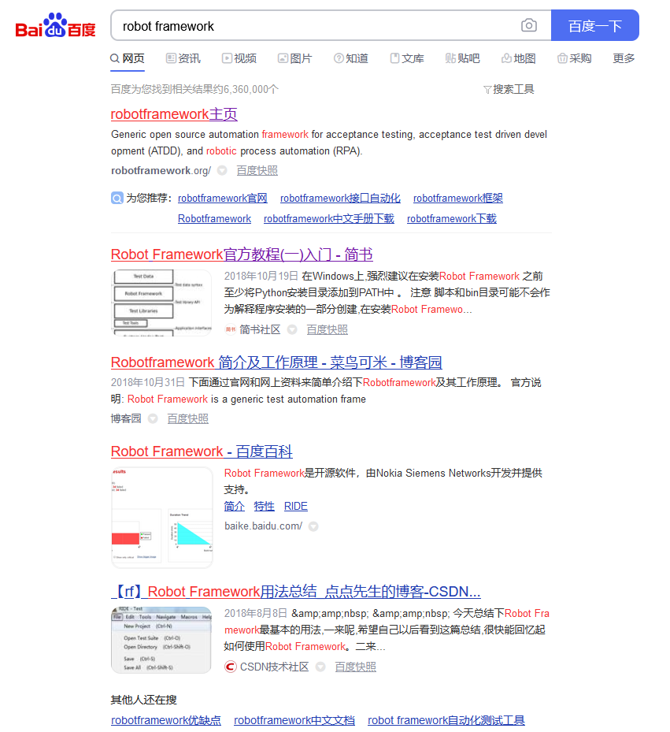
Automated Testing

Slide 16
5. Project Management
Gantt
Evaluation

Slide 17
Gantt
We are HERE!
Role | Task | Week 1 | Week 2 | Week 3 | Week 4 | Week 5 | Week 6 | Week 7 | Week 8
P.M. | Team Construction
 | Progress Control
 | Iteration Evaluation
Liason | Team Communication
 | A.S.M.
R.A. | Customer Communication
 | Requirement Analysis
Arch. | System Design
 | Technique Route
Coder | Implementation
 | Functional Testing
Tester | Test Case Design
 | System Testing

Slide 18
Team Sites
All sites are available.
Few sites are updated.

Slide 19
Evaluation
All teams are pulling the forms in the right place, except…

Slide 20
Data
Everyone is supposed to …
Name your file according to the naming conventions.
Evaluate the performance of you teammates (not yourself).
Grades should be carefully weighed.
PM is supposed to …
Complete the tasks for everyone.
Evaluate the performance of the other teams (not his/her own).

Slide 21
Thanks!

