Slide 1
ARCANE: Adversarial Robustness using class-conditional generative models
Arian Tashakkor
Advisor: Dr. Mohammad Hossein Manshaei
Isfahan University of Technology

Slide 2
overview
Motivation
Introduction to Adversarial Attacks
Existing Adversarial Defense Methods
Proposed Method: ARCANE
Experimental Results
Future Work & Conclusion

Slide 3
Motivation

Slide 4
Motivation
AI systems are rapidly advancing across industries:
77% of the devices used worldwide include at least one AI feature.
In the US 50% of the mobile users utilize voice search daily.
By 2030, it’s estimated that 10% of all vehicles will be self-driving.
AI is very highly valuated:
Currently the global AI market is valued at over $196 billion.
Which is projected to increase by a factor of 13x over the next 7 years.
The US AI market alone is forecast to reach $299.65 billion by 2026.
By 2025, as many as 97 million people will work in the AI space.

Slide 5
Motivation
With AI so ingrained in our daily lives, it is important to ensure their safety against potential cyberattacks.
A class of which, dubbed Adversarial Attacks, can manipulate AI models by adding imperceptible amounts of noise to an input.
These attacks can affect a vast array of AI models:
Autonomous Vehicles
Facial Recognition Systems
Intrusion Detection Systems
Large Language Models
…

Slide 6
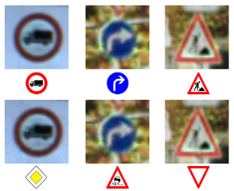
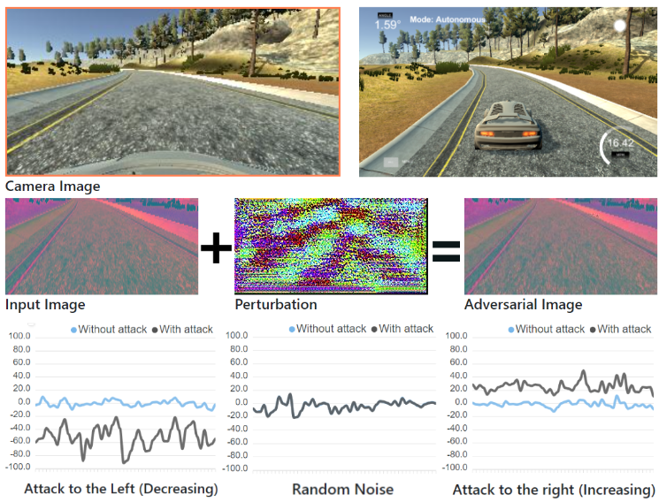
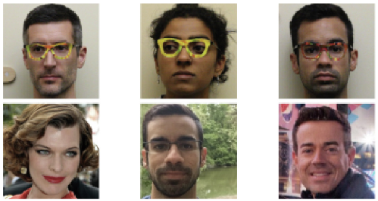
Motivation

Slide 7
Introduction to Adversarial attacks

Slide 8
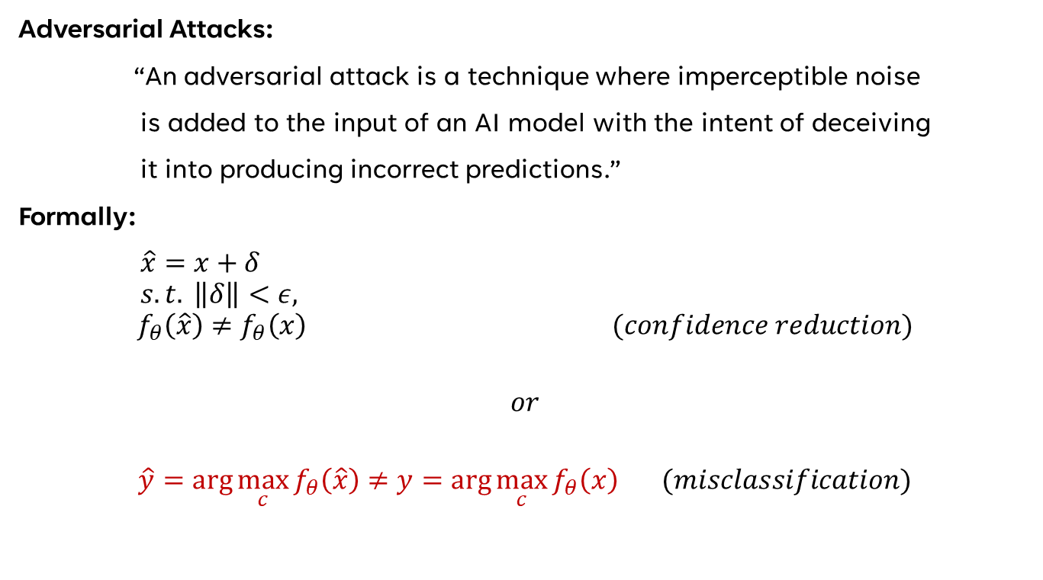
Introduction to Adversarial attacks
Adversarial Attacks:
“An adversarial attack is a technique where imperceptible noise
is added to the input of an AI model with the intent of deceiving
it into producing incorrect predictions.”
Formally:
$\hat{x}=x+δ$ $s.t. \left\|δ\right\|<ε,$
$$f_{θ}\left(\hat{x}\right)≠f_{θ}\left(x\right) (confidence reduction)$$
$$or$$
$$\hat{y}=\arg{\max_{c}{f_{θ}\left(\hat{x}\right)}}≠y=\arg{\max_{c}{f_{θ}\left(x\right)}} (misclassification)$$

Slide 9
Introduction to Adversarial attacks
White-box Attack:
Attacker presumed to have total access to model, including it’s output logits, gradients, training data, etc.
Black-box Attack:
Attacker presumed to have limited access to the model, potentially only to the output predictions or at most, the raw logits.
In this study we will be focusing on defense against white-box attacks.

Slide 10
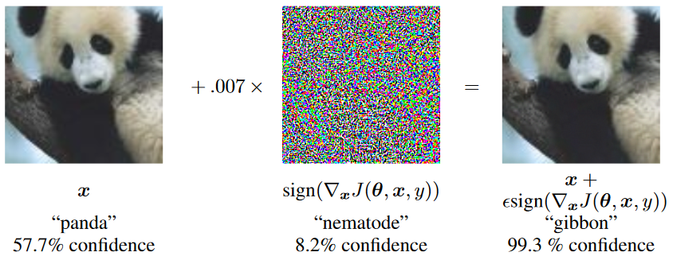
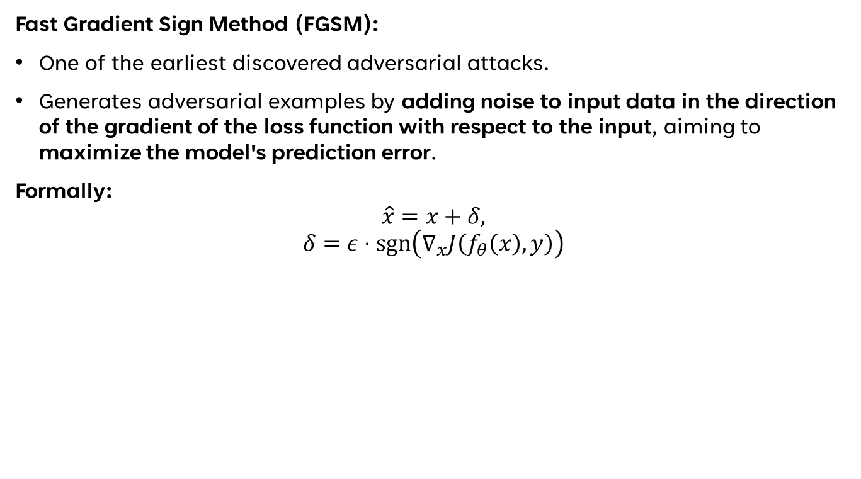
Introduction to Adversarial attacks (FGSM)
Fast Gradient Sign Method (FGSM):
One of the earliest discovered adversarial attacks.
Generates adversarial examples by adding noise to input data in the direction of the gradient of the loss function with respect to the input, aiming to maximize the model's prediction error.
Formally:
$$\hat{x}=x+δ,$$
$$δ=ε⋅\operatorname{sgn}\left(∇_{x}J\left(f_{θ}\left(x\right),y\right)\right)$$

Slide 11
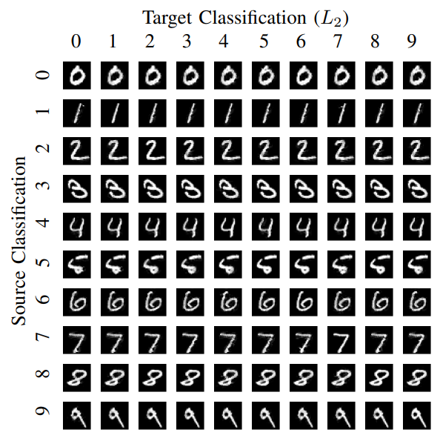
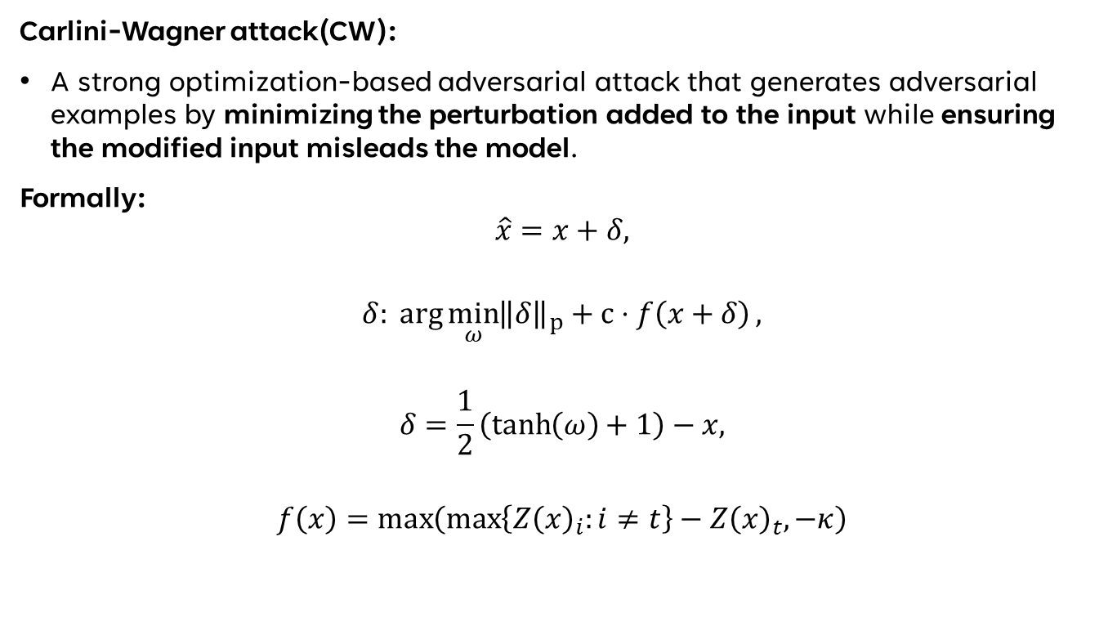
Introduction to Adversarial attacks (CW)
Carlini-Wagner attack(CW):
A strong optimization-based adversarial attack that generates adversarial examples by minimizing the perturbation added to the input while ensuring the modified input misleads the model.
Formally:
$$\hat{x}=x+δ,$$
$$δ: \arg{\min_{ω}{{\left\|δ\right\|}_{p}+c⋅f\left(x+δ\right)}},$$
$$δ=\frac{1}{2}\left(\tanh\left(ω\right)+1\right)−x,$$
$$f\left(x\right)=\max\left(\max\left\{Z{\left(x\right)}_{i}:i≠t\right\}−Z{\left(x\right)}_{t},−κ\right)$$

Slide 12
Existing Adversarial Defense Methods

Slide 13
Existing Adversarial Defense Methods
Adversarial Defense:
Detection: Simply detect the existence of an attack.
Purification: Make the victim model more robust so that it manages to deflect adversarial attacks or use and auxiliary model to correct the prediction output of the victim model.
Our focus: Detection + Purification using an auxiliary model

Slide 14
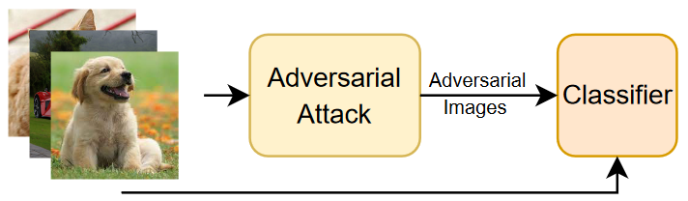
Existing Adversarial Defense Methods
Adversarial Training:
Make adversarial samples.
Train model on a mix of normal and adversarial samples.

Slide 15
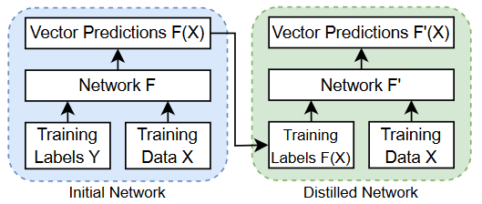

Existing Adversarial Defense Methods
Defensive Distillation:
Train model $F$ on dataset $D:(X, Y)$ to obtain predictions $F(X)$.
Train distilled model $F_{distilled}$ on $D^{′}:\left(X, F\left(X\right)\right)$.
Compact model with relaxed labels $→$ More robust against attacks with less risk of overfitting.

Slide 16
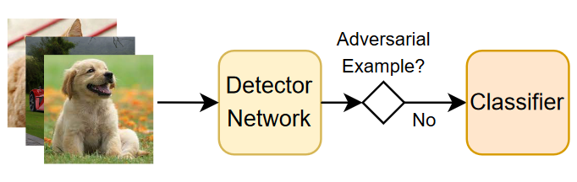
Existing Adversarial Defense Methods
Detectors:
Estimate the statistical features of clean samples with a mathematical model.
Decide if given sample is adversarial through the trained model.

Slide 17
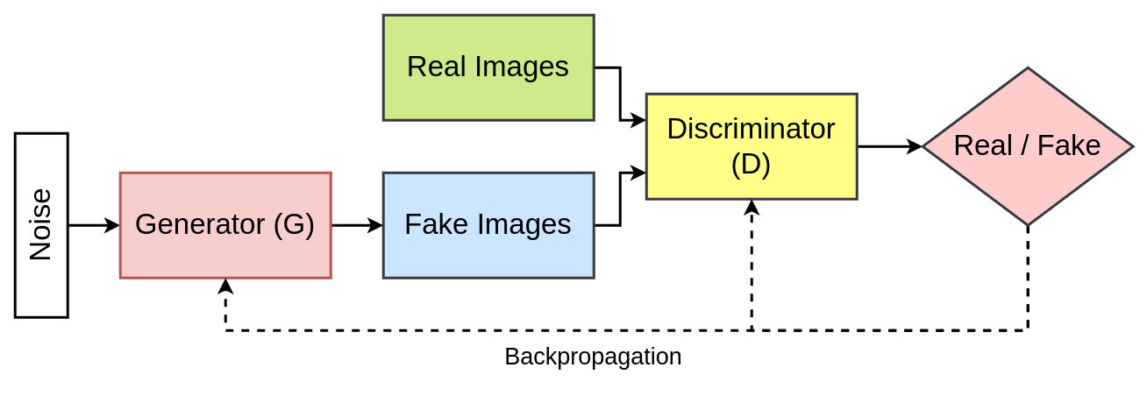
Detour: GANs
Generative Adversarial Networks (GANs):

Slide 18
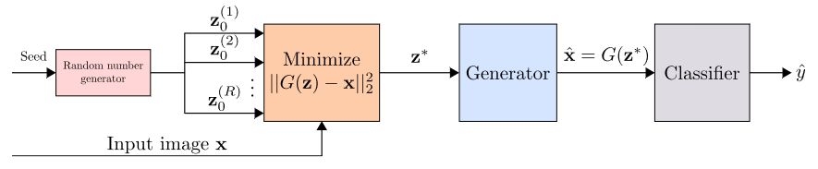

Existing Adversarial Defense Methods
Projection (Our Focus):
Train generative model $G$ on clean samples.
At test time, project input image $x$ onto the distribution learned by $G.$
I.e., $x_{clean}=\arg{\min_{G\left(z\right)}{{\left\|x−G\left(z\right)\right\|}_{2}^{2}}}$
Example: Defense-GAN

Slide 19
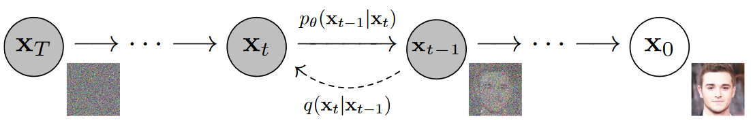
Detour: Diffusion Models
Diffusion Models:

Slide 20
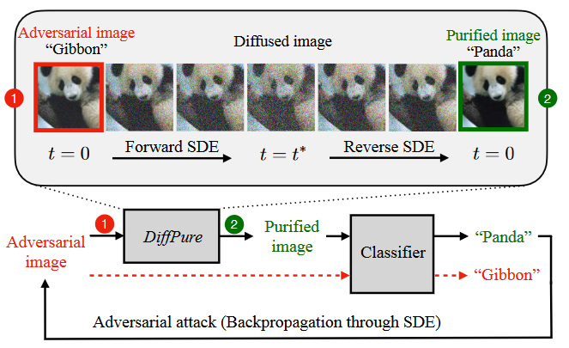

Existing Adversarial Defense Methods
Projection:
Example: DiffPure
Train a generative diffusion model $Diff$ on the clean samples.
Forward diffusion for $t^{∗}$ timesteps.
Backward diffusion for $t^{∗}$ timesteps.

Slide 21
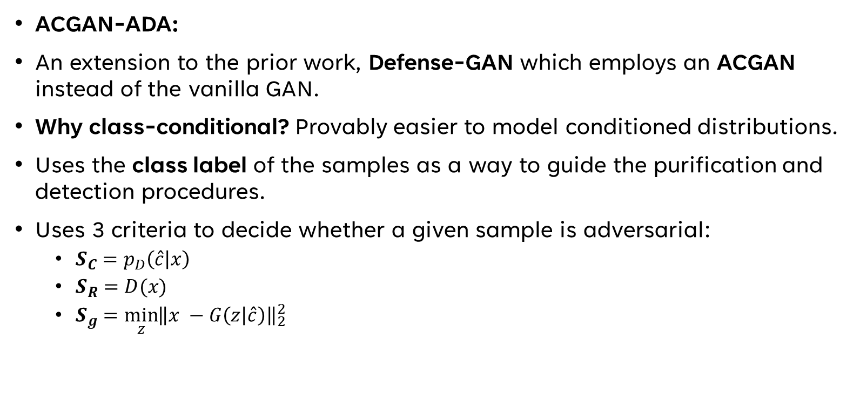
Existing Adversarial Defense Methods - Predecessor
ACGAN-ADA:
An extension to the prior work, Defense-GAN which employs an ACGAN instead of the vanilla GAN.
Why class-conditional? Provably easier to model conditioned distributions.
Uses the class label of the samples as a way to guide the purification and detection procedures.
Uses 3 criteria to decide whether a given sample is adversarial:
${S_{C}=p}_{D}\left(\hat{c} | x\right)$
$S_{R}=D(x)$
$S_{g}=\min_{z}{{\left\|x −G\left(z | \hat{c}\right)\right\|}_{2}^{2}}$

Slide 22
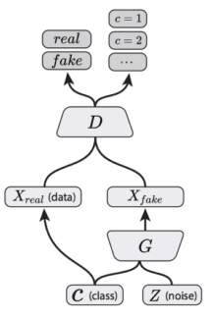


DETOUR: ACGAN
Auxiliary Classifier Generative Adversarial Networks (ACGANs):
Generator Objective:
$\min{L_{C}−L_{S}}$
Discriminator Objective:
$\min{L_{C}+L_{S}}$

Slide 23
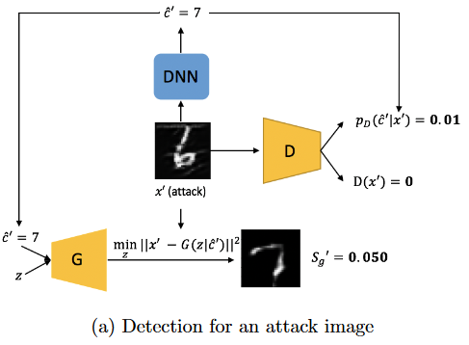
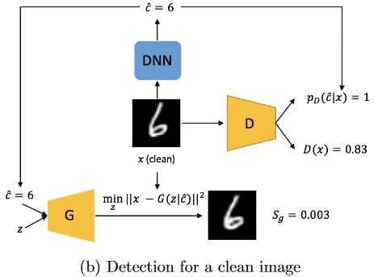
Existing Adversarial Defense Methods - Predecessor
ACGAN-ADA:

Slide 24
Existing Adversarial Defense Methods - Predecessor
ACGAN-ADA Shortcomings:
Poor performance when the dataset has many modes.
Poor generation quality for purification tasks.
Use of limited criteria with manually tuned hyperparameters.

Slide 25
Proposed Method: Arcane

Slide 26
Proposed Method: Arcane
We aim to improve ACGAN-ADA by:
Employing a more advanced ACGAN architecture (ReACGAN) that boosts the performance in highly multi-modal settings.
Adding new decision criteria for adversarial sample detection and use of a trained XGBoost classifier instead of manually tuned thresholds.
Moreover, we investigate the use of Conditional Diffusion Models instead of GANs to see how they can affect purification performance.
Finally, we present a novel purification regime to make use of the conditional generative models to the fullest.

Slide 27
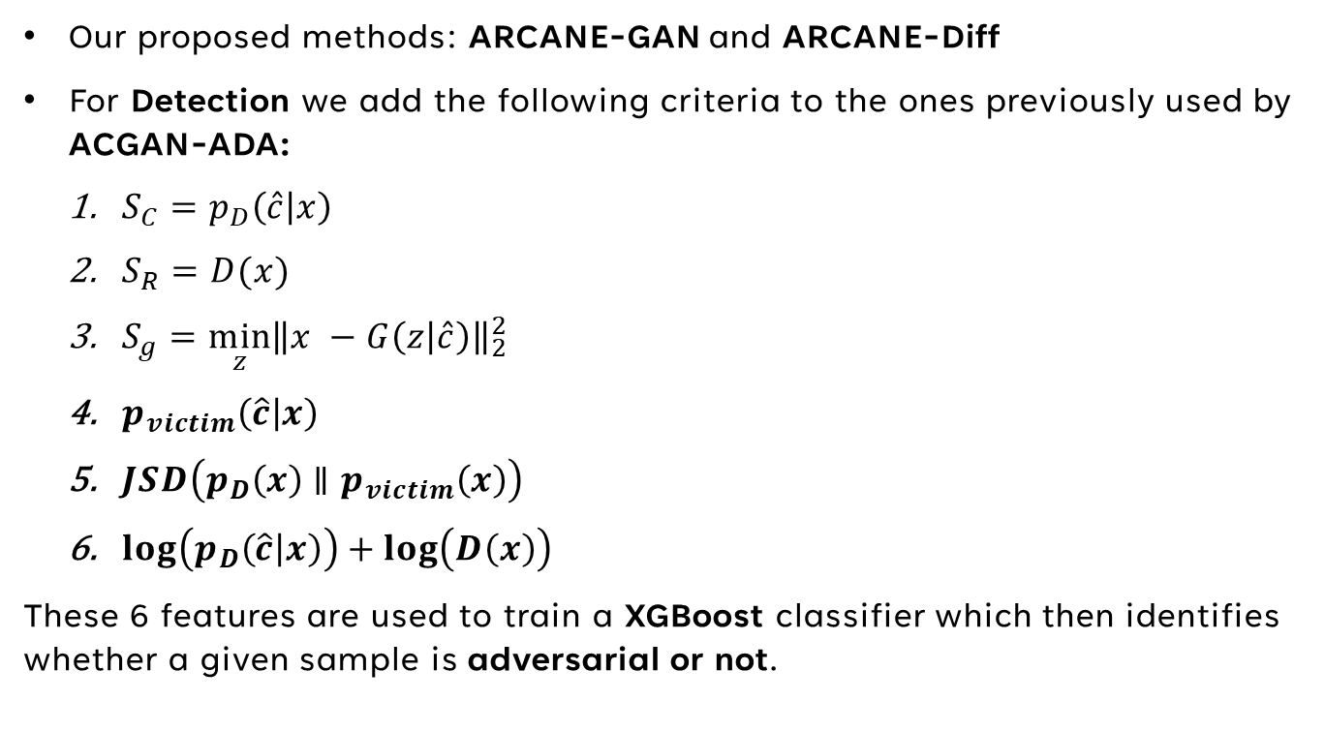
ARCANE: Detection
Our proposed methods: ARCANE-GAN and ARCANE-Diff
For Detection we add the following criteria to the ones previously used by ACGAN-ADA:
${S_{C}=p}_{D}\left(\hat{c} | x\right)$
$S_{R}=D(x)$
$S_{g}=\min_{z}{{\left\|x −G\left(z | \hat{c}\right)\right\|}_{2}^{2}}$
$p_{victim}\left(\hat{c} | x\right)$
$JSD\left(p_{D}\left(x\right)∥p_{victim}\left(x\right)\right)$
$\log\left(p_{D}\left(\hat{c} | x\right)\right)+\log\left(D\left(x\right)\right)$
These 6 features are used to train a XGBoost classifier which then identifies whether a given sample is adversarial or not.

Slide 28
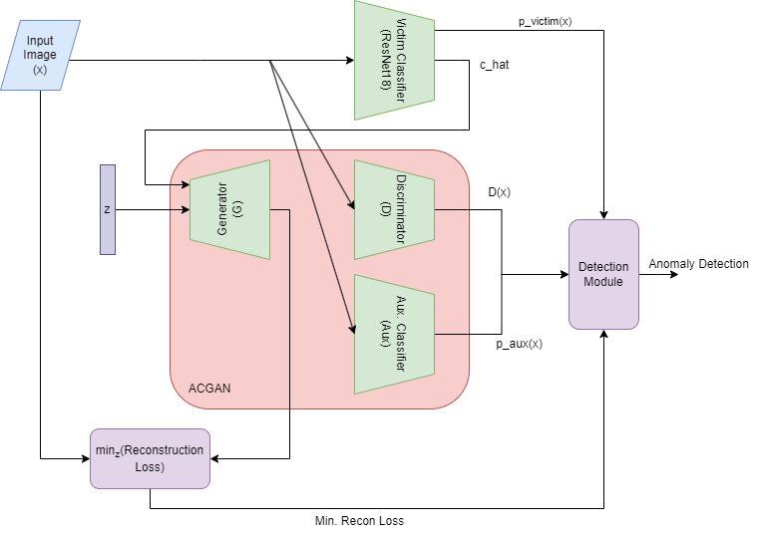
ARCANE: DETECTION
ARCANE-GAN

Slide 29
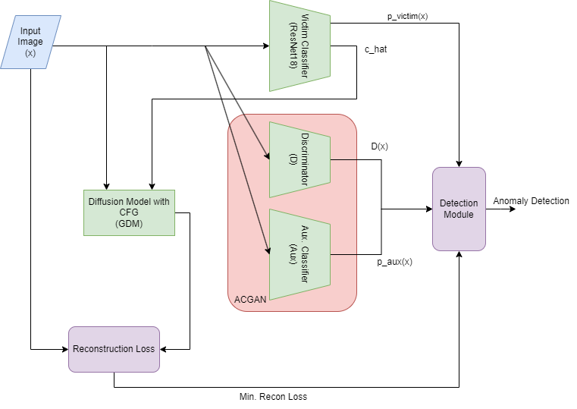
ARCANE: DETECTION
ARCANE-Diff

Slide 30
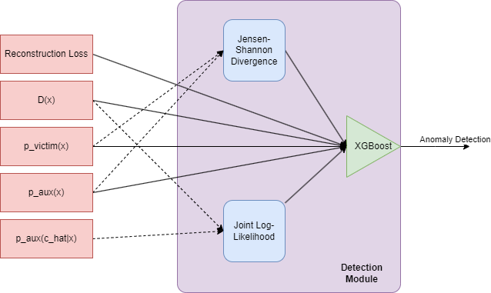
ARCANE: DETECTION
Detection Module

Slide 31
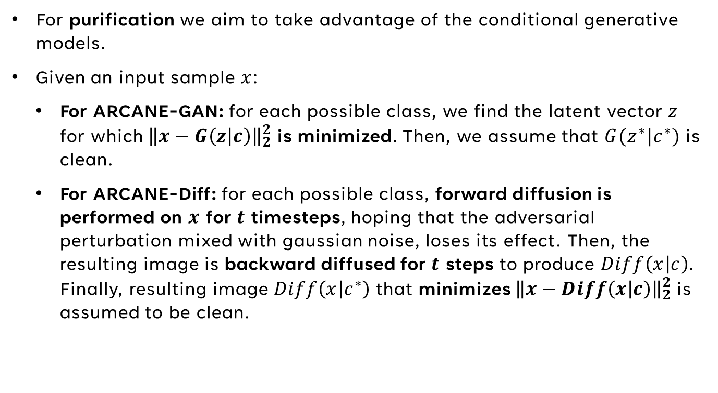
ARCANE: Purification
For purification we aim to take advantage of the conditional generative models.
Given an input sample $x$:
For ARCANE-GAN: for each possible class, we find the latent vector $z$ for which ${\left\|x−G\left(z | c\right)\right\|}_{2}^{2}$ is minimized. Then, we assume that $G(z^{∗}|c^{∗})$ is clean.
For ARCANE-Diff: for each possible class, forward diffusion is performed on $x$ for $t$ timesteps, hoping that the adversarial perturbation mixed with gaussian noise, loses its effect. Then, the resulting image is backward diffused for $t$ steps to produce $Diff\left(x | c\right)$. Finally, resulting image $Diff\left(x | c^{∗}\right)$ that minimizes ${\left\|x−Diff\left(x | c\right)\right\|}_{2}^{2}$is assumed to be clean.

Slide 32
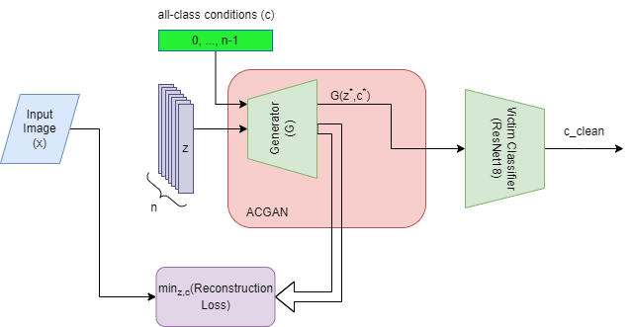
ARCANE: Purification
ARCANE-GAN

Slide 33
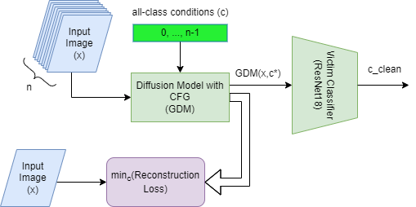
ARCANE: Purification
ARCANE-Diff

Slide 34
Experimental Results

Slide 35
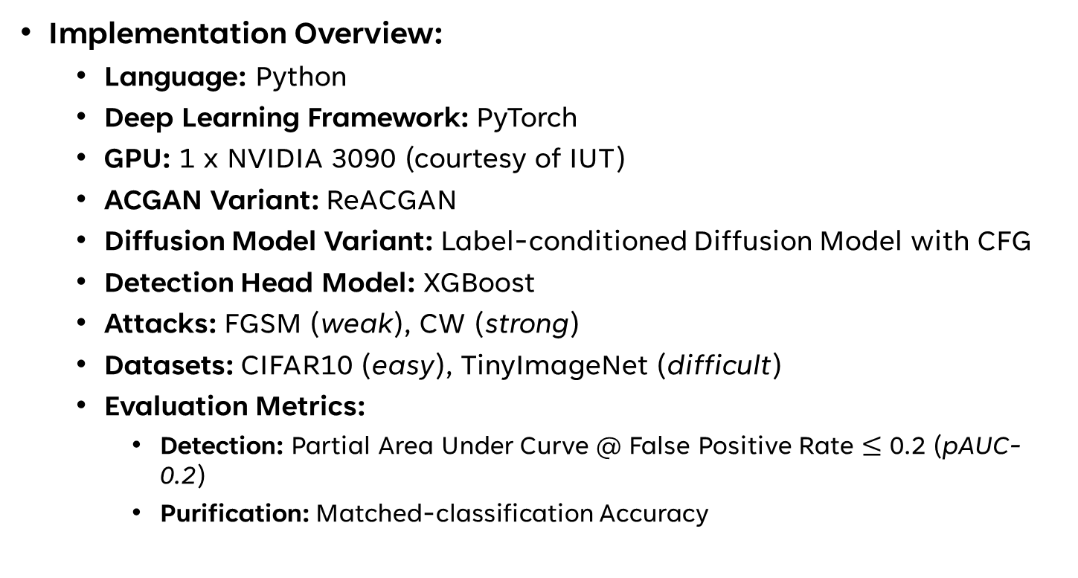
Experimental Results
Implementation Overview:
Language: Python
Deep Learning Framework: PyTorch
GPU: 1 x NVIDIA 3090 (courtesy of IUT)
ACGAN Variant: ReACGAN
Diffusion Model Variant: Label-conditioned Diffusion Model with CFG
Detection Head Model: XGBoost
Attacks: FGSM (weak), CW (strong)
Datasets: CIFAR10 (easy), TinyImageNet (difficult)
Evaluation Metrics:
Detection: Partial Area Under Curve @ False Positive Rate $≤$ 0.2 (pAUC-0.2)
Purification: Matched-classification Accuracy

Slide 36
Experimental Results
Training Method:
Generation: Entire training splits of both datasets used to train the diffusion and GAN models.
Detection: In order to train the XGBoost classification head:
1000 clean images balanced-sampled from each dataset.
1000 adversarial images for each attack method (CW, FGSM) created.
For each (dataset, attack) pair, a total of 2000 samples (1000 clean and 1000 adversarial) form the final training dataset.
5-fold cross-validation across the dataset performed to tune the hyperparameters of the XGBoost model.
Evaluation Method:
Same number of balanced samples as training (2000) used for each (attack, dataset) pair with a different seed to prevent cross-contamination.

Slide 37
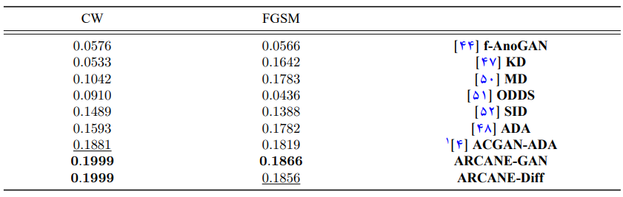
Experimental Results: Detection
Detection Results on CIFAR10

Slide 38
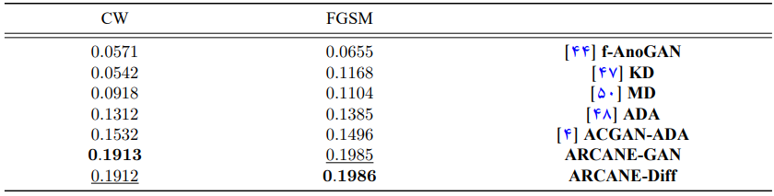
Experimental Results: Detection
Detection Results on Tiny-ImageNet

Slide 39
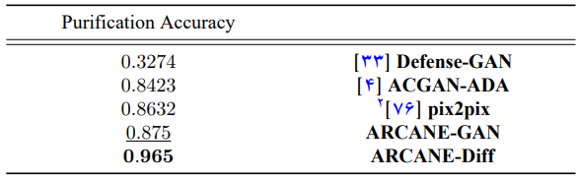
Experimental Results: Purification
Purification Results on CIFAR10 + CW

Slide 40
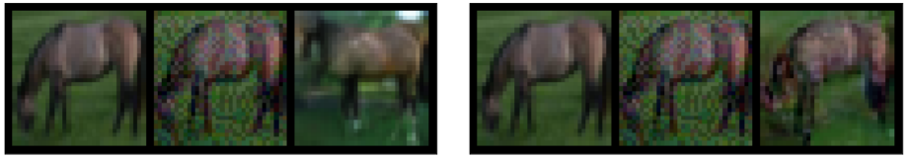
Experimental Results: Purification
ARCANE-GAN
ARCANE-Diff
Clean Adversarial Purified
Clean Adversarial Purified

Slide 41
Experimental Results: Summary
On detection:
CIFAR10: ARCANE beats the SOTA by 6.27% and 2.58% on CW and FGSM respectively.
Tiny-ImageNet: ARCANE beats the SOTA by 24.87% and 32.75% on CW and FGSM respectively.
On purification:
CIFAR10: ARCANE beats the SOTA by 11.79% on CW.

Slide 42
Future Work & Conclusion

Slide 43
Future Work
Reconstruction Loss as a feature is not very impactful. Potential improvements:
Use of a better reconstruction loss measure.
ARCANE is slow. Potential improvements:
Fasters sampling techniques on the diffusion model.

Slide 44
Conclusion
In this work we presented ARCANE.
A novel adversarial robustness framework based on class-conditional generative modelling.
We used two new generative models in ReACGAN and a Conditional Diffusion Model.
We evaluated ARCANE on CIFAR10 and Tiny-ImageNet dataset over FGSM and CW attacks.
We have experimentally shown that ARCANE on average:
Performs 16.62% better on detection than the current SOTA.
Performs 11.8% better on purification than the current SOTA.

Slide 45
Thanks for your attention

Slide 46
Q&A

Slide 47
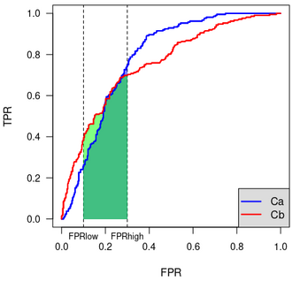
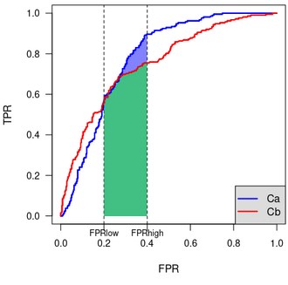
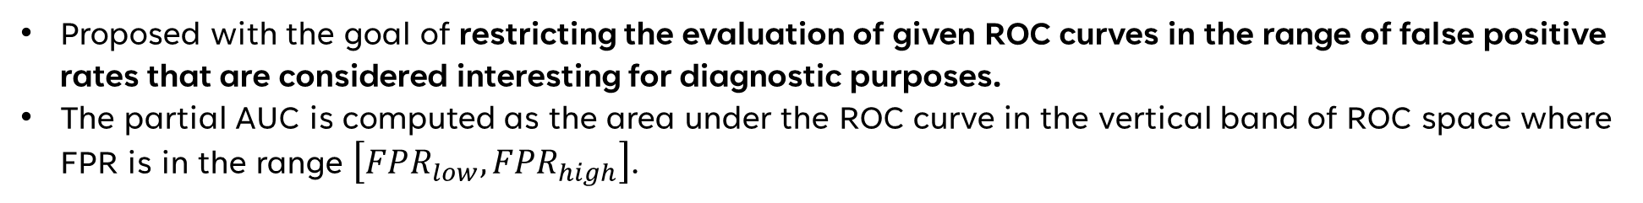


Addendum I: P-AUC
Proposed with the goal of restricting the evaluation of given ROC curves in the range of false positive rates that are considered interesting for diagnostic purposes.
The partial AUC is computed as the area under the ROC curve in the vertical band of ROC space where FPR is in the range $\left[FPR_{low}, FPR_{high}\right]$.
$$FPR_{low}=0.1, FPR_{high}=0.3$$
$$FPR_{low}=0.2, FPR_{high}=0.4$$

Slide 48
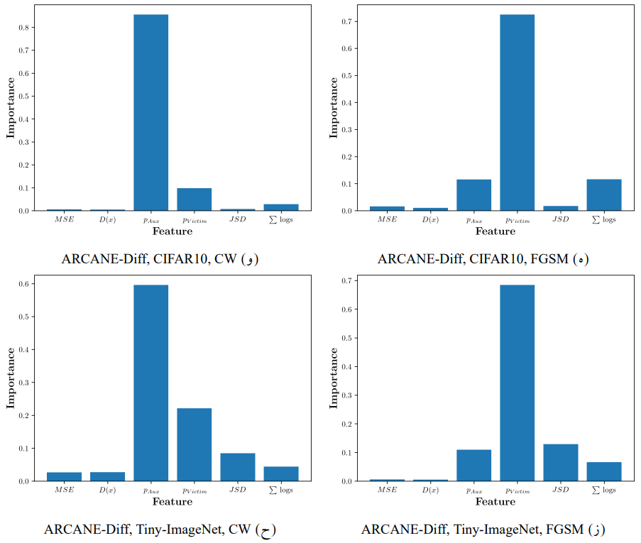
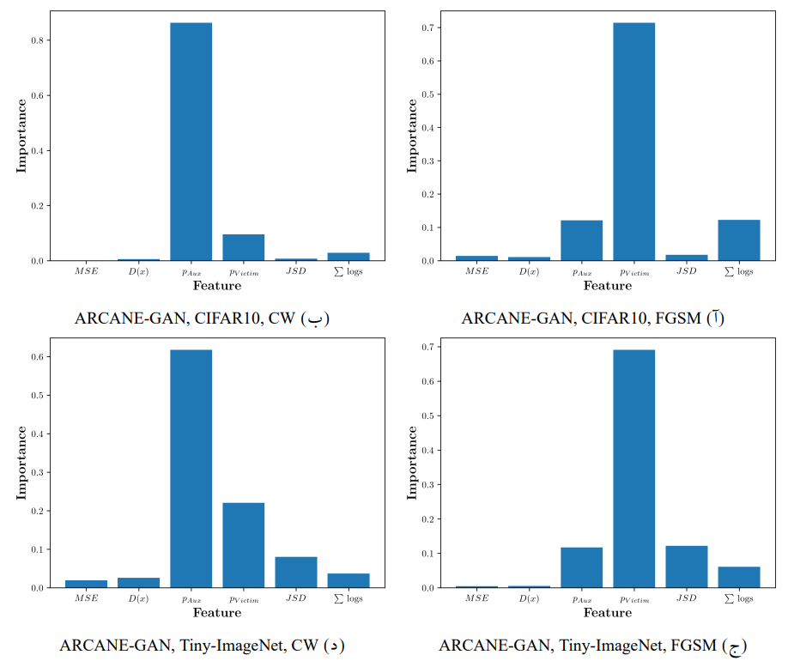
Addendum II: Feature Importance

Slide 49
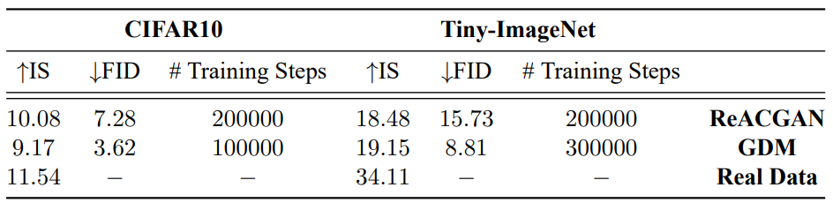
Addendum III: Generation Evaluation Results

