Slide 1
AI for Simulation
Three easy pieces

Slide 2
Overview
Introduction: a digital world model in your computer
AI for Simulation:
Implicit Neural Representations (INRs)
End-to-end Neural Simulator
Learned aids for existing simulator/solver
Conclusion & Future works

Slide 3
Introduction: World Model
Why is important:
Perceive: abstract the external world to gain a deep understanding of its underlying mechanisms
Predict: possess the capacity to envision possible future states to inform decision-making.
How to (the classical way):
Derive from physics laws: from Newton’s Laws, constitutive equations, and PDEs to discretized ODE/linear systems

Slide 4
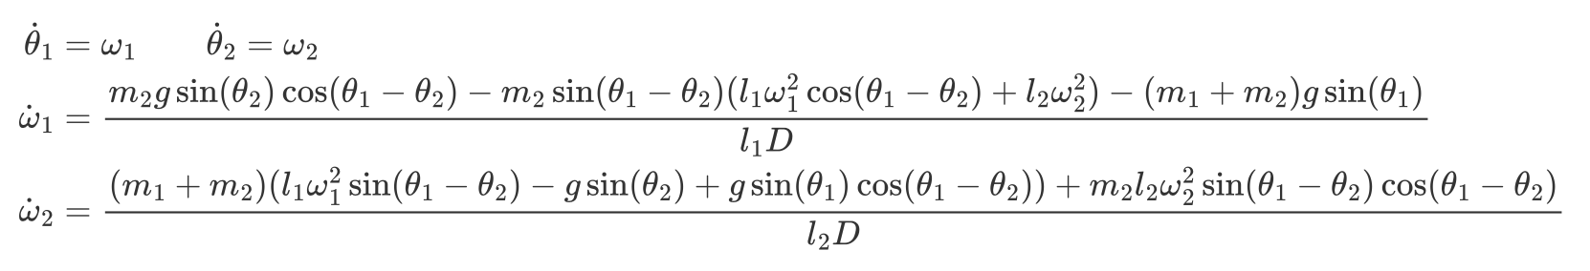
Example: Double Pendulum
Physical law: Newton/Lagrange mechanics gives coupled nonlinear ODEs for the two joint angles.
Simulation: choose parameters and initial angles/velocities, then compute the ODE forward in time via numerical integration (e.g. Euler, RK)
Run`python 00-discrete-solver/simulate.py`.

Slide 5
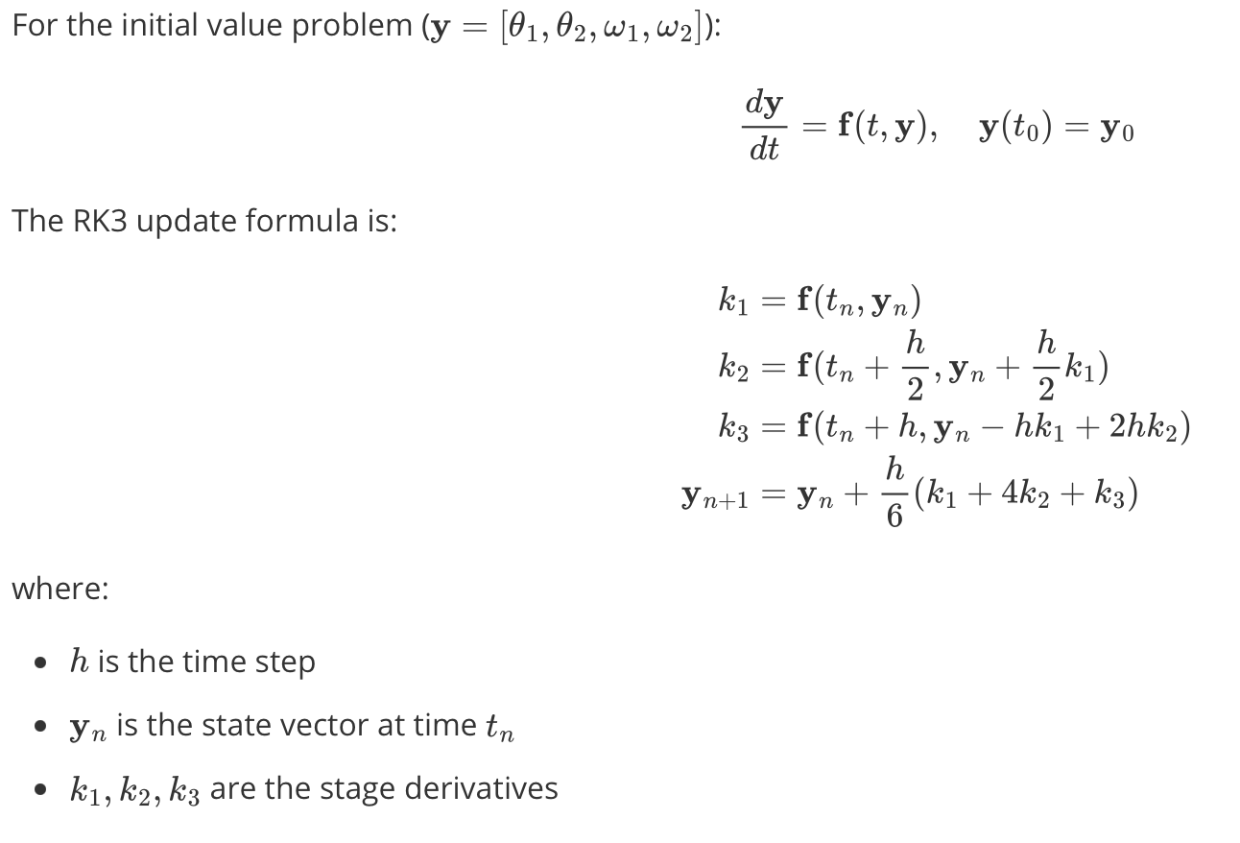
Example: Double Pendulum (Cont.)
Run`python 00-discrete-solver/simulate.py`.

Slide 6
Introduction: World Model (cont.)
Why is important:
Perceive: abstract the external world to gain a deep understanding of its underlying mechanisms
Predict: possess the capacity to envision possible future states to inform decision-making.
How to (the classical way):
Derive from physics laws: from Newton’s Laws, constitutive equations, and PDEs to discretized ODE/linear systems
Learn from data/physics laws: today’s talk

Slide 7
Implicit Neural Representations (INRs)
// TODO what is INR.
Use a neural net to fit (represent) the desired model.
// TODO: why this will work – train NN to do interpolation/regression
// TODO: the loss can depends on the physics law (typically), or data (optional as an aid).
// TODO, note the MLPs as an example
// TODO, different models/tricks exists, such as model arch (KAN) and positional embeddings (sinusoidal), but the big idea is above.

Slide 8
INRs: The Double Pendulum Example
// How To part.
// TODO: Write some code, describe how to use a mlp to represent it.
// a mlp that maps (x, t) to x.
// LOSS(data): regression, direct MSE loss.
// LOSS(data free): define losses according to the ODE and initial/boundary conditions

Slide 9
INRs: Takeaways
The learned model itself is the world model!
// Advantages: data is optional and the method itself can be very flexible (various applications).
// TODO: other names exists! E.g. PINNs. NeRF. They are INRs in different area/community, but the people like tends to use that name.
// Disadvantages: efficiency very slow to train, and per-case
// Dis2: not accurate – see the paper (pinn requires near zero loss)
// why: The physical law typically has higher order derivatives and the PDEs/BC/IC are actually regarded as a “penelization”

Slide 10
Learn an End-to-End Solver (E2E)
Suppose we have a large set of data of some physical phenomena,
Train a large neural network to “memorize”: given boundary/initial condition B, X_0, and the state X_t.
or just x_t-1 to x_t, with some bc.
When will be this large set available: weather forcast!
// TODO: what is E2E solver, formally.
// TODO: why this will work?

Slide 11
E2E: The Double Pendulum Example
// How To part.
// Step 1: generate a large amount of trajectories
// Step 2: Train a MLP, that takes prev state (x, velocity), estimate next state.
// delta t is fixed at 0.1

Slide 12
E2E: Takeaways
Learn to evolve/predict the states in the world model.
// TODO: what are people caring about in State-of-the-art works:
// 1. although cnn/gnn/rnn/Transformers works, we need a better neural architecture for prediction in simulation tasks. (e.g. neural operator)
// 2. Integrate physical law in the neural architecture, e.g. mass conservation
// 3. Integrate physical laws/PDE in training to save data requirements

Slide 13
E2E: Takeaways (cont.)
Learn to evolve/predict the states in the world model.
// Advantage 1: new case only requires a forward call of the neural net. This is super fast! And even differentiable to your input!
// Advantage 2: Developers do NOT need to understand the physics
// Disadvantages: data requirement. some reviewer of my paper said, acquiring the data to train a E2E solver is not cheap, so I reject your paper!
// Disadvantages 2: difficult change the parameters (e.g. delta T in our tiny example)
// Disadvantages 3: also not as accurate as we think… also cannot extrapolates to unseen case

Slide 14
Learn AI Aids for Classical Solvers
We need machine precision solution.
We get back our PDE and classical numerical solver
How to improve it?
Its robustness is good, accuracy is very good. So
=> Improve the classical solver’s efficiency!
// TODO: what it is. Why this important.

Slide 15
AI Aids: The Double Pendulum Example
// TODO: how to.
// use RK1 implicit method and we use the network to predict a preconditioner (approximate the inverse matrix)

Slide 16
AI Aids: Takeaways
// advantages: very accurate
// disadvantages: you really need some domain knowledge. Such as
// 1. What part is you can change? Are they valuable to change?
// 2. How? Is that really easy to train?
// 3. Is this method truly competitive compared to SOTAs?
// 4. If yes -> write a paper; If not, go 1 :)

Slide 17
AI Aids: Takeaways
// State of the arts: Preconditioners. Learn to Optimiz
// e.g. learned Incomplete cholesky.
// e.g. Learned Gradient Descent/SR1/BFGS
// However, they are the actually same!
// What you need for an optimizer? -> newton’s direction!
// what you need for a linear solver(for a SPD matrix)? -> also newton’s direction!

Slide 18
Conclusion
world model, and the Double Pendulum Example
AI for Simulation:
Implicit Neural Representations (INRs)
End-to-end Neural Simulator
Learned aids for classical simulator/solver

