Slide 1
PC322

Slide 2
Integrating Data from LOB Systems with Project Server 2010
Tim Runcie, MCP, MCTS, PMP, MVP
President / Project MVP
Advisicon Inc.
Chetan Patel, MCP, MCTS, PMP
Senior Developer
Advisicon Inc.

Slide 3

Key Statistics
October 2011, Gartner estimated
Data Integration Tools Market worth $1.63 billion last year
& Expected to grow 15 percent this year
Believes it will reach $2.7 billion by 2015
Background in Stat’s – Tailored?
5 out of 5 Cows
So What about Us Today?
Key Project Data Scattered
Want/Need Integration (Disparate Systems)
Other Reasons?
@ProjectMVP #PC322 #mspc12

Slide 4







Meet Tim & Chetan
Microsoft Booth
Contact: Tim.Runcie@Advisicon.com Chetan@Advisicon.com
Integrated Technology Solutions for PMO’s for 20 years
Building / Customizing Enterprise Solutions for 20 years
Scheduling with Microsoft Project for nearly 20 years
Published Authors, Trainers & Implementation Consultants
Project MVP
@ProjectMVP #PC322 #mspc12

Slide 5

Session Objectives
Not a Technical Step by Step Session
Showcase the ability to Integrate External / Competing LOB Systems with Project Server Leveraging it’s Forecasting & Reporting
Key Topics of Focus Include:
Address Shortcomings of External Systems & Solve Business Pain Points
Concepts for Retrieving & Integrated External Data
Transforming Data and Embedding it with Project Server
Understanding the Pitfalls to Avoid & Solutions to Leverage
@ProjectMVP #PC322 #mspc12

Slide 6

Session Guidelines
Turn your Cell Phones Off
Questions:
Use the Microphones
Taken at Pre-Arranged Stages
Should Address Steps Covered
Not Directly Related Will be Covered Offline
Fill in your Eval’s
We will be Available Afterwards for More Questions
Have Fun!
@ProjectMVP #PC322 #mspc12

Slide 7

So Why Integrate with Project Server?

Slide 8


Bringing Good Things Together
+
Peanut Butter
Chocolate

Slide 9

Needed:
Simple reports that help end users
to understand past and future project performance.
If you can’t say it simply, you simply don’t understand it.
Notes:
First – Simple minded -Confusion – Mastery – Simplicity
Our teams need a clear – easily to comprehend answer to “what are we doing?”
Customers need a simple answer “why are you doing that?”
A purpose or concept can be simple – process complex
When leading – get people to comprehend – Simplify – Particularly when they haven’t mastered (yet) the complexity.
You sound more competent when you are comprehensible.

Slide 10
Common Customer Pain Points
Solutions Need to Be Cost Effective & Easy to Deploy
Little or No Control of IT / Development
Incompatible Metrics between Different LOB Systems
Actuals not Connected to Project Planning
Simplicity & Commonality of Tools
Resource Managers & PM’s Want the Same Tools they Use Daily
Existing Forecasting & Reporting Tools Not Tied to Project / Resource Management
Automation - Transforming Data & Business Logic with Planning Tools
@ProjectMVP #PC322 #mspc12

Slide 11









Where is this Being Used?

Slide 12
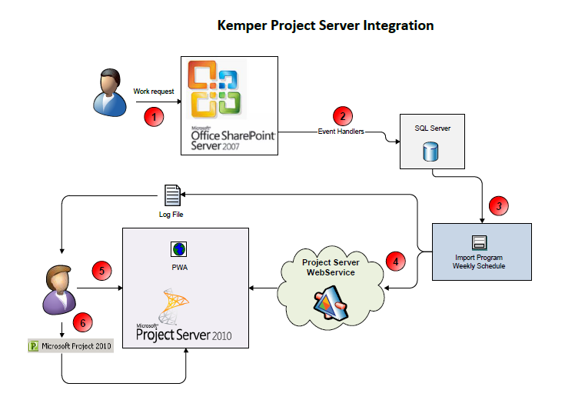
SharePoint Lists to Project 2010
Transform
Into
Custom EPT’s

Slide 13
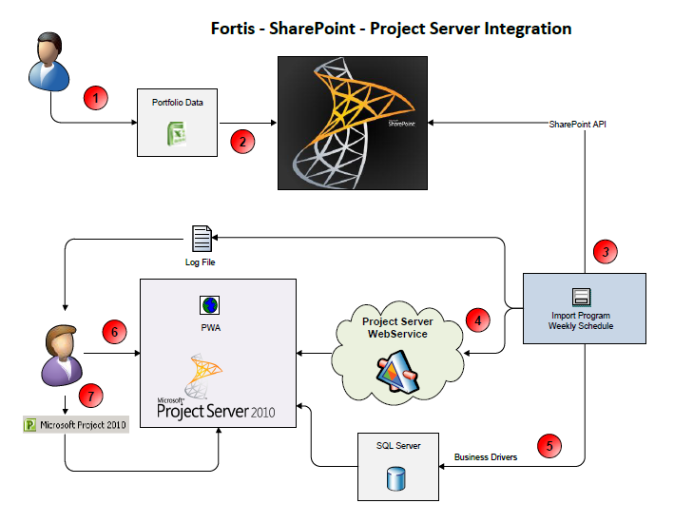
Portfolio Server External Data Load
Without PSI
Strategies, Business Drivers Proposals

Slide 14
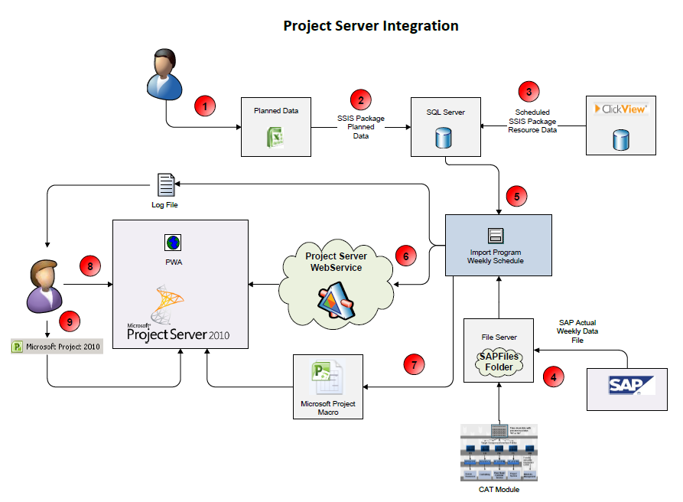
SAP Integration
HR Capacity
&
Actuals
To
Project 2010

Slide 15
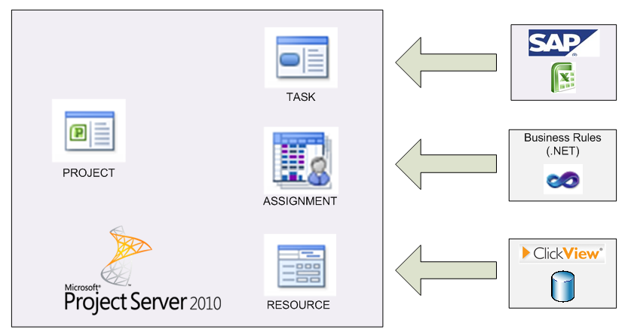
Case Study Walkthrough

Slide 16
Customer Profile
Pre-Existing Environment
Pain Points
Goals
Excel for Forecasting
Using SAP/CATS (Actuals)
No Project Server
Limited SharePoint
HR Data in ClickSoft
Forecasting 100% Manual
LOB Systems Data Incompatible
Budget Constraints for Licensing
Long Delays to get Actuals & HR Reports
Automate & Expedite
Reduce Costs in Software
Scalable & Scenario Planning
Empower End Users
Low Overhead (Time)
Snapshots & Historical Review
@ProjectMVP #PC322 #mspc12

Slide 17
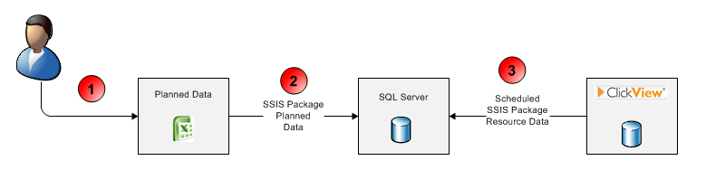
Demo Steps 1 - 3
(Planned & Capacity Data)

Slide 18

Steps 1-3 Issues Faced / Lessons Learned
Issues:
Addressing & Mapping Inconsistent Workflows
Correcting Data Sources & Standardizing on Data / Quantities
Crossing Political & IT Spheres of Control
Source Archiving (20 Days)
Lessons Learned:
Training on Project Helped Expedite the Solution Mapping
The Better the Diagram, the Better the Solution
Managing the Excitement: Scope Management
Break it down to Smaller Components (Large project, smaller jobs)

Slide 19
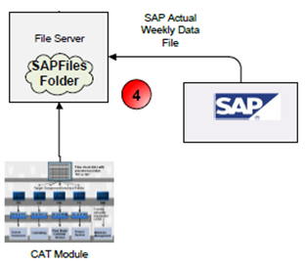
Demo Step 4
(SAP & CATS Actuals)
Notes:
CATS (Cross Application Timesheet

Slide 20

Steps 4 Issues Faced / Lessons Learned
Issues:
Establishing Common Data Drop (Actuals by Time Intervals)
Cultural Resistance to Source of Record Access
Planned Data Missing (or new Actuals without Planned data)
Lessons Learned:
Establish Workflow & Governance Around Linking, Reporting and Data Extracts
Patience with Process
Executive Support Trumps Tactical Brilliance
Independent System Rather than Direct Connection (Don’t Bring ERP System Down)

Slide 21
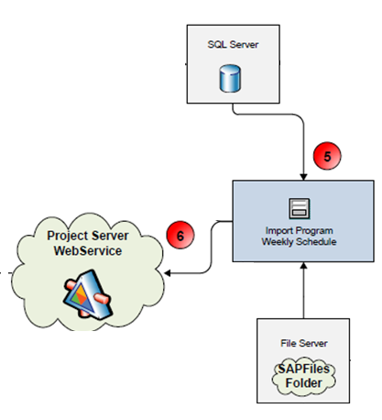
Demo Steps 5 & 6
(Importing & Data Transformation)

Slide 22

Steps 5-6 Issues Faced / Lessons Learned
Issues:
Managing Data Complexities
Actuals Overwriting / Planned Work
Writing Time-Phased Baselines
Low Tech vs. High Tech Approach (Customer Based KISS)
Building Artificial Intelligence (Multi Level Resource Capacity)
Lessons Learned:
Leverage Out of the Box Functionality
Wider Range of Solution Knowledge (5 Good tools better than 1 Great Tool)
Capturing Actuals to Improve Automation (Self Improving Process)

Slide 23
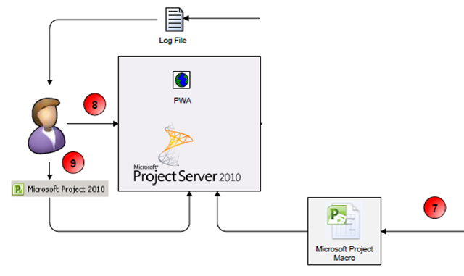
Demo Step 7 - 9
(Using Project Server)

Slide 24

Steps 7-9 Issues Faced / Lessons Learned
Issues:
Localizing Automation to the Server
Limitless SharePoint BI vs. Project Client Views
Performance for 1 Million+ Data Points (Weekly Load)
Capture Notes (Task & Assignment) and Preserve for Next Data Load
Overallocation (ROGG) Dashboard KPI
Lessons Learned:
Training Power Users Extended Capabilities & Saved Costs
Culture Adjustments to Optimized Resource Time
Ribbon Impact & Upgrading Hardware

Slide 25


What was Achieved
➔

Slide 26


Value Delivered
Resource Planner Time Reduced by 50%
Analysis time Reduced from weeks to hours
Enabled What-If Scenario’s at No Cost to the Solution
Resource Planner Time Reduced by 50%
Customer Loved MS Project for Use in Forecasting & Reporting
Added Daily on-demand Impact Analysis
of the deck could be statistics
Eliminated 80% of Manual Effort in Building Collecting & the Reporting Forecast Information
50%
Forecast Errors Reduced by 80%
Savings Paid for Itself in Under a Year
@ProjectMVP #PC322 #mspc12

Slide 27
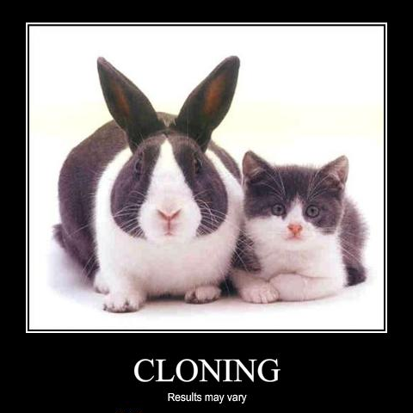
You Can Do this!
Results May Vary

Slide 28
You Can Do this – 3 Approaches
Do It Yourself:
Can work in a Hosted Environment (BeMo, etc.)
Leverage the Rich API of Project Server
Access & Transform Data from Any Source
Utilize Lessons Learned, Here & in White Paper
Purchase off the Shelf (Campana-Schott, Advisicon, etc.)
Full Blown SAP Integration
Selective Project Transform Loader (PT Loader)
Leverage Partners to Expedite or to Get Training
@ProjectMVP #PC322 #mspc12

Slide 29
PC# 322 Session Wrap Up

Slide 30
Session Wrap-up
Other / Similar Sessions:
PC-203 (SAP Integration)
PC-320 (Project Server Extensibility
PC-400 (Cloud & General Ledger/Financial Reporting)
Fill out your Survey to Win Prizes
Let us Know if we Can Help
Microsoft Booth
MVP Forum’s
Call or E-mail (b-TimRun@Microsoft.com / Tim.Runcie@Advisicon.com
@ProjectMVP #PC322 #mspc12

Slide 31
Connect with Tim & Chetan
Microsoft Project Booth
Tim.Runcie@Advisicon.com
Chetan@Advisicon.com
www.linkedin.com/in/TimRuncie
www.linkedin.com/in/Chetankumar
Twitter: @ProjectMVP
White Paper Links:
http://technet.microsoft.com/en-us/library/hh770392.aspx
http://www.Advisicon.com/case_studies/case_study_SAP.htm
@ProjectMVP #PC322 #mspc12

Slide 32


www.msprojectconference.com
MYPC
fill out evaluations & win prizes!
Your feedback is very important to us! You can fill out session evaluations by logging into MyPC on your laptop or mobile device
evaluation prizes daily
Should you win an evaluation prize, you may claim it at the Registration Desk on Level 3

Slide 33

Thank You!
© 2012 Microsoft Corporation. All rights reserved. Microsoft, Windows, Windows Vista and other product names are or may be registered trademarks and/or trademarks in the U.S. and/or other countries.
The information herein is for informational purposes only and represents the current view of Microsoft Corporation as of the date of this presentation. Because Microsoft must respond to changing market conditions, it should not be interpreted to be a commitment on the part of Microsoft, and Microsoft cannot guarantee the accuracy of any information provided after the date of this presentation. MICROSOFT MAKES NO WARRANTIES, EXPRESS, IMPLIED OR STATUTORY, AS TO THE INFORMATION IN THIS PRESENTATION.

