Slide 2
Making the Most of Project Professional When Managing Multiple Projects (PC336)
Cindy Lewis, PMP, PMI-SP, MCITP, MCTS, MCT
Senior Project Advisor
Advisicon, Inc.
Concepts presented may be applied to Project Std/Pro 2003, 2007 and 2010
@LewisCindy #PC336 #mspc12

Slide 3


Meet Cindy
Cindy Lewis, PMP, PMI-SP, MCITP, MCTS, MCT
Senior Project Advisor
Advisicon, Inc.
Scheduling with Microsoft Project for nearly 20 years
Project Professional Certification SME 2003, 2007, 2010
Co-author MVP Press, Advisicon Publishing, Dynamic Scheduling
Western Michigan PMI Director of Public Relations
PMI TheProject2012 collegiate competition committee
@LewisCindy #PC336 #mspc12

Slide 4
Session Objectives
In this session, participants will learn the benefits of using Project Professional to manage multiple projects and drive project selection decisions.
Some critical topics of focus include:
Experiencing a customer evolve their business through this solution
Harnessing workloads with a limited set of shared resources
Creating an integrated master schedule with cross-project links
Balancing staffing and project selection decisions across a company
@LewisCindy #PC336 #mspc12

Slide 5


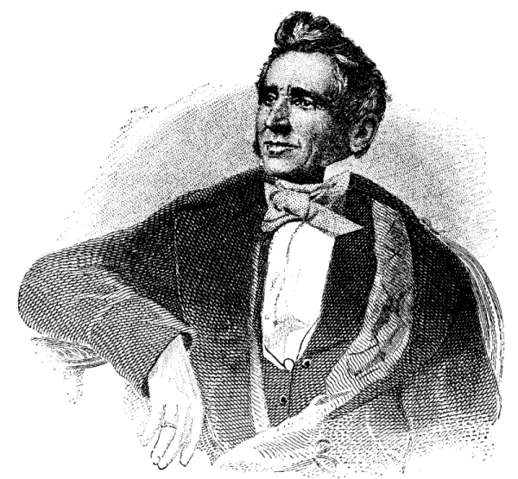

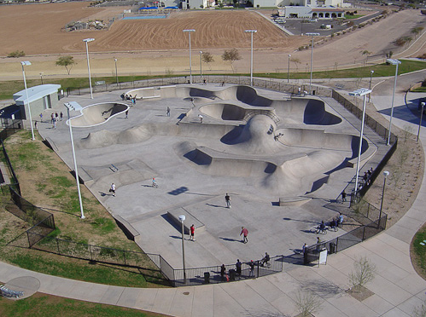
Charles Goodyear
Dec 1800 – July 1860
Danville, VA
Goodyear Skate Park Arizona

Slide 6
Customer Profile

Slide 7
Problem – Job Management
Tom Keane and Ron Bartalucci
J.L. Becker Company
customer
@LewisCindy #PC336 #mspc12

Slide 8
J.L. Becker Company
General Info
Pluses
Minuses
Created in 1970
Plymouth, Michigan
Commercial Heating Equipment
Top reputation
Quality backed by owner
No shortage of work
Experienced workforce/long-term employees
Putting out fires
Unrealistic promises
Department isolation
Business decisions impossible to make
@LewisCindy #PC336 #mspc12

Slide 9
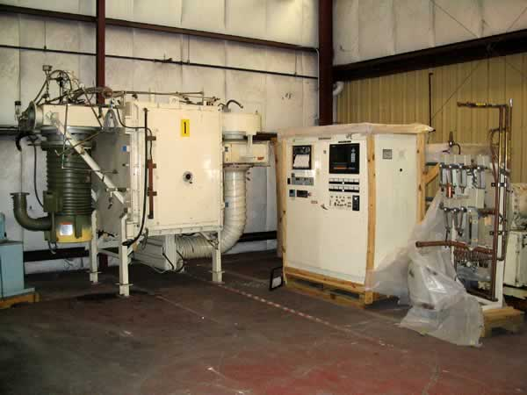
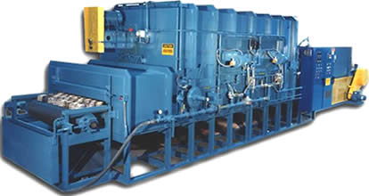
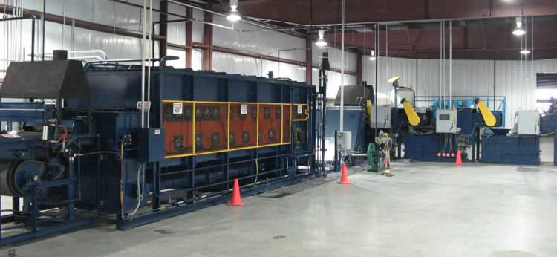
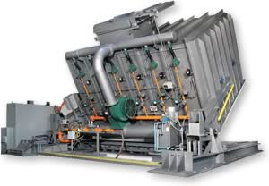
50
©J.L. Becker Company

Slide 10
Demonstrations

Slide 11
J.L. Becker Project Schedules
Independent Projects
demo
@LewisCindy #PC336 #mspc12

Slide 12

Solution/Implementation Demos
1
Shared Resource Pool
2
Master Projects, Critical Path
3
Cross-Project Links
4
Shared Resource Assignments, Identifying Issues
5
Resolving Overallocated Resources, Leveling
@LewisCindy #PC336 #mspc12

Slide 13
Solution/Implementation Demos
1
Shared Resource Pool
2
3
4
5
@LewisCindy #PC336 #mspc12

Slide 14
Resource Pool
Creation and linking to projects
demo
@LewisCindy #PC336 #mspc12

Slide 15
Solution/Implementation Demos
1
2
Master Projects, Critical Path
3
4
5
@LewisCindy #PC336 #mspc12

Slide 16
Master Projects
Master/sub projects and consolidated projects
demo
@LewisCindy #PC336 #mspc12

Slide 17
Critical Path
Project versus program level Critical Path
demo
@LewisCindy #PC336 #mspc12

Slide 18
Solution/Implementation Demos
1
2
3
Cross-Project Links
4
5
@LewisCindy #PC336 #mspc12

Slide 19
Cross-Project Links
Dependencies across projects
demo
@LewisCindy #PC336 #mspc12

Slide 20
Solution/Implementation Demos
1
2
3
4
Shared Resource Assignments, Identifying Issues
5
@LewisCindy #PC336 #mspc12

Slide 21
Resource Assignments
Viewing assignments across linked projects
demo
@LewisCindy #PC336 #mspc12

Slide 22
Overallocated Resources
Identifying overallocations
demo
@LewisCindy #PC336 #mspc12

Slide 23
Solution/Implementation Demos
1
2
3
4
5
Resolving Overallocated Resources, Leveling
@LewisCindy #PC336 #mspc12

Slide 24
Resolving Overallocations
Resource modifications by resource pool manager
demo
@LewisCindy #PC336 #mspc12

Slide 25
Leveling Resources
Using leveling to solve overallocations
demo
@LewisCindy #PC336 #mspc12

Slide 26
Recap of Demonstrations
1
Shared Resource Pool
2
Master Projects, Critical Path
3
Cross-Project Links
4
Shared Resource Assignments, Identifying Issues
5
Resolving Overallocated Resources, Leveling
@LewisCindy #PC336 #mspc12

Slide 27
Lessons Learned

Slide 28
Resource Pool Tips
Project Summary Row On
Quick consolidation where possible
One Pool Manager
Centralize Pool
and Files
Resource Pool DO NOT DELETE
Unlink
Relink
Best suited for small enterprise

Slide 29
Takeaways

Slide 30
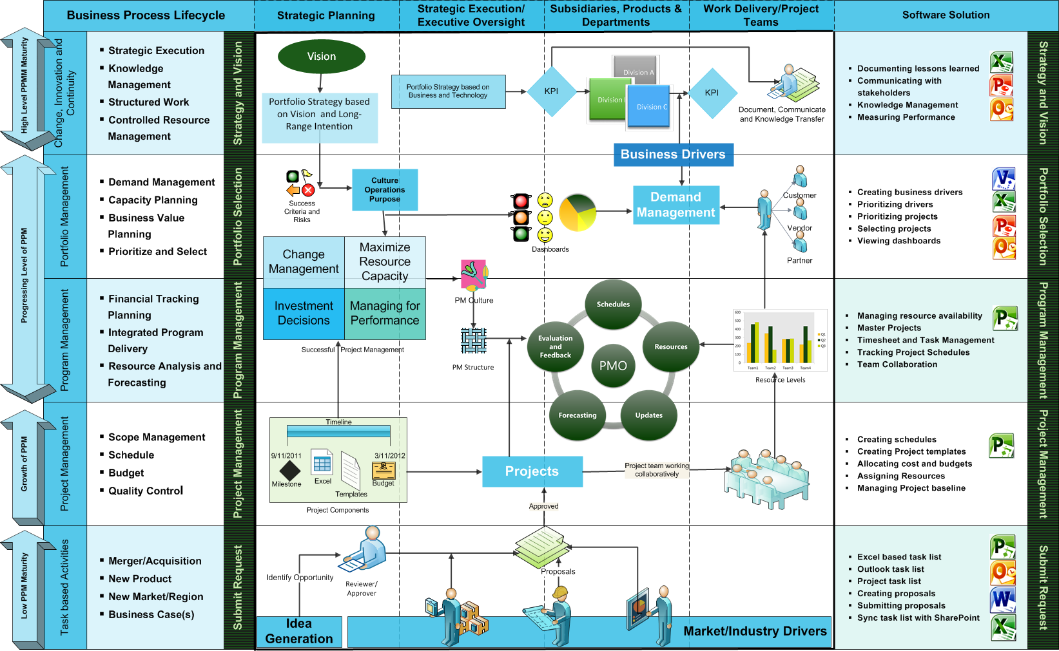
Suggesting Software Based on PM Maturity
@LewisCindy #PC336 #mspc12

Slide 31
Obtaining the Free PPM Scalability Lifecycle
In both English and Spanish
Available in Visio
Also within the PDF on Choosing Project Server
http://tinyurl.com/73av76z
@LewisCindy #PC336 #mspc12

Slide 32
Next Steps
Resources
MSPC12 Sessions
www.advisiconblog.com
Presentation resources
Preview of sessions
Other Sessions from Advisicon:
PC 212 Landing Strategy in 3 Steps (Javier Gonzalez and Rene Alvarez of Advisicon Mexico)
PC 315 - Journey from 2007-2010 (Customer Sol’n - Meijer)
PC 322 – Integrating Data from External LOB Systems (SAP, ClickSoft, etc.) for Strategic Resource Planning & Forecasting (Tim Runcie, MVP and Chetan Patel)
@LewisCindy #PC336 #mspc12

Slide 33
Thank You for Attending

Slide 34
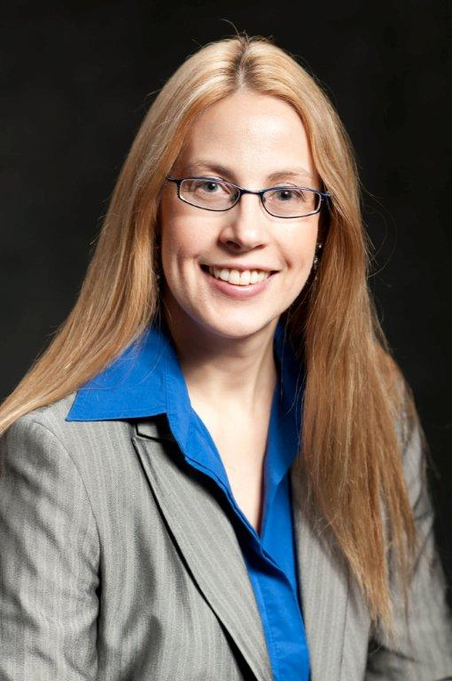
Connect with Cindy
cindy.lewis@advisicon.com
www.linkedin.com/in/cindylewis2
@LewisCindy
@LewisCindy #PC336 #mspc12

Slide 35

© 2012 Microsoft Corporation. All rights reserved. Microsoft, Windows, Windows Vista and other product names are or may be registered trademarks and/or trademarks in the U.S. and/or other countries.
The information herein is for informational purposes only and represents the current view of Microsoft Corporation as of the date of this presentation. Because Microsoft must respond to changing market conditions, it should not be interpreted to be a commitment on the part of Microsoft, and Microsoft cannot guarantee the accuracy of any information provided after the date of this presentation. MICROSOFT MAKES NO WARRANTIES, EXPRESS, IMPLIED OR STATUTORY, AS TO THE INFORMATION IN THIS PRESENTATION.

