Slide 1
Fast Food Chains
Nutrition Analysis
A diagnostic look at calories, fat, sodium and protein across 8 restaurants
Project: CDACL-004 | Rubixe Internship Project
Prepared by: Advitiya Srivastava
Submission Date: 29/08/2026
CDACL-004 | Rubixe Internship Project

Slide 2
What This Project Is About
1
Look at the data
Nutrition info for 513 menu items across 8 fast food restaurants
2
Find patterns
Compare calories, fat, sodium, sugar and protein across items and chains
3
Pick one restaurant
Do a deeper dive into one chain to see what its menu actually looks like
4
Build a dashboard
An interactive Power BI dashboard so anyone can explore the data themselves
CDACL-004 | Fast Food Nutrition Analysis
2

Slide 3
About the Dataset
513
8
17
Cleaning Steps
Removed 2 duplicate rows
menu items
restaurants
nutrition columns
Dropped 'satish' column — 100% empty
Restaurants covered:
McDonald's, Chick-Fil-A, Sonic, Arby's, Burger King, Dairy Queen, Subway, Taco Bell
Dropped 'age' column — always 0
'salad' column was constant (‘Other’) — not useful
Missing fiber/protein/vitamin data left blank, not guessed
No price column available in the data
CDACL-004 | Fast Food Nutrition Analysis
3

Slide 4
Spotlight: McDonald's
Chosen for the deep-dive — good mix of burgers, chicken and salads, 57 items in total
640
32g
1438mg
40g
avg calories per item
avg fat per item
avg sodium per item
avg protein per item
Heaviest item
Lightest item
20 piece Buttermilk Crispy Chicken Tenders
Premium Asian Salad w/o Chicken
2430 calories • 141g fat • 6080mg sodium
140 calories • 7g fat • 20mg sodium
This is also the single highest-sodium item in the entire dataset, across all 8 restaurants.
Best protein-per-calorie picks are the grilled chicken salads — good option for lighter, high-protein meals.
CDACL-004 | Fast Food Nutrition Analysis
4

Slide 5
Average Calories by Restaurant
CDACL-004 | Fast Food Nutrition Analysis
5

Slide 6
Average Sodium by Restaurant
Arby's has the highest average sodium — even though it isn't the highest in calories.

Slide 7
Which Restaurant Is 'Healthiest'?
Measured by protein-to-calorie ratio (more protein per calorie = generally healthier)
CDACL-004 | Fast Food Nutrition Analysis
7

Slide 8
Key Takeaways
McDonald's and Sonic have the highest average calories; Chick-Fil-A has the lowest
✓
Arby's menu is the most sodium-heavy overall, even though it's not the highest in calories
✓
Chick-Fil-A gives the most protein per calorie — the best ratio of all 8 chains
✓
Taco Bell is light on calories and sodium, but also lowest in protein — less filling per item
✓
Even within one restaurant (McDonald's), items range from 140 to 2430 calories — menu choice matters a lot
✓

Slide 9
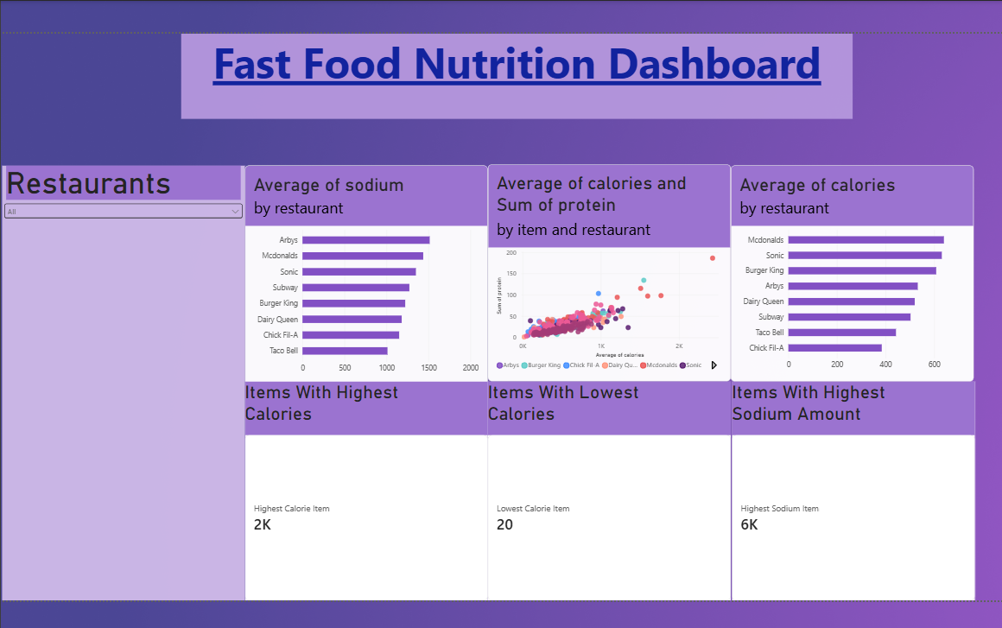
Interactive Dashboard
Built in Power BI — Fast Food Analysis Dashboard
• Restaurant filter (slicer)
• Calories vs protein scatter (513 items)
• Highest / lowest calorie & sodium cards
• Avg calories & sodium bar charts
CDACL-004 | Fast Food Nutrition Analysis
9

Slide 10
Limitations
No price data
Couldn't calculate average price per dish as mentioned in the assignment
Missing vitamins
Vitamin A, vitamin C and calcium missing for ~41% of items (mainly Taco Bell, Burger King, Arby's)
Constant 'salad' column
Every row had the same value, so it couldn't be used for salad vs non-salad comparison
Menu data only
Doesn't account for real portion sizes or customizations people actually order
CDACL-004 | Fast Food Nutrition Analysis
10

Slide 11
Thank You
Questions welcome
CDACL-004 | Fast Food Chains Nutrition Analysis | Rubixe Internship Project

