Slide 1
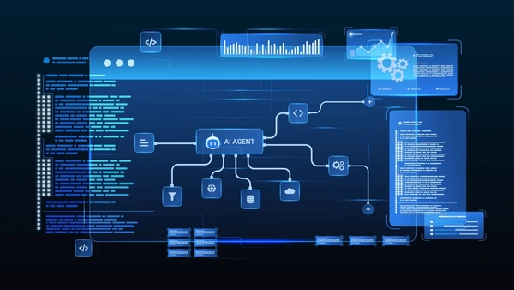
Finance Credit Follow-Up
Email Agent
Task 2 · AI Enablement Internship
Built with LangGraph + Google Gemini 2.0 Flash

Slide 2
Agenda
01 Problem Statement
02 Solution Overview
03 Key Features
04 System Architecture
05 Tone Escalation Matrix
06 Technology Stack
07 Security Mitigations
08 Results & Impact
09 Learnings & Next Steps

Slide 3
The Problem:
Manual Follow-Up
Is Broken
Finance teams waste significant time manually chasing overdue payments
Manual follow-ups are inconsistent in tone, timing, and urgency
High DSO (Days Sales Outstanding) impacts cash flow negatively
Risk of damaging client relationships with poorly worded reminders
Finance teams struggle with inefficient, inconsistent overdue payment collection
No standardised process leads to missed invoices and revenue leakage

Slide 4
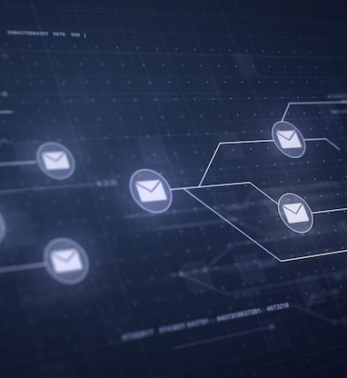
The Solution:
An Autonomous
AI Agent
An end-to-end autonomous system that monitors, generates, and sends personalised follow-up emails
Reads invoice data from CSV/Excel automatically
Generates personalised emails using Google Gemini LLM
Escalates tone progressively based on overdue days
Logs every action for a full audit trail

Slide 5
Key Features at a Glance
Powerful capabilities built for professional finance operations
4-Stage Escalation
LLM Personalisation
Escalation Flagging
Warm → Polite → Formal → Stern tone progression based on invoice age
Google Gemini 2.0 Flash generates professional, context-aware emails
30+ day invoices automatically routed to finance manager review
Immutable Audit Trail
Dry-Run Mode
Streamlit Dashboard
SHA-256 body hashing ensures tamper-proof compliance records
Safe testing environment with zero risk of accidental sends
Real-time metrics and monitoring for full operational visibility

Slide 6
System Architecture
LangGraph StateGraph pipeline — 6 sequential nodes, deterministic flow
INGESTION
CLASSIFIER
EMAIL GENERATION
SEND
AUDIT LOGGER
ESCALATION FLAGGING
Ingestion: Reads CSV/Excel invoice data automatically
Send: Dispatches emails via configured provider
Classifier: Categorises invoices by days overdue
Audit Logger: SHA-256 hashed immutable records
Email Generation: LLM crafts personalised follow-up emails
Escalation: 30+ day invoices flagged for manager review

Slide 7
Tone Escalation Matrix
Progressive communication strategy based on invoice overdue age
Overdue Period | Tone | Action & Messaging
1 – 7 days | Warm & Friendly | Gentle reminder with pay-now link. Assumes oversight rather than delay.
8 – 14 days | Polite but Firm | Requests payment confirmation and provides invoice details for reference.
15 – 21 days | Formal & Serious | Demands response within 48 hours. Highlights potential service impact.
22 – 30 days | Stern & Urgent | Immediate payment demanded. Warns of escalation to collections.
30+ days | No Auto-Email | Flagged for legal/finance manager review. No automated email sent.

Slide 8
Tech Stack
Modern, lightweight tools chosen for speed, reliability, and cost-efficiency
Category | Technology | Purpose
LLM | Google Gemini 2.0 Flash | Free tier, high-speed email generation
Agent Framework | LangGraph 0.2.x + LangChain 0.3.x | Deterministic state machine pipeline
Data Processing | pandas + openpyxl | CSV/Excel invoice ingestion
Validation | Pydantic v2 | Structured output validation
Audit Storage | SQLite | Local, lightweight audit logging
Dashboard UI | Streamlit | Real-time metrics and monitoring
Secrets Mgmt | python-dotenv | Secure API key management

Slide 9

Security Mitigations
Enterprise-grade safeguards built into every layer of the pipeline
PROMPT INJECTION
Input sanitisation + structured JSON output + Pydantic validation
DATA PRIVACY
Email masking in logs, SHA-256 hashing of all email bodies
API KEY SAFETY
.env + .gitignore — API keys never hardcoded in source
HALLUCINATION GUARD
Post-generation validation checks invoice number and amount accuracy
DUPLICATE & RATE PROTECTION
Audit log checked before every send; hard cap of 100 invoices per run

Slide 10
Results & Impact
Measurable improvements for the finance team's daily operations
FULL AUTOMATION
CONSISTENT QUALITY
ZERO-RISK TESTING
Completely automated overdue invoice follow-up pipeline from ingestion to send
Professional, consistent communication at every escalation stage
Dry-run mode eliminates risk of accidental live email sends
COMPLIANCE READY
REDUCED DSO
REAL-TIME METRICS
Complete audit trail with SHA-256 hashing for finance review
Less manual effort and faster follow-ups reduce Days Sales Outstanding
Streamlit dashboard provides live operational visibility

Slide 11

Learnings &
Next Steps
LEARNINGS
Structured JSON output from day one saved significant debugging time. Dry-run mode was essential for safe, iterative development.
NEXT STEPS
• APScheduler/cron for automated scheduling
• SendGrid integration for production email sends
• LangSmith tracing for full observability
• Multi-language email support

