Slide 1
Managing Structured Collections of Community Data
Wolfgang Gatterbauer, Dan Suciu University of Washington, Seattle

Slide 2
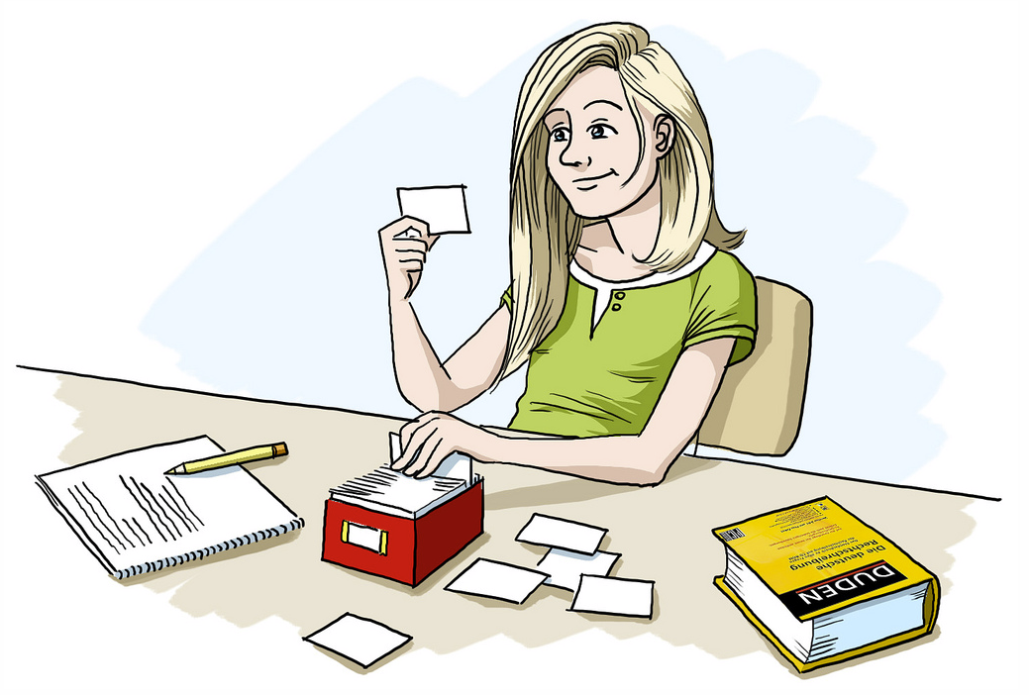
1: Flashcards

Slide 3
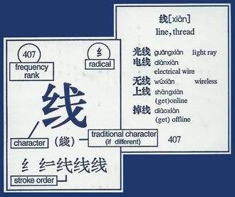
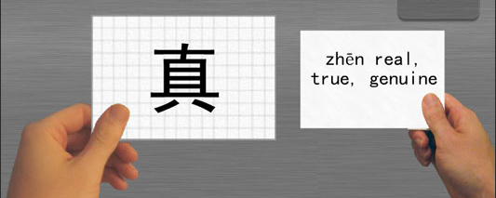
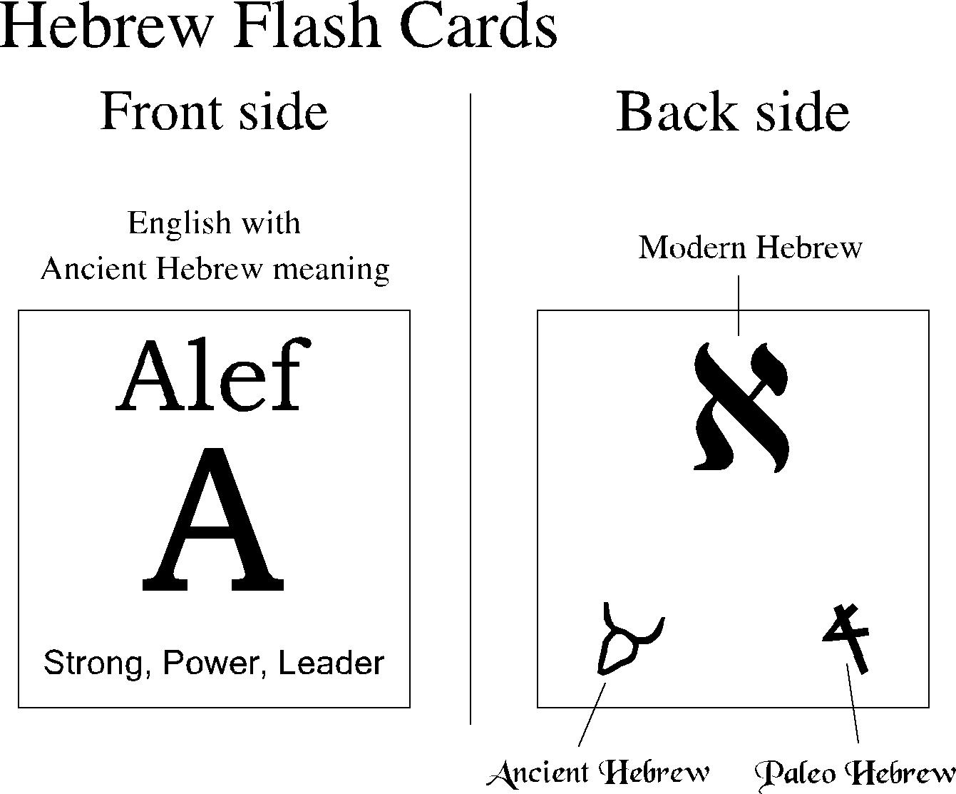
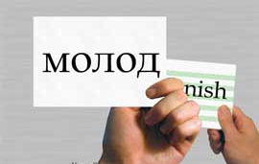
1: Flashcards

Slide 4
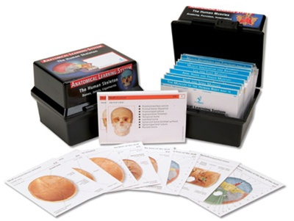
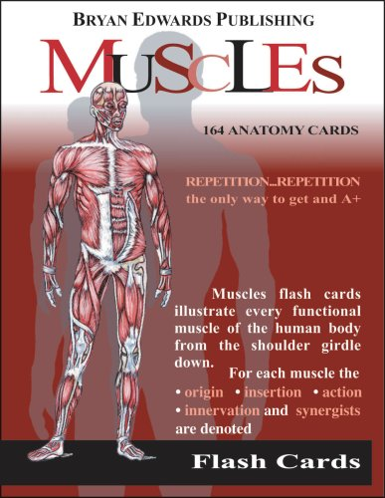
1: Flashcards

Slide 5

1: Flashcards
Computer Science Abbreviations:
4NF
ACID
MVD
RAID
SQL
FPGA
FTL
...
Computer Science Concepts:
Merge Sort
Two-phase locking
...

Slide 6
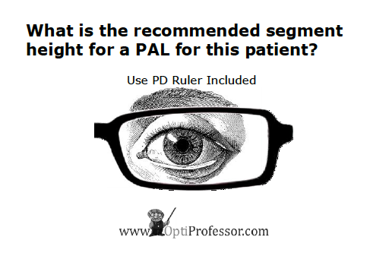
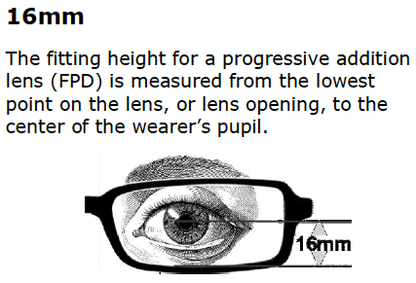
1: Flashcards

Slide 7
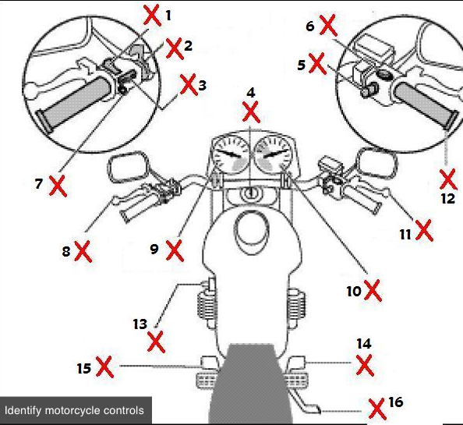
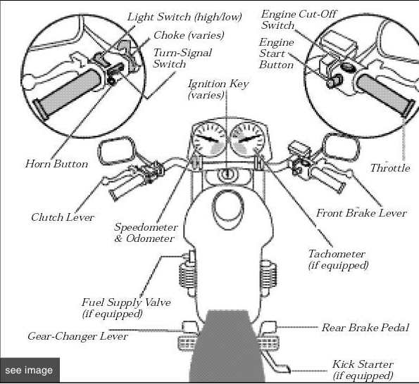
1: Flashcards
Texas DPS Motorcycle Operators Manual

Slide 8
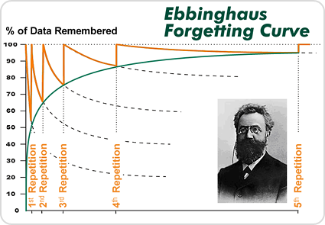
2: Spaced Repetition
Ebbinghaus Forgetting Curve
Leitner System (Pimsleur's graduated
interval recall)
correct
1 day
3 days
1 week
1 month
6 months
incorrect

Slide 9
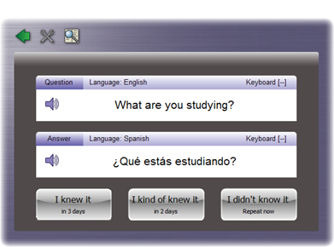
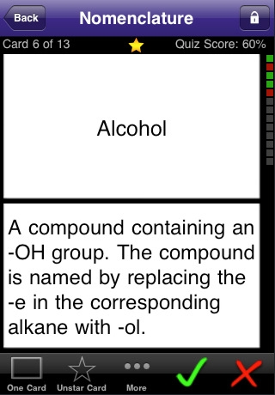
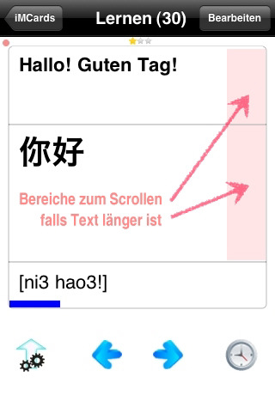
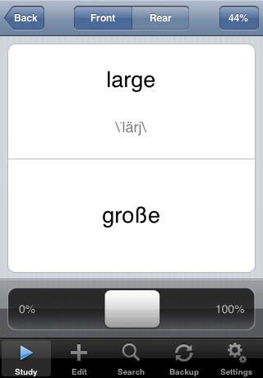
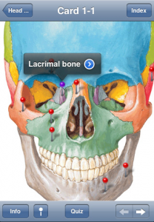
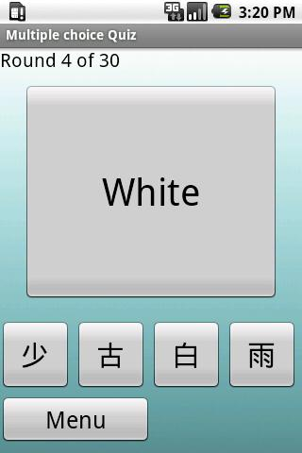
2: Spaced Repetition

Slide 10


2: Spaced Repetition
Specialized Software
used by 3.000 schools
sold 500.000 times

Slide 11














3: A Community
myPairSpace.com

Slide 12
An example PairSpace scenario
Spanish 1
A. Alice inserts her first Spanish lesson
Spanish 1
go/ir
1.
2.
3.
...
100.
go/ir
1.
2.
3.
...
100.
pay/pagar
pay/pagar
come/venir
B. Bob searches and finds Alice's lesson
come/venir
Alice
...
...
hear/oir
hear/oir
C. Bob adapts his copy of her original lesson
Spanish 1
1.
2.
3.
...
100.
go/andar
Bob
pay/pagar
D. Charlie comes and searches for Spanish lessons
come/venir
...
hear/oir
What to return, how to present, how to query, and how to rank?
?
Charlie

Slide 13
Challenge 1
Spanish 1
1: What to return?
1.
2.
3.
...
100.
go/ir
pay/pagar
Alice's (original)
Bob's (most recent)
their intersection
their union
presenting the one conflicting tuple
come/venir
Alice
...
hear/oir
Spanish 1
1.
2.
3.
...
100.
go/andar
Bob
pay/pagar
come/venir
...
hear/oir
How to inform the user about the structural variation in collections?
?
Charlie

Slide 14
Challenge 2
Spanish 1
2: How to present?
1.
2.
3.
...
100.
go/ir
pay/pagar
lists of tuples ☹
lists lessons & example tuples
majority vs diversity
cluster collections into meta-collections
come/venir
Alice
...
hear/oir
Spanish 1
1.
2.
3.
...
100.
go/andar
Bob
pay/pagar
come/venir
...
hear/oir
What are optimal "return structures" and their visual representation?
?
Charlie

Slide 15
Challenge 3
Spanish 1
3: How to search?
1.
2.
3.
...
100.
go/ir
pay/pagar
Keyword-based
Form-based
Language-based
varying trust
given we search for collections
come/venir
Alice
...
hear/oir
Spanish 1
1.
2.
3.
...
100.
go/andar
Bob
pay/pagar
come/venir
...
hear/oir
How to best (fast, easy) allow users to to express their search needs?
?
Charlie

Slide 16
Challenge 4
Spanish 1
4: How to rank?
1.
2.
3.
...
100.
go/ir
pay/pagar
Syntactic & semantic similarity (across languages)
Structure (items vs collection)
Trust (vote- vs rule-based
Provenance (on collections)
Learning/Adjustment over time
come/venir
Alice
...
hear/oir
Spanish 1
1.
2.
3.
...
100.
go/andar
Bob
pay/pagar
come/venir
...
hear/oir
?
Charlie

Slide 17
Overview of Challenges
Spanish 1
New Challenges
Representation
Interface
Relevance measures
Cross-Cutting Challenges
inconsistency/trust
non-monotonicy (dynamic evolution)
uncertainty
provenance
1.
2.
3.
...
100.
go/ir
pay/pagar
come/venir
Alice
...
hear/oir
Spanish 1
1.
2.
3.
...
100.
go/andar
Bob
pay/pagar
come/venir
...
hear/oir
?
Charlie

Slide 18
Some promising solutions
New Challenges
Representation
Interface
Relevance measures
Cross-Cutting Challenges
inconsistency/trust
non-monotonicy (dynamic evolution)
uncertainty
provenance
VLDB 2009
Sigmod 2010
MUD 2010
(VLDB 2011)

Slide 19
Managing the human genome
1:
ACCGCAACGTTATAGGCACGCTATATCG
2:
ACCGCAACGTATTATAGGCACGCTATATCG
3:
ACCGCAACGTATTATAGGCACGATATCTCG
4:
ACCGCAACGTATTAGGCACGATATCTCG
5:
ACCGCAATTAGGCACGTACGATATCTCG
...
1B:
ACCGCAATTAGGGACGTACGATATCTCG

Slide 20
Managing the human genome
1:
ACCGCAACGTTATAGGCACGCTATATCG
insertion
2:
ACCGCAACGTATTATAGGCACGCTATATCG
large-scale structural variations
inversion
3:
ACCGCAACGTATTATAGGCACGATATCTCG
deletion
4:
ACCGCAACGTATTAGGCACGATATCTCG
translocation
5:
ACCGCAATTAGGCACGTACGATATCTCG
single nucleotide
polymorphism
...
SNP
1B:
ACCGCAATTAGGGACGTACGATATCTCG
Notes:
* optimal structure depends on something which we try to discover in the first place
* we know how hard it is in DBs to change the schema. here the schema changes all the time; as we go and learn

Slide 21
The Vision
myPairSpace.com
one massive central repository for ce-learning needs
has the typical DM challenges of any community DB
new: management of collections and their evolution
Then abstract and apply learned principles
data determines the structure
management of the human genome ("management" versus "scientific management")

