Slide 1
Visual Cloud
A Database System for Virtual Reality Applications
[TODO Authors]

Slide 2
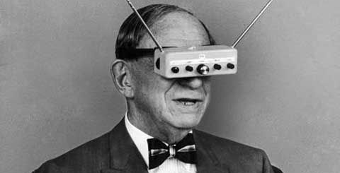

Slide 3
Youtube:
Ideally a video with two bubbles
And painful switch therebetween

Slide 4

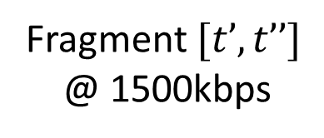
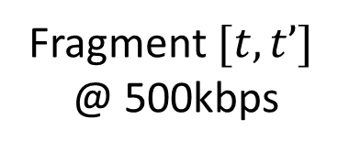
Netflix
Adaptive Streaming
Fragment $[t, t’]$
@ 500kbps
Fragment $[t’, t’’]$
@ 1500kbps
500
kbps
1500
kbps
100
kbps
Time

Slide 5
Static encoding does not capture viewer orientation, which changes at runtime.

Slide 6
No one looks at the sky (NOLATS) conjecture

Slide 7

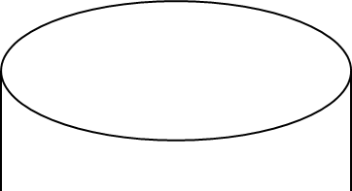








Array
Time $0$
Time $m$
Time $n$
Keyframe
TileDB
Fragment
(H.264 Encoded)
H.264
H.264 Encoder
$$m$$
Time $0$

Slide 8
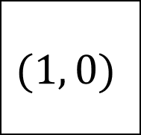
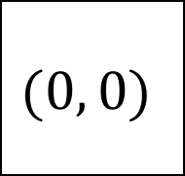

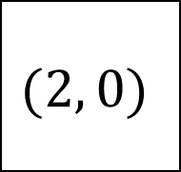


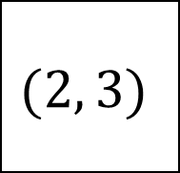

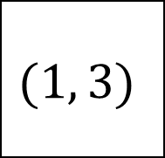
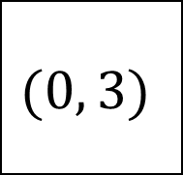
Contiguous H.264-Encoded TileDB Fragments
$$(1, 0)$$
$$(1, 3)$$
$$(2, 3)$$
$$(2, 0)$$
$$(0, 0)$$
$$(0, 3)$$
Fragment-aligned queries:
get$\left(\left\langle \left(1, 0\right), …, \left(1,3\right)\right\rangle , \left[0,m\right]\right)$
get$\left(\left\langle \left(1, 0\right), …, \left(0,3\right)\right\rangle , \left[0,c⋅m\right]\right)$
H.264
Keyframe-Aligned queries:
get$\left(\left\langle \left(1, 0\right), …, \left(1,3\right)\right\rangle , \left[t_{key},t′\right]\right)$
$$m$$
Unaligned queries:
Time $0$
get$\left(\left\langle \left(1, 0\right), …, \left(1,3\right)\right\rangle , \left[t>0,t′\right]\right)$

Slide 9
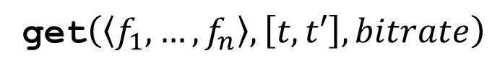
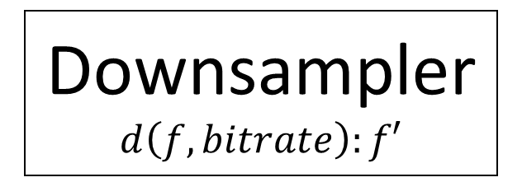
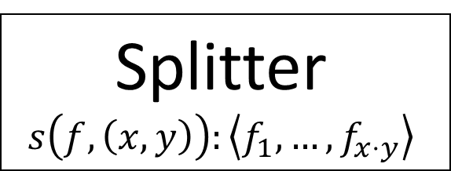
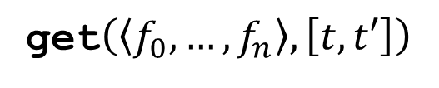
get$\left(\left\langle f_{1},…, f_{n}\right\rangle , \left[t,t′\right], bitrate\right)$
Downsampler
$$d\left(f, bitrate\right):f′$$
Cache
store
get$\left(\left\langle f_{0},…, f_{n}\right\rangle , \left[t,t′\right]\right)$
Splitter
$$s\left(f, \left(x, y\right)\right):\left\langle f_{1}, …, f_{x⋅y}\right\rangle$$
H.264
Visual Cloud
Storage Manager

Slide 10
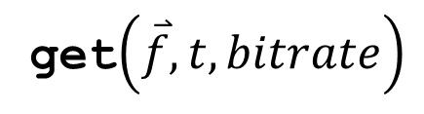
Visual Cloud
Server
Fragments
Prediction Engine
Fragment Server
Query Engine
Ingest Pipeline
get$\left(\overset{⃑}{f}, t, bitrate\right)$
Storage Manager

Slide 11

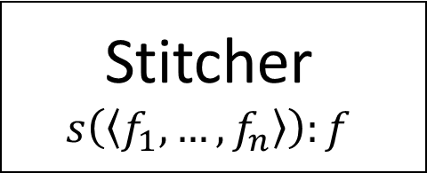
Stitcher
$$s\left(\left\langle f_{1}, …, f_{n}\right\rangle \right):f$$
Client
Local Cache
Fragment Manifest
Current Time
Current Orientation
Fragments
Prediction Engine
Fragment Server
Query Engine
Ingest Pipeline
get$\left(\overset{⃑}{f}, t, bitrate\right)$
Storage Manager
Visual Cloud
Client

Slide 12
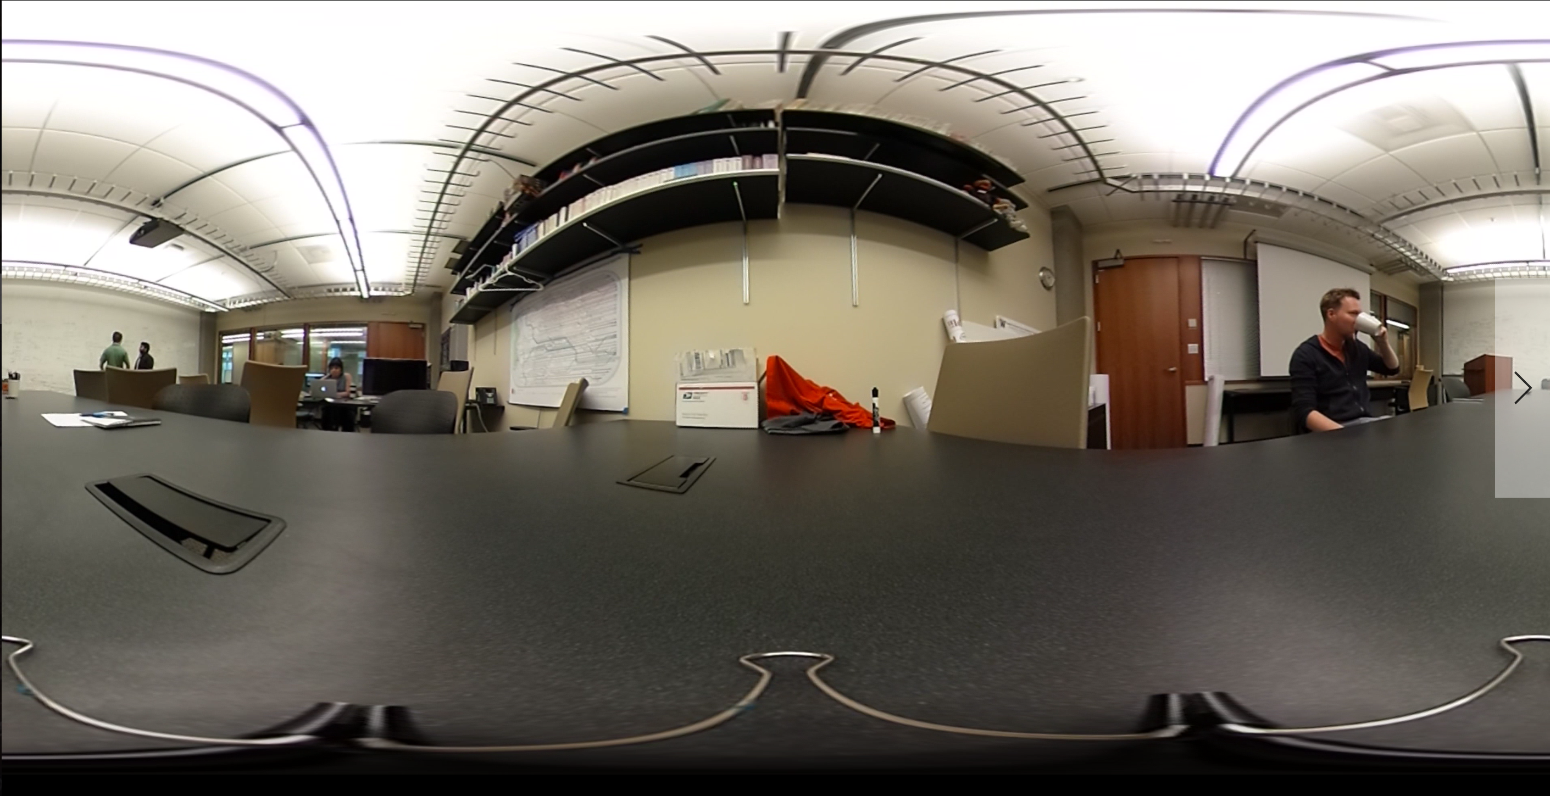

Slide 14

Frequently Viewed
Bitrate = $15,000$kbps

Slide 15
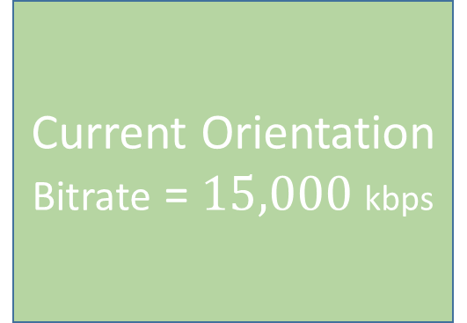
Frequently Viewed
Bitrate = $15,000$kbps
Current Orientation
Bitrate = $15,000$kbps

Slide 16
Frequently Viewed
Bitrate = $15,000$kbps
Current Orientation
Bitrate = $15,000$kbps
Adjacent Fragment
Bitrate = 500 kbps

Slide 17
No one looks
at the ceiling!
Bitrate = 10 kbps
Frequently Viewed
Bitrate = $15,000$kbps
Current Orientation
Bitrate = $15,000$kbps
Adjacent Fragment
Bitrate = 500 kbps

Slide 18
No one looks
at the ceiling!
Bitrate = 10 kbps
Frequently Viewed
Bitrate = $15,000$kbps
Current Orientation
Bitrate = $15,000$kbps
Adjacent Fragment
Bitrate = 500 kbps
Nonadjacent
Bitrate = 10 kbps

Slide 19
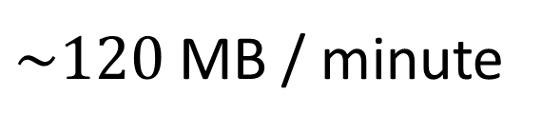
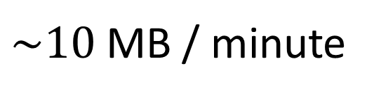
Have to prorate visual cloud kbps :(
Ordinary Video Transfer
Visual Cloud Transfer
15,000 kbps
10 kbps
15,000 kbps
15,000 kbps
500 kbps
10 kbps
Stitcher
Device
Device
$\sim 120$ MB / minute
$\sim 10$ MB / minute

Slide 20
Spatial prediction

Slide 21
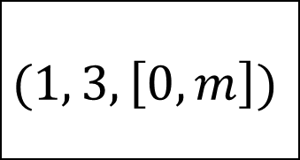
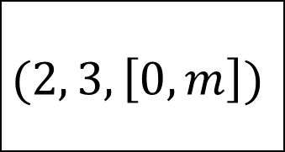
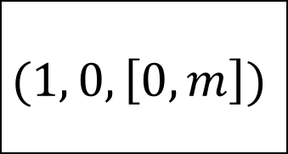
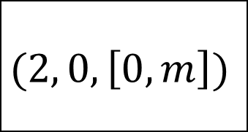
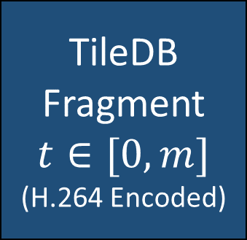
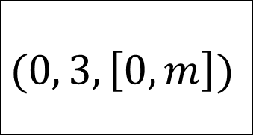
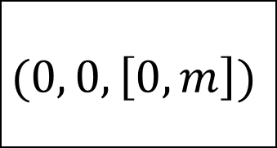
Contiguous H.264-Encoded TileDB Fragments
$$(1, 0, \left[0, m\right])$$
$$(1, 3, \left[0, m\right])$$
$$(0, 0, \left[0, m\right])$$
$$(0, 3, \left[0, m\right])$$
$$(2, 0, \left[0, m\right])$$
$$(2, 3, \left[0, m\right])$$
TileDB
Fragment
$$t∈[0,m]$$
(H.264 Encoded)
H.264

