Slide 1
Drawing Causal Inference from Big Data
Babak Salimi*, Dan Suciu*, Johannes Gehrke⁺
*University of Washington ⁺Microsoft

Slide 2
Causal Inference is important
Performance Debugging:
What is the effect of the new version of Postgres (vs. the pervious version) on query runtime, given a population of queries? [VISKA]
Health Science:
What is the efficacy of a given drug in a population?
Social/political Science:
What causes ethnic violence?
Why are rural people more politically conservative than urban people?
Marketing :
Evaluating new ideas/policies for a business
Notes:
FIX formatting

Slide 3
Causal Inference
Causality: “X is a cause for Y” if by perturbing/intervening X and keeping everything else unchanged we affect Y
Causal inference: is the process by which one can use data to make claims about causal relationships
Causal vs. Predictive analysis:
Predictive analysis P(X,Y)
Causal analysis P(Y, Intervening (X))
Fundamentally different!

Slide 4
Goal of this Research
Causal inference is performed today using statistical software such as SAS, SPSS, or R [MatchIt 2015, CausalImpact 2015,CEM 2016, …]
Work well on small, single table
Our research:
Integrate causal inference in relational database
We can perform causal inference with SQL queries
Fast SQL queries Scalable causal inference
Notes:
Causal inference has been studied extensively in statistics and computer science inference [Neyman 1923, Rubin 1973, Holland 1986,Pearl 2000 ]

Slide 5
Causal Effect of Weather on Delay
What is the causal effect of the Snow Delay?
Data: 100M rows; 23 attributes!
Treatment T
Outcome Y
FlightNo | Date | Origin | Snow | … | Visibility | Delay
DL033 | 10/10/01 | Seattle | 0 |  | 1 | 0
AS55 | .. | Seattle |  |  | 2 | 5m
… |  | .. | 1 |  | 10 | 0
 |  | .. | 0 |  | 1 | 1h
Other causal questions:
Effect of LowVisibility(Visibility< 2KM), or Windspeed (Wspdm> 32 MPH), or ...?

Slide 6
Rubin’s Causality SQL
Single attribute Y
Unit (ID) | T | X(1) | X(2) | ... | Y(0) | Y(1)
1 | 0 | A | B |  | y1 | NULL
2 | 1 | A | B |  | NULL | y2
Def. Causal effect = E[Y(1) – Y(0)]
(1) SELECT avg(Y(1) – Y(0)) FROM R
Problem: missing values!
Controlled experiment: E[Y(T) | T] = E[Y(T)] (independence assumption)
(2) (SELECT avg(Y) FROM R WHERE T=1) - (SELECT avg(Y) FROM R WHERE T=0)
Causal effect = E[Y(1)|T=1] – E[Y(0)|T=0]
Problem: our data is not randomized!
(Observational Data)
Strong Ignorability: E[Y(T) | T,X] = E[Y(T)|X]
(3) AVG[
(SELECT avg(Y) FROM R WHERE T=1 GROUP BY X) - (SELECT avg(Y) FROM R WHERE T=0 GROUP BY X) ]
Causal effect = E_{X}[E[Y(1)|T=1,X] – E[Y(0)|T=0,X]]
Problem: homogeneous groups!
Data processing: retain only groups with both T=0 and T=1 (subclassification)

Slide 7
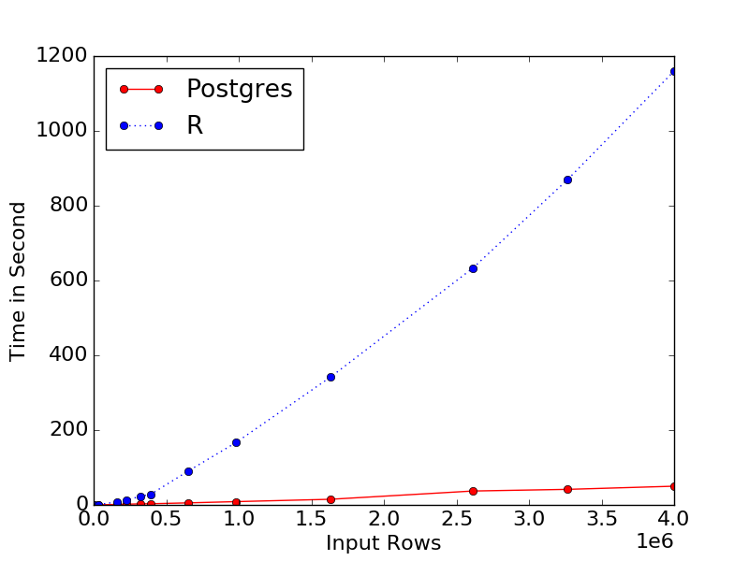
Subclassification in SQL
Subclassification : retain only groups with both T=0 and T=1
CREATE VIEW Subclassification
WITH subclasses AS ( SELECT *, max(ID) FROM R GROUP BY X HAVING max(T)!=min(T) )
SELECT * FROM subclasses, R WHERE subclasses.X = R.X
25x speed up!
The query takes more than an hour on the entire data!
Can we do better?

Slide 8
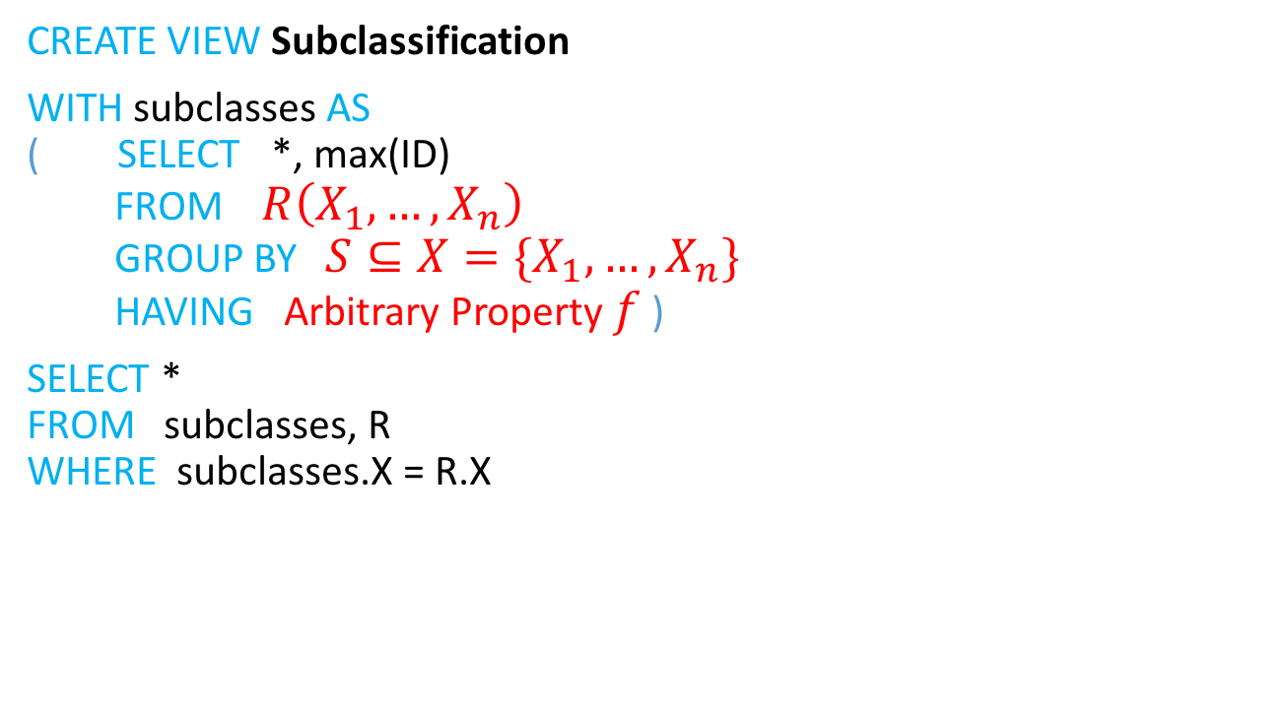
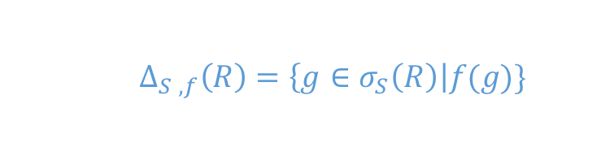
Subclassification queries are important
CREATE VIEW Subclassification
WITH subclasses AS ( SELECT *, max(ID) FROM $R\left(X_{1},…, X_{n}\right)$ GROUP BY $S⊆X={\{X}_{1},…, X_{n}\}$ HAVING Arbitrary Property $f$ )
SELECT * FROM subclasses, R WHERE subclasses.X = R.X
$$∆_{S ,f}\left(R\right)=\left\{g∈σ_{S}\left(R\right)\right|f(g)\}$$
Important class of queries!
Data Mining (Iceberg Queries )
Discovery of FDs
Statistical methods
They have certain algebraic properties that enable us to perform them much faster!

Slide 9
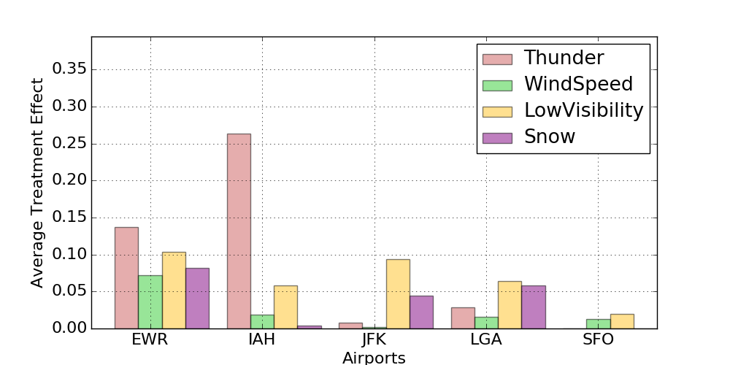
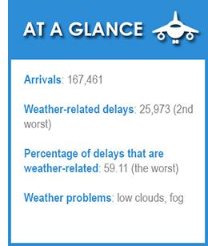
Effect of weather on flight delay
San Francisco International Airport (SFO)
George Bush Intercontinental Airport (IAH)
[https://weather.com/]

Slide 10

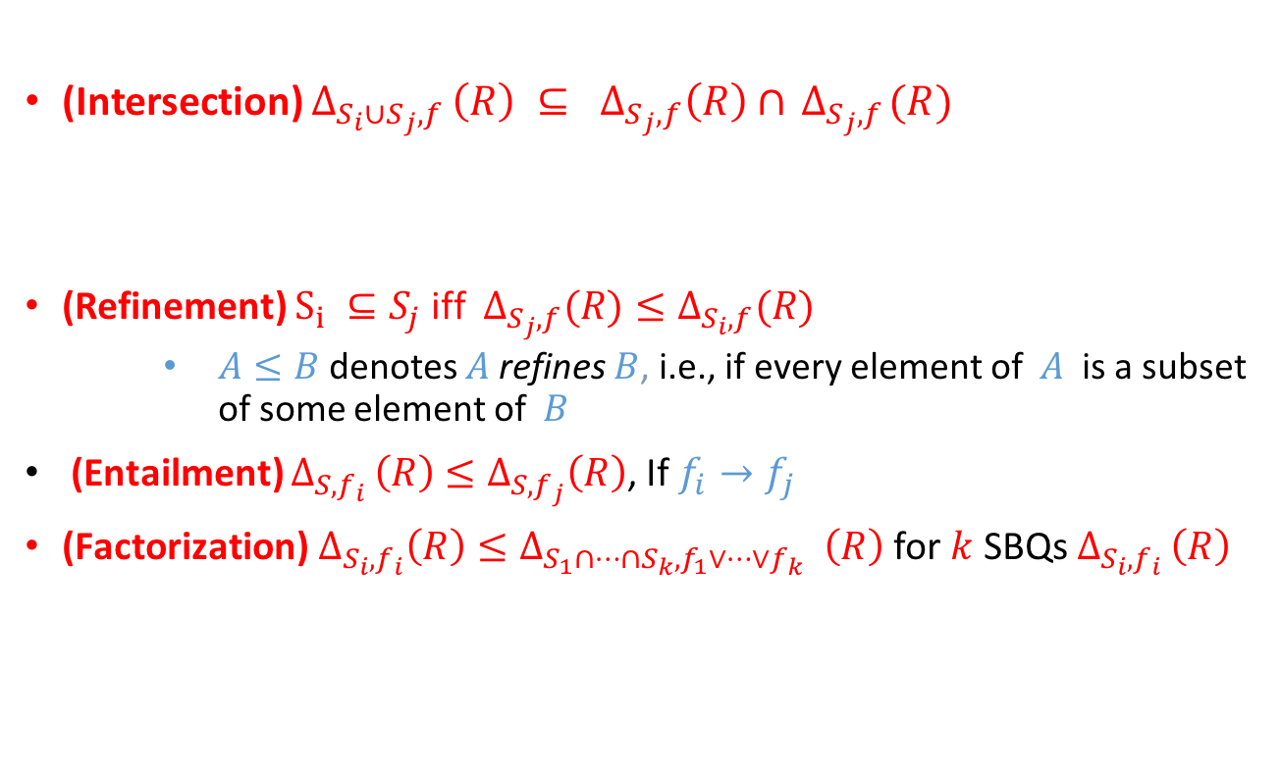
Algebraic Properties (monotone $f$ )
(Intersection) $∆_{{S_{i}∪S}_{j},f }\left(R\right) ⊆ ∆_{S_{j},f}\left(R\right)∩{ ∆}_{S_{j},f}(R)$
(Refinement) $S_{i} ⊆S_{j}$ iff $∆_{S_{j},f}(R)≤∆_{S_{i},f}(R)$
$A≤B$ denotes $A$ refines $B$, i.e., if every element of $A$ is a subset of some element of $B$
(Entailment) $∆_{S,f_{i} }\left(R\right)$ $≤∆_{S,f_{j}}\left(R\right)$, If $f_{i}→f_{j}$
${\text{(}\text{Factorization}\text{)} ∆}_{S_{i},f_{i}}\left(R\right)≤∆_{S_{1}∩…∩S_{k},f_{1}∨…∨f_{k}} _{ }\left(R\right)$ for $k$ SBQs $∆_{S_{i},f_{i} }\left(R\right)$
Start prubing wrt. larger groups
Start pruning the shared attributes between all groups and disjunction of aggregate conditions

Slide 11
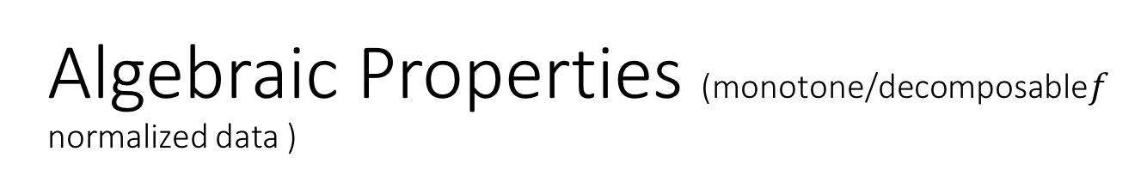
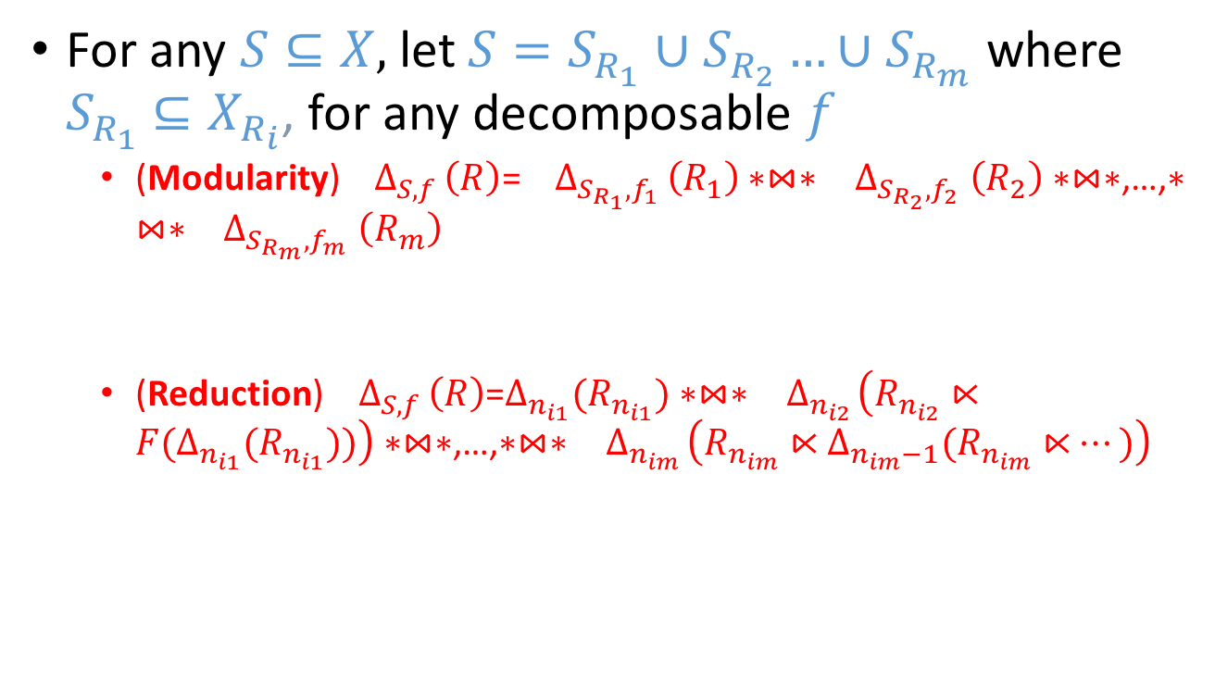
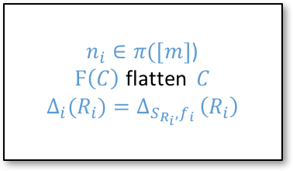
Algebraic Properties (monotone/decomposable$f$ normalized data )
For any $S⊆X,$ let $S=S_{R_{1}}∪S_{R_{2}}…∪S_{R_{m}}$ where $S_{R_{1}}$ $⊆X_{R_{i}}$, for any decomposable $f$
(Modularity)${ ∆}_{S,f }\left(R\right)$=${ ∆}_{S_{R_{1}},f_{1} }\left(R_{1}\right)∗⋈∗{ ∆}_{S_{R_{2}},f_{2} }\left(R_{2}\right)∗⋈∗$,…,$∗⋈∗{ ∆}_{S_{R_{m}},f_{m} }\left(R_{m}\right)$
(Reduction)${ ∆}_{S,f }\left(R\right)$=$∆_{n_{i1}}(R_{n_{i1}})∗⋈∗{ ∆}_{n_{i2}}\left(R_{n_{i2}}⋉{F(∆}_{n_{i1}}(R_{n_{i1}}))\right)∗⋈∗$,…,$∗⋈∗{ ∆}_{n_{im}}\left(R_{n_{im}}⋉∆_{n_{im}−1}(R_{n_{im}}⋉…)\right)$
Filtering can be pushed down to the base relations
$n_{i}∈π([m]$)
$Ϝ\left(C\right)$ flatten $C$
$${∆_{i}(R_{i})=∆}_{S_{R_{i}},f_{i} }\left(R_{i}\right)$$
We can perfum semi-join reduction

Slide 12
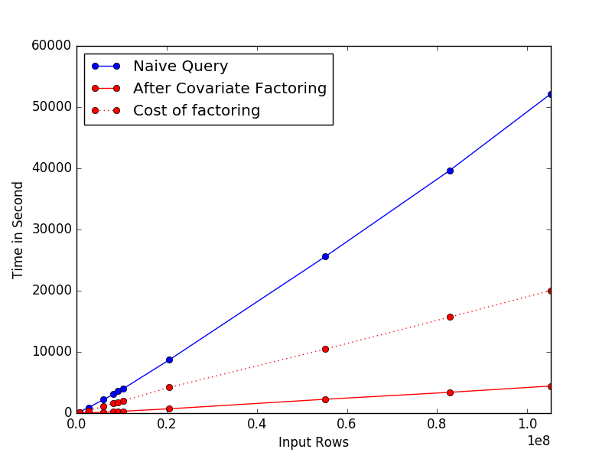
Factorization for multiple queries
Causal queries: T1:LowVisibility; T2:HeavySnow; T3:SnowStrom; T4:Windspeed; T5:Thunder;
Partition treatments (heuristic)
G1={T1, T5}
G2={ T2,T3,t4}
Prune wrt. each group
(Shared attributes, disjunction of the treatments)
Impose the original queries to the pruned data
10x speed up!
After pruning we can run several SBs wrt. Different treatments for different subsets of the data

Slide 13
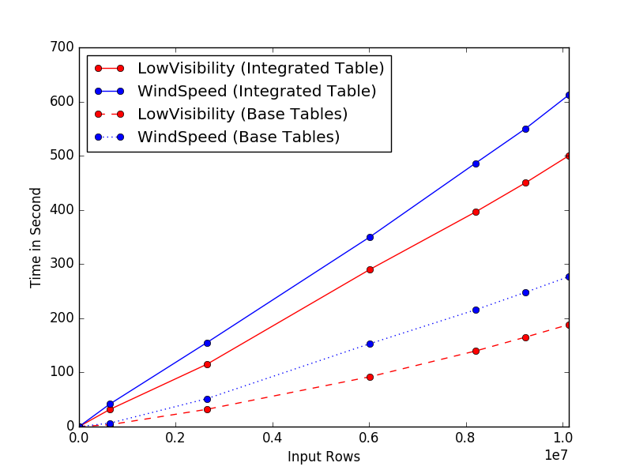
Modularity and Reduction reduction
Causal queries: LowVisibility; Windspeed;
Decompose Data into flight and weather data
Filter weather data wrt. A weather treatment e.g., Low visibility
Semi-join with the flight data
Filter the reduced flight data ; join with the filtered weather data
2x speed up!

Slide 14
Future Directions
Develop more efficient algorithm to take maximum advantage of the algebraic properties
Investigate other properties of SBs to further optimize multiple queries
Go beyond monotone aggregate conditions e.g., condition based on entropy
Apply the optimization techniques to border ranges of problem e.g., association rule discovery/ other statistical methods

Slide 15
END

