Slide 1
The Open World Database
Laurel Orr, Magda Balazinska, Dan Suciu
UWDB Affiliates Workshop
July 2018

Slide 2
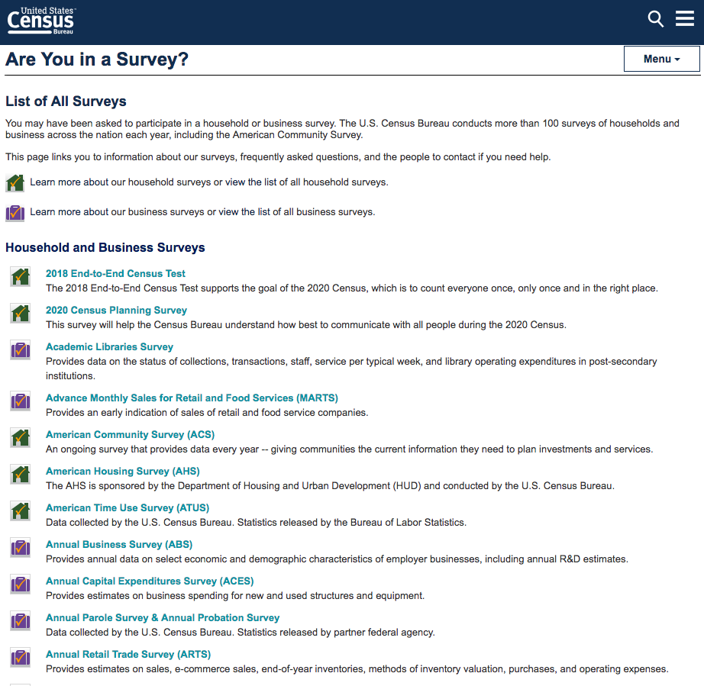
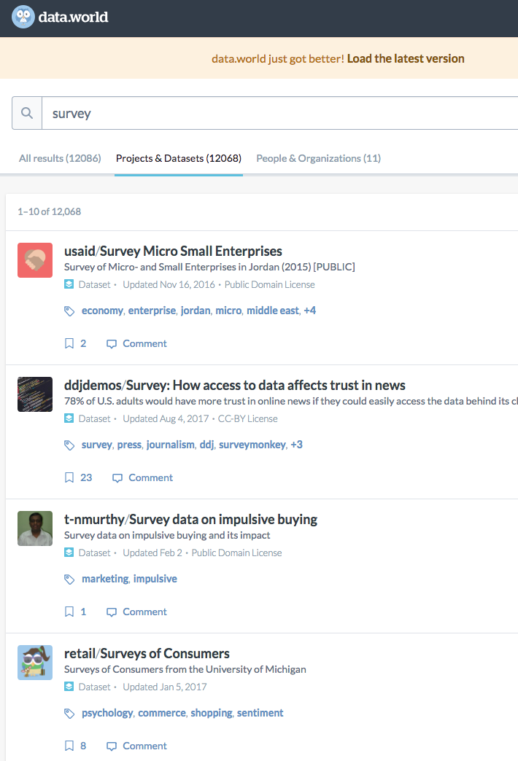
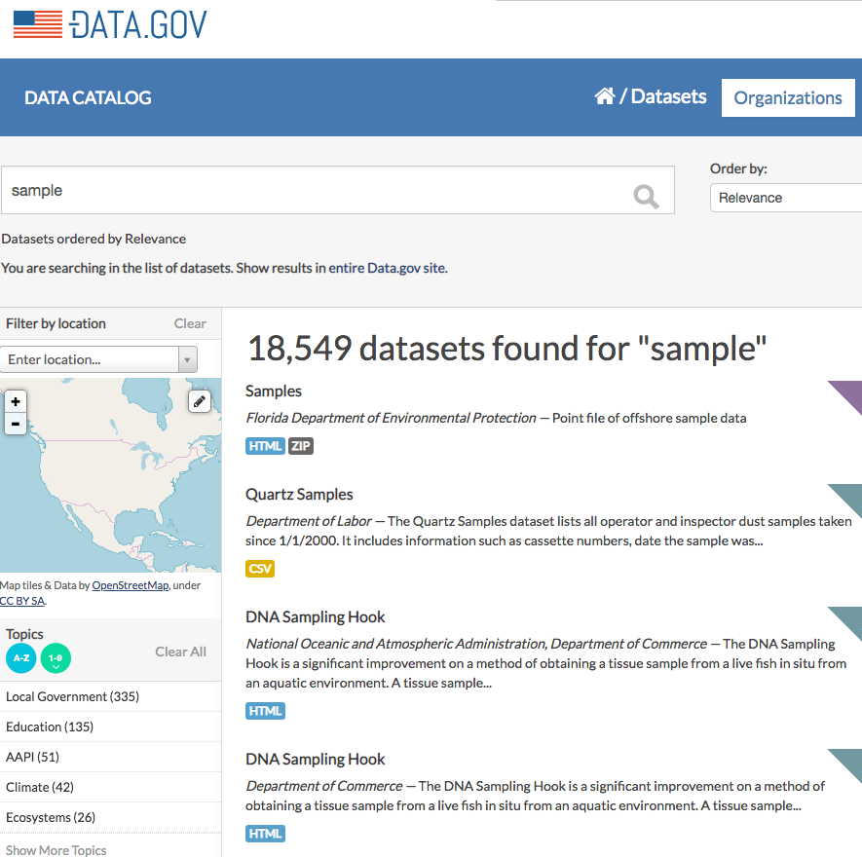
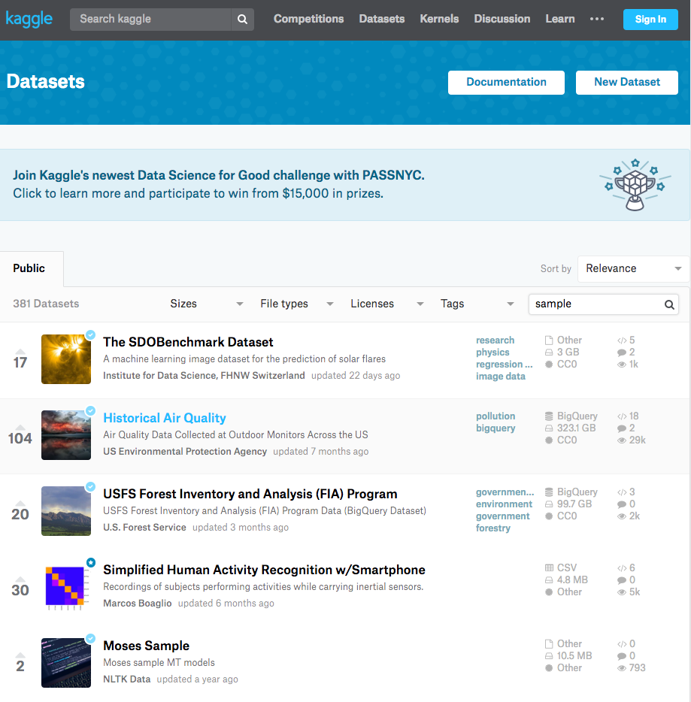
Science is Samples

Slide 3

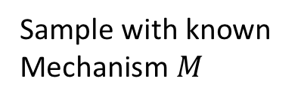
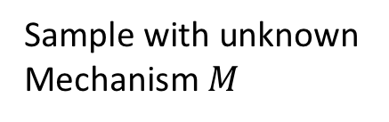
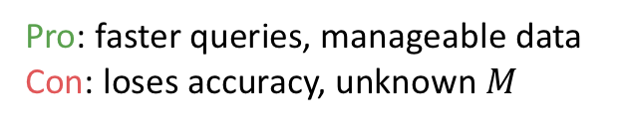

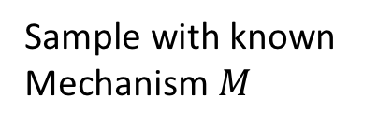

Three “Types” of Sampling
Known Population, Known $M$
Unknown Population, Known $M$
Unknown Population, Unknown $M$
Population
Population
Population
Sample with known Mechanism $M$
Sample with known Mechanism $M$
Sample with unknown Mechanism $M$
Sample
Sample
Sample
Pro: faster queries
Con: loses accuracy
Pro: faster queries, manageable data
Con: loses accuracy
Pro: faster queries, manageable data
Con: loses accuracy, unknown $M$

Slide 4

Enter the Database
Known Population
, Known $M$
Population
Assumes the data is the entire population (e.g., a data warehouse)
Sample with known Mechanism $M$
Provides sampling operators
Sample
Lead to a lot of great research making population queries faster

Slide 5
Three “Types” of Sampling
Our Target Audience
Known Population, Known $M$
Unknown Population, Known $M$
Unknown Population, Unknown $M$
Population
Population
Population
Sample with known Mechanism $M$
Sample with known Mechanism $M$
Sample with unknown Mechanism $M$
Sample
Sample
Sample
Pro: faster queries
Con: loses accuracy
Pro: faster queries, manageable data
Con: loses accuracy
Pro: faster queries, manageable data
Con: loses accuracy, unknown $M$

Slide 6
Motivating Example
704,352 Seattletonians
10 min/person
=
11 years
What is the average age of people in Seattle who have gotten a texting/phone citation?
Unknown Sampling Mechanism
Survey of 100 People Living in the U District
Selection Bias
5/100 people got phone tickets with average age of 26
This implies ~35,000 phone tickets in Seattle, but WA reported that ~33,000 tickets given. How can this be?
Databases Should Correct This Answer
(or at least say it has error)

Slide 7
To Summarize
Claim: Scientists analyze (often biased) data samples to learn about the population as a whole.
Problem: Databases assumed a closed world (the data is NOT a sample).
Goal: Build an Open World Database system that natively assumes data ingested is a biased sample of some population, even if the sampling mechanism is unknown. Allow for user interaction to determine best technique to correct for sample bias.
Solution: (work in progress…)

Slide 8
What about Probabilistic Databases?
Probabilistic Databases:
Can assume an open world
Probabilities measure uncertainty in data (e.g., data scraped from possibly unreliable web sources)
Sample data is certain data, but not all the certain data is contained in the database.

Slide 9
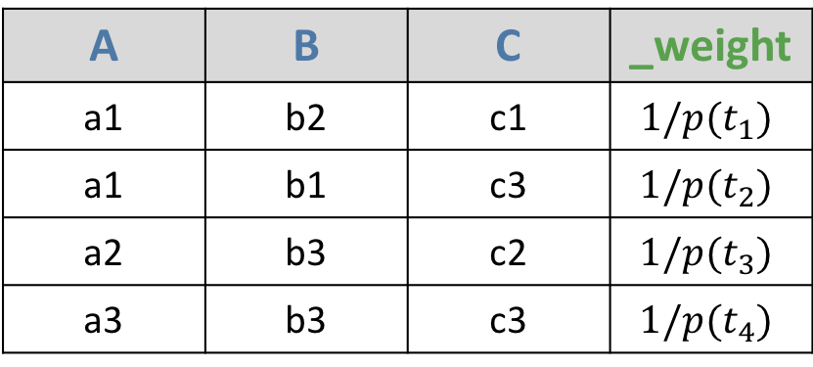
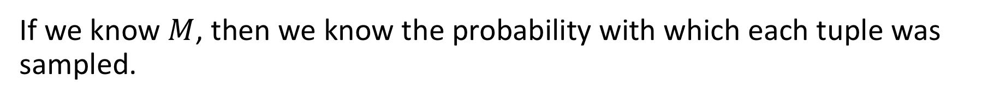
If Sampling Mechanism is Known
If we know $M$, then we know the probability with which each tuple was sampled.
A | B | C
a1 | b2 | c1
a1 | b1 | c3
a2 | b3 | c2
a3 | b3 | c3
A | B | C | _weight
a1 | b2 | c1 | $$1/p(t_{1})$$
a1 | b1 | c3 | $$1/p(t_{2})$$
a2 | b3 | c2 | $$1/p(t_{3})$$
a3 | b3 | c3 | $$1/p(t_{4})$$
Reweight each tuple with the inverse of its sample probability
If we do not know $M$, how can we still determine sample probability?

Slide 10

Logisitic Regression
Idea: classify tuples as being in sample (1) or not (0) using logistic regression on tuple attributes.
A | B | C | _class
a1 | b2 | c1 | 1
a1 | b1 | c3 | 1
a2 | b3 | c2 | 1
a3 | b3 | c3 | 1
a1 | b1 | c1 | 0
a3 | b3 | c1 | 0
a2 | b2 | c2 | 0
a2 | b1 | c2 | 0
A | B | C | _weight
a1 | b2 | c1 | 1/$p_{L}(t_{1})$
a1 | b1 | c3 | $$\text{1/}p_{L}(t_{2})$$
a2 | b3 | c2 | $$\text{1/}p_{L}(t_{3})$$
a3 | b3 | c3 | $$\text{1/}p_{L}(t_{4})$$
Problem: the 0 labelled data does not exist or is challenging to access.

Slide 11
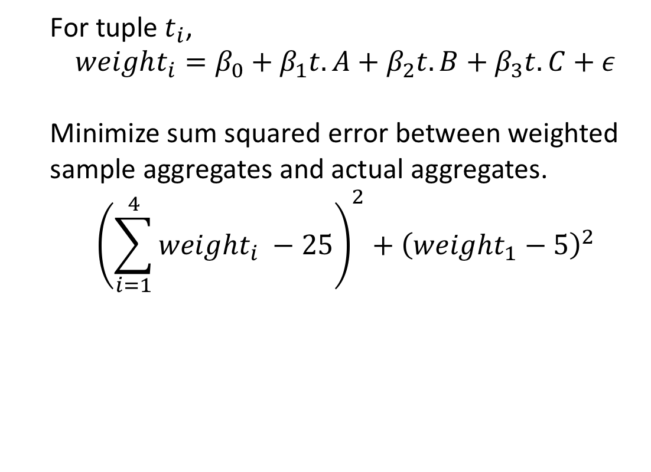
What Else do We Know?
This implies ~35,000 speeding tickets in Seattle, but WA reported that ~33,000 tickets given. How can this be?
This implies ~35,000 speeding tickets in Seattle, but WA reported that ~33,000 tickets given. How can this be?
WA reported aggregates without releasing the data
A | B | C
a1 | b2 | c1
a1 | b1 | c3
a2 | b3 | c2
a3 | b3 | c3
For tuple $t_{i}$,
$$weight_{i}=β_{0}+β_{1}t.A+β_{2}t.B+β_{3}t.C+ε$$
Minimize sum squared error between weighted sample aggregates and actual aggregates.
$${\left(\sum_{i=1}^{4}{weight_{i}} −25\right)}^{2}+{\left(weight_{1}−5\right)}^{2}$$
Idea: use linear regression to model the weights constrained by the given aggregates.
25 rows in population
5 rows of (a1, b2, *)
Note: we assume the weight is a linear combination of the attributes

Slide 12
Open Questions
How can we add in user interaction or partial information about the sampling mechanism?
Is a linear model adequate to model the weight?
How does our accuracy change given our set of aggregates?
What if we have multiple samples instead of just one?
How do we handle error?

