Slide 1
Mining Approximate Acyclic Schemes from Relations
Batya Kenig | Pranay Mundra | Guna Prasad | Babak Salimi | Dan Suciu
University of Washington

Slide 2

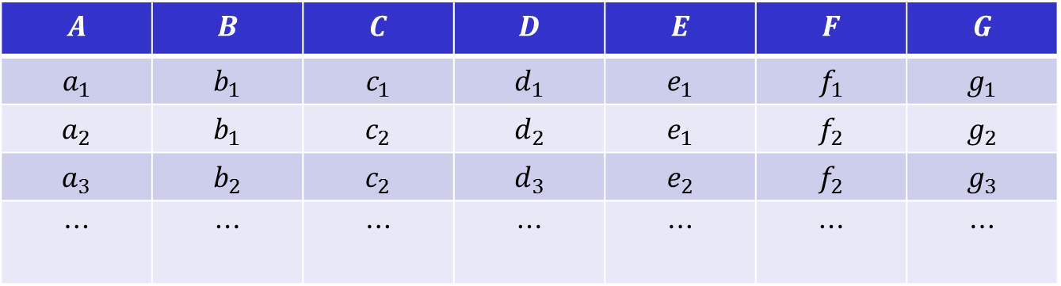



A Problem
$$A$$ | $$B$$ | $$C$$ | $$D$$ | $$E$$ | $$F$$ | $$G$$
$$a_{1}$$ | $$b_{1}$$ | $$c_{1}$$ | $$d_{1}$$ | $$e_{1}$$ | $$f_{1}$$ | $$g_{1}$$
$$a_{2}$$ | $$b_{1}$$ | $$c_{2}$$ | $$d_{2}$$ | $$e_{1}$$ | $$f_{2}$$ | $$g_{2}$$
$$a_{3}$$ | $$b_{2}$$ | $$c_{2}$$ | $$d_{3}$$ | $$e_{2}$$ | $$f_{2}$$ | $$g_{3}$$
$$⋯$$ | $$⋯$$ | $$⋯$$ | $$⋯$$ | $$⋯$$ | $$⋯$$ | $$⋯$$
$$R:$$
Goal
Find a Database schema that holds in the data
$$S=\{AC,AB,CDF,BD,CDE,BDG\}$$
$$⇔$$
$$R=R\left[AC\right]⋈R\left[AB\right]⋈R\left[CDF\right]⋈R\left[BD\right]⋈R\left[CDE\right]⋈R\left[BDG\right]$$
Holds (exactly) in $R$
Question.
Which schemas should we search for ?

Slide 3
Acyclic Schemas
Many desirable properties
Efficient query evaluation algorithms [Yannakakis ‘81]
Speed up query evaluation with multiple aggregates [Abo Khamis, Ngo, Rudra, 2016]
Speed up machine learning applications [Schleich et al. 2016, 2019]
“At the very least, database designers should be aware of acyclicity and strive for it.” [Beeri et al. 1983]

Slide 4
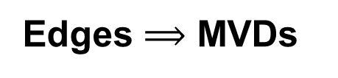








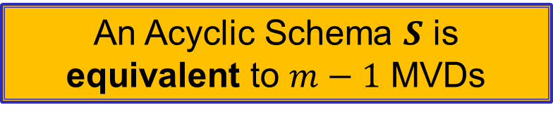
Acyclic Schemas have Join Trees
$$BDG$$
$$BDE$$
BD
BD
$$ABD$$
Bags
Running Intersection property
AD
An Acyclic Schema $S$ is
equivalent to $m−1$ MVDs
$$ACD$$
$$CF$$
C
Edges $⟹$ MVDs
C
$$C→→F|ABDEG⟹R=R\left[CF\right]⋈R\left[ABCDEG\right]$$
AD
$$AD→→CF|BEG⟹R=R\left[ADCF\right]⋈R\left[ADBEG\right]$$
BD
$$BD→→G|ACEF$$
$$⟹BD→→G\left|E\right|ACF⟹$$
$$R=R\left[BDG\right]⋈R\left[BDE\right]⋈R\left[BDACF\right]$$
BD
$$BD→→E|ACFG$$

Slide 5




























Some Acyclic schemes are better than others
$$BDG$$
$$BDE$$
$$BDG$$
$$BDE$$
$$BDEG$$
BD
BD
BD
BD
BD
$$ABD$$
$$ABD$$
$$BCDF$$
merge
AD
AD
BC
$$ACD$$
$$ACD$$
$$ABC$$
$$CF$$
C
$$CF$$
C
merge
$$BDG$$
$$BDE$$
$$BDG$$
$$BDE$$
$$BDG$$
$$BDE$$
Extend Edge
BD
BD
BD
BD
BD
BD
$$ABD$$
$$BCD$$
$$BCD$$
Extend Edge
AD
BC
BC
C
BC
$$ACD$$
$$BCF$$
$$ABC$$
$$CF$$
$$ACF$$
AC
$$ABC$$

Slide 6
MVDs → Acyclic Schemas
Discover all MVDs that hold in the relation.
Synthesize acyclic schemes from this set.
Bernstein [1976]
Lien [1981]
Fagin, Mendelzon, Ullman [1982]
Beeri, Fagin, Maier, Yannakakis [1983]
Goodman and Tay [1984]
Van Gucht [1988]
Lakshmanan [1988]

Slide 7



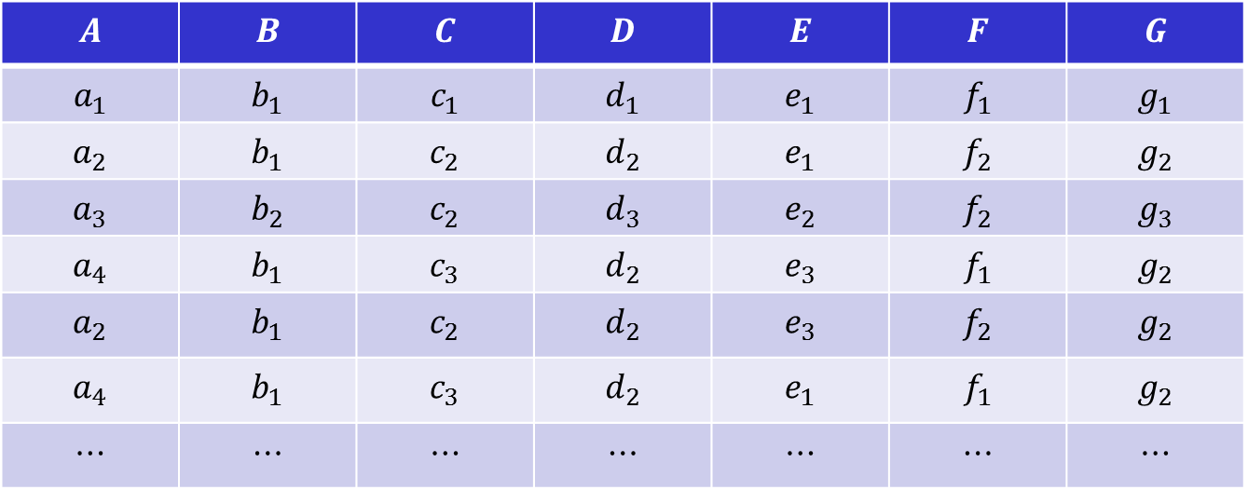



Approximations
$$A$$ | $$B$$ | $$C$$ | $$D$$ | $$E$$ | $$F$$ | $$G$$
$$a_{1}$$ | $$b_{1}$$ | $$c_{1}$$ | $$d_{1}$$ | $$e_{1}$$ | $$f_{1}$$ | $$g_{1}$$
$$a_{2}$$ | $$b_{1}$$ | $$c_{2}$$ | $$d_{2}$$ | $$e_{1}$$ | $$f_{2}$$ | $$g_{2}$$
$$a_{3}$$ | $$b_{2}$$ | $$c_{2}$$ | $$d_{3}$$ | $$e_{2}$$ | $$f_{2}$$ | $$g_{3}$$
$$a_{4}$$ | $$b_{1}$$ | $$c_{3}$$ | $$d_{2}$$ | $$e_{3}$$ | $$f_{1}$$ | $$g_{2}$$
$$a_{2}$$ | $$b_{1}$$ | $$c_{2}$$ | $$d_{2}$$ | $$e_{3}$$ | $$f_{2}$$ | $$g_{2}$$
$$a_{4}$$ | $$b_{1}$$ | $$c_{3}$$ | $$d_{2}$$ | $$e_{1}$$ | $$f_{1}$$ | $$g_{2}$$
$$⋯$$ | $$⋯$$ | $$⋯$$ | $$⋯$$ | $$⋯$$ | $$⋯$$ | $$⋯$$
$$BDG$$
$$BDE$$
BD
BD
$$ABD$$
AD
$$ACD$$
$$CF$$
C
Single missing or wrong tuple invalidates the MVD – and the entire schema!
Real-world data may have errors and missing values → overlook strong dependencies.
$$BD→→G|E|ACF$$

Slide 8
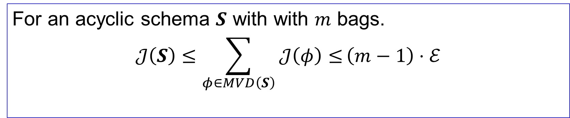
Approximations
Assign an information theoretic measure to each MVD.
$$0≤𝒥\left(BD→→G\left|E\right|ACF\right)≤ℰ$$
Always Positive
Holds exactly when 0
Theorem: approximation is additive
For an acyclic schema $S$ with with $m$ bags.
$$𝒥\left(S\right)≤\sum_{φ∈MVD\left(S\right)}{𝒥\left(φ\right)≤}\left(m−1\right)⋅ℰ$$

Slide 9

MVDs → Acyclic Schemas
Discover all $𝓔$-MVDs that hold in the relation
Synthesize approximate acyclic schemes ($ℰ$-Schemes) from this set.

Slide 10
Approximations
Breast-Cancer-Wisconsin
Letter
Bridges
Spurious Tuples [%]
* Datasets are part of the Metanome data profiling project [Papenbrock et al. VLDB 2015]

Slide 11
Challenges
Too many MVDs, not all of them interesting.
Discover a much smaller set of MVDs that entail the rest.
Those with a minimal key.
Lead to largest extent of decomposition.
Enumeration of acyclic schemas.
Performance: computing entropy is expensive.
$$A→→BCD|EF⟹AE→→BCD|F$$
$$A→→BC|D|EF⟹A→→BCD|EF$$

Slide 12

























Enumerating Acyclic Schemas
$$ℰ−\text{MVDs}$$
Pairwise Compatibility [Beeri et al., Van Gucht, Goodman&Tay,…]
For each max set
synthesize an
Acyclic schema
Split-free: Do not split keys
Decompose a bag.
$$C→→F|ABDEG$$
Enumerate Maximal
Independent sets
of a graph
[Cohen et al. 2008]
$$BD→→E|G|ACF$$
$$AD→→CF|BEG$$
$$BDG$$
$$BDE$$
$$BC→→A|F|DEG$$
BD
BD
$$ABD$$
$$1$$
$$2$$
AD
$$ACD$$
$$3$$
$$CF$$
C
$$1$$
$$2$$
$$BDG$$
$$BDE$$
$$3$$
$$4$$
$$1$$
$$2$$
BD
BD
$$BCD$$
$$4$$
C
BC
$$CF$$
$$ABC$$

Slide 13

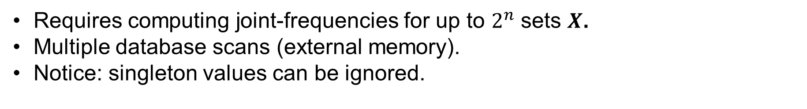
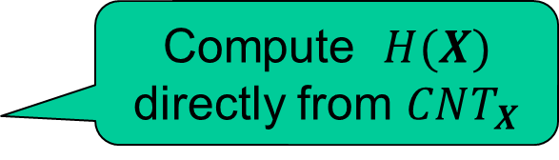
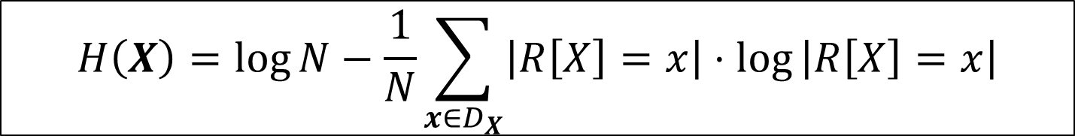




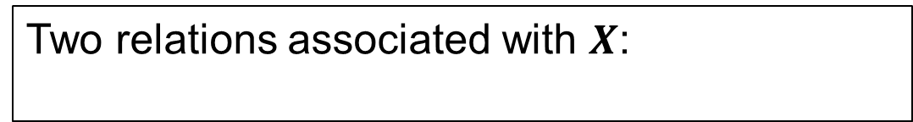

Computing Entropy
$$H\left(X\right)=\log{N−\frac{1}{N}\sum_{x∈D_{X}}{\left|R\left[X\right]=x\right|⋅log}}\left|R\left[X\right]=x\right|$$
Requires computing joint-frequencies for up to $2^{n}$ sets $X$.
Multiple database scans (external memory).
Notice: singleton values can be ignored.
Compute entropies using SQL over in-memory DBs.
Two relations associated with $X$:
Compute $H(X)$
directly from $CNT_{X}$
$$CNT_{X}(\text{val}, \text{cnt})$$
$$TID_{X} (\text{val}, \text{tid})$$
$$TID_{X} (\text{val}, \text{tid})$$
$$CNT_{X∪Y} (\text{val},\text{cnt})$$
$$TID_{X∪Y} (\text{val},\text{tid})$$
$$TID_{Y} (\text{val}, \text{tid})$$

Slide 14
Enables Scaling (rows)
Ditag-Feature (N=3960124, Cols=13)
Spots (N=973516, Cols=15)
0.0 [#MVDs]
0.01 [#MVDs]
0.1 [#MVDs]
0.0 [sec]
0.01 [sec]
0.1 [sec]
Rows [%]

Slide 15
Enables Scaling (Columns)
Voter State (N=10000, Cols=45)
Entity-Source (N=26139, Cols=33)
0.0 [#MVDs]
0.01 [#MVDs]
0.0 [sec]
0.01 [sec]

Slide 16
Thank You!

Slide 17




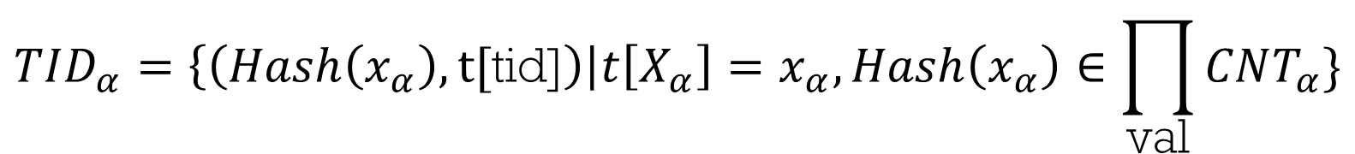














$$CNT_{α}=\left\{\left(Hash\left(x_{α}\right),\text{cnt}\right)\right|\text{cnt}=\left|R\left(X_{α}\right)=x_{α}\right|,\text{cnt}>1\}$$
$$TID_{α}=\left\{\left(Hash\left(x_{α}\right),\text{t}\text{[}\text{tid}\text{]}\right)\right|t\left[X_{α}\right]=x_{α},Hash\left(x_{α}\right)∈\prod_{\text{val}}{CNT_{α}}\}$$
$$AC$$
$$AB$$
$$R_{1}$$
$$A$$ | $$B$$
$$R_{2}$$
$$B$$ | $$D$$
$$CDF$$
$$R_{3}$$
$$C$$ | $$D$$ | $$F$$
$$R_{4}$$
$$A$$ | $$C$$
$$BD$$
$$R_{6}$$
$$BDE$$
$$R_{5}$$
$$B$$ | $$D$$ | $$E$$
$$B$$ | $$D$$ | $$G$$
$$BDG$$

