Slide 1
Tiresias
The Database Oracle for How-To Queries
Alexandra Meliou§✜
Dan Suciu✜
§University of Massachusetts Amherst
✜University of Washington

Slide 2


Hypothetical (What-if) Queries
Key Performance Indicators (KPI)
Brokerage company
DB
Example from [Balmin et al. VLDB’00]:
“An analyst of a brokerage company wants to know what would be the effect on the return of customers’ portfolios if during the last 3 years they had suggested Intel stocks instead of Motorola.”
change something in the source (hypothesis)
observe the effect in the target
forward

Slide 3
How-To Queries
Key Performance Indicators (KPI)
Brokerage company
DB
Modified example:
“An analyst wants to ask how to achieve a 10% return in customer portfolios, with the least number of trades.”
find changes to the source that achieve the desired effect
declare a desired effect in the target
reverse

Slide 4
TPC-H example
A manufacturing company keeps records of inventory orders in a LineItem table.
KPI: Cannot order more than 7% of the inventory from any single country
Can reassign orders to new suppliers as long as the supplier can supply the part
Minimize the number of changes
(variables)
(constraints)
(optimization objective)
constraint optimization

Slide 5
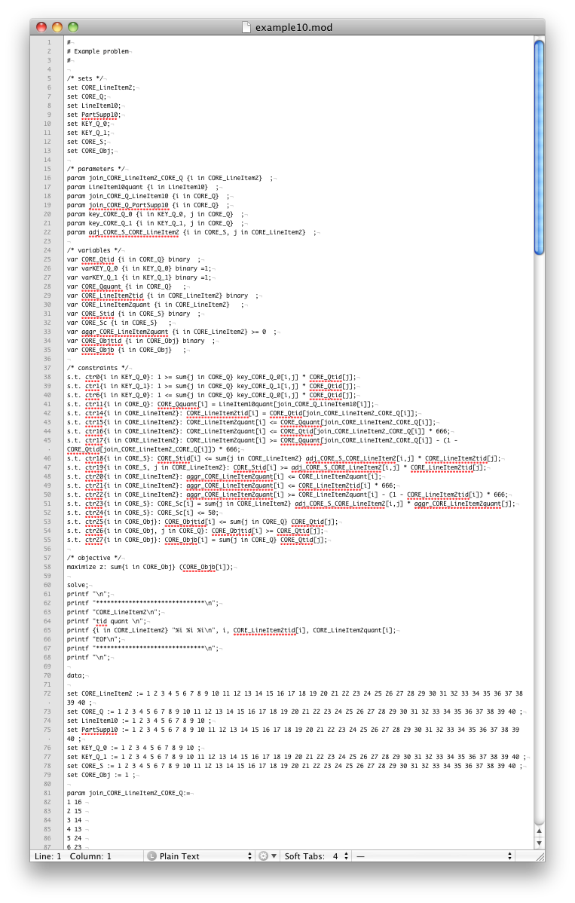
Constraint Optimization on Big Data
this is for a set of 10 lineitems and 40 suppliers
MathProg
DB
Impractical!
construct optimization model
extract data
Mixed Integer Programming (MIP) solver
transform into data updates

Slide 6
Demo: Tiresias
a tool that makes
how-to queries practical

Slide 7


Tiresias: How-To Query Engine
TiQL (Tiresias Query Language)
MIP
solver
Tiresias
Declarative interface, extension to Datalog
DBMS

Slide 8
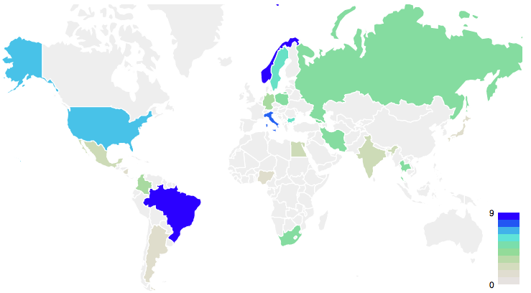
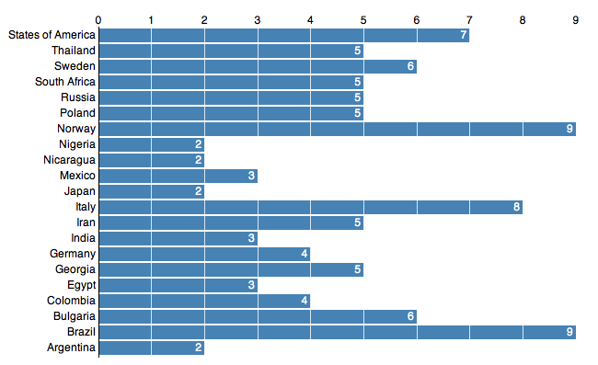
Overview
Visualizations
TiQL
MathProg
or AMPL

Slide 9
Overview
Visualizations
Demo
TiQL
MathProg
or AMPL

Slide 10
Overview
Visualizations
Demo
TiQL
Language semantics
Evaluation of a TiQL program: Translation from TiQL to linear constraints
MathProg
or AMPL
Performance optimizations

Slide 11
Tiresias Query Language
Datalog-like notation:
TiQL semantics:
Mapping from EDBs (Extensional Database) to possible worlds over HDBs (Hypothetical Database)
head
body: conjunction of predicates
HDB

Slide 12
TiQL Rules
Deduction Rule
Semantics:
Similar to repair-key semantics [Antonova et al. SIGMOD’07], [Koch ICDT’09]
Reduction Rule
Semantics:
Takes a subset of tuples
Constraint Rule
Semantics:
The head predicate needs to hold for all tuples

Slide 13
Overview
Visualizations
Demo
TiQL
Language semantics
Evaluation of a TiQL program: Translation from TiQL to linear constraints
MathProg
or AMPL
Performance optimizations

Slide 14
Evaluating a TiQL Program
TiQL
DB
Mixed Integer Program
(MIP)

Slide 15
Evaluating a TiQL Program
possible worlds

Slide 16
Key Constraints
NOT a possible world

Slide 17
Provenance Constraints
A TiQL rule specifies transformations
Transformations define provenance
Boolean semantics for queries without aggregates
Semi-module provenance for queries with aggregates [Amsterdamer et al. PODS’11]
Disjunction:
Conjunction:

Slide 18
Overview
Visualizations
Demo
TiQL
Language semantics
Evaluation of a TiQL program: Translation from TiQL to linear constraints
MathProg
or AMPL
Performance optimizations

Slide 19
Optimizing Performance
Model optimizer
eliminates variables, constraints, and parameters
uses key constraints, functional dependencies, and provenance
Partitioning optimizer
Significantly faster than letting the MIP solver do it

Slide 20
Evaluation of the Model Optimizer
baseline
with optimization

Slide 21
Evaluation of Tiresias Partitioning
complex dependency on the granularity of partitioning
10k tuples
1M tuples
granularity of partitioning

Slide 22
Scalability
Constructor time depends on DB query execution time
The MIP solver runtime (per partition) does not increase with data size

Slide 23
Related Work
Provenance
[Amsterdamer et al. PODS’11], [Cui et al. TODS’00], [Green et al. PODS’07]
Incomplete databases
[Antonova et al. SIGMOD’07], [Imielinski et al. JACM’84], [Koch ICDT’09]
Other RDM problems
[Arasu et al. SIGMOD’11], [Binnig et al. ICDE’07], [Bohannon et al. PODS’06], [Fagin et al. JACM’10]

Slide 24
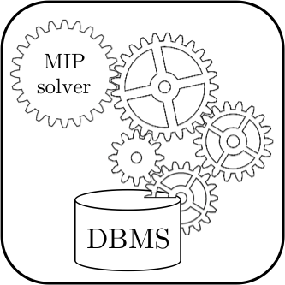
Next Steps with Tiresias
Handling non-partitionable problems
Tiresias
Approximations
Parallelization and handling of skew
Result analysis and feedback-based problem generation

Slide 25
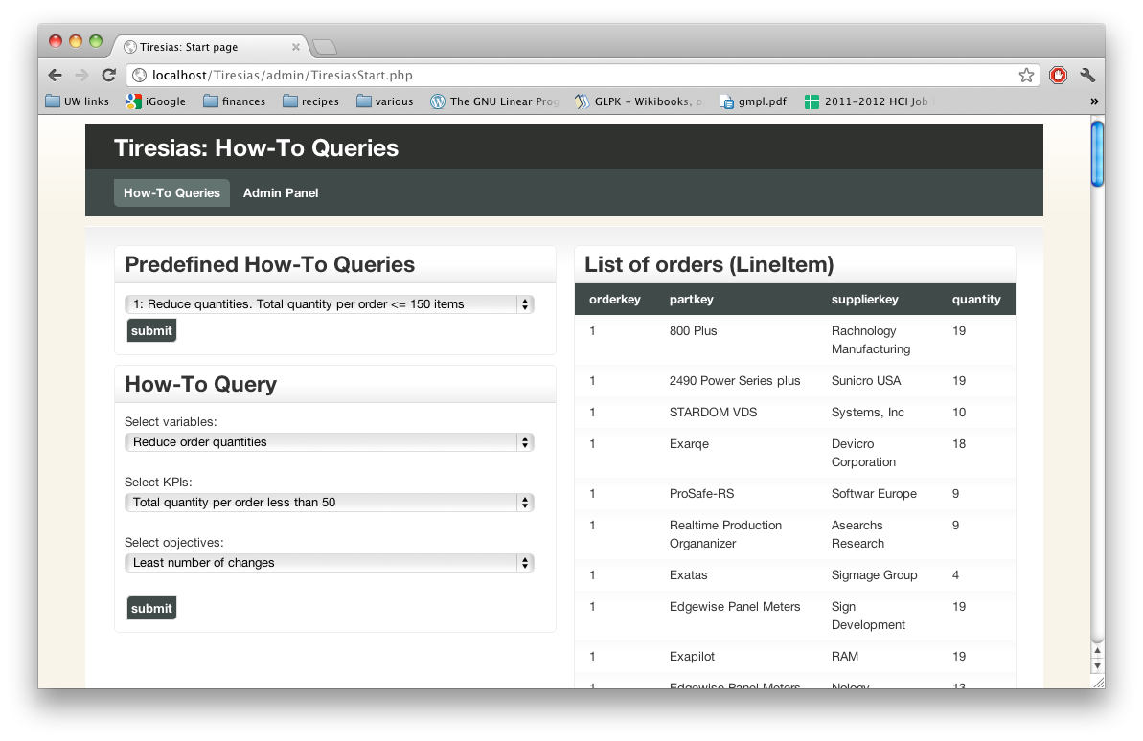
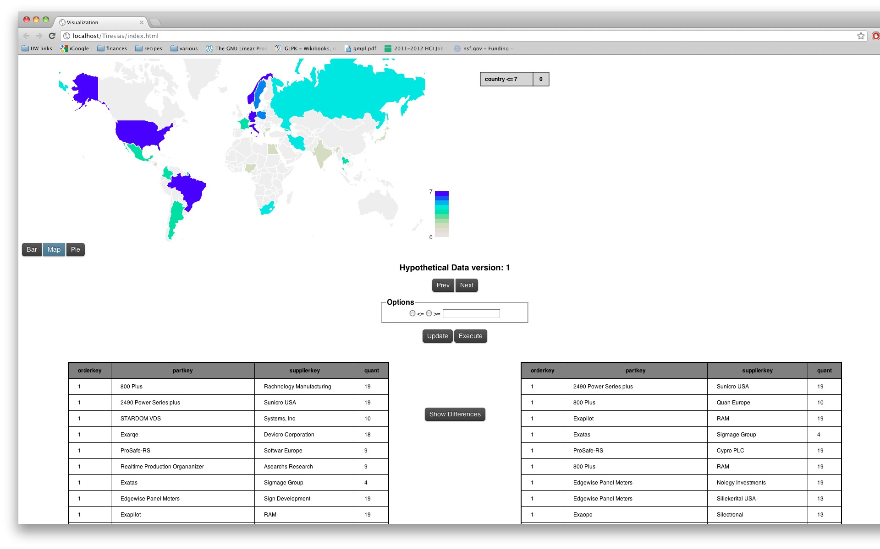
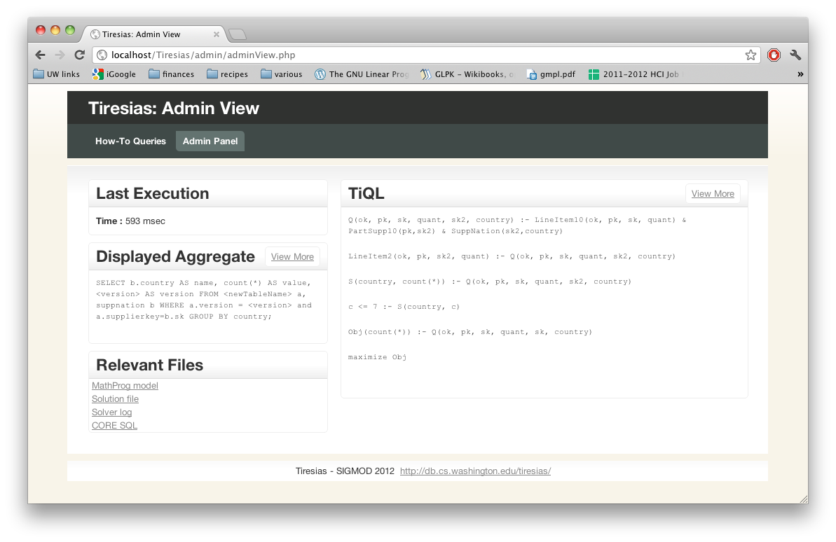
SIGMOD Demo Group C
Location: Vaquero A
Time: 13:30-15:00

Slide 26
Contributions
How-To queries
Using MIP solvers to answer How-To queries
Tiresias prototype implementation
http://db.cs.washington.edu/tiresias

