Slide 1
Chatbot Overview
By: Antonio Turner

Slide 2
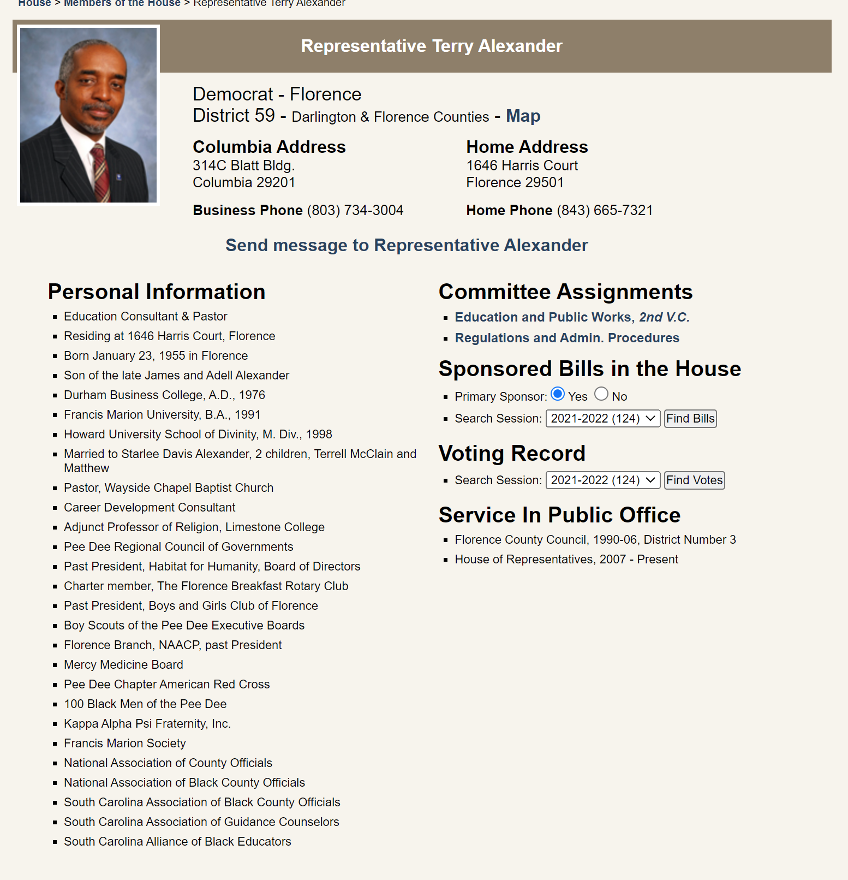
Scope
District 59
Using C++ as my language

Slide 3
Data
Contact information
Name, address, phone, etc.
Committee Assignments
Two committees
Sponsored Bills in the House
Voting Record
Service In Public Office
Service records
Personal Information
Family information, schools, fraternities, etc.

Slide 4
Code Organization
12 classes and 11 header files
Each holding about 4-5 methods on average
P1
P2
P3
P4
P5
Different ways to retrieve information
Separating and parsing information
First started using classes to be able to talk with user and regex
Correcting misspelled words, I used 80% as my base
Store and print sessions, used CPU: and User:

Slide 5
Code Reuse by and of
Throughout P1-P6, Ayden Owens and I used a few pointers from each other to help
I used his Regex and class/header structure
He used my toLower() and Summary structure

Slide 6
Queries
[#1] “Quit” or “quit” or just “q” => Program exits
[#2]“Tell me about the representative”, “Tell me about the rep” => Personal Information (Type-I2)
[#3]“Where does the rep live” => Contact Information (Type-I1): Home Address
[#4]“How do I contact my rep ” => Contact Information (Type-I1) [#5]“What committees is my repo on” => Committee Assignments (Type-I3)
[#6]“Tell me everything” => Give all information Extracted
[#7] “What district do you support for Q/A” => Give district number and name
[#8] => “I do not know this information” or “Here is my guess”

Slide 7
Summary Queries
myrep-chatbot –summary => There are 12 chats to date with user asking 23 times and system respond 24 times. Total duration is 456 seconds.
• myrep-chatbot –showchat-summary 2 => Chat 2 has user asking 2 times and system respond 2 times. Total duration is 4 seconds.
• myrep-chatbot –showchat 2 => Chat 2 chat is: …
• myrep-chatbot –showchat 200 => ERROR: there are only 12 chat sessions. Please choose a valid number.

Slide 8
Video Link
https://github.com/Adw010/CSCE-240/tree/main/myrep-chatbot/Doc

Slide 9
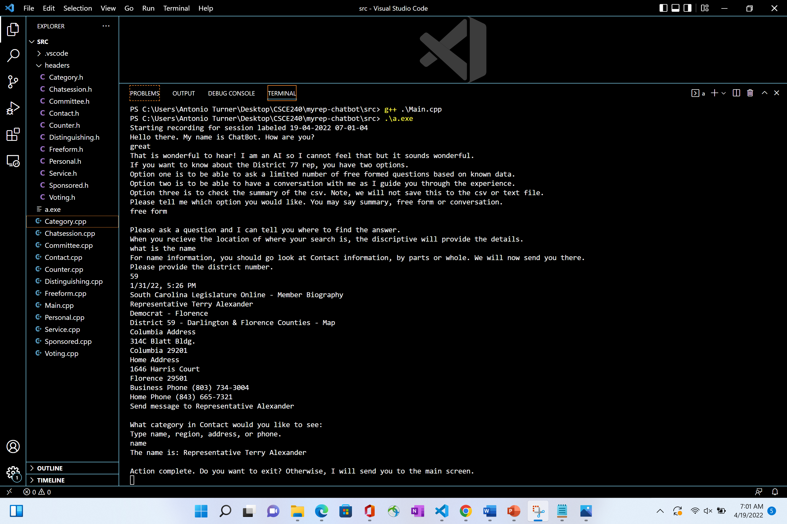
Examples/Testing

Slide 10
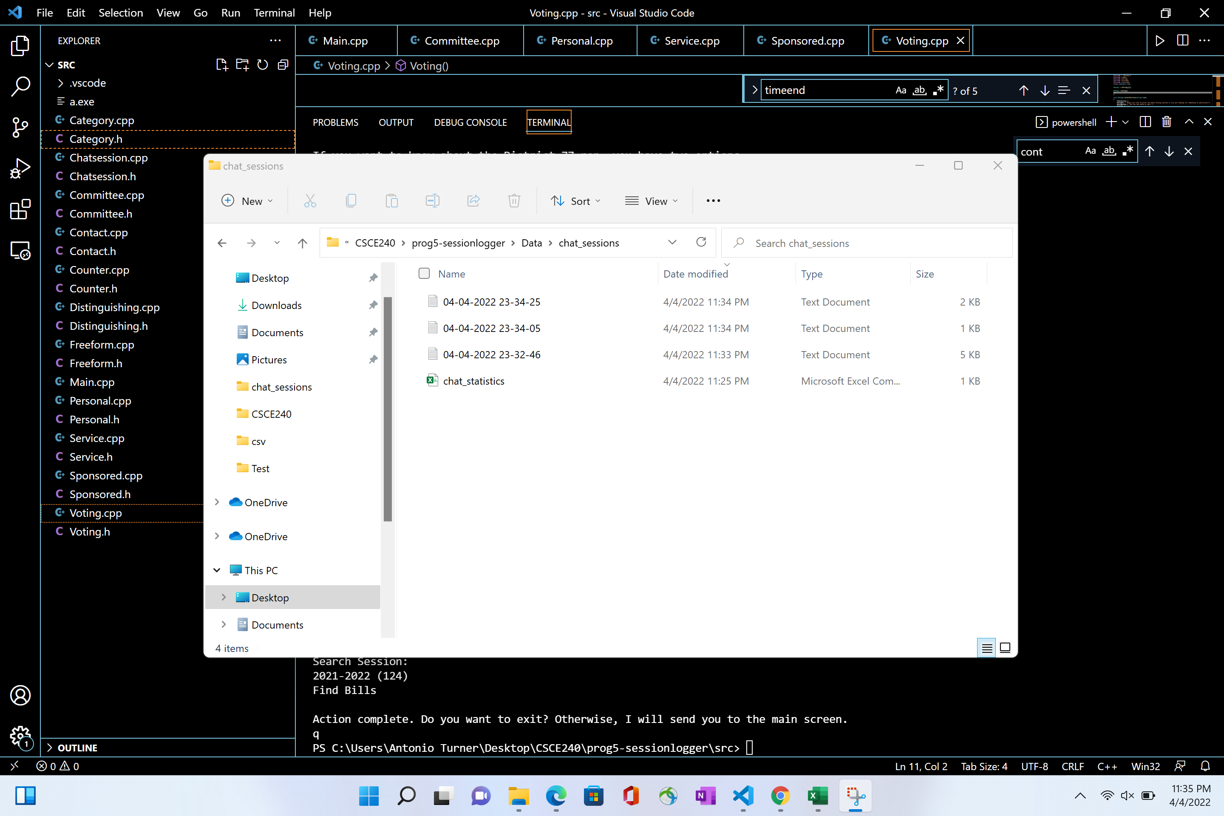
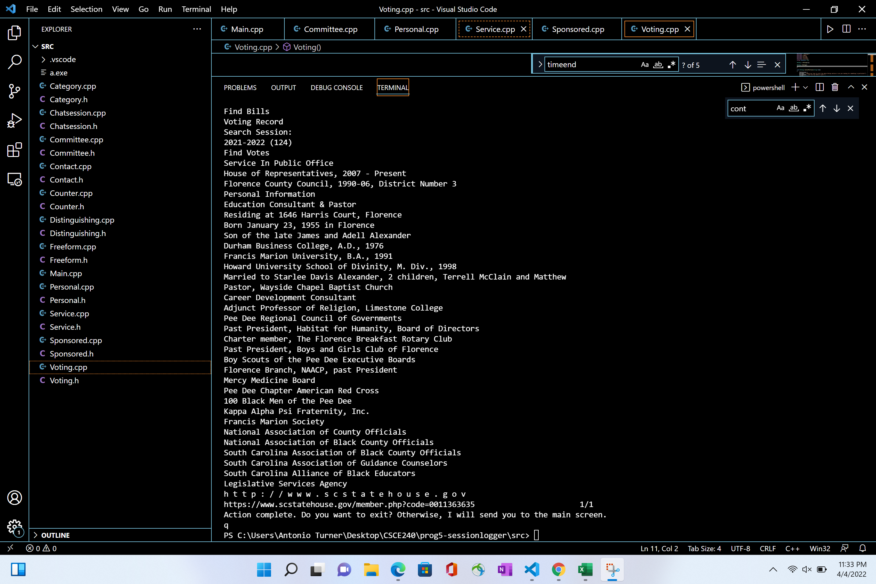
Examples/Testing

Slide 11
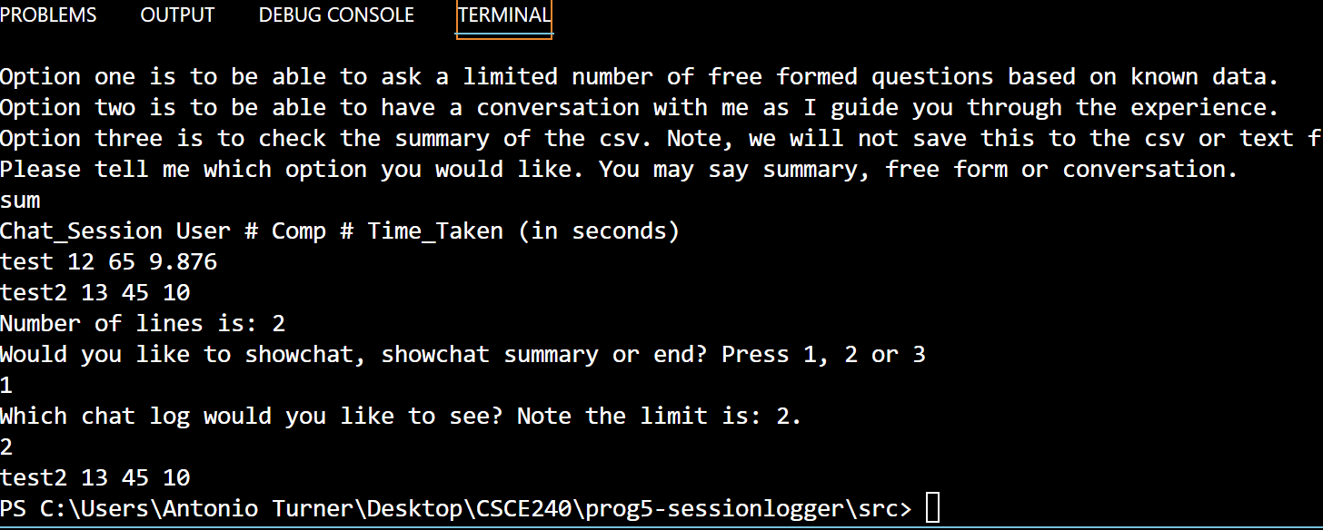
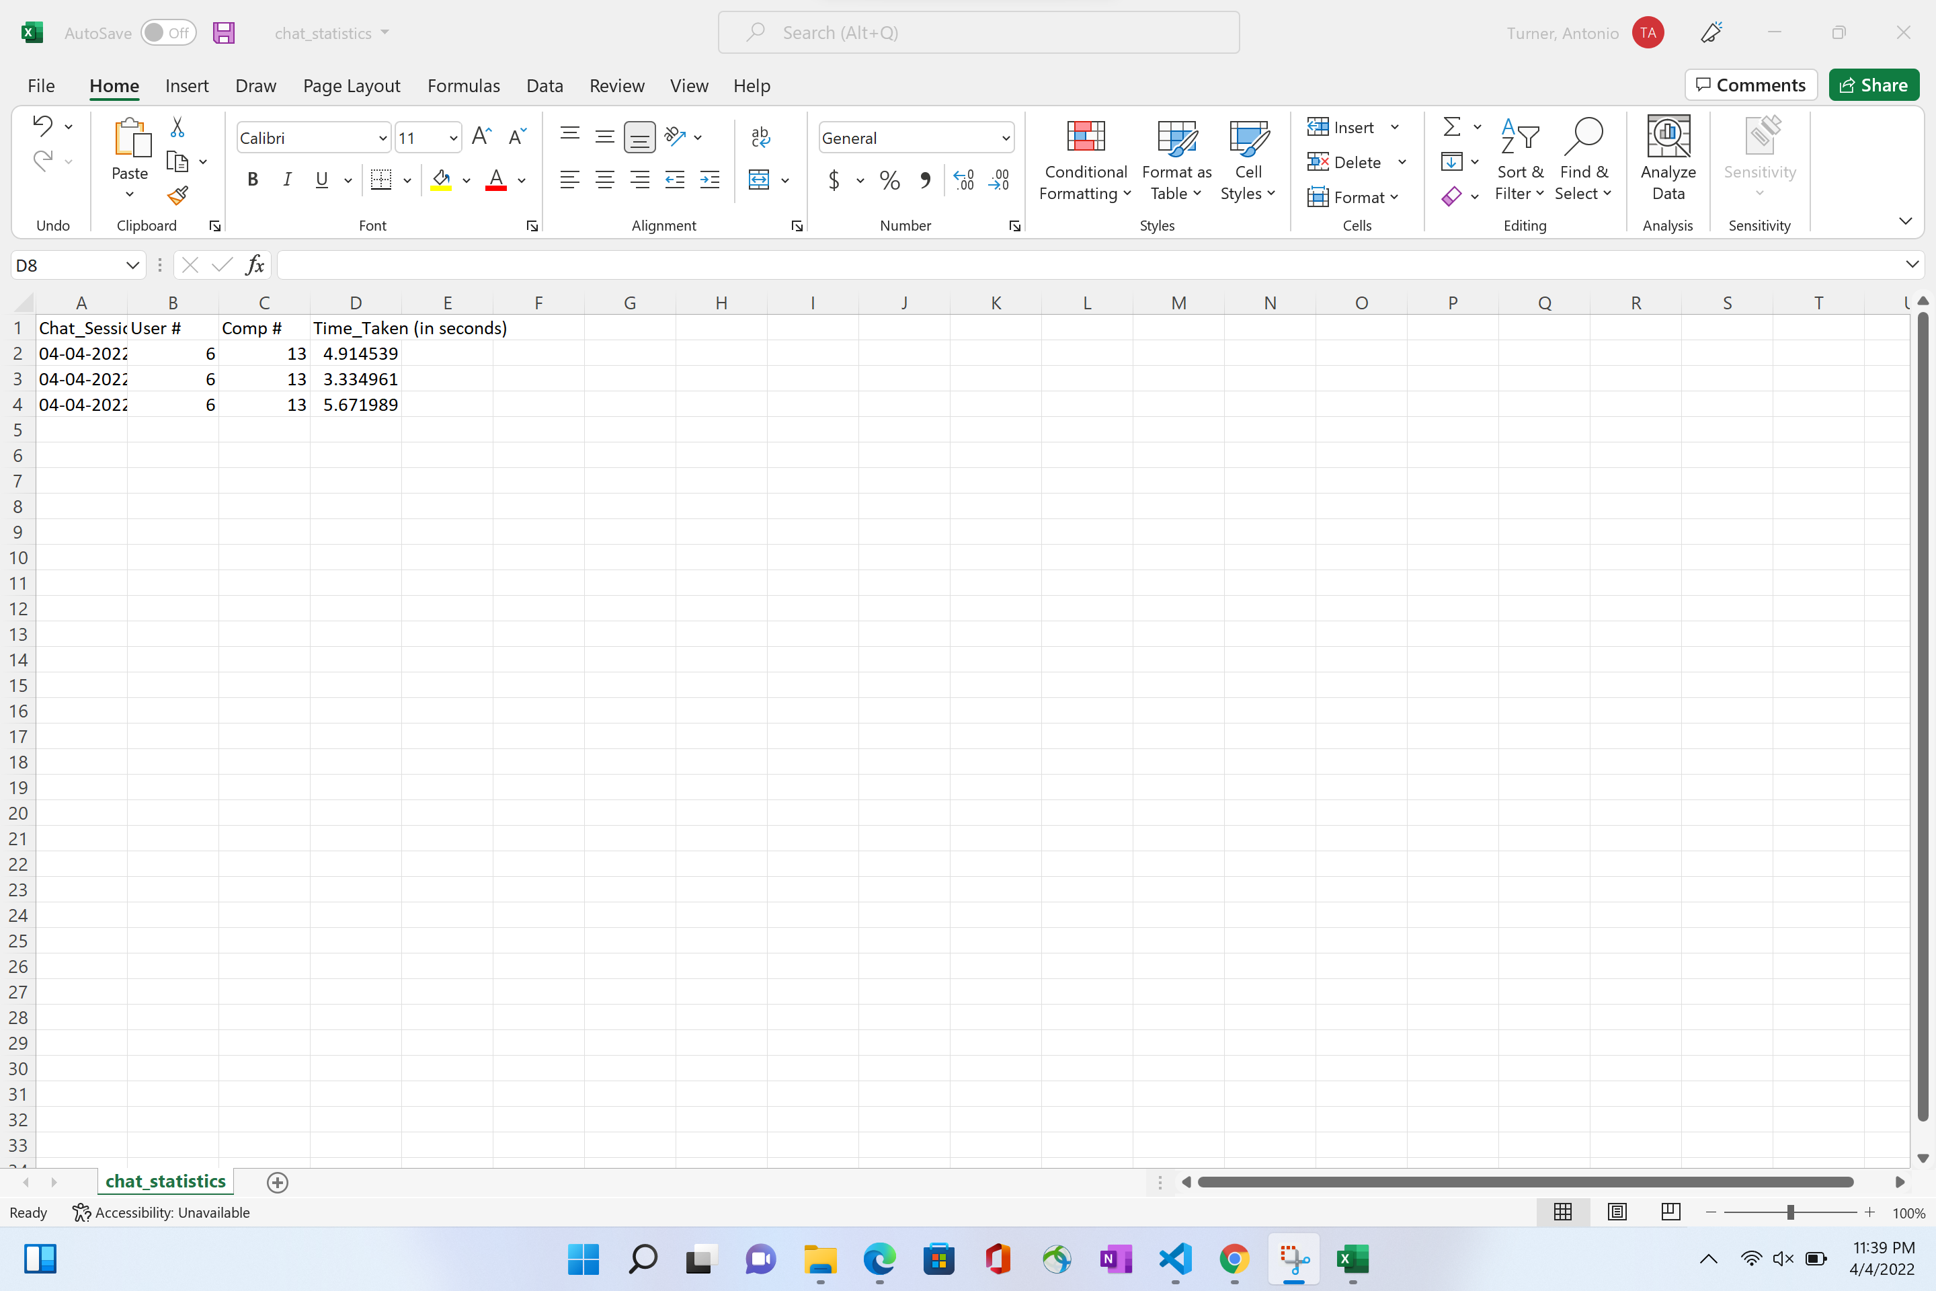
Examples/Testing

