Slide 1
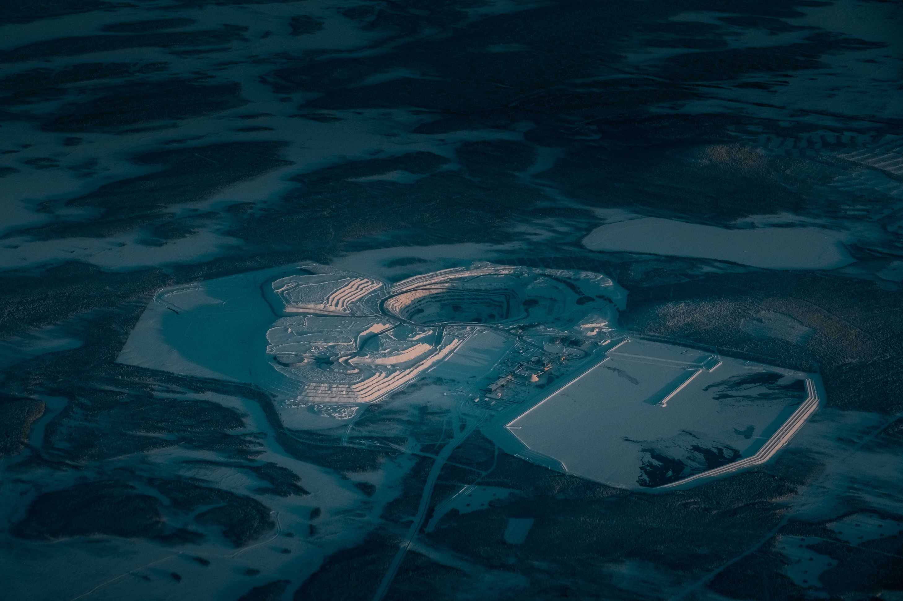



Home
Services
Solution
About
AIR QUALITY ANALYSIS USING DATA MINNIG TECHNIQUES
IT 326 -Data Mining
ماريا الشمراني 445202990
أضواء الهزاني 444201650
لين عبدالله المقحم 445204203
رهف الشلوي 445201250
فاطمه المحسن 443200782

Slide 2
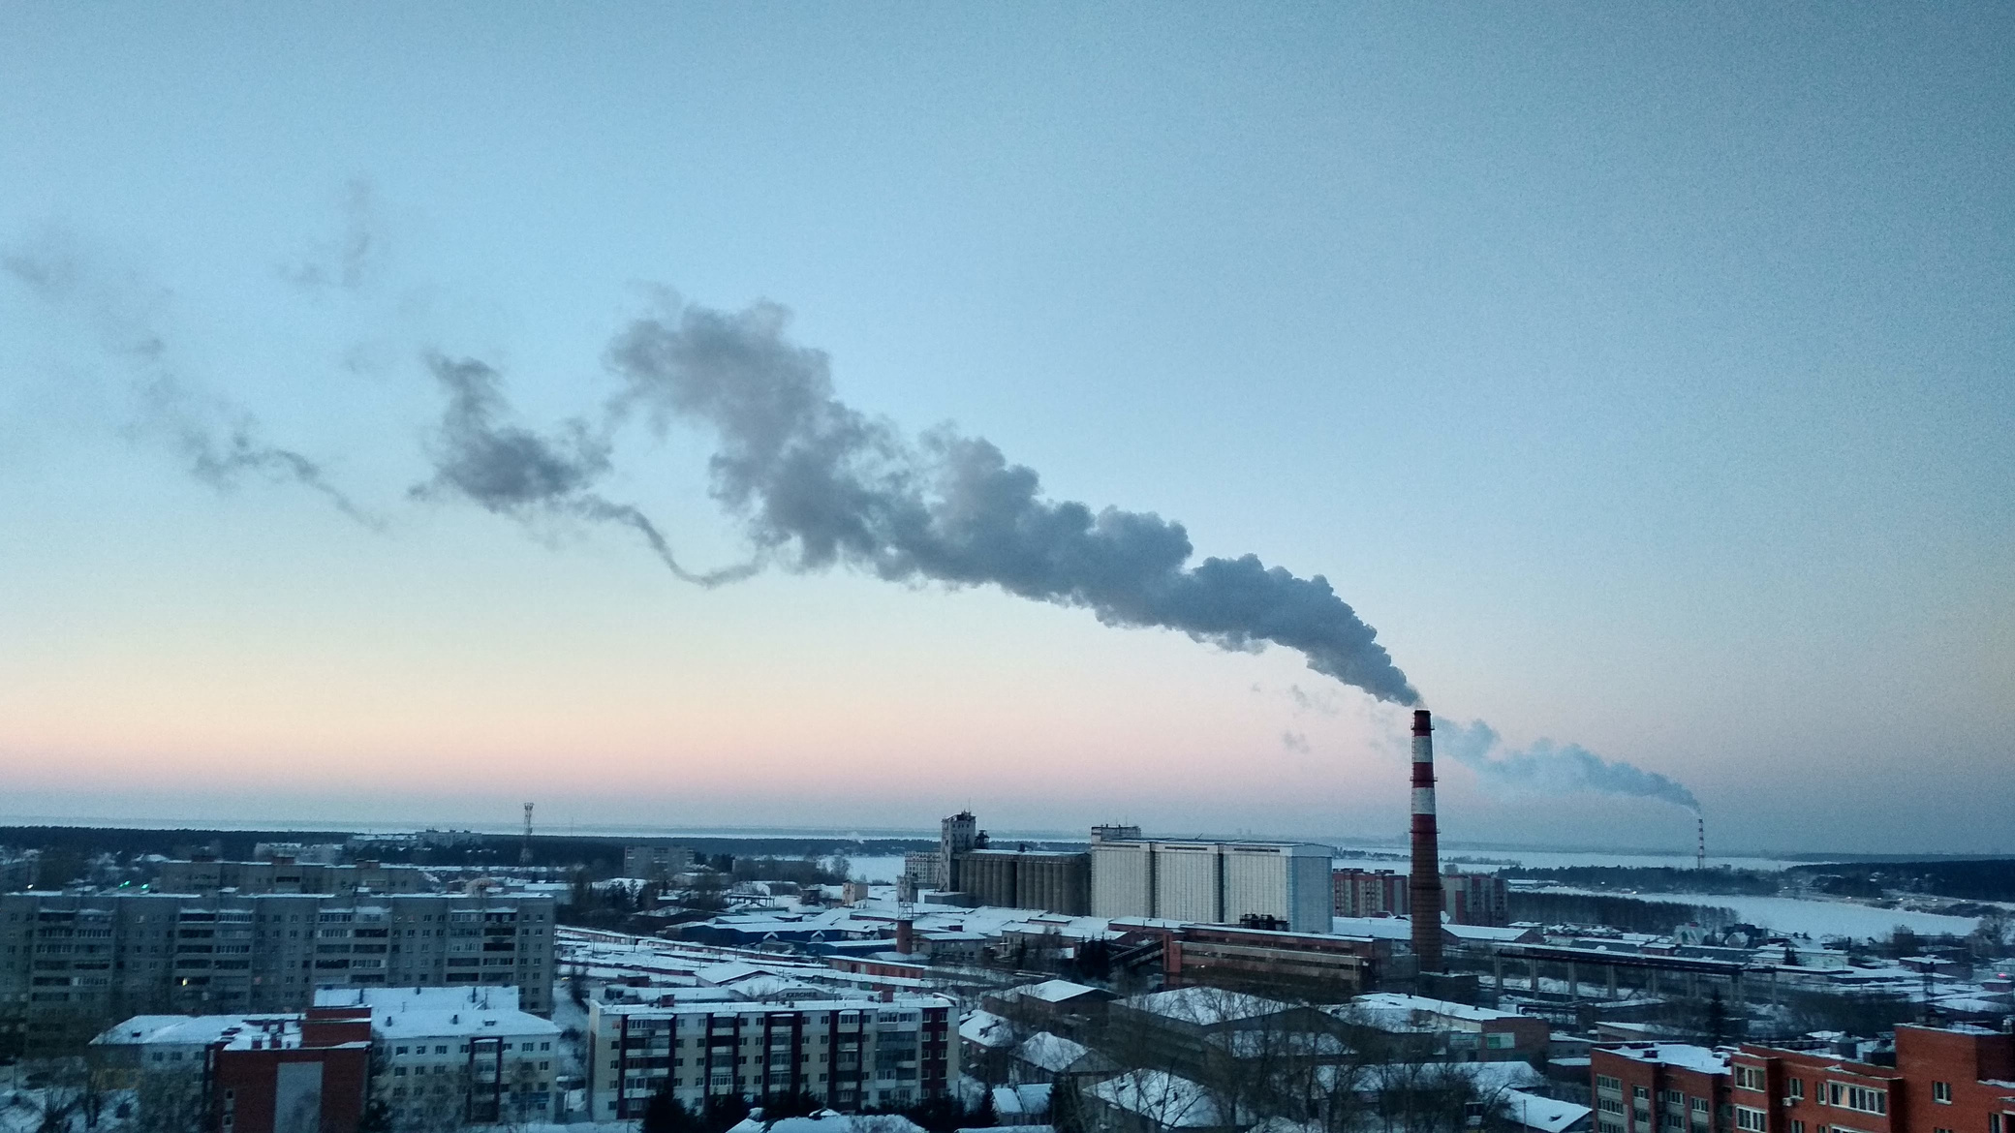
Home
Services
Solution
About
INTRODUCTION
Our Project Goal:
This project analyzes and predicts air quality using classification and clustering. Classification predicts air quality levels, while clustering uncovers hidden patterns in environmental data. Together, they help us understand pollution trends and improve environmental decision

Slide 3

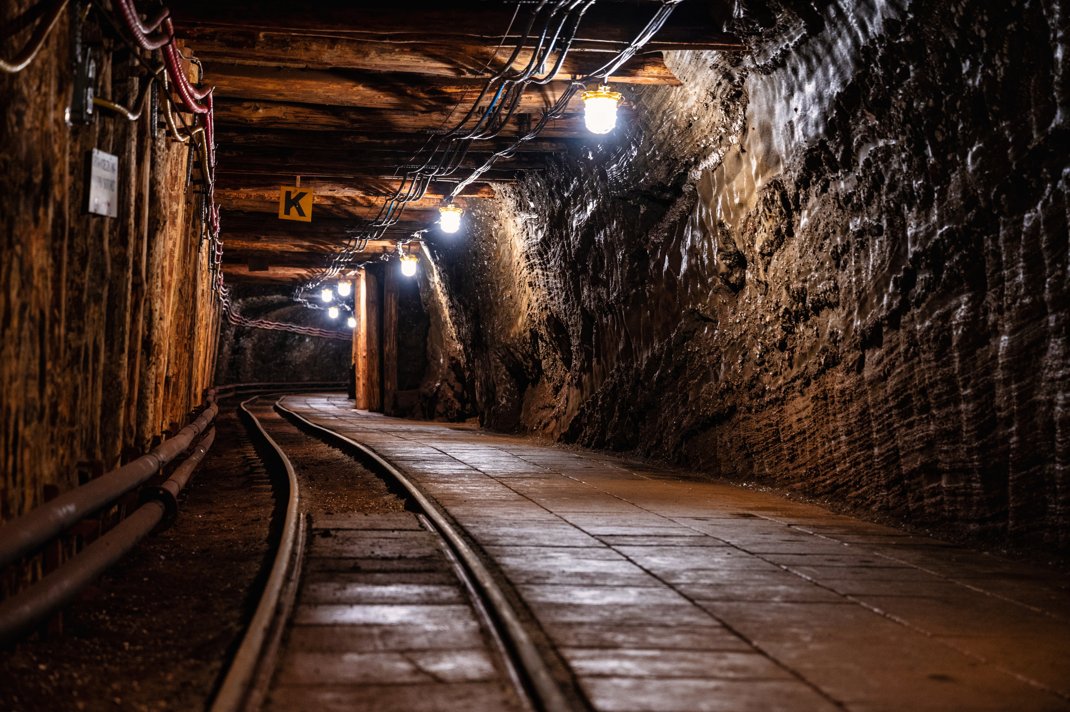
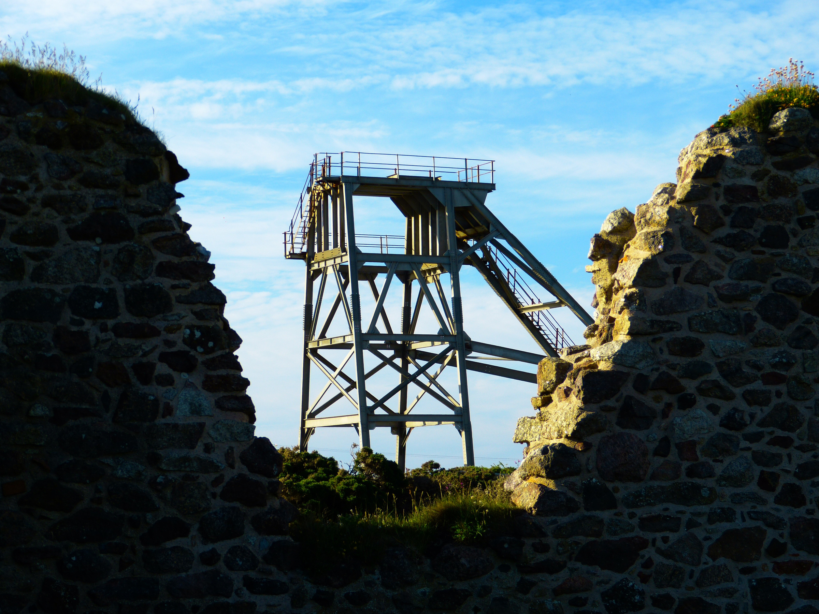
Home
Services
PROBLEM
Air pollution is a major environmental issue that affects public health. High levels of pollutants such as PM2.5, PM10, NO₂, SO₂, and CO increase the risk of respiratory and heart diseases.
Understanding how environmental factors (temperature, humidity, population density, industrial areas, etc.) influence air quality is challenging, and raw measurements alone are hard to interpret.
Our project aims to analyze air quality data to:
Identify the key factors affecting air quality
Compare pollution levels across different locations
Enable better classification and clustering of air quality level

Slide 4
Home
Services
Solution
About
DATASET DESCRIPTION
Dataset Source: Kaggle —Air Quality and pollution Assessment Dataset
Number of Attributes: 9 attributes
Number of Records: 5000
our Attirbute: ['Temperature', 'Humidity', 'PM2.5', 'PM10', 'NO2', 'SO2', 'CO', 'Proximity_to_Industrial_Areas', 'Population_Density']

Slide 5
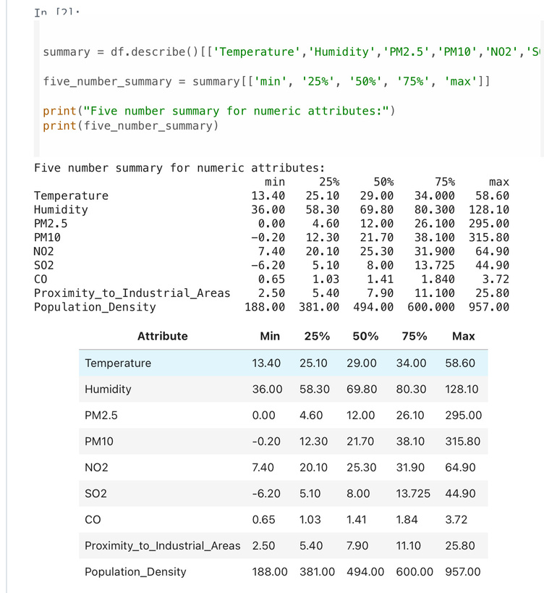
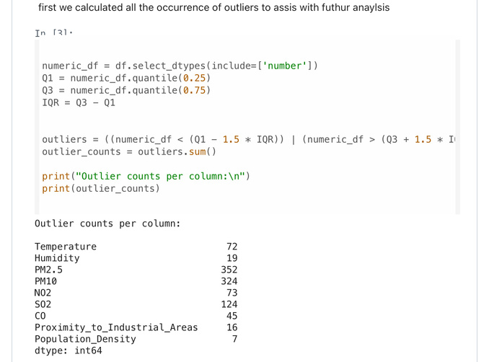
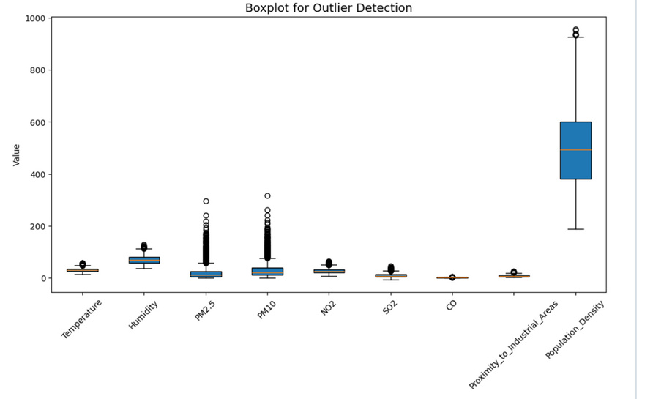
Home
Services
Solution
About
DATA ANALYSIS
Five number Summary:
Outliers detection
The boxplots show many outliers in PM2.5, PM10, and SO₂, and moderate outliers in Temperature, NO₂, and CO.
In contrast, Humidity, Industrial Proximity, and Population Density are more stable.

Slide 6
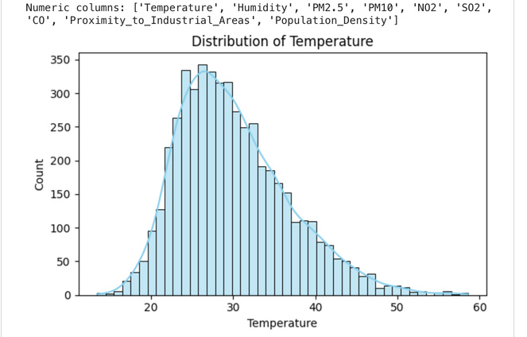
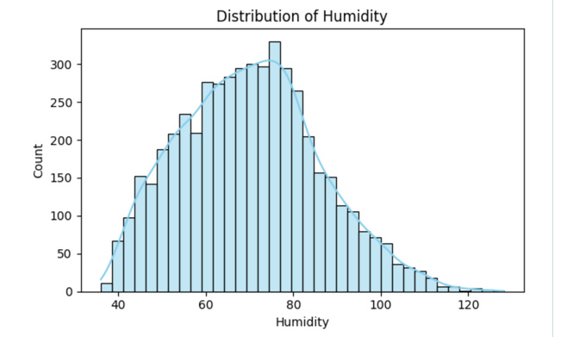
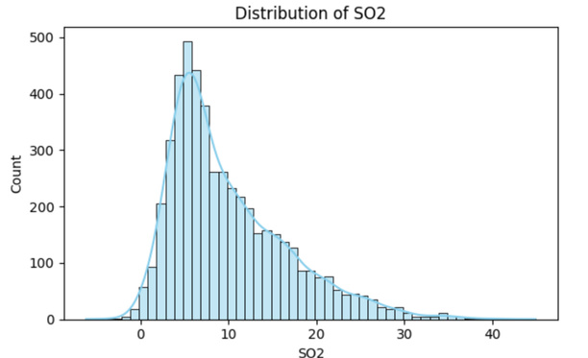
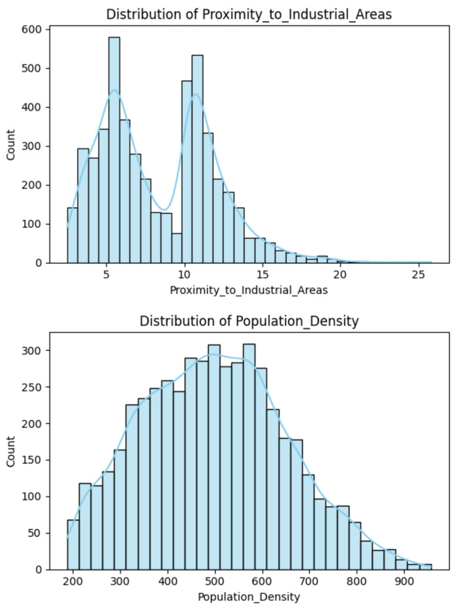
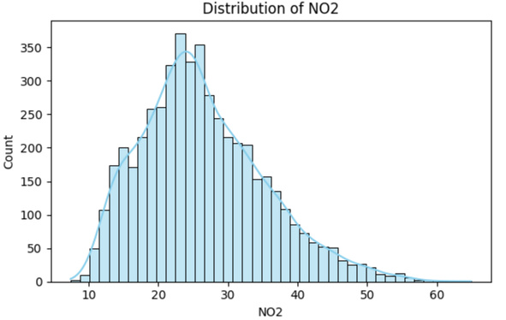
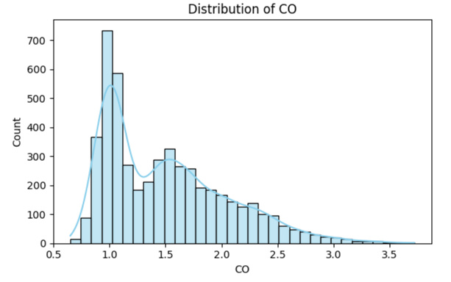
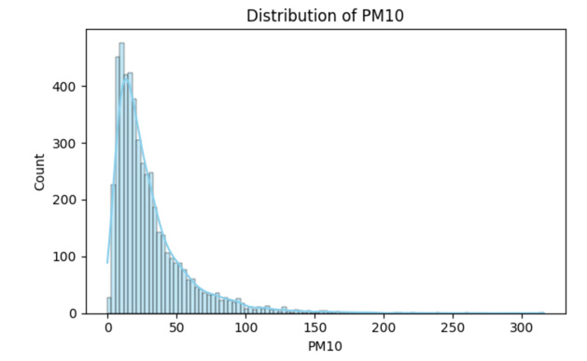
About
Variable Distribution
DATA ANALYSIS

Slide 7
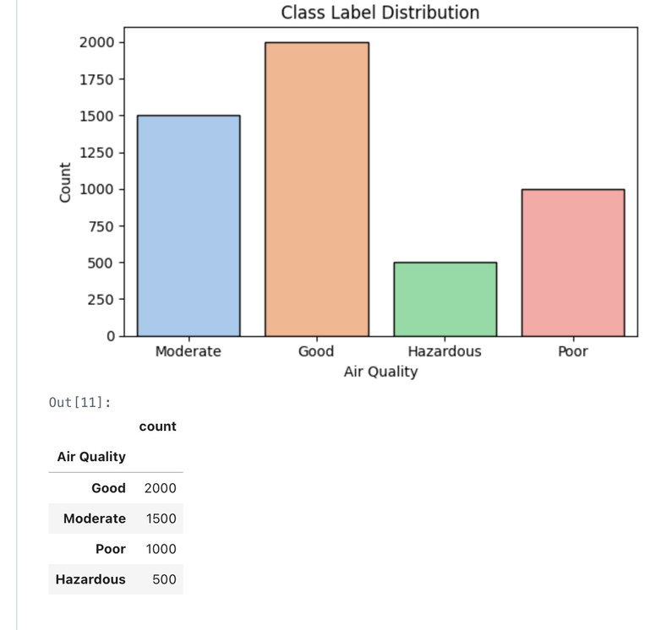
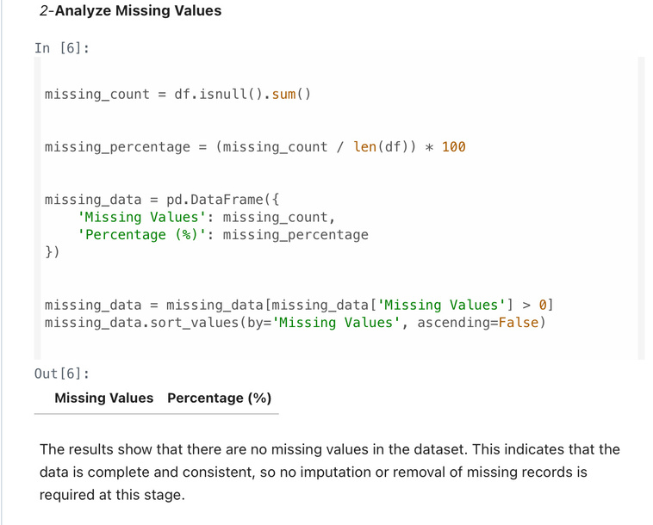
About
DATA ANALYSIS
Class Distribution Plot
Analyze Missing Values

Slide 8
PREPROCESSING
No Missing Values: Dataset was already complete, so no imputation was required.
Min–Max Normalization: All numerical features were scaled to the range [0, 1] to handle differences in feature scales.
Outlier Removal (IQR): Extreme values were removed using the IQR method, reducing the dataset from 5000 —> 4160 rows and improving data reliability.
Discretization: Continuous numerical features were transformed into 3 bins to simplify patterns and reduce noise.
Class Encoding: The Air Quality label was converted into numerical form for machine learning models.

Slide 9
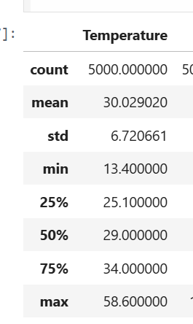
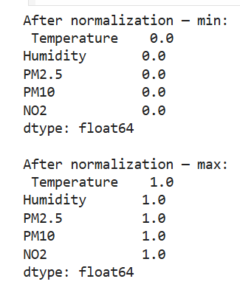
Home
Services
Solution
About
PREPROCESSING
NORMALIZATION:
All numerical features were rescaled to [0, 1] for consistent feature scaling.

Slide 10
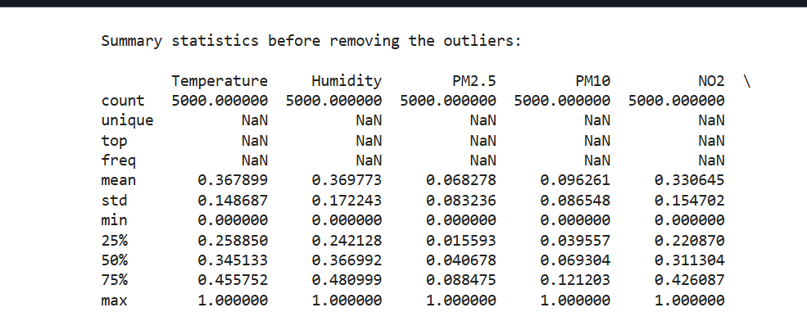
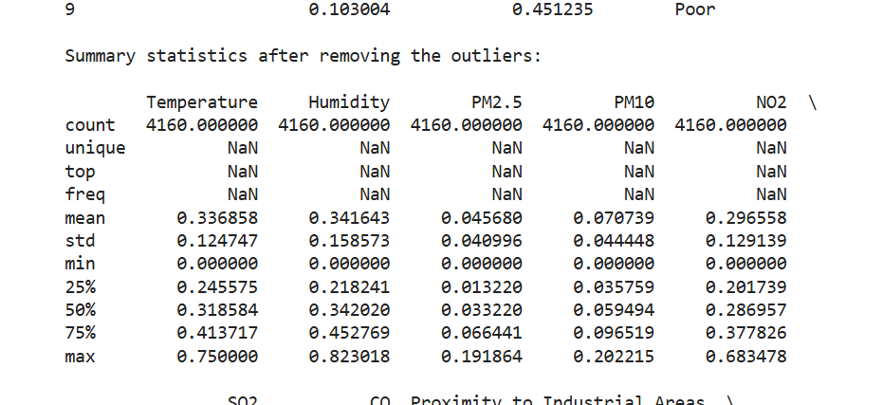
Home
Services
Solution
About
PREPROCESSING
Outliers
Before Removing Outliers
After Removing Outliers

Slide 11
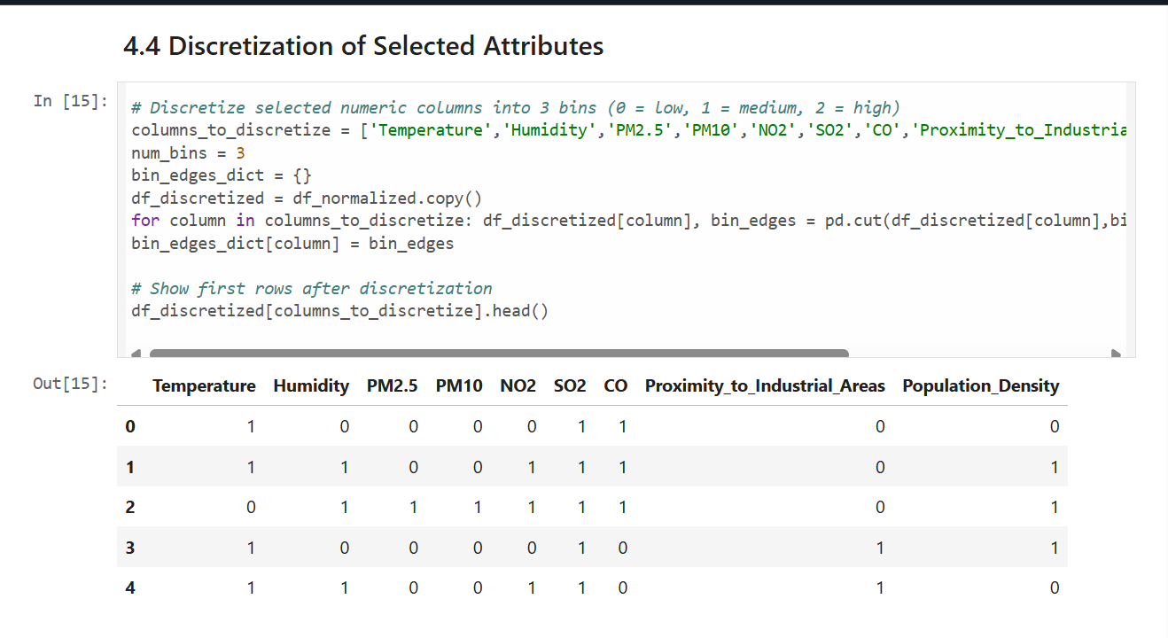
PREPROCESSING
Discretization
continuous values were grouped into categories.

Slide 12
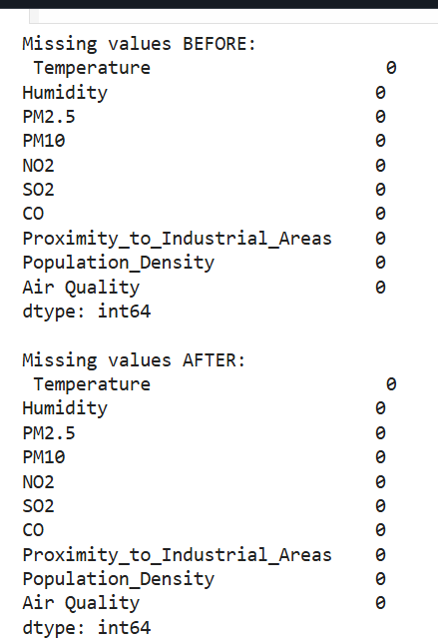
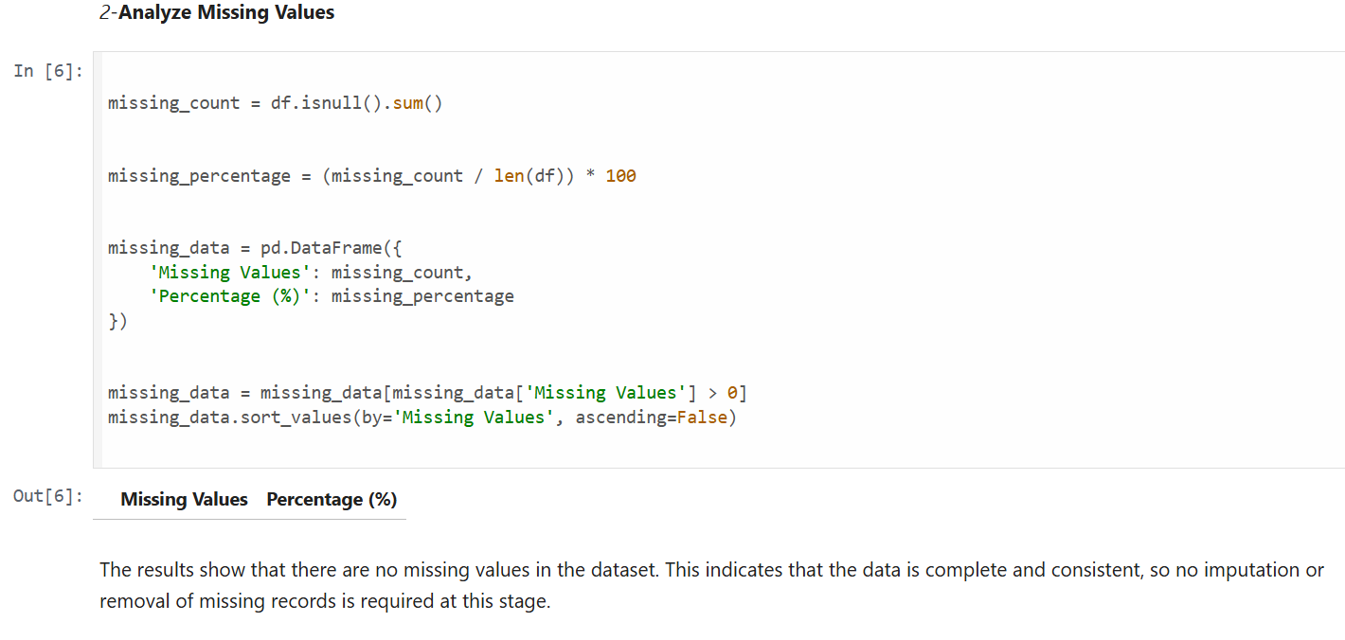
Home
Services
Solution
About
PREPROCESSING
Missing values

Slide 13
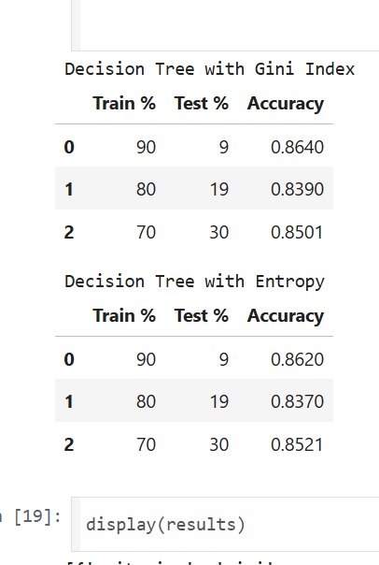
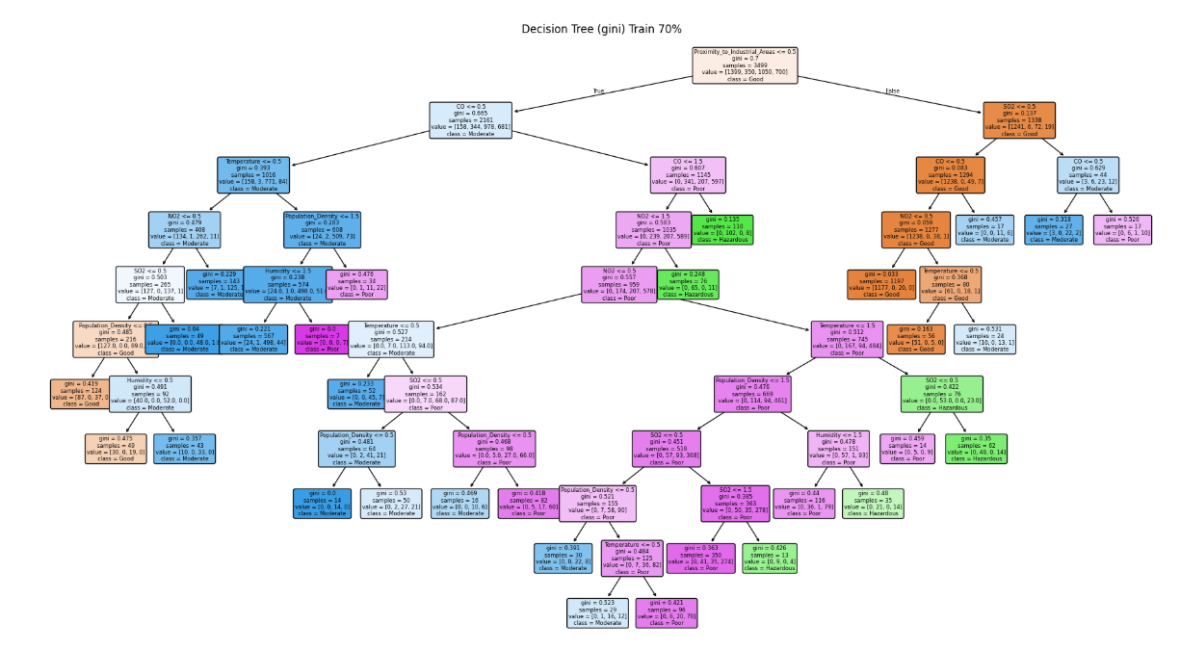
CLASSIFICATION

Slide 14
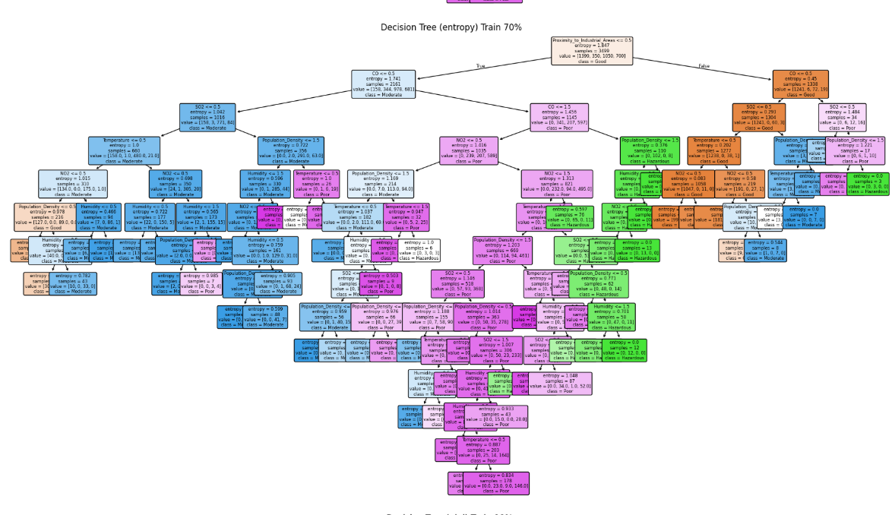
CLASSIFICATION

Slide 15
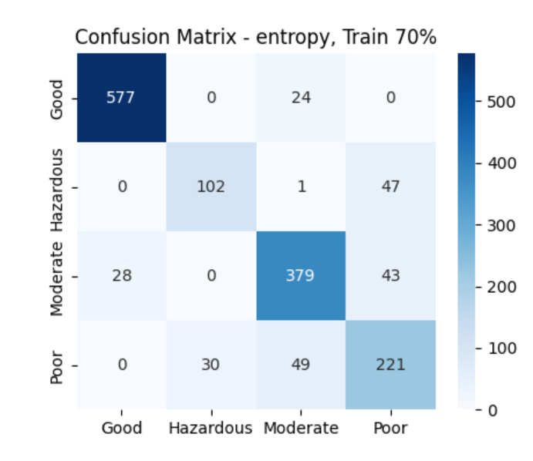
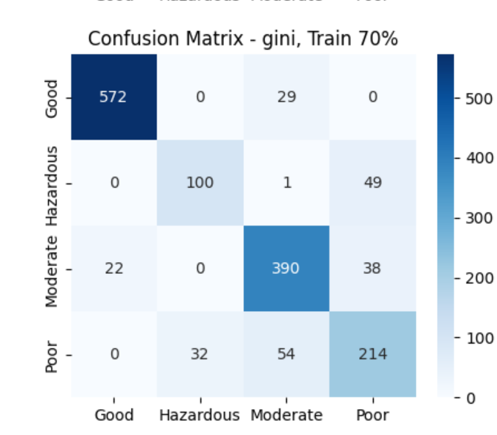
CLASSIFICATION

Slide 16
CLASSIFICATION
DIFFERENCE BETWEEN GINI AND ENTROPY
Gini Index:
Produces simpler trees with fewer splits. It measures how mixed the classes are, and prefers splits that reduce impurity quickly.
Entropy (Information Gain):
Produces more detailed and deeper trees. It selects splits based on the amount of information gained.

Slide 17
CLASSIFICATION
EFFECT OF TRAIN/TEST SPLITS (70%, 80%, 90%)
70% Training:
Less training data , slightly lower accuracy. More testing data → stronger evaluation.
80% Training:
Balanced split. Stable and reliable results.
90% Training:
Highest accuracy, but can lead to overfitting because the testing set is too small.

Slide 18
ClustERING METHOD
TECHNIQUE: K-MEANS CLUSTERING
We tested three different values of K:
2, 3, and 4
We used the following evaluation metrics:
SILHOUETTE SCORE (MEASURES CLUSTER SEPARATION)
ELBOW METHOD (WCSS) (MEASURES INTRA-CLUSTER COMPACTNESS)
DATA WAS STANDARDIZED USING STANDARDSCALER BEFORE CLUSTERING.
THE AIR QUALITY LABEL WAS REMOVED SINCE CLUSTERING IS UNSUPERVISED.

Slide 19
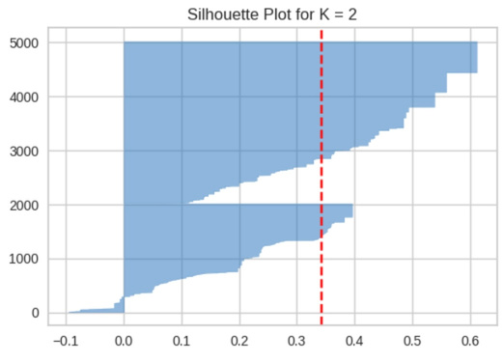
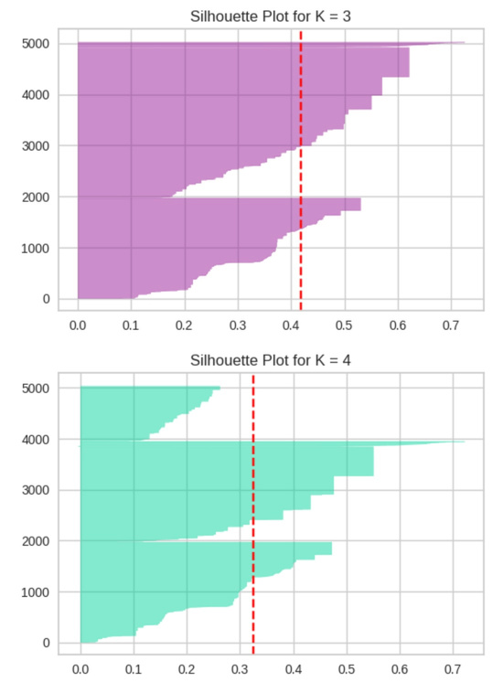
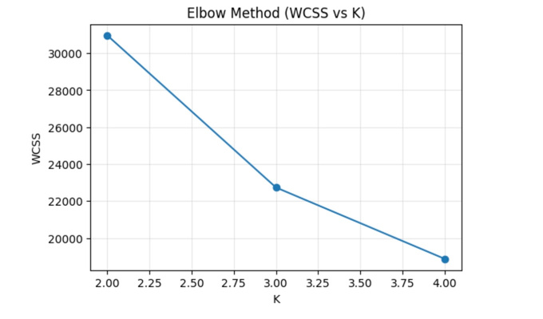
ClusterING RESULTS
COMPARISON OF K VALUES BASED ON WCSS AND SILHOUETTE SCORE:
K | WSS | Silhouette
2 | 30967.25 | 0.39
3 | 22734.42 | 0.41 (best)
4 | 18871.12 | 0.32
BEST K : 3
INTERPRETATION:
EACH CLUSTER GROUPS SIMILAR CITIES BASED ON POLLUTANT LEVELS AND ENVIRONMENTAL FACTORS.

Slide 20
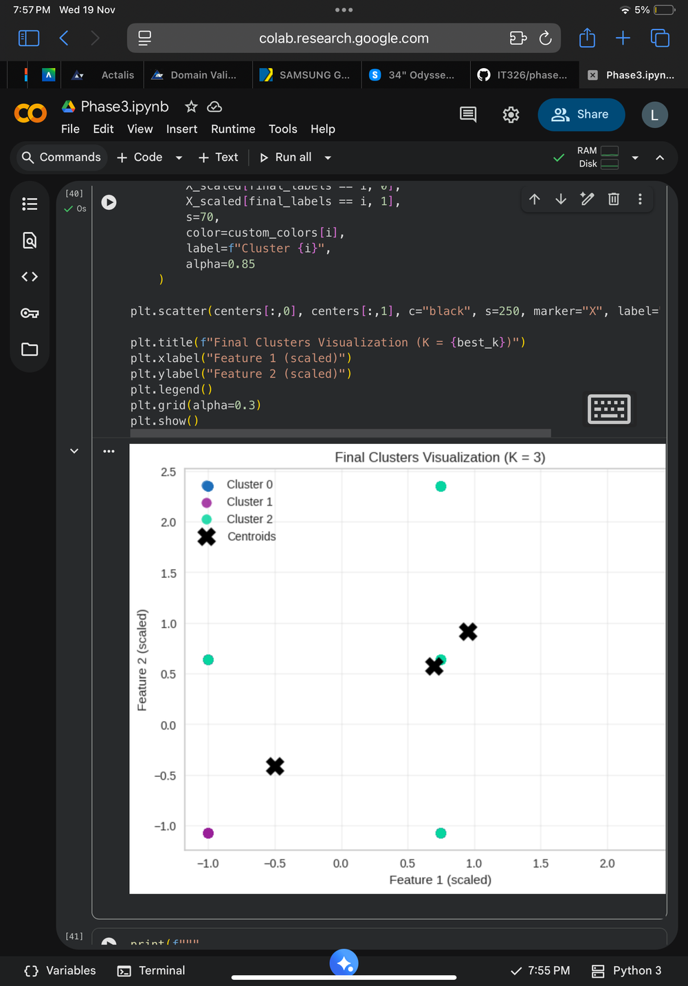
FINDINGS & DISCUSSION
BEST CLASSIFICATION MODEL:
Decision Tree (Gini – 90/10 split)
MOst influential features:
SO₂
NO₂
CO
CLUSTERING INSIGHTS:
DATA FORMED THREE MEANINGFUL GROUPS BASED ON POLLUTION LEVELS.
CLUSTER 0: LOW POLLUTION
CLUSTER 1: MODERATE POLLUTION
CLUSTER 2: HIGH POLLUTION (RISK AREAS)
THE CLUSTERING RESULTS ALIGN WITH ENVIRONMENTAL EXPECTATIONS AND LITERATURE.

Slide 21
CONCLUSION
“IN CONCLUSION, WE ANALYZED THE DATASET, CLEANED IT WITH PREPROCESSING, AND IMPROVED ITS QUALITY.THE DECISION TREE GAVE ACCURATE AIR-QUALITY PREDICTIONS, AND K-MEANS REVEALED THREE NATURAL POLLUTION GROUPS.
BY COMBINING DATA ANALYSIS, PREPROCESSING, CLASSIFICATION, AND CLUSTERING, WE GAINED A CLEAR OVERALL UNDERSTANDING OF THE AIR-QUALITY PATTERNS.

Slide 22
THANK YOU

