Slide 1

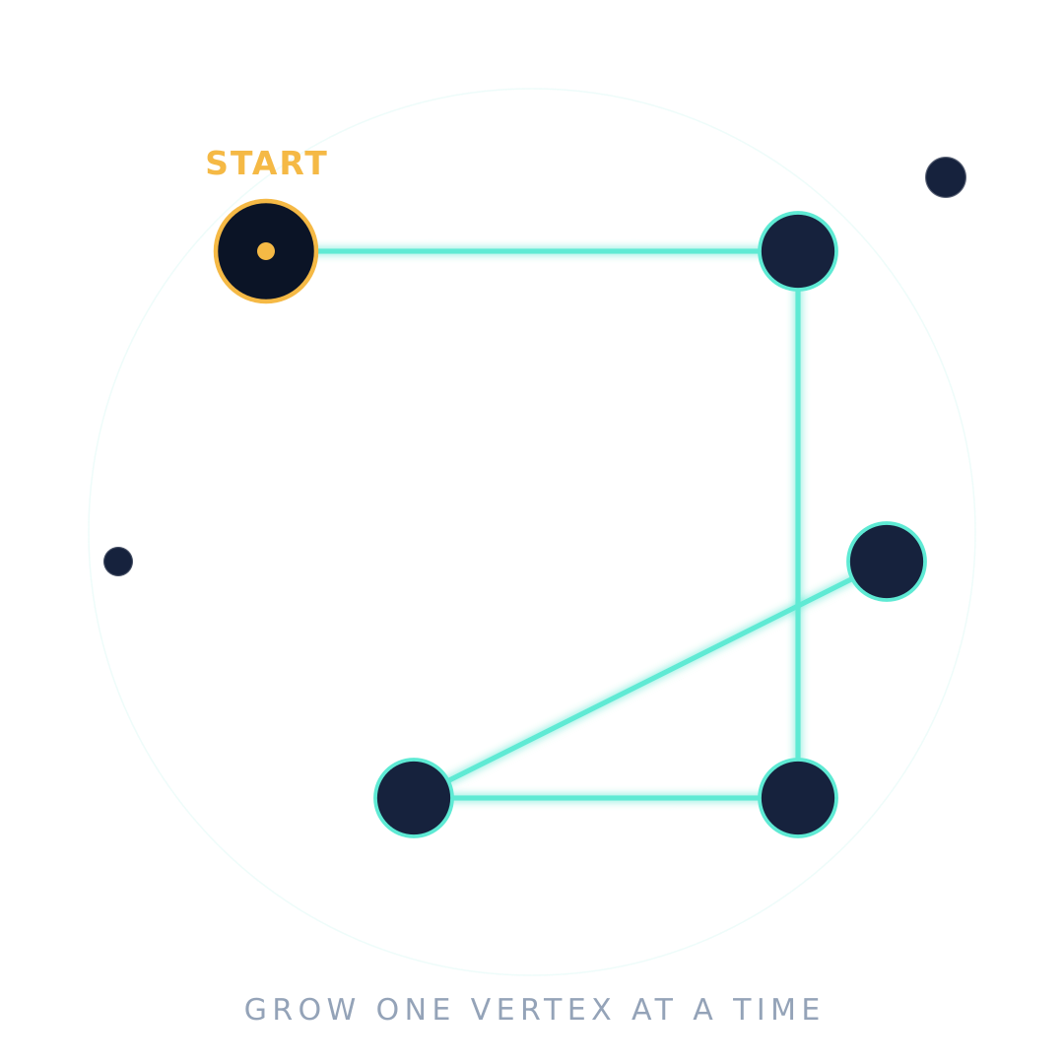
Design & Analysis of Algorithms
A LECTURE-WALKTHROUGH · GRAPH ALGORITHMS · GREEDY METHOD
Minimum
Spanning Tree
Prim’s Algorithm
Build the cheapest connected network, one vertex at a time — a step-by-step walkthrough.
Student Name
Roll Number
Division
Faculty
B.Tech Computer Science & Engineering · Subject: Design and Analysis of Algorithms

Slide 2


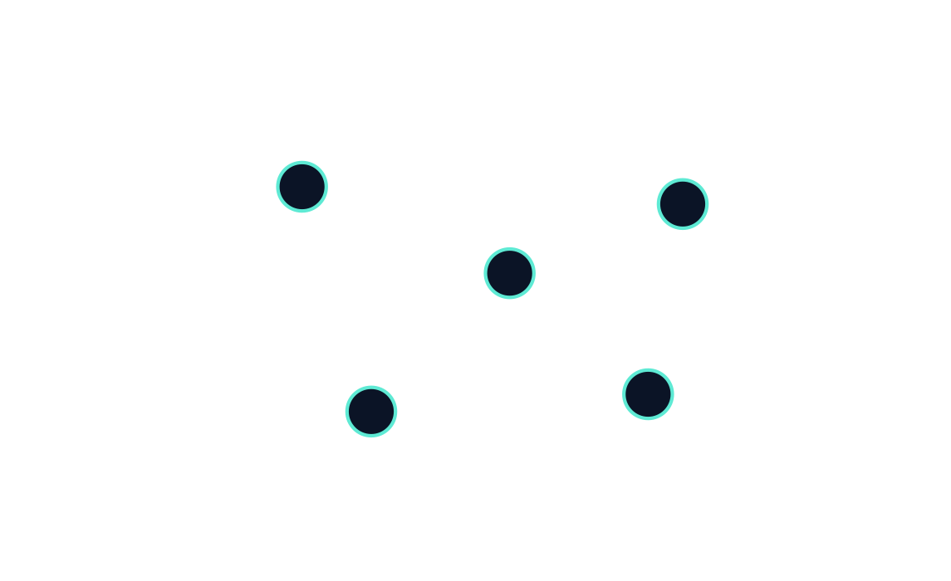
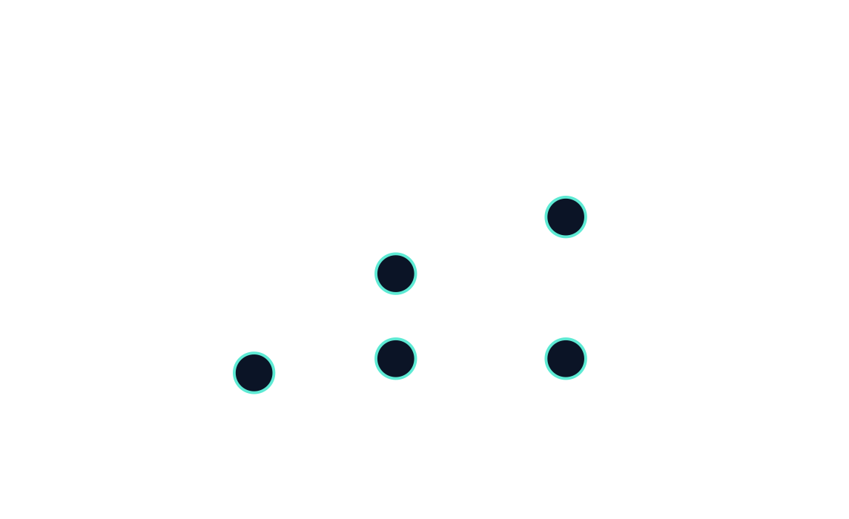

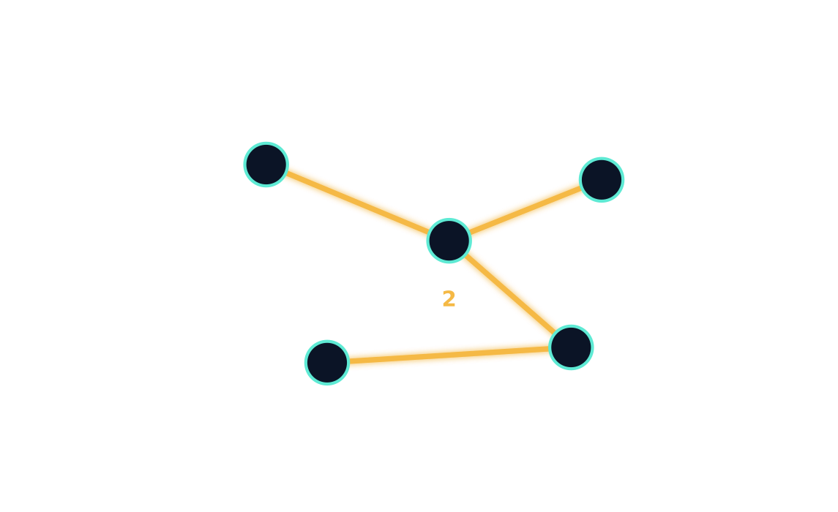
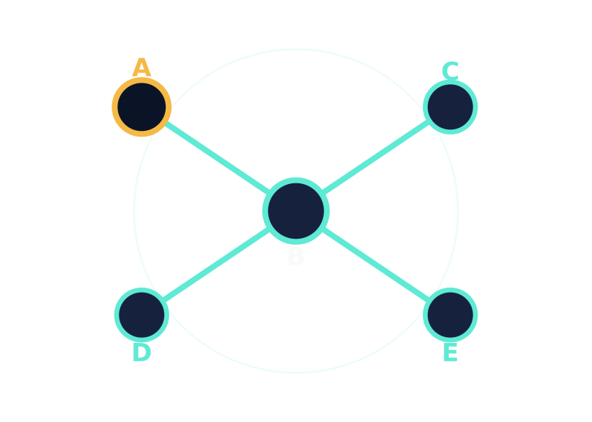

01 · Concepts
Three small definitions —
and one way to build the cheapest.
A · definition
B · subset
Graph
Spanning Tree
A set of vertices joined by edges.
Each edge may carry a weight.
Reaches every vertex using
(V − 1) edges, no cycles.
|V| vertices · |V|−1 edges · 0 cycles
G = (V, E)
C · minimum
D · the idea
Minimum Spanning Tree
Prim’s Idea
Start at any vertex. Grow the tree
by always picking the cheapest edge
that reaches a new vertex.
A spanning tree whose total edge weight is the smallest possible.
min Σ w(e)
greedy · vertex-based

Slide 3





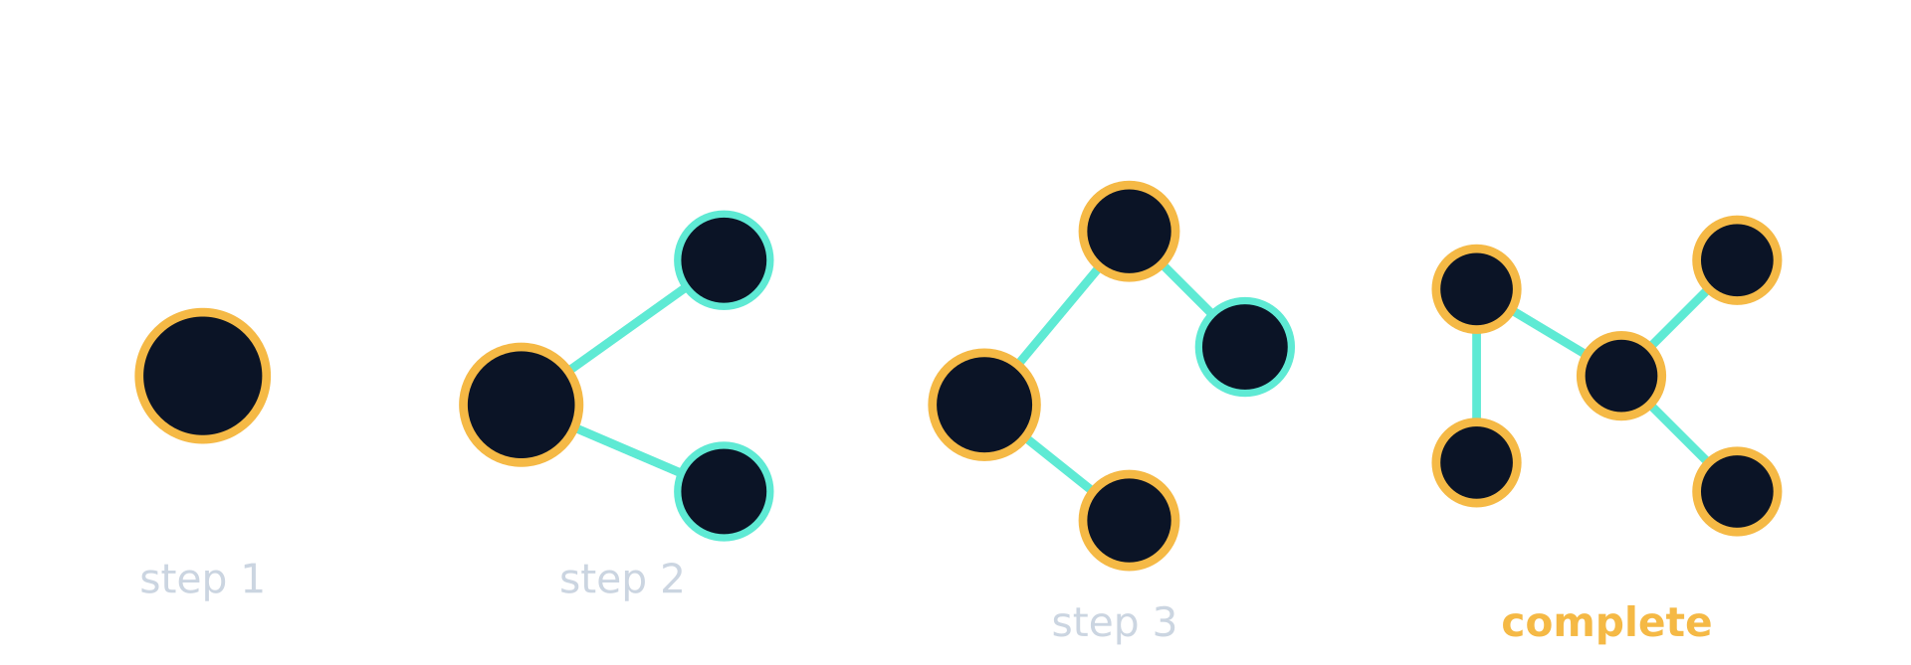
02 · How it operates
Five steps. Repeated until every vertex is in.
01
02
03
04
05
1
2
3
4
5
Start anywhere
Mark it visited
Cheapest outgoing edge
Add edge & vertex
Repeat
Pick any vertex. It becomes the seed of the tree.
The seed vertex joins the MST. Track it in a visited set.
Lock that edge and mark the new vertex visited. The tree grows by one.
Until every vertex is in — the MST is complete.
Among edges from a visited to an unvisited vertex, pick the lowest-weight one.
A · snapshot
Take note
Tree grows one
vertex at a time
Local minimum at each
step — global optimum.
Visited nodes turn amber. The cheapest outgoing edge joins a new vertex on each iteration.
Prim never reconsiders. It is a greedy algorithm — but the proof shows every local pick lands inside some MST, so the final tree is provably minimum.

Slide 4



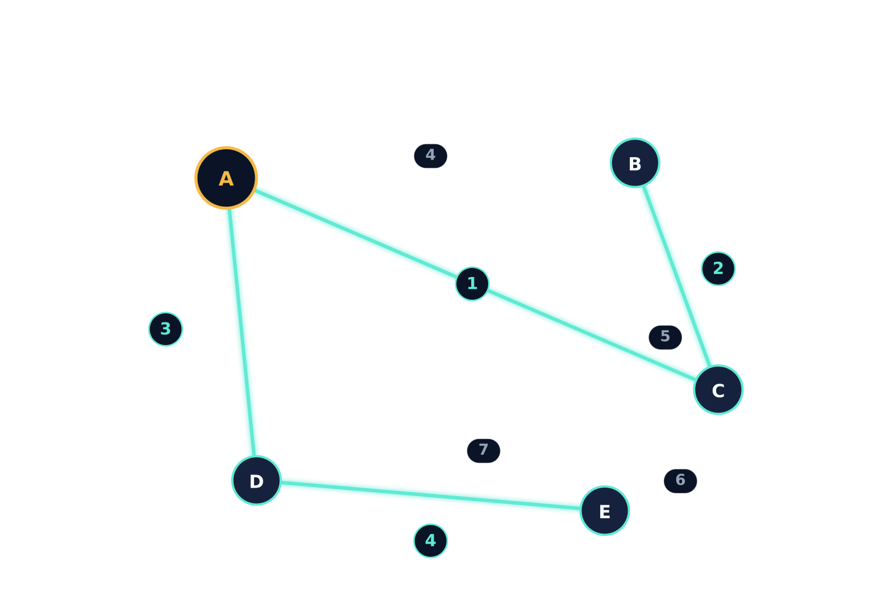

03 · Worked example
Five vertices, eight edges —
cheapest four win.
The starting graph
Step-by-step trace
5 vertices · 8 weighted edges
STEP | SELECTED EDGE | WEIGHT | RUNNING TOTAL
1 | A — C | 1 | 1
2 | B — C | 2 | 3
3 | A — D | 3 | 6
4 | D — E | 4 | 10
in MST
not chosen
start vertex
MST total cost
10
Final tree · 4 edges
connecting all 5 vertices.
undirected · weighted · connectivity assumed

Slide 5





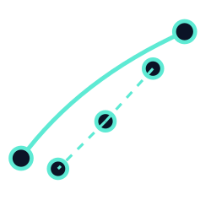

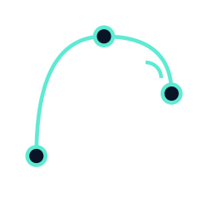


04 · Implementation & Context
In code, in cost — in the real world.
Pseudocode
Adjacency matrix
Prim(G, start)
Linear scan for the cheapest edge
O(V²)
function Prim(G = (V, E), s):
for each v in V: key[v] = ∞, parent[v] = null
V = vertices · E = edges
key[s] = 0
Q = priority queue of V, keyed by key[]
while Q is not empty:
u = vertex in Q with smallest key
Adjacency list + min-heap
O(E·log V)
remove(u)
Priority queue with decrease-key
for each neighbor v of u:
if v in Q and w(u, v) < key[v]:
preferred for sparse graphs
key[v] = w(u, v); parent[v] = u
return edges { (parent[v], v) : v ≠ s }
Where MSTs live
Computer networks
Road & rail networks
Power grids
Telecommunications
LAN cabling, broadcast trees
Cheapest highway, rail links
Distribution: least cable, all served
Backbone: minimum-cost routing
Side by side
Three to remember
End of deck
Prim vs Kruskal
Key takeaways
Thank You.
Prim
Kruskal
Greedy — cheapest local edge wins each round.
Grows one tree from a start vertex.
Best for dense graphs.
Grows a forest from cheapest edges.
Best for sparse graphs.
Proven — every local pick lives inside some MST.
Practical — from cable layouts to chip routing.

