Slide 1
Mutual Funds predictor using Python and ML.
B.Tech F.Y.
Div. c , Batch 1
1.12010398.Rohan Bhole
2.12010022.Pushkaraj Bhor
3.12010576.Aditya Bhosale
4.12011391.Adwait Bhosale
5.12010825.Dhairyashil Bhosale
Course Project
Computing with Python
Department of Engineering, Sciences and Humanities (DESH)
Vishwakarma Institute of Technology, Pune
A.Y.(2020-2021) Term 2

Slide 2
OUTLINE
Introduction
problem statement
objectives and aim
background
Implementation
Results and discussion
Conclusion and Future Scope
References

Slide 3
Introduction
This is a web application based on machine learning algorithms that provides us predictions on how the mutual funds price will perform for the day and the next seven days.
This aims to determine the future movement of the stock value of a financial exchange.
The goal is to give people full control over their investing decisions and allow them to take on bigger risks that wealth managers typically aren’t willing to make.
This web is totally a free stock monitoring application that lets user gain valueable insights into daily M.F movements

Slide 4
problem statement
Develop a web application which predicts the price of Mutual Funds using Machine Learning and Python.

Slide 5
objectives and aim
objectives
To gain a basic understanding in Machine Learning and Data Science - the hottest topics right now!
To dive into the deeper parts of Python by using them with ML and DS.
To learn various libraries of Numpy, Pandas, Keras, matplotlib, tenserflow etc.
aim
To predict future price of Mutual Funds.

Slide 6
background
Our Background includes the usage of Streamlit as well as Machine Learning
Streamlit – For Creating the web application.
Machine Learning – Making our web app predictable on the entered data values.

Slide 7
Implementation
Category of the project:
Website.
Tools / Platform:
Streamlit ,G-Colab,TensorFlow.
Front end-Backend Software Requirement:
Streamlit ,G-Colab,TensorFlow.

Slide 8
Implementation (Cont.)
The mutual Funds Prediction app to predict the values of the specific fund needs to get through some important steps like:
1. Import the data
2. Get hands on the data(Be one with it)
3. Remove the unnecessary data
4. Prepare a model as per the requirements
5. Fit the model
6. Evaluate the model
7. Tweak the model if required
8. Repeat until satisfied
Tweaking the model is a step where Hyperparameters are tuned to improve the model for better predictions and good quality result at the end.

Slide 9
In this Mutual Funds we have Tweaked our model 4 times for better accuracy and good Result.,
Here the Tweaking of model involves changing of Optimizers form (SGD to Adam) ,
Also changing the error type to (mse to mae) or Vice Versa.
Adding of extra Layers as well as some extra neuron which Helped us having a great accuracy score at the end.

Slide 10
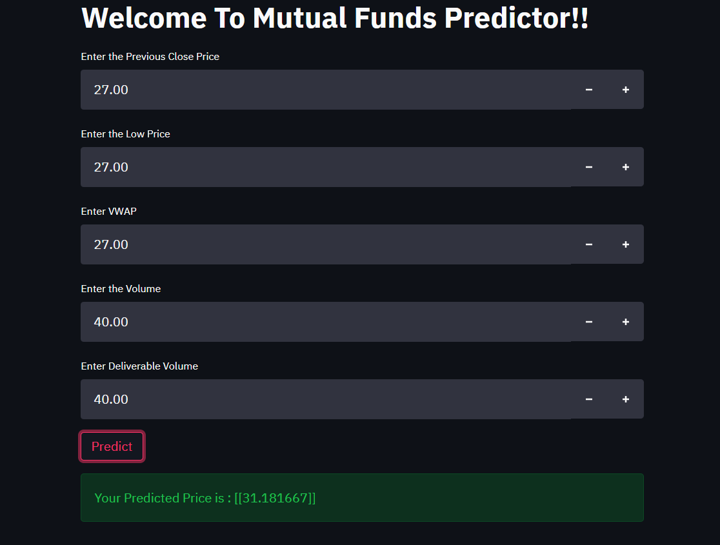
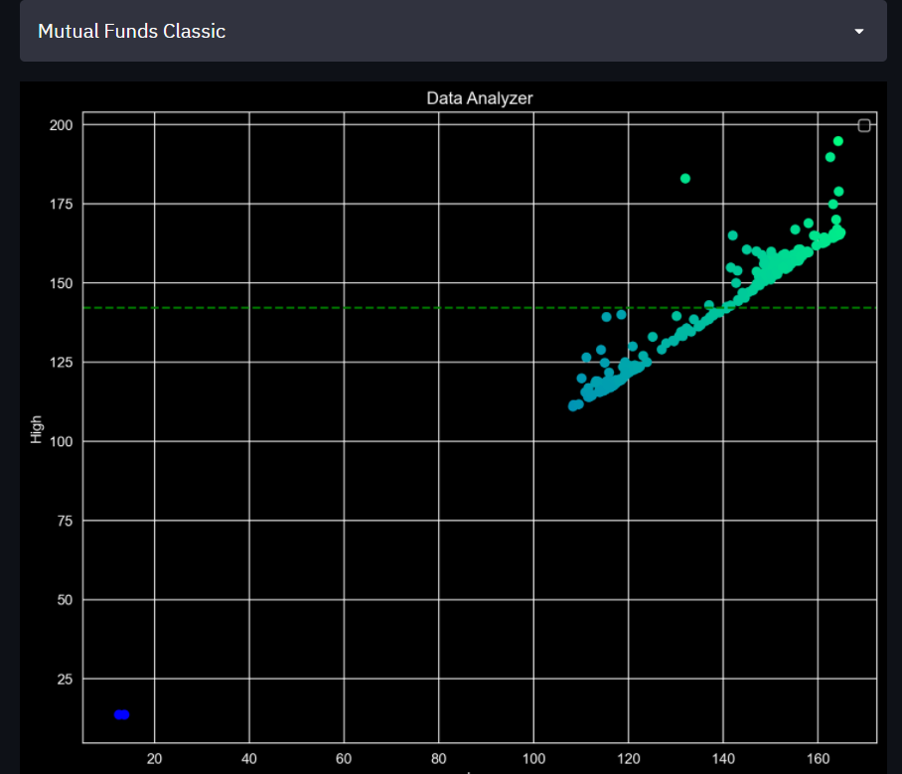
Quick Glance to the view of Our Web Application

Slide 11
Results and discussion
Made a web app which currently help the users to learn the predictions and visualization of the data.
Also make them Well trained for the future predictions of the data.
There are no prerequisites for the user to get started with our web and predictions.

Slide 12
Conclusion and Future Scope
Conclusion
After visualizing the graphs we have finally come to conclusion of using CNN(convolutional neural network).
Future Scope
Humans tend to invest their finances and since stock has been one of the most trusted ways of investment for people, it will continue to have scope in future.
In future the stock prediction will be increasingly accurate thus giving people more control over their investments.
It has and will eliminate the need of broker for trading in stocks.
Beside the tools and technology used like Machine Learning and Data Science are the most trending topics which are expected to bloom in future.

Slide 13
Contribution
Div c Batch B1
Roll No 1-GRNo-12010398-Rohan Bhole
Coding , report.
Roll No 2-GRNo-12010022-Pushkaraj Bhor
Coding , report.
Roll No 3-GRNo-12010576-Aditya Bhosale
Coding , making of ppt.
Roll No 4-GRNo-12011391-Adwait Bhosale
Module integration , Coding , project testing.
Roll No 5-GRNo-12010825-Dhairyashil Bhosale
Coding , Making of ppt.
Also you can include, Documentation, Requirement Analysis, Data Collection,…etc

Slide 14
References
Websites
Books.
Personal knowledge.
4. Youtube.

Slide 15
Thank You

